Slide 1
Operational WAN
Complete guide to setup, demonstrate, test and troubleshoot
Focus on PW and data & voice

Slide 2
Introduction
Overview of the Application
Bill of Materials
Diagram of setup
Detailed instructions
Test Procedure & Success Criteria
Appendix: Scripts

Slide 3
Operational WAN
This guide is designed to allow you to setup, demonstrate, test and trouble shoot an Operational WAN
The application is based on ERP and uses Pseudowire on MP-4100 and ETX-220
It is aimed at the Critical Infrastructures market
The main benefits to the user are
High reliability
Continued support for legacy devices
Single infrastructure for all services

Slide 4
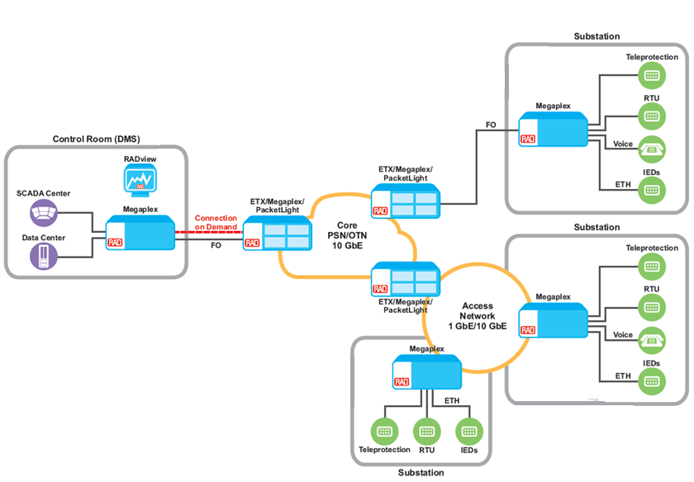
Application Overview
The diagram shows the Operational WAN with the MP-4100 and the ETX-220 in the ERP ring
We will focus on the SHDSL, Voice and data services
ETX-5
ETX-5
SDH/SONET
STM-4/OC-12
ETX-5
SDH/SONET
STM-1/OC-3

Slide 5
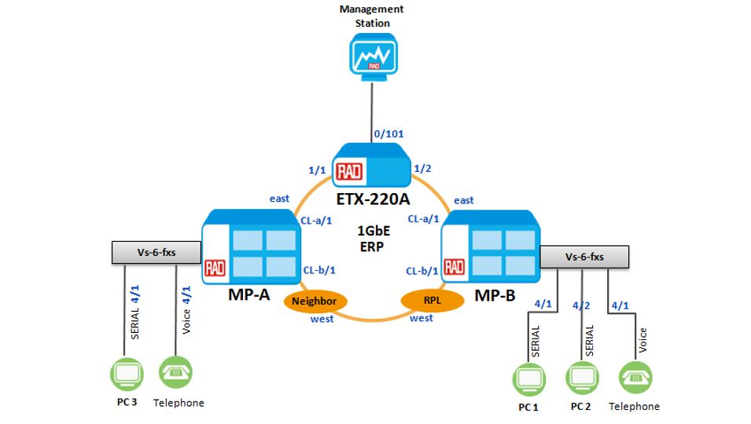
Voice and Serial Data services over ERP with the VS-6-FXS card
Each MP-4 uses one VS-6-FXS card in slot 4

Slide 6
Bill of Materials
Product | Catalog Name and Number | S/W version | Quantity
MP-4100 | MP-4100-MN | N/A | 2
Power supply | MP-4100M-PS/230 | N/A | 2
Common logic | MP-4100M-CL.2/622GBEAUTP | 4.70.20 | 4
TP module | MP-4100M-TP/220/SSR | 2.50.7 | 2
VS voice data | MP-4100M-VS/6S/8FXS/UTP | 1.60 | 2
ETX-220A | ETX220A/AC/3XFP/10U/SYE/BSK | 5.9.0(0.15) | 1
Non-RAD Name | Description | Quantity | Notes
ETH cables | Copper – gigabit cables | 5 | Connecting the ring and the laptops to the ring
USB-Serial converter |  | 2 | Plus 2 laptops
Telephones |  | 2

Slide 7
Diagram of setup
RADview NMS
ETH Traffic
Generator
0/101
ETH Traffic
Generator
1/1
ETX-220A
1/2
ETH
1/1
Megaplex-4
“A”
Megaplex-4
“B”
ETH
East
East
ASMi-54L
M/ETH
CL-A/1
1 GbE
ERP
CL-A/1
SH16-E1-PW
2/1
SHDSL
E1
VS-E1-PW
Traffic
Generator
2/1
VS-6-FXS
CL-B/1
CL-B/1
VS-6-FXS
Serial
4/1
Voice
4/1
Neighbor
West
RPL
West
Serial
4/1
Serial
4/2
Voice
4/1
E1
PC
Phone
PC
PC
Phone
We will not use RADview – just Shelfview

Slide 8
Let’s build it!

Slide 9
What are the steps…?
Build the infrastructure
Define the modules
Configure the bridge
Setup the flows
Configure the PW router
Cross-connect
Station clock
Install the Voice and Serial data

Slide 10
1. Build the Infrastructure
We’re going to use the existing ERP ring
See appendix for CLI scripts to build the ERP ring
RADview NMS
0/101
1/1
ETX-220A
1/2
Megaplex-4
“A”
East
East
Megaplex-4
“B”
CL-A/1
1 GbE
ERP
CL-A/1
CL-B/1
CL-B/1
Neighbor
West
RPL
West

Slide 11
2. Define the modules
Odd groups: (MP-4 ‘A’)
Configure slot 2 card-type versatile vs-e1-pw
Even groups: (MP-4 ‘B’)
Configure slot 2 card-type dsl sh16-e1-pw
Give a few moments for these cards to be recognized

Slide 12
Table of VLAN numbers and Bridge ports
VLAN | Bridge Ports | Profile | Ingress | Egress
54 | 1, 2 & 3 | MNG | CL-A/1 | BP#1
 |  |  | CL-B/1 | BP#2
 |  |  | SVI 1 | BP#3
100 | 1, 2 & 4 | DATA_METH | CL-A/1 | BP#1
 |  |  | CL-B/1 | BP#2
 |  |  | ETH 1/1 | BP#4
1000 | 1, 2 | OAM_SF_TRIGGER | CL-A/1 | BP#1
 |  |  | CL-B/1 | BP#2

Slide 13
3. Configure the bridge
In ODD groups, we are going to open one new BP and 2 VLANs
In EVEN groups we’ll use two more BPs and the same 2 VLANs
ODD groups EVEN Groups
configure bridge 1
port 5
no shutdown
exit
vlan 200
tagged-egress 1,2,4
exit
vlan 300
tagged-egress 1,2,5
exit all
configure bridge 1
port 5
no shutdown
exit
port 10
no shutdown
exit
vlan 200
tagged-egress 1,2,10
exit
vlan 300
tagged-egress 1,2,5
exit all

Slide 14
4. Set up the Flows
Your task: Setup the following flows (all require reverse-direction)
ODD groups:
Even Groups
VLAN | Bridge Ports | Profile | Ingress | Egress
200 | 1, 2 & 10 | DATA_PCS | CL-A/1 | BP#1
 |  |  | CL-B/1 | BP#2
 |  |  | ETH 1/1 | BP#4
300 | 1, 2 & 5 | VS_16_E1_PW | CL-A/1 | BP#1
 |  |  | CL-B/1 | BP#2
VLAN | Bridge Ports | Profile | Ingress | Egress
200 | 1, 2 & 4 | DATA_PCS | CL-A/1 | BP#1
 |  |  | CL-B/1 | BP#2
 |  |  | PCS 2/1 | BP#10
300 | 1, 2 & 5 | SH16_E1_PW | CL-A/1 | BP#1
 |  |  | CL-B/1 | BP#2

Slide 15
Table of VLAN numbers and Bridge ports – ODD groups
VLAN | Bridge Ports | Profile | Ingress | Egress
54 | 1, 2 & 3 | MNG | CL-A/1 | BP#1
 |  |  | CL-B/1 | BP#2
 |  |  | SVI 1 | BP#3
100 | 1, 2 & 4 | DATA_METH | CL-A/1 | BP#1
 |  |  | CL-B/1 | BP#2
 |  |  | ETH 1/1 | BP#4
1000 | 1, 2 | OAM_SF_TRIGGER | CL-A/1 | BP#1
 |  |  | CL-B/1 | BP#2
200 | 1, 2 & 10 | DATA_PCS | CL-A/1 | BP#1
 |  |  | CL-B/1 | BP#2
 |  |  | ETH 1/1 | BP#4
300 | 1, 2 & 5 | VS_16_E1_PW | CL-A/1 | BP#1
 |  |  | CL-B/1 | BP#2

Slide 16
Table of VLAN numbers and Bridge ports – EVEN groups
VLAN | Bridge Ports | Profile | Ingress | Egress
54 | 1, 2 & 3 | MNG | CL-A/1 | BP#1
 |  |  | CL-B/1 | BP#2
 |  |  | SVI 1 | BP#3
100 | 1, 2 & 4 | DATA_METH | CL-A/1 | BP#1
 |  |  | CL-B/1 | BP#2
 |  |  | ETH 1/1 | BP#4
1000 | 1, 2 | OAM_SF_TRIGGER | CL-A/1 | BP#1
 |  |  | CL-B/1 | BP#2
200 | 1, 2 & 4 | DATA_PCS | CL-A/1 | BP#1
 |  |  | CL-B/1 | BP#2
 |  |  | PCS 2/1 | BP#10
300 | 1, 2 & 5 | SH16_E1_PW | CL-A/1 | BP#1
 |  |  | CL-B/1 | BP#2

Slide 17
5. PW Router setup
ODD groups
EVEN Groups
Notice how these are equal and opposite
configure port svi 2 no shutdown
configure router 2 interface 1 address 2.2.2.10/24
configure router 2 interface 1 bind svi 2
configure router 2 static-route 2.2.2.0/24 address 2.2.2.1
configure peer 1 ip 2.2.2.11
configure port svi 2 no shutdown
configure router 2 interface 1 address 2.2.2.11/24
configure router 2 interface 1 bind svi 2
configure router 2 static-route 2.2.2.0/24 address 2.2.2.1
configure peer 1 ip 2.2.2.10

Slide 18
5. Set up the PW Router Flows
Your task: Setup the following flows
ODD groups:
You will need to configure both directions
Even Groups
VLAN | Bridge Ports | Profile | Ingress | Egress
300 | 1, 2 & 5 | VS_16_E1_PW | SVI 2 | BP#5
VLAN | Bridge Ports | Profile | Ingress | Egress
300 | 1, 2 & 5 | SH16_E1_PW | SVI 2 | BP#5

Slide 19
Table of VLAN numbers and Bridge ports – ODD groups
VLAN | Bridge Ports | Profile | Ingress | Egress
54 | 1, 2 & 3 | MNG | CL-A/1 | BP#1
 |  |  | CL-B/1 | BP#2
 |  |  | SVI 1 | BP#3
100 | 1, 2 & 4 | DATA_METH | CL-A/1 | BP#1
 |  |  | CL-B/1 | BP#2
 |  |  | ETH 1/1 | BP#4
1000 | 1, 2 | OAM_SF_TRIGGER | CL-A/1 | BP#1
 |  |  | CL-B/1 | BP#2
200 | 1, 2 & 10 | DATA_PCS | CL-A/1 | BP#1
 |  |  | CL-B/1 | BP#2
 |  |  | ETH 1/1 | BP#4
300 | 1, 2 & 5 | VS_16_E1_PW | CL-A/1 | BP#1
 |  |  | CL-B/1 | BP#2
 |  |  | SVI 2 | BP#5

Slide 20
Table of VLAN numbers and Bridge ports – EVEN groups
VLAN | Bridge Ports | Profile | Ingress | Egress
54 | 1, 2 & 3 | MNG | CL-A/1 | BP#1
 |  |  | CL-B/1 | BP#2
 |  |  | SVI 1 | BP#3
100 | 1, 2 & 4 | DATA_METH | CL-A/1 | BP#1
 |  |  | CL-B/1 | BP#2
 |  |  | ETH 1/1 | BP#4
1000 | 1, 2 | OAM_SF_TRIGGER | CL-A/1 | BP#1
 |  |  | CL-B/1 | BP#2
200 | 1, 2 & 4 | DATA_PCS | CL-A/1 | BP#1
 |  |  | CL-B/1 | BP#2
 |  |  | PCS 2/1 | BP#10
300 | 1, 2 & 5 | SH16_E1_PW | CL-A/1 | BP#1
 |  |  | CL-B/1 | BP#2
 |  |  | SVI 2 | BP#5

Slide 21
5. PW Router flows
(ODD Groups only)
########################## E1 on VS_16_E1_PW ############################
configure port e1 2/1
line-type unframe
no shutdown
exit all
######################## DS1 on VS_16_E1_PW ############################
configure port ds1 2/1
line-type unframe
no shutdown
exit all
################################################################
######## VS_16_E1_PW Satop psn udp-over-ip ########
################################################################
configure pwe pw 1 type e1satop psn udp-over-ip
peer 1
label in 1 out 1
no oam
tdm-payload size 32
jitter-buffer 5000
far-end-type unframe
exit all

Slide 22
6. Setup SHDSL on SH16-E1-PW
EVEN Groups only
We will use the 1st port on the 16 port SHDSL module to send the traffic to the ASMi-54L
configure qos
queue-block-profile shdsl
exit all
configure qos shaper-profile 5632 bandwidth cir 5632
configure qos queue-group-profile shdsl_2wire
queue-block 0/1 profile shdsl
queue-block 0/1 shaper profile 5632
exit all
configure port shdsl 2/1 no line-prob
configure port shdsl 2/1 data-rate maximum 5632
configure port shdsl 2/1 stu central
configure port shdsl 2/1 tc hdlc
configure port shdsl 2/1 far-end-type managed
configure port shdsl 2/1 wires 2
configure port shdsl 2/1 no shutdown
configure port pcs 2/1 bind shdsl 2/1
configure port pcs 2/1 queue-group profile shdsl_2wire
configure port pcs 2/1 no shutdown
exit all

Slide 23
6. Setup the E1 and the DS1 on the SH16 card
########################## E1-i on SH16-E1-PW ###
configure port e1-i 2/1
line-type unframed
no shutdown
exit all
########################## ds1 on SH16-E1-PW ###
configure port ds1 2/1
line-type unframed
no shutdown
exit all
EVEN groups only

Slide 24
6. Setup the SATOP PSN UDP over IP
EVEN Groups only
################################################################
######## SH16-E1-PW Satop psn udp-over-ip ########
################################################################
configure pwe pw 1 type e1satop psn udp-over-ip
peer 1
label in 1 out 1
no oam
tdm-payload size 32
jitter-buffer 5000
far-end-type unframe
exit all

Slide 25
6. Perform the Cross-connect
All groups
We need to link the PW 1 to the internal E1 on slot 2 port 1 using all the timeslots
configure cross-connect pw-tdm pw 1 e1-i 2/1 time-slots 1..31

Slide 26
7. System clock
We’ll recover the system clock from the PW
All groups
################################################################
######## Station Clock Recovered PW 1 ########
################################################################
configure system clock recovered 1 pw 1
configure system clock recovered 1 no shutdown
configure system clock domain 1
source 1 recovered 1
wait-to-restore 0
quality-level prc
commit
exit all
and we’re done!

Slide 27
Well nearly done…
We still need to configure the ASMi-54L to transmit traffic (VLAN 200)
First check that the SHDSL port 2/1 in MP-B (EVEN groups) is UP
configure port shdsl 2/1
show status
Should show the port as being up, the line rate as 5632 and the HW type as SHDSL

Slide 28
ASMi-54 - EVEN Groups only

Slide 29
Setup VLAN membership on ASMi-54L
Add VLAN 200 to Bridge>Vlan Membership (port 2,6)
Bridge port 2 → ETH port 1
Bridge port 6 →SHDSL port
S for Save

Slide 30
Install Voice and Serial Data - 1
MP-A - script
MP-B – script
The scripts create
Serial service thru PW over the ERP network using VLAN 500.
Voice service thru PW over the ERP network using VLAN 600
Router interface for PW peer

Slide 31
Install Voice and Serial Data - 2
Connect the COM port of the 3 PCs to the serial ports of the vs-6-fxs module as follows.
PC1 – MP-B : slot 4 Serial port 1
PC2 – MP-B : slot 4 Serial port 2
PC3 – MP-A : slot 4 Serial port 1
Open a terminal emulation program on all PCs (Hyper terminal, Putty, Teraterm, etc.)
Set the serial port to the following parameters:
Baud rate: 9.6K, Data: 8 bits, Parity: None, Stop bits: 1 bit
Connect Telephone to the voice ports of the vs-6-fxs module as follows.
PC1 – MP-A : slot 4 voice port 1
PC2 – MP-B : slot 4 voice port 1

Slide 32
Review the steps
Build the infrastructure
Define the modules
Configure the bridge
Setup the flows
Configure the PW router
Cross-connect
Station clock
Install Voice and Serial Data

Slide 33
Testing the setup and Success Criteria

Slide 34
Test Procedure 1
Checking the services
Action | Expected Result | Pass/Fail
On MP-A & MP-B: Go To-->configure pwe pw 1 show status | Connectivity Status should be UP | PASS
Place an E1 LOOP on MP-A E1 port 2/1 Run traffic from the HBT connected to the ASMi-54L E1 | Traffic should be received without errors | PASS
Run ETH traffic between ASMi-54L ETH port to MP-A port ETH 1/1. Traffic is on VLAN 200; rate 2Mbps | Traffic passes with no errors | PASS

Slide 35
Test the Serial Data
Traffic | Expected Results | Pass/Fail
Type characters on PC 1 | Characters received on the terminal emulation program on the PC 3 | PASS
Type characters on PC 2 | Characters received on the terminal emulation program on the PC 3 | PASS
Type characters on PC 3 | Characters received on the terminal emulation program on the PC 1 and PC2 | PASS
Test traffic using a dedicated tester for 1 min (optional) | Data is running without errors | PASS
Disconnect Ethernet CL-A/1 and check connectivity between the PCs (steps 1-3) | Characters received on all PCs | PASS
Reconnect Ethernet CL-A/1 | Characters received on all PCs | PASS
Disconnect Ethernet CL-B/1 and check connectivity between the two PCs | Characters received on all PCs | PASS

Slide 36
Test the voice (FXS-FXS)
Traffic | Expected Results | Pass/Fail
Check audio between two phones | Audio is transferred | PASS
Pick up the phone connected to MP-A | Phone connected to MP-B rings | PASS
Pick up the phone connected to MP-B | Phone connected to MP-A rings | PASS
Disconnect ETH CL-A/1 and repeat the first 3 steps | Audio and signaling transferred successfully | PASS
Reconnect ETH CL-A/1 and wait 60 seconds Repeat the first 3 steps | The ring is back to idle Audio and Signaling transferred successfully | PASS

Slide 37
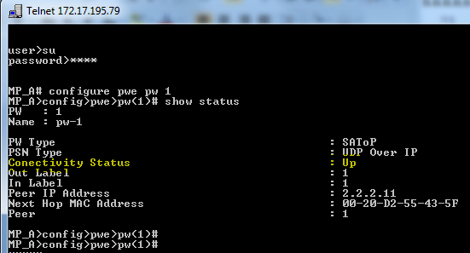
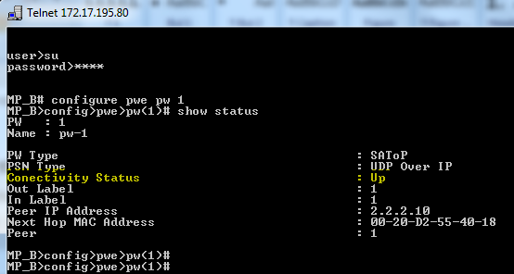
Test the PW
First – check if the PW is Up
configure pwe pw 1
show status
You should see (MP-A and MP-B)

Slide 38
Appendix The Script

Slide 39
CLI scripts for ERP setup
Setup the ETX-220
Setup the first MP
Setup the second MP

Slide 40
Appendix – the Scripts for this service
MP-A
MP-B

Slide 41
Additional Scripts for Voice and Data
MP-A
MP-B

