Slide 1
Ruggedized LAN
Complete guide to setup, demonstrate, test and troubleshoot
Focus on RING

Slide 2
Introduction
Overview of the Application
Bill of Materials
Diagram of setup
Detailed instructions
Test Procedure & Success Criteria
Appendix: Scripts

Slide 3
Ruggedized LAN
This guide is designed to allow you to setup, demonstrate, test and trouble shoot the Ruggedized LAN
The application is based on ERP ring and uses SecFlow-2
It is aimed at the Critical Infrastructure market
Utility installations (electricity, water, gas and oil)
Intelligent transportation (highway, railway)
Manufacturing facilities (chemical, food industry)
Military and defense applications (HLS, safe city).
The main benefits to the user are network-based distributed security in a protected ring

Slide 4
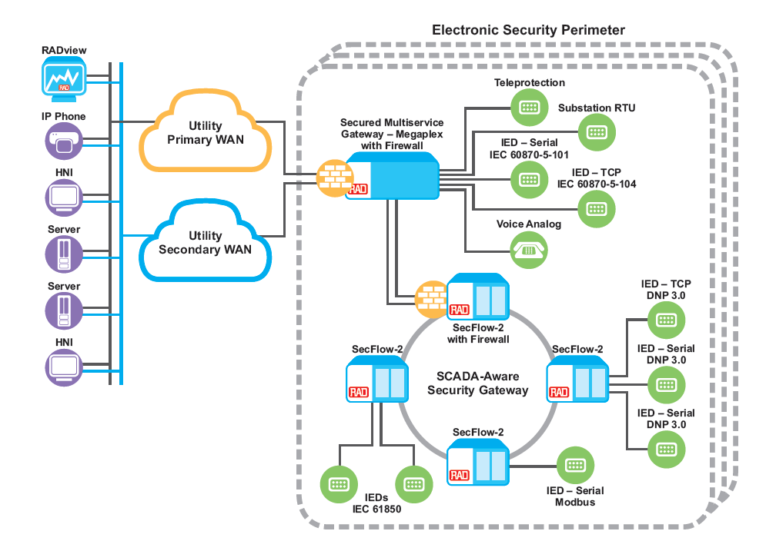
Application Overview
The diagram shows the Ruggedized LAN with the SecFlow-2
We will focus on the ERP ring

Slide 5
Bill of Materials
Product Name | Catalog Number | S/W version | Quantity | Notes
SecFlow-2 | SF2/S/AC/2GE8UTP/RS232 |  | 3
Eth cables |  |  | 4

Slide 6
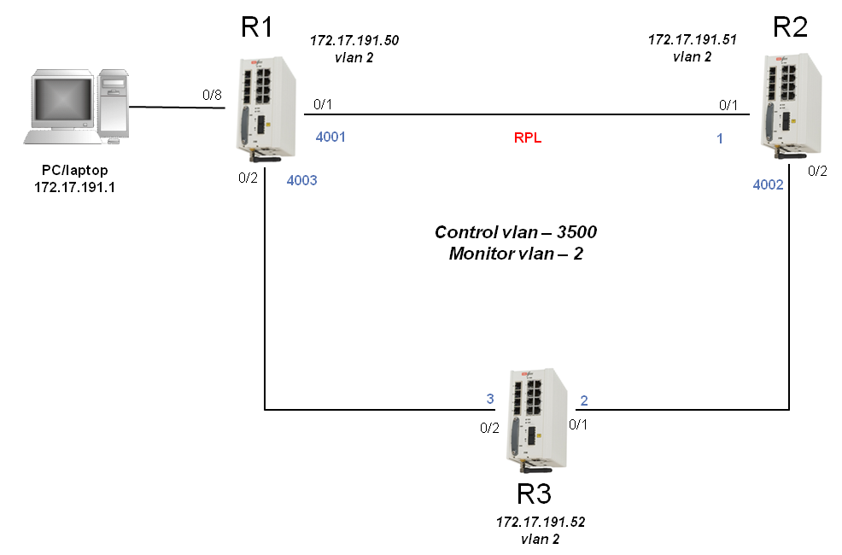
Diagram of setup

Slide 7
Let’s build it!

Slide 8
How to get it to work
Follow these steps:
Layout the units but do not connect the cables
Configure the first unit
Configure the second unit
Configure the third unit
Connect the cables

Slide 9
Don’t connect the cables!

Slide 10
1. Configuring R1 SecFlow

Slide 11
1. Configuring R1 SecFlow (cont)

Slide 12
1. Configuring R1 SecFlow (cont)

Slide 13
1. Configuring R1 SecFlow (cont)

Slide 14
1. Configuring R1 SecFlow (cont)

Slide 15
1. Configuring R1 SecFlow (cont)

Slide 16
2. Configuring R2 SecFlow

Slide 17
2. Configuring R2 SecFlow (cont)

Slide 18
2. Configuring R2 SecFlow (cont)

Slide 19
2. Configuring R2 SecFlow (cont)

Slide 20
3. Configuring R3 SecFlow

Slide 21
3. Configuring R3 SecFlow (cont)

Slide 22
3. Configuring R3 SecFlow (cont)

Slide 23
3. Configuring R3 SecFlow (cont)

Slide 24
Connecting the Cables

Slide 25
Connecting the Cables (cont)
Connect a Ethenet full straight cable between fastethernet port 0/1 on R1 and fastethernet port 0/1 on R2
Connect a Ethenet full straight cable between fastethernet port 0/2 on R2 and fastethernet port 0/1 on R3
Connect a Ethenet full straight cable between fastethernet port 0/2 on R3 and fastethernet port 0/2 on R1
Connect a Ethenet full straight cable between fastethernet port 0/8 on R1 and your laptop LAN port

Slide 26
Review the setup process
Layout the units but do not connect the cables
Configure the first unit
Configure the second unit
Configure the third unit
Connect the cables

Slide 27
Testing the setup and Success Criteria

Slide 28
Test Procedure
Checking Management and ERP Connectivity
Action | Expected Result | Pass/Fail
Set a ping command from your laptop towards R1, R2 and R3 in parallel with the following command: “ping 172.17.191.50 –t” which will generate a constant ping commands. | SecFlow R1, R2 and R3 answer to the Ping | PASS
Disconnect one of the ETH cables of the ring | SecFlow R1, R2 and R3 answer to the Ping | PASS
Reconnect the cable again and check it each time with a different cable | SecFlow R1, R2 and R3 answer to the Ping | PASS

Slide 29
Checking Management and ERP Connectivity
Set a ping command from your laptop towards R1, R2 and R3 in parallel with the following command: “ping 172.17.191.50 –t” which will generate a constant ping commands.
Check that SecFlow answer to the ping.
Disconnect one of the ETH cables of the ring – and check that the ping is still working well (notice that during ETH cable disconnection you might loss some pings, but connectivity should restore – this is normal behavior).
Reconnect the cable again and check it each time with a different cable to verify that the ERP is functioning.
Once done, open a telnet session to SecFlows R1, R2 and R3 to see that telnet is working as well.

Slide 30
Appendix The Script

Slide 31
Appendix – the Script
The scripts are in the slides

