Slide 1
SAA - Ethernet Application
Complete guide to setup, demonstrate, test and troubleshoot
Focus on Ethernet Services

Slide 2
Introduction
Applications Overview
  Carrier Ethernet Services (E-Line, E-LAN, E-Tree)
  IP VPNs for International Service Providers
  vCPE
  Wholesale Networking (E-Line, E-LAN, E-Tree)
Diagram of setup
Bill of Materials
Detailed instructions
Test Procedure and Success Criteria
  Service Activation Test - Y.1564
Appendix: Scripts

Slide 3
Introduction
This guide is designed to allow you to setup, demonstrate, test and trouble shoot the SAA Ethernet based applications
The Ethernet services that are described in this guide are suitable for the following applications:
  Carrier Ethernet Services
  IP VPNs for International Service Providers
  vCPE
  Wholesale Networking

Slide 4
Applications Overview as presented in the LOB Application Diagram

Slide 5
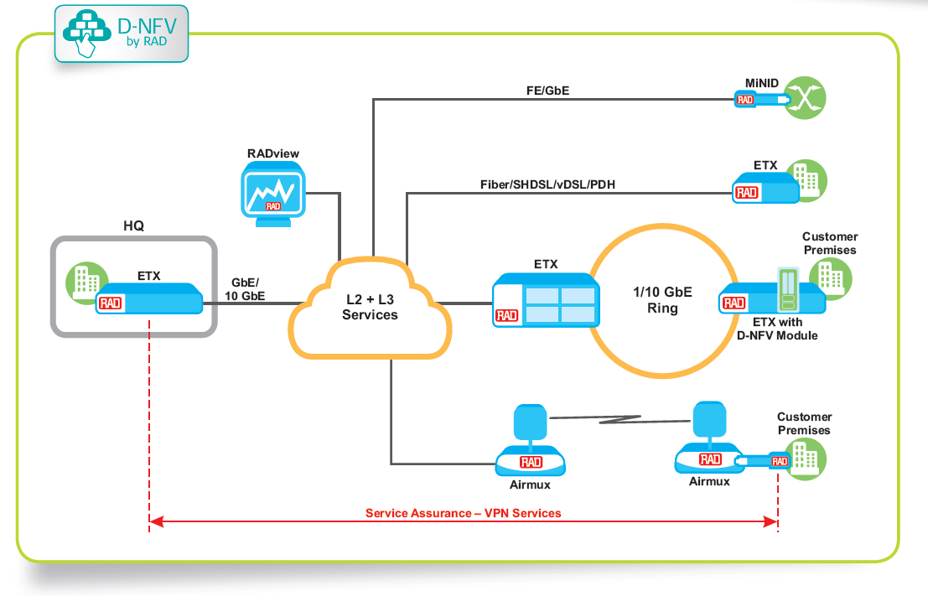
Carrier Ethernet and IP VPNs

Slide 6
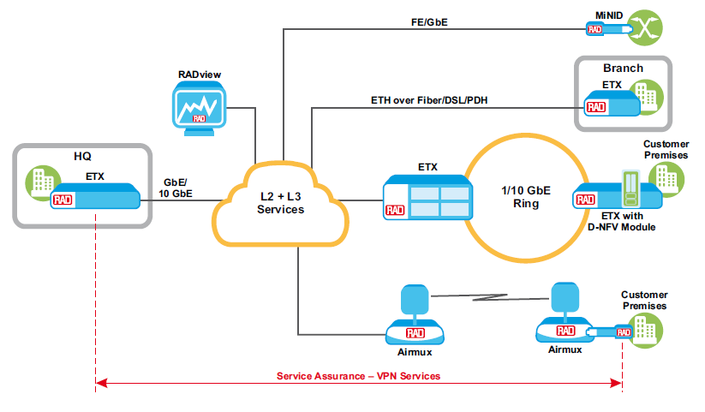
IP VPN For International Service Provider

Slide 7
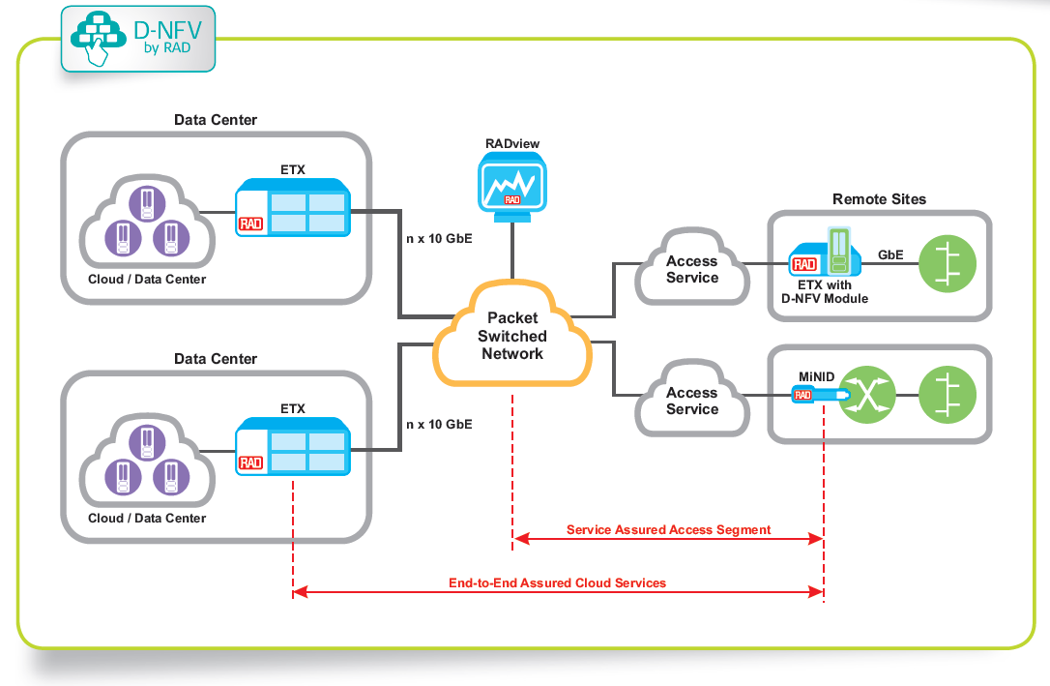
vCPE

Slide 8
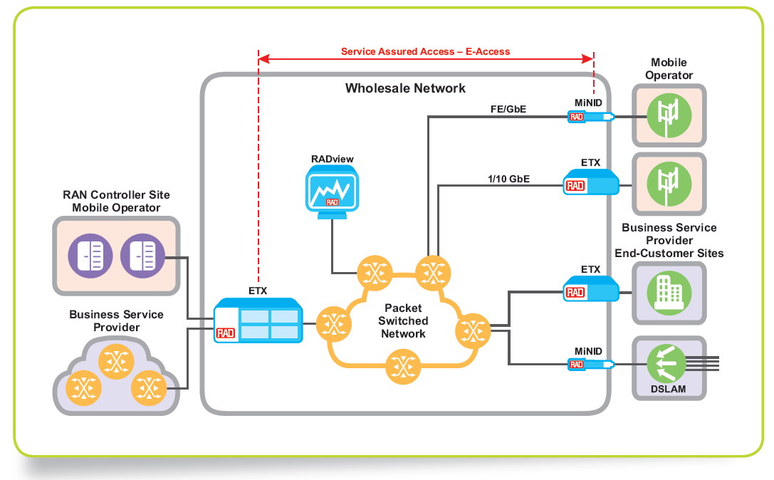
Wholesale Networking

Slide 9
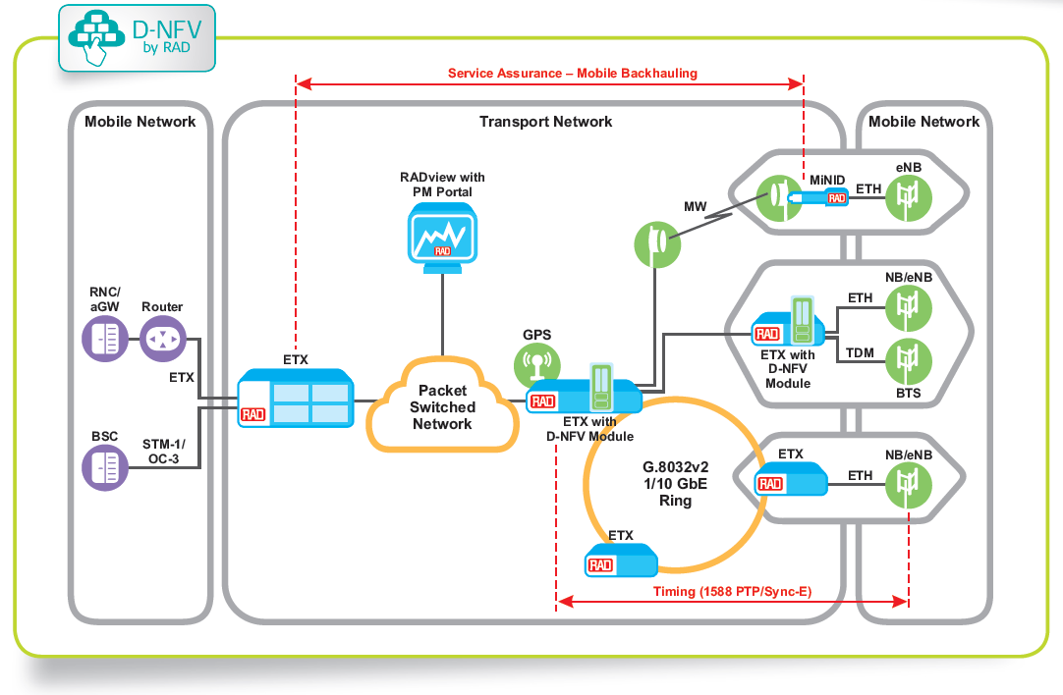
Mobile Backhaul

Slide 10
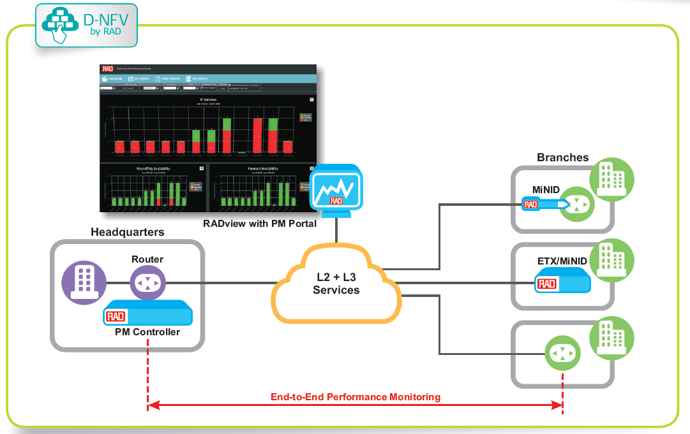
PM for Business VPNs

Slide 11
Diagram Setup for Configuration and Training Workshop

Slide 12






SAA Complete Application Layout
ETX-2i
“A”
ETX-2i “C”
0/1
0/1
172.17.195.110
LAG
172.17.195.130
ETX-2i
“B”
ETX-2i “D”
0/1
0/1
172.17.195.120
172.17.195.140
MC-A/2
MC-A/2
1/1
ETX-5_A
MC-A/1
MC-A/1
1/1
1/2
10G
G.8032
ETX-5_B
1/2
1/3
RPL
1/3
172.17.195.119
MiNID-SA “E”
1/4
1/4
MiNID-SA “A”
MC-A/3
MC-A/3
172.17.195.201
172.17.195.202
172.17.195.159
4/1
4/2
MiNID-SLV “F”
1/20
ETX-220A
1/4
MiNID-SLV “B”
172.17.195.203
172.17.195.169
1/1
1/2
1/3
172.17.195.129
MiNID-SA “C”
172.17.195.139
MiNID-SLV “D”
172.17.195.149
0/1
0/1
RADview 5.0
Controller
172.17.160.125
172.17.160.202
ETX-2i
“E”
ETX-2i
“F”
172.17.195.150
172.17.195.160

Slide 13
SAA – Demo Application Overview
Diagram:
MC-A/2
MC-A/2
ETX-5_A
MC-A/1
MC-A/1
10G
G.8032
ETX-5_B
1/3
RPL
MiNID-SA “E”
1/4
MC-A/3
MC-A/3
172.17.195.201
172.17.195.202
172.17.195.159
4/1
4/2
MiNID-SLV “F”
1/20
ETX-220A
1/1
172.17.195.203
172.17.195.169
1/2
0/1
0/1
RADview 5.0
Controller
172.17.160.125
172.17.160.202
ETX-2i
“E”
ETX-2i
“F”
172.17.195.150
172.17.195.160

Slide 14
Bill of Materials*
Product Name | Catalog Number | S/W version | Quantity
ETX-220A/AC/2XFP/20S/SYE/BSK | 5600470000 | 5.9.0 (0.22) | 1
ETX-5300A/AC | 5700040000 | 2.6.0 (0.14) | 2
ETX-5300A-MC/4XFP/AT | 6170210000 | 2.6.0 (0.14) | 2
ETX-5300A-ETH/20XGE/SFP | 6170060000 | 2.6.0 (0.14) | 2
ETX-2I/ACHP/19V | 5470080001 | 5.9.0 (0.22) | 2
ETX-DNFV-M/I7/128S | 5271590000 | 5.9.0 (0.22) | 2
MINID/STU/GE/ACEX/CMB | 6790080000 | 2.3 (0.29) | 1
MINID/SLV/GE | 6790050000 | 2.3 (0.29) | 1
MINID-SW/DEMARC | 6790000000 | 2.3 (0.29) | 2
SFP-5 | 1278060000 |  | 8
XFP-1D | 1279010000 |  | 8
CBL-LC/LC/SM | 2504520000 |  | 8
CBL-ETH/UTP/STR | 2500580000
Ethernet tester
*quantities may change according to the tested application

Slide 15

Let’s build it!

Slide 16
How to get it to work
Backbone Configuration
  Preliminary Configuration (HW and QoS)
  ERP Ring
  Management Configuration
End Units Configuration
  MiNID
    Management
  ETX-2i
    SM (Service Manager) & Management
RADview configuration
  Map, links
  Ethernet Services (SM):
    For Carrier Ethernet Application and Wholesale Networking:
      E-Line Single CoS
      E-Line Multi CoS and E-LAN
      E-Tree
    For vCPE and IP VPNs for International Service Providers – E-Line through NFV component

Slide 17
Backbone Configuration
In the following slides you can find the configuration scripts of the application backbone
The backbone topology consist a 10GbE ERP ring over LAG
(between 2 x ETX-5)
LAG
MC-A/2
MC-A/2
ETX-5_A
MC-A/1
MC-A/1
10G
G.8032
ETX-5_B
RPL
MC-A/3
MC-A/3
4/1
4/2
ETX-220A

Slide 18
Scripts
Device | SM Scripts | ERP, D-NFV and Management Scripts
ETX-5_A
ETX-5_B
ETX-220A
ETX-2i
LAG
MC-A/2
MC-A/2
ETX-2i
0/1
ETX-5_A
MC-A/1
MC-A/1
10G
G.8032
ETX-5_B
RPL
MC-A/3
MC-A/3
4/1
4/2
MSA/Port 1
ETX-220A
*MiNID Configuration is done via Web browser and RADview
MiNID

Slide 19
Backbone Configuration:
Ring Topology

Slide 20
Ring Topology
LAG
MC-A/2
MC-A/2
ETX-5_A
MC-A/1
MC-A/1
10G
G.8032
ETX-5_B
RPL
MC-A/3
MC-A/3
4/1
4/2
ETX-220A
VLANS:
4094 – Management
10 – OAM VLAN
20 – OAM VLAN
777 – R-APS Control
999 - VNF MNG

Slide 21
Ring Topology
Node Port
Node Port
LAG
MC-A/2
MC-A/2
ETX-5_A
MC-A/1
MC-A/1
10G
G.8032
ETX-5_B
172.17.195.201
172.17.195.202
RPL
MC-A/3
MC-A/3
4/1
4/2
Node Port
rpl
ETX-220A
172.17.195.203
Neighbor
Node Port
VLANS:
4094 – Management
10 – OAM VLAN
20 – OAM VLAN
777 – R-APS Control
999 - VNF MNG

Slide 22
ETX-220 Configuration

Slide 23
Default Configuration
ETX product have default management configuration:
#*************ETX-220A*************
#*******Default Configuration*******
configure
port
svi 96
no shutdown
exit
exit
#******* Classification Configuration *******
flows
classifier-profile mng_untagged match-any
match untagged
exit
classifier-profile mng_all match-any
match all
exit
#******* MNG Flows Configuration *******
flow mng_access_default_in
classifier mng_untagged
no policer
ingress-port ethernet 0/101
egress-port svi 96
no shutdown
exit
flow mng_access_default_out
classifier mng_all
no policer
ingress-port svi 96
egress-port ethernet 0/101
no shutdown
exit
exit
#******* Router Configuration *******
router 1
interface 32
address 169.254.1.1/16
bind svi 96
no shutdown
exit
exit
exit
The default configuration is set so that the IP address of device would be 169.254.1.1 and accessible from the Out-Of-Band port (MNG-ETH)
1
2
Starting from SW version:
ETX- 2: 5.9 Onward
ETX-5: 2.6 Onward

Slide 24
Removing Default Configuration
The following command will remove the default configuration:
#*************ETX-220A*************
configure router 1
interface 32
shutdown
exit
no interface 32
exit all
#*************************************
configure flows
flow mng_access_default_in
shutdown
exit
flow mng_access_default_out
shutdown
exit
#*************************************
no flow mng_access_default_in
no flow mng_access_default_out
#*************************************
no classifier-profile mng_all
no classifier-profile mng_untagged
exit all
#**************************************

Slide 25
ETX-220 – MNG Pre-Configuration
#********ETX-220A*********
#*****Bridge_Bind_PORT********configure
# Bridge Configuration
bridge 1
name "BRIDGE 1"
# Bridge Port Configuration
port 1
no shutdown
exit
port 2
no shutdown
exit
port 3
no shutdown
exit
port 4
no shutdown
exit
# VLAN Configuration
vlan 4094
exit
vlan 999
exit
vlan 20
exit
vlan 30
exit
vlan 777
exit
exit all
#*************ETX-220A*************
#*********** SVI ***************
Configure port
# Service Virtual Interface- Port Configuration
svi 1
no shutdown
exit
exit all
ETX-220A
1
Bridge 1
4
2
3
#*************ETX-220A*************
#*******Classifier Profile Configuration*******
configure
# Flows Configuration
flows
# Classifier Profile Configuration
classifier-profile "untagged" match-any
match untagged
exit
classifier-profile "match_all" match-any
match all
exit
classifier-profile "v4094" match-any
match vlan 4094
exit
classifier-profile "v999" match-any
match vlan 999
exit
classifier-profile "v20" match-any
match vlan 20
exit
classifier-profile "v30" match-any
match vlan 20
exit all
SVI 1
unt
all
v4094
v999
v20
v30

Slide 26
MNG Pre-Configuration
#************ETX-220A***************
#**********Flows Configuration*********
Configure flows
# Flow Configuration
flow "mng_svi_1"
classifier "match_all"
vlan-tag push vlan 4094 p-bit fixed 0
ingress-port svi 1
egress-port bridge-port 1 3
reverse-direction
no shutdown
exit
flow "mng_for_CPE"
classifier "v4094"
ingress-port ethernet 1/1
egress-port bridge-port 1 4
reverse-direction block 0/1
no shutdown
exit
exit all
ETX-220A
1
Bridge 1
4
2
3
Mng_for_CPE
1/1
v4094
mng_svi_1
all
SVI 1
Interface 1 IP 172.17.195.203
#*************ETX-220A*************
#******Router_Interface **************
configure
router 1
name "Router#1"
interface 1
address 172.17.195.203/24
bind svi 1
dhcp-client
client-id mac
exit
no shutdown
exit
static-route 0.0.0.0/0 address 172.17.195.1 metric 1
exit all
1
Router 1
MNG

Slide 27
ERP Major Ring Configuration
#************ETX-220A***************
#******* ERP Configuration(MAJOR)*********
configure
# Protection Configuration
protection
# Ethernet Ring Protection
erp 1 major
bridge 1
east-port 1 ethernet 4/1
west-port 2 ethernet 4/2
r-aps vlan 777 vlan-priority 1 mel 1
port-type east neighbor
port-type west node-port
timers guard 2000 holdoff 0
vlan 4094
queue-block east 0/2 west 0/2
no shutdown
exit
vlan 999
queue-block east 0/2 west 0/2
no shutdown
exit
vlan 20
queue-block east 0/2 west 0/2
no shutdown
exit
vlan 30
queue-block east 0/2 west 0/2
no shutdown
exit
no shutdown
exit
exit all
ERP 1 – instance #1/Ring number
Ring type is Major
East/West – locally defines the east and the west side of the node within the ring instance
R-APS - configuring a dedicated VLAN for the R-APS messaging in order to detect ring failures
MEL – Maintenance Entity Level
VLANs:
4094 – Management
999 – VNF Management
20 – OAM on one link
30 – OAM for second link
LAG
MC-A/2
MC-A/2
ETX-5_A
MC-A/1
MC-A/1
10G
G.8032
ETX-5_B
RPL
MC-A/3
MC-A/3
4/1
4/2
ETX-220A
Neighbor
Node Port
Notes:
ERP 1-16
Bridge 1-32
east-port - Defining bridge port as an East port of ERP node . Port type cannot be changed after ring creation. Sub-rings do not have West ports. Sub-rings have East ports only
R-APS settings must be the same for all ring members
What about revertive/non revertive - relevant to RPL owner node

Slide 28
ERP OAM CFM Configuration
#************ETX-220A***************
#****OAM CFM Configuration For Ring*****
Configure oam cfm
maintenance-domain 1
md-level 4
no name
maintenance-association 1
name uint 20
ccm-interval 3.33ms
classification vlan 20
mep 12
bind ethernet 4/1
classification vlan 20
queue fixed 0 block 0/2
remote-mep 2
client-md-level 5
no shutdown
exit
exit
maintenance-association 2
name uint 30
ccm-interval 3.33ms
classification vlan 30
mep 13
bind ethernet 4/2
classification vlan 30
queue fixed 0 block 0/2
remote-mep 3
client-md-level 5
no shutdown
exit
exit all
#************ETX-220A***************
#******** sf-trigger For Ring **************
Configure protection
erp 1
sf-trigger east mep 1 1 12
sf-trigger west mep 1 2 13
exit all
#************** END ***********
SF Trigger – enabling the propagation of the signal failure condition from the Ethernet OAM service layer. (CFM parameters must be configured first)
OAM CFM is needed for the CC (continuity check) messages.
Each two nodes will exchange the information allowing the failure condition to be recognize if several CCM messages are missing
LAG
MC-A/2
MC-A/2
ETX-5_A
MC-A/1
MC-A/1
10G
G.8032
ETX-5_B
RPL
MC-A/3
MC-A/3
4/1
4/2
ETX-220A

Slide 29

Where are we?
We’ve configured the ETX-220A with the relevant parameters:
We still have to configure:
  ETX-5_A (RPL Owner)
  ETX-5_B
LAG
MC-A/2
MC-A/2
ETX-5_A
MC-A/1
MC-A/1
10G
G.8032
ETX-5_B
RPL
MC-A/3
MC-A/3
4/1
4/2
ETX-220A

Slide 30
ETX-5 Configuration
Pre-Configuration

Slide 31
Default Configuration
ETX product have default management configuration:
#*************ETX-5300A*************
#*******Default Configuration*******
config
port
svi 4000 router
exit
exit
#******* Classification Configuration *******
flows
classifier-profile classall match-any
match all
exit
classifier-profile classutg match-any
match untagged
exit
#******* MNG Flows Configuration *******
flow mng_access_default_in
classifier classutg
ingress-port mng-ethernet main-a/0
egress-port svi 4000
no shutdown
exit
flow mng_access_default_out
classifier classall
ingress-port svi 4000
egress-port mng-ethernet main-a/0
no shutdown
exit
exit
#******* Router Configuration *******
router 1
interface 128
address 169.254.1.1/16
bind svi 4000
no shutdown
exit
exit
The default configuration is set so that the IP address of device would be 169.254.1.1 and accessible from the Out-Of-Band port (MNG-ETH)
Starting from SW version:
ETX- 2: 5.9 Onward
ETX-5: 2.6 Onward

Slide 32
Removing Default Configuration
The following command will remove the default configuration:
#*************ETX-5300A*************
configure router 1
interface 128
shutdown
exit
no interface 128
exit all
#*************************************
configure flows
flow mng_access_default_in
shutdown
exit
flow mng_access_default_out
shutdown
exit
#*************************************
no flow mng_access_default_in
no flow mng_access_default_out
#*************************************
no classifier-profile classall
no classifier-profile classutg
exit all
#**************************************
This configuration is similar to both ETX-5_A and ETX-5_B in this workshop

Slide 33
ETX-5_A Configuration Steps
LAG Configuration
  Define LAG entity and port binding
Pre-Configuration
  Define the svi, bridge, classification profiles
Management Traffic configuration
  VLAN 4094: Management flows for remote device
  VLAN 999: Management flows for VF
ERP Configuration
  Define the ERP instance and ports
  Define OAM parameters for signal failure(sf) trigger

Slide 34
LAG Configuration
LAG 1+1 (Redundancy)
  Data is sent only over one single link at any moment in time.
  LAG ports must belong to different 10-port group (ETX-5)
Load Sharing
  Capacity increase as data is sent over multiple links simultaneously.
  LAG ports must belong to the same 10-port group (ports 1–10 or ports 11–20) on the same card (ETX-5)
LACP - Link Aggregation Control Protocol mechanism for:
  Negotiation: exchanging port and system information to
  create and maintain LAG bundles
  Failures: detect failures and redistribute traffic (slow)
LAG
MC-A/2
MC-A/2
ETX-5_A
MC-A/1
MC-A/1
10G
G.8032
ETX-5_B
RPL
MC-A/3
MC-A/3
4/1
4/2
ETX-220A

Slide 35
LAG Configuration
L2CP = Layer 2 Control Protocol
L2CP Frames have specific MAC DAs belonging to reserved multicast MAC address ranges. Some of the L2CPs protocols share a MAC DA.
For example, the address 01-80-C2-00-00-02 is allocated for all "slow protocols" like LACP. Most of them use untagged frames
Creating the L2 tunnel for LAG control messages
over 01-80-c2-00-00-02 multicast address
#*************ETX-5300A********************************
#***********L2CP Configuration**********************
config port l2cp-profile "1"
mac 01-80-C2-00-00-02 peer
exit all
#*************** QoS Configuration ***********************
configure qos queue-group-profile q_group_3_level_default_LAG-1
inherited-from q_group_3_level_default
exit all
#**************** LAG-1 Configuration *********************
config port lag 1
name "LAG-1"
admin-key ten-giga-ethernet
queue-group profile "q_group_3_level_default_LAG-1"
mode load-balance
minimum-link-number 1
bind ethernet main-a/1
bind ethernet main-a/2
lacp tx-activity active tx-speed slow
distribution-method src-ip
anchor-port ethernet main-a/1
l2cp profile "1"
no shutdown
exit all
LAG-1: Load Balancing
Create the LAG entity (lag 1)
Configure LAG Mode “load-balance” (Load Sharing)
Assigning the physical ports to the LAG entity
TX- Activity Active - send and receive LACP traffic
Tx-speed - Slow/Fast – slow/long(90 sec), Fast/Short (3 sec)
Distribution- Method - Set the traffic to distribute between the ports based on their source IP address
Set the LAG Anchor port
Binding the physical ports of the LAG with LAG profile

Slide 36

ETX-5 Management Example
ETX-5300 Internal Management Flows
Interface 1 IP 172.17.195.201
Router 1
NMS
LAG 1
East
I/O
1/20
SVI 99
Node Port
SVI 3
SVI 1
SVI 100
BP 3
BP 100
BP1
Bridge 1
BP 2
SVI 2
Network Main a/3
West
RPL
ETX-5300A_A

Slide 37
ETX-5 Pre-Configuration
#*********** SVI *******
Configure port
  svi 1 bridge
  exit
  svi 2 bridge
  exit
  svi 3 bridge
  exit
  svi 100 bridge
  exit
  svi 99 router
  exit
exit all
#***************************
#********ETX-5300*********
#******Bridge_Bind_PORT******
configure
# Bridge Configuration
bridge 1
name "Bridge 1"
aging-time 300
# Bridge Port Configuration
port 1
bind svi 1
no shutdown
exit
port 2
bind svi 2
no shutdown
exit
port 3
bind svi 3
no shutdown
exit
port 100
  bind svi 100
  no shutdown
exit
SVI 99
LAG 1
SVI 3
SVI 1
SVI 100
BP 3
BP 100
BP1
Bridge 1
BP 2
SVI 2
Network Main a/3

Slide 38
ETX-5 Pre-Configuration
#*******VLAN Configuration**********
vlan 4094
tagged-egress 3,100
maximum-mac-addresses 1024
exit
vlan 999
  tagged-egress 1..3
  maximum-mac-addresses 1024
  exit
  vlan 10
  tagged-egress 1
  maximum-mac-addresses 1024
  exit
  vlan 20
  tagged-egress 2
  maximum-mac-addresses 1024
  exit
  vlan 777
  exit
exit all
#**********************************
SVI 99
LAG 1
SVI 3
SVI 1
SVI 100
BP 3
BP 100
BP1
Bridge 1
BP 2
#************Marking Profile Configuration*********************
configure
qos
# Marking Profile Configuration
marking-profile "markp0" color-aware green-yellow dei mapping
mark 0..7 green to 0 dei green
mark 0..7 yellow to 0 dei green
exit
cos-map-profile "cos_map" classification p-bit
exit
exit all
#**********************************************************
SVI 2
Network Main a/3

Slide 39
ETX-5 Pre-Configuration
#********ETX-5300*********
#***********Classifier Profile Configuration***************
configure
# Flows Configuration
flows
# Classifier Profile Configuration
classifier-profile "classall" match-any
match all
exit
classifier-profile "mng_4094" match-any
match vlan 4094
exit
classifier-profile "VF_mng_999" match-any
  match vlan 999
exit
classifier-profile "untagged" match-any
match untagged
exit
classifier-profile "v_raps_777" match-any
match vlan 777
exit
classifier-profile "v_10_OAM" match-any
  match vlan 10
exit
classifier-profile "v_20_OAM" match-any
  match vlan 20
exit
exit all
all
v4094
v999
unt
v777
v10
v20

Slide 40
Management Configuration
#********ETX-5300*********
#******* MNG Flows ******************
flow "svi100_svi99_v4094"
classifier "mng_4094"
ingress-color green
cos-mapping fixed 0
no policer
mark all
no marking-profile
no inner-marking-profile
exit
vlan-tag pop vlan
no l2cp
ingress-port svi 100
egress-port svi 99
no shutdown
exit
flow "svi99_svi100_v4094"
classifier "classall"
ingress-color green
cos-mapping fixed 0
no policer
mark all
no marking-profile
no inner-marking-profile
exit
vlan-tag push vlan 4094 p-bit profile "markp0" tag-ether-type 0x8100
no l2cp
ingress-port svi 99
egress-port svi 100
no shutdown
exit
NMS
I/O
1/20
SVI 99
svi100_svi99_v4094
LAG 1
all
svi99_svi100_v4094
SVI 3
v4094
SVI 100
SVI 1
BP 3
BP 100
BP1
Bridge 1
BP 2
SVI 2
Network Main a/3

Slide 41
Management Configuration
#********ETX-5300*********
#************* MNG Flows ************
flow "eth1/20_sap1/2/200_v4094"
classifier "mng_4094"
ingress-color green
cos-mapping fixed 0
no policer
mark all
no marking-profile
no inner-marking-profile
exit
  no l2cp
ingress-port 1/20
egress-port sap 1/2/200 queue-map-profile "QueueMapDefaultProfile" block 0/1
pm-enable
no shutdown
exit
flow "sap1/2/200_svi3_v4094"
classifier "mng_4094"
ingress-color green
cos-mapping fixed 0
no policer
mark all
no marking-profile
no inner-marking-profile
exit
vlan-tag pop vlan
no l2cp
ingress-port sap 1/2/200
egress-port svi 3
pm-enable
no shutdown
exit
eth1/20_sap1/2/200_v4094
SAP 1/2/200
NMS
v4094
Sap1/2/200_svi3_v4094
I/O
1/20
v4094
SVI 99
svi100_svi99_v4094
LAG 1
all
svi99_svi100_v4094
svi3_eth1/20_v4094
SVI 3
v4094
v4094
SVI 100
SVI 1
BP 3
BP 100
BP1
#********ETX-5300*********
#********* MNG Flows ********
flow "svi3_eth1/20_v4094"
classifier "mng_4094"
ingress-color green
cos-mapping fixed 0
no policer
mark all
no marking-profile
no inner-marking-profile
exit
  no l2cp
ingress-port svi 3
egress-port ethernet 1/20 queue-map-profile "QueueMapDefaultProfile" block 0/1
  pm-enable
no shutdown
exit
Bridge 1
BP 2
SVI 2
Network Main a/3

Slide 42
Management Configuration
#********ETX-5300*********
#********* MNG Flows **************
flow “lag1_svi1_v4094"
classifier "mng_4094"
ingress-color green
cos-mapping fixed 0
no policer
mark all
no marking-profile
no inner-marking-profile
exit
no vlan-tag
no l2cp
ingress-port lag 1
egress-port svi 1
pm-enable
no shutdown
exit
flow "svi1_lag1_v4094"
classifier "mng_4094"
ingress-color green
cos-mapping fixed 0
no policer
mark all
no marking-profile
no inner-marking-profile
exit
no vlan-tag
no l2cp
ingress-port svi 1
egress-port lag 1 queue-map-profile "QueueMapDefaultProfile" block 0/1
pm-enable
no shutdown
exit
eth1/20_sap1/2/200_v4094
SAP 1/2/200
NMS
v4094
Sap1/2/200_svi3_v4094
I/O
1/20
v4094
SVI 99
svi1_lag1_v4094
svi100_svi99_v4094
LAG 1
all
svi99_svi100_v4094
v4094
svi3_eth1/20_v4094
SVI 3
v4094
v4094
v4094
SVI 100
SVI 1
lag1_svi1_v4094
BP 3
BP 100
BP1
Bridge 1
BP 2
SVI 2
Network Main a/3

Slide 43
Management Configuration
#********ETX-5300*********
#********* MNG Flows **************
flow "a3_svi2_v4094"
classifier "mng_4094"
ingress-color green
cos-mapping fixed 0
no policer
mark all
no marking-profile
no inner-marking-profile
exit
no vlan-tag
no l2cp
ingress-port ethernet main-a/3
egress-port svi 2
pm-enable
no shutdown
exit
flow "svi2_a3_v4094"
classifier "mng_4094"
ingress-color green
cos-mapping fixed 0
no policer
mark all
no marking-profile
no inner-marking-profile
exit
no vlan-tag
no l2cp
ingress-port svi 2
egress-port ethernet main-a/3 queue-map-profile "QueueMapDefaultProfile" block 0/2
pm-enable
no shutdown
exit
eth1/20_sap1/2/200_v4094
SAP 1/2/200
NMS
v4094
Sap1/2/200_svi3_v4094
I/O
1/20
v4094
SVI 99
svi1_lag1_v4094
svi100_svi99_v4094
LAG 1
all
svi99_svi100_v4094
v4094
svi3_eth1/20_v4094
SVI 3
v4094
v4094
v4094
SVI 100
SVI 1
lag1_svi1_v4094
BP 3
BP 100
BP1
Bridge 1
BP 2
svi2_a3_v4094
v4094
SVI 2
Network Main a/3
v4094
a3_svi2_v4094

Slide 44
Management Configuration
eth1/20_sap1/2/200_v4094
Router 1
Interface 1 IP 172.17.195.201
SAP 1/2/200
NMS
v4094
Sap1/2/200_svi3_v4094
I/O
1/20
v4094
SVI 99
svi1_lag1_v4094
svi100_svi99_v4094
LAG 1
all
#********ETX-5300*********
#************** Router_Interface **********
configure
router 1
name "Router#1"
interface 1
address 172.17.195.201/24
bind svi 99
dhcp-client
client-id mac
exit
no shutdown
exit
static-route 0.0.0.0/0 address 172.17.195.1
exit
exit all
#************** END ********************
svi99_svi100_v4094
v4094
svi3_eth1/20_v4094
SVI 3
v4094
v4094
v4094
SVI 100
SVI 1
lag1_svi1_v4094
BP 3
BP 100
BP1
Bridge 1
BP 2
svi2_a3_v4094
v4094
SVI 2
Network Main a/3
v4094
a3_svi2_v4094

Slide 45
Management Flows for VF
#********ETX-5300*********
#******* VF MNG Flows ****************
flow "eth1/20_sap1/2/201_v999"
classifier "VF_mng_999"
ingress-color green
cos-mapping fixed 0
no policer
mark all
no marking-profile
no inner-marking-profile
exit
vlan-tag pop vlan
no l2cp
ingress-port ethernet 1/20
egress-port sap 1/2/201 queue-map-profile "QueueMapDefaultProfile" block 0/1
  pm-enable
  no shutdown
exit
flow “sap1/2/201_svi3_v999"
classifier "VF_mng_999"
ingress-color green
cos-mapping fixed 0
no policer
mark all
no marking-profile
no inner-marking-profile
exit
  no l2cp
ingress-port sap 1/2/201
egress-port svi 3
no shutdown
exit
eth1/20_sap1/2/201_v999
SAP 1/2/201
NMS
v999
Sap1/2/201_svi3_v999
I/O
1/20
v999
LAG 1
svi3_eth1/20_v999
SVI 3
v999
SVI 100
SVI 1
BP 3
BP 100
BP1
#********ETX-5300*********
#******** VF MNG Flows ********
flow "svi3_eth1/20_v999"
classifier "VF_mng_999"
ingress-color green
cos-mapping fixed 0
no policer
mark all
no marking-profile
no inner-marking-profile
exit
  no l2cp
ingress-port svi 3
egress-port ethernet 1/20 queue-map-profile "QueueMapDefaultProfile" block 0/1
  pm-enable
no shutdown
exit
Bridge 1
BP 2
SVI 2
Network Main a/3

Slide 46
ETX-5 Configuration
ERPS Configuration

Slide 47
ERP Major Ring
#************ETX-5300***************
#******** ERP_Configuration(MAJOR)**********
configure
# Protection Configuration
protection
# Ethernet Ring Protection
erp 1 major
bridge 1
east-port 1
west-port 2
r-aps vlan 777 vlan-priority 1 mel 1
port-type east node-port
port-type west rpl
data-vlan 4094
data-vlan 999
data-vlan 10
data-vlan 20
timers guard 2000 holdoff 0
no shutdown
exit all
#*********************************************************************************
LAG
Node Port
MC-A/2
E
MC-A/2
ETX-5_A
MC-A/1
MC-A/1
10G
G.8032
ETX-5_B
RPL
W
MC-A/3
MC-A/3
4/1
4/2
ETX-220A
rpl

Slide 48
ETX-5 Pre-Configuration
#*****************ETX-5300*****************************
#************ MAJOR RING R_APS flows **************************
configure
# Flow Configuration
flows
flow “lag1_svi1_v777"
classifier "v_raps_777"
ingress-color green
cos-mapping fixed 0
no policer
mark all
no marking-profile
no inner-marking-profile
exit
no vlan-tag
no l2cp
ingress-port lag 1
egress-port svi 1
pm-enable
no shutdown
exit
flow "svi1_lag1_v777"
classifier "v_raps_777"
ingress-color green
cos-mapping fixed 0
no policer
mark all
no marking-profile
no inner-marking-profile
exit
no vlan-tag
no l2cp
ingress-port svi 1
egress-port lag 1 queue-map-profile "QueueMapDefaultProfile" block 0/1
pm-enable
no shutdown
exit
SVI 99
svi1_lag1_v777
LAG 1
v777
SVI 3
SVI 100
SVI 1
lag1_svi1_v777
BP 3
BP 100
BP1
Bridge 1
BP 2
SVI 2
Network Main a/3

Slide 49
ETX-5 Pre-Configuration
#********ETX-5300*********
#************ MAJOR RING R_APS flows **************************
flow "a3_svi2_v777"
classifier "v_raps_777"
ingress-color green
cos-mapping fixed 0
no policer
mark all
no marking-profile
no inner-marking-profile
exit
no vlan-tag
no l2cp
ingress-port ethernet main-a/3
egress-port svi 2
pm-enable
no shutdown
exit
flow "svi2_a3_v777"
classifier "v_raps_777"
ingress-color green
cos-mapping fixed 0
no policer
mark all
no marking-profile
no inner-marking-profile
exit
no vlan-tag
no l2cp
ingress-port svi 2
egress-port ethernet main-a/3 queue-map-profile "QueueMapDefaultProfile" block 0/1
pm-enable
no shutdown
exit
SVI 99
svi1_lag1_v777
LAG 1
v777
SVI 3
SVI 100
SVI 1
lag1_svi1_v777
BP 3
BP 100
BP1
Bridge 1
BP 2
svi2_a3_v777
SVI 2
Network Main a/3
v777
a3_svi2_v777

Slide 50
#********ETX-5300*********
#********* OAM Flows For Ring *******
flow “lag1_svi1_v10_RX_OAM"
classifier "v_10_OAM"
ingress-color green
cos-mapping fixed 0
no policer
mark all
no marking-profile
no inner-marking-profile
exit
no vlan-tag
no l2cp
ingress-port lag 1
egress-port svi 1
pm-enable
no shutdown
exit
flow "svi1_lag1_v10_TX_OAM"
classifier "v_10_OAM"
ingress-color green
cos-mapping fixed 0
no policer
mark all
no marking-profile
no inner-marking-profile
exit
no vlan-tag
no l2cp
ingress-port svi 1
egress-port lag 1 queue-map-profile "QueueMapDefaultProfile" block 0/1
pm-enable
no shutdown
exit
#********ETX-5300*********
#*********** OAM Flows For Ring ********
flow "a3_svi2_v20_RX_OAM"
classifier "v_20_OAM"
ingress-color green
cos-mapping fixed 0
no policer
mark all
no marking-profile
no inner-marking-profile
exit
no vlan-tag
no l2cp
ingress-port ethernet main-a/3
egress-port svi 2
pm-enable
no shutdown
exit
flow "svi2_a3_v20_TX_OAM"
classifier "v_20_OAM"
ingress-color green
cos-mapping fixed 0
no policer
mark all
no marking-profile
no inner-marking-profile
exit
no vlan-tag
no l2cp
ingress-port svi 2
egress-port ethernet main-a/3 queue-map-profile "QueueMapDefaultProfile" block 0/1
pm-enable
no shutdown
exit
exit all
SVI 99
svi1_lag1_v10_TX_OAM
LAG 1
v10
SVI 3
SVI 100
SVI 1
lag1_svi1_v10_RX_OAM
BP 3
BP 100
BP1
Bridge 1
BP 2
svi2_a3_v20_TX_OAM
SVI 2
Network Main a/3
v20
a3_svi2_v20_RX_OAM

Slide 51
OAM Configuration
#********ETX-5300*********
#************ OAM CFM Configuration For Ring *****************
configure oam
# OAM CFM Configuration
cfm
maintenance-domain 1
md-level 4
maintenance-association 1
name uint 10
ccm-interval 3.33ms
mep 1
bind lag 1
cos-mapping profile "cos_map"
flow uni-direction rx “lag1_svi1_v10_RX_OAM" tx "svi1_lag1_v10_TX_OAM"
queue queue-mapping "QueueMapDefaultProfile" block 0/2
remote-mep 11
client-md-level 5
no shutdown
exit
exit
maintenance-association 2
name uint 20
ccm-interval 3.33ms
mep 2
bind ethernet main-a/3
cos-mapping profile "cos_map"
flow uni-direction rx "a3_svi2_v20_RX_OAM" tx "svi2_a3_v20_TX_OAM"
queue queue-mapping "QueueMapDefaultProfile" block 0/2
remote-mep 12
client-md-level 5
no shutdown
exit all
#********ETX-5300*********
#***** sf-trigger For Ring ******************
Configure protection erp 1
sf-trigger east mep 1 1 1
sf-trigger west mep 1 2 2
exit all

Slide 52

Where are we?
We configured ETX-220A and ETX-5_A
In the following slides you can find the script for ETX-5_B
The QoS configuration is the same as in ETX-5_A
LAG
Node Port
MC-A/2
E
MC-A/2
ETX-5_A
MC-A/1
MC-A/1
10G
G.8032
ETX-5_B
172.17.195.201
172.17.195.202
RPL
W
MC-A/3
MC-A/3
4/1
4/2
ETX-220A
rpl
172.17.195.203

Slide 53
ETX-5_B Configuration Scripts
#********ETX-5300*********
#********* SVI *********************
#***************************
configure
port
svi 1 bridge
exit
svi 2 bridge
exit
svi 100 bridge
exit
svi 99 router
exit
exit all
#***************************
#***********Bridge_Bind_PORT***********
#***************************
configure
#Bridge Configuration
bridge 1
name "Bridge 1"
aging-time 300
#Bridge Port Configuration
port 1
bind svi 1
no shutdown
exit
port 2
bind svi 2
no shutdown
exit
port 100
bind svi 100
no shutdown
exit
#********ETX-5300*********
#***************************
#VLAN Configuration
vlan 4094
tagged-egress 1,2,100
maximum-mac-addresses 1024
exit
vlan 999
tagged-egress 1..2
maximum-mac-addresses 1024
exit
vlan 10
tagged-egress 1
maximum-mac-addresses 1024
exit
vlan 30
tagged-egress 2
maximum-mac-addresses 1024
exit
vlan 777
exit
exit all
1
2

Slide 54
ETX-5_B Configuration Scripts
#********ETX-5300*********
#********L2cp profile for LAG***********
config port l2cp-profile "1"
mac 01-80-C2-00-00-02 peer
exit all
#***************END****************
configure qos queue-group-profile q_group_3_level_default_LAG-1
inherited-from q_group_3_level_default
exit all
#***************************
#********LAG-1 Definition ********************
config port lag 1
name "LAG-1"
admin-key ten-giga-ethernet
queue-group profile "q_group_3_level_default_LAG-1"
mode load-balance
minimum-link-number 1
bind ethernet main-a/1
bind ethernet main-a/2
lacp tx-activity active tx-speed slow
distribution-method src-ip
anchor-port ethernet main-a/1
l2cp profile "1"
no shutdown
exit all
#********ETX-5300*********
#************ ERP_Configuration(MAJOR)**********
#***************************
configure
#Protection Configuration
protection
#Ethernet Ring Protection
erp 1 major
bridge 1
east-port 1
west-port 2
r-aps vlan 777 vlan-priority 1 mel 1
port-type east node-port
port-type west node-port
data-vlan 4094
data-vlan 999
data-vlan 10
data-vlan 30
timers guard 2000 holdoff 0
no shutdown
exit all
3
4
5
#********ETX-5300*********
#*******Marking Profile Configuration********
#***************************
configure
qos
# Marking Profile Configuration
marking-profile "markp0" color-aware green-yellow dei mapping
mark 0..7 green to 0 dei green
mark 0..7 yellow to 0 dei green
exit
cos-map-profile "cos_map" classification p-bit
exit
exit all

Slide 55
ETX-5_B Configuration Scripts
#********ETX-5300*********
#**********Classifier Profile Configuration********
#***************************
configure
flows
classifier-profile "classall" match-any
match all
exit
classifier-profile "mng_4094" match-any
match vlan 4094
exit
classifier-profile "VF_mng_999" match-any
match vlan 999
exit
classifier-profile "untagged" match-any
match untagged
exit
classifier-profile "v_raps_777" match-any
match vlan 777
exit
classifier-profile "v_10_OAM" match-any
match vlan 10
exit
classifier-profile "v_30_OAM" match-any
match vlan 30
exit
exit all
#********ETX-5300*********
#********* MAJOR RING R_APS flows *************
#***************************
configure
#Flow Configuration
flows
flow "lag1_svi1_v777"
classifier "v_raps_777"
ingress-color green
cos-mapping fixed 0
no policer
mark all
no marking-profile
no inner-marking-profile
exit
no vlan-tag
no l2cp
ingress-port lag 1
egress-port svi 1
pm-enable
no shutdown
exit
6
7
#***************************
flow "svi1_lag1_v777"
classifier "v_raps_777"
ingress-color green
cos-mapping fixed 0
no policer
mark all
no marking-profile
no inner-marking-profile
exit
no vlan-tag
no l2cp
ingress-port svi 1
egress-port lag 1 queue-map-profile "QueueMapDefaultProfile" block 0/1
pm-enable
no shutdown
exit
8

Slide 56
#********ETX-5300*********
#***************************
flow "a3_svi2_v777"
classifier "v_raps_777"
ingress-color green
cos-mapping fixed 0
no policer
mark all
no marking-profile
no inner-marking-profile
exit
no vlan-tag
no l2cp
ingress-port ethernet main-a/3
egress-port svi 2
pm-enable
no shutdown
exit
#***************************
flow "svi2_a3_v777"
classifier "v_raps_777"
ingress-color green
cos-mapping fixed 0
no policer
mark all
no marking-profile
no inner-marking-profile
exit
no vlan-tag
no l2cp
ingress-port svi 2
egress-port ethernet main-a/3 queue-map-profile "QueueMapDefaultProfile" block 0/1
pm-enable
no shutdown
exit
#********ETX-5300*********
#*************** MNG Flows ****************
#***************************
flow "svi100_svi99_v4094"
classifier "mng_4094"
ingress-color green
cos-mapping fixed 0
no policer
mark all
no marking-profile
no inner-marking-profile
exit
vlan-tag pop vlan
no l2cp
ingress-port svi 100
egress-port svi 99
no shutdown
exit
#***************************
flow "svi99_svi100_v4094"
classifier "classall"
ingress-color green
cos-mapping fixed 0
no policer
mark all
no marking-profile
no inner-marking-profile
exit
vlan-tag push vlan 4094 p-bit profile "markp0" tag-ether-type 0x8100
no l2cp
ingress-port svi 99
egress-port svi 100
no shutdown
exit
#***************************
9
10

Slide 57
#********ETX-5300*********
flow "lag1_svi1_v4094"
classifier "mng_4094"
ingress-color green
cos-mapping fixed 0
no policer
mark all
no marking-profile
no inner-marking-profile
exit
no vlan-tag
no l2cp
ingress-port lag 1
egress-port svi 1
pm-enable
no shutdown
exit
#***************************
flow "svi1_lag1_v4094"
classifier "mng_4094"
ingress-color green
cos-mapping fixed 0
no policer
mark all
no marking-profile
no inner-marking-profile
exit
no vlan-tag
no l2cp
ingress-port svi 1
egress-port lag 1 queue-map-profile "QueueMapDefaultProfile" block 0/1
pm-enable
no shutdown
exit
#***************************
12
11
#********ETX-5300*********
flow "a3_svi2_v4094"
classifier "mng_4094"
ingress-color green
cos-mapping fixed 0
no policer
mark all
no marking-profile
no inner-marking-profile
exit
no vlan-tag
no l2cp
ingress-port ethernet main-a/3
egress-port svi 2
pm-enable
no shutdown
exit
#***************************
flow "svi2_a3_v4094"
classifier "mng_4094"
ingress-color green
cos-mapping fixed 0
no policer
mark all
no marking-profile
no inner-marking-profile
exit
no vlan-tag
no l2cp
ingress-port svi 2
egress-port ethernet main-a/3 queue-map-profile "QueueMapDefaultProfile" block 0/2
pm-enable
no shutdown
exit
#***************************

Slide 58
#********ETX-5300*********
#**** VF MNG Flows for remote VF V999******
flow "lag1_svi1_v999"
classifier "VF_mng_999"
ingress-color green
cos-mapping fixed 0
no policer
mark all
no marking-profile
no inner-marking-profile
exit
no vlan-tag
no l2cp
ingress-port lag 1
egress-port svi 1
pm-enable
no shutdown
exit
#***************************
flow "svi1_lag1_v999"
classifier "VF_mng_999"
ingress-color green
cos-mapping fixed 0
no policer
mark all
no marking-profile
no inner-marking-profile
exit
no vlan-tag
no l2cp
ingress-port svi 1
egress-port lag 1 queue-map-profile "QueueMapDefaultProfile" block 0/1
pm-enable
no shutdown
exit
#**************************
14
13
#********ETX-5300*********
#**** VF MNG Flows for remote VF V999******
flow "a3_svi2_v999"
classifier "VF_mng_999"
ingress-color green
cos-mapping fixed 0
no policer
mark all
no marking-profile
no inner-marking-profile
exit
no vlan-tag
no l2cp
ingress-port ethernet main-a/3
egress-port svi 2
pm-enable
no shutdown
exit
#***************************
flow "svi2_a3_v999"
classifier "VF_mng_999"
ingress-color green
cos-mapping fixed 0
no policer
mark all
no marking-profile
no inner-marking-profile
exit
no vlan-tag
no l2cp
ingress-port svi 2
egress-port ethernet main-a/3 queue-map-profile "QueueMapDefaultProfile" block 0/2
pm-enable
no shutdown
exit#***************************

Slide 59
ETX-5_B Configuration Scripts
14
#********ETX-5300*********
#***** OAM Flows For Ring ***************
#***************************
flow "lag1_svi1_v10_RX_OAM"
classifier "v_10_OAM"
ingress-color green
cos-mapping fixed 0
no policer
mark all
no marking-profile
no inner-marking-profile
exit
no vlan-tag
no l2cp
ingress-port lag 1
egress-port svi 1
pm-enable
no shutdown
exit
#***************************
flow "svi1_lag1_v10_TX_OAM"
classifier "v_10_OAM"
ingress-color green
cos-mapping fixed 0
no policer
mark all
no marking-profile
no inner-marking-profile
exit
no vlan-tag
no l2cp
ingress-port svi 1
egress-port lag 1 queue-map-profile "QueueMapDefaultProfile" block 0/1
pm-enable
no shutdown
exit
#***************************
13
#********ETX-5300*********
flow "a3_svi2_v30_RX_OAM"
classifier "v_30_OAM"
ingress-color green
cos-mapping fixed 0
no policer
mark all
no marking-profile
no inner-marking-profile
exit
no vlan-tag
no l2cp
ingress-port ethernet main-a/3
egress-port svi 2
pm-enable
no shutdown
exit
#***************************
flow "svi2_a3_v30_TX_OAM"
classifier "v_30_OAM"
ingress-color green
cos-mapping fixed 0
no policer
mark all
no marking-profile
no inner-marking-profile
exit
no vlan-tag
no l2cp
ingress-port svi 2
egress-port ethernet main-a/3 queue-map-profile "QueueMapDefaultProfile" block 0/1
pm-enable
no shutdown
exit
exit all

Slide 60
15
16
#********ETX-5300*********
#********* OAM CFM Configuration For Ring ************** #***************************
configure
oam
#OAM CFM Configuration
cfm
maintenance-domain 1
md-level 4
maintenance-association 1
name uint 10
ccm-interval 3.33ms
mep 11
bind lag 1
cos-mapping profile "cos_map"
flow uni-direction rx "lag1_svi1_v10_RX_OAM" tx "svi1_lag1_v10_TX_OAM"
queue queue-mapping "QueueMapDefaultProfile" block 0/2
remote-mep 1
client-md-level 5
no shutdown
exit
exit
maintenance-association 2
name uint 30
ccm-interval 3.33ms
mep 3
bind ethernet main-a/3
cos-mapping profile "cos_map"
flow uni-direction rx "a3_svi2_v30_RX_OAM" tx "svi2_a3_v30_TX_OAM"
queue queue-mapping "QueueMapDefaultProfile" block 0/2
remote-mep 13
client-md-level 5
no shutdown
exit all
#***************************
#********ETX-5300*********
#*************************** sf-trigger For Ring **************************
#***************************
configure
protection
erp 1
sf-trigger east mep 1 1 11
sf-trigger west mep 1 2 3
exit all
17
#********ETX-5300*********
#************ Router_Interface ***********************
#***************************
configure
router 1
name "Router#1"
interface 1
address 172.17.195.202/24
bind svi 99
dhcp-client
client-id mac
exit
no shutdown
exit
static-route 0.0.0.0/0 address 172.17.195.1
exit
exit all
#***************************
#******************** END ****************

Slide 61


Where Are We?
We finished with Backbone configuration.
ERP State should be “Idle” (‘show status’ command)
Now you should be able to ping from the server to the backbone elements
The next step is to
configure the MiNID
MC-A/2
MC-A/2
ETX-5_A
MC-A/1
MC-A/1
10G
G.8032
ETX-5_B
1/3
RPL
MiNID-SA “E”
1/4
MC-A/3
MC-A/3
172.17.195.201
172.17.195.202
172.17.195.159
4/1
4/2
MiNID-SLV “F”
1/20
ETX-220A
1/1
172.17.195.203
172.17.195.169
1/2
0/1
0/1
RADview 5.0
Controller
172.17.160.125
172.17.160.202
ETX-2i
“E”
ETX-2i
“F”
172.17.195.150
172.17.195.160

Slide 62

End Units Configuration:
MiNID Configuration

Slide 63
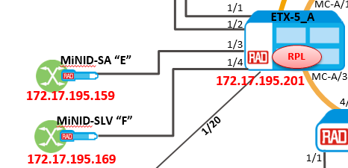
Configuration Steps
Preliminary configuration in the remote device:
  Setting the MNG flows so we can reach the MiNID via inband MNG VLAN
Preliminary configuration in the MiNID:
  Setting the MiNID IP address
  Configuring manager IP (For SNMP Traps)
  Classification validation (For Service creation from the SM)
RADView Configuration
  Add the MiNID
  Create link
  Create service
PM View
Explained in this presentation
Not explained in this presentation. Service configuration is done from RV GUI and is part of the SM presentation

Slide 64
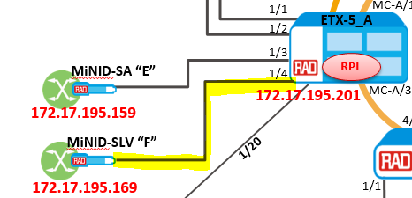
Preliminary configuration in the remote device
#***************************
#*** MNG flow for Device V4094 ***************************
configure flows
flow "eth_1/4_to_sap_1_1_6"
classifier "mng_4094"
ingress-color green
cos-mapping fixed 0
no policer
mark all
no marking-profile
no inner-marking-profile
exit
no vlan-tag
no l2cp
ingress-port ethernet 1/4
egress-port sap 1/1/6 queue-map-profile "QueueMapDefaultProfile" block 0/1
no shutdown
exit
#***************************
flow "sap_1_1_6_to_svi_7"
classifier "mng_4094"
ingress-color green
cos-mapping fixed 0
no policer
mark all
no marking-profile
no inner-marking-profile
exit
no vlan-tag
no l2cp
ingress-port sap 1/1/6
egress-port svi 7
no shutdown
exit
2
#***************************
flow "from_svi_7_to_eth_1/4_v4094"
classifier "mng_4094"
ingress-color green
cos-mapping fixed 0
no policer
mark all
no marking-profile
no inner-marking-profile
exit
no vlan-tag
no l2cp
ingress-port svi 7
egress-port ethernet 1/4 queue-map-profile "QueueMapDefaultProfile" block 0/1
no shutdown
exit
exit all
#********ETX-5300*********
#* MNG for device connected to port 1/4**
#****** Bridge and SVI ************
configure
port
svi 7 bridge
exit
exit all
#***************************
configure
#Bridge Configuration
bridge 1
#Bridge Port Configuration
port 7
bind svi 7
no shutdown
exit
#VLAN Configuration
vlan 4094
tagged-egress 7
maximum-mac-addresses 1024
exit
vlan 999
tagged-egress 7
maximum-mac-addresses 1024
exit
exit all
3
1

Slide 65
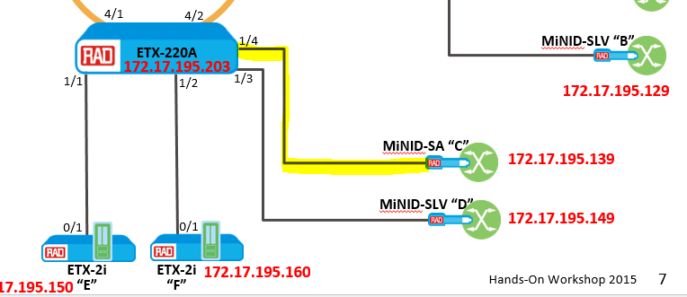
Preliminary configuration in the remote device
#********ETX-220A*********
#*********** MNG for device connected to port 1/4 (MiNID)#***************************
configure
  bridge 1
#Bridge Port Configuration
  port 7
    no shutdown
  exit
exit all
#*************************** MNG flow for Device V4094 ***************************
configure flows flow MNG_In_1_4_v4094
  classifier v4094
  ingress-port ethernet 1/4
  egress-port bridge-port 1 7
  reverse-direction block 0/1
  no shutdown
exit all

Slide 66

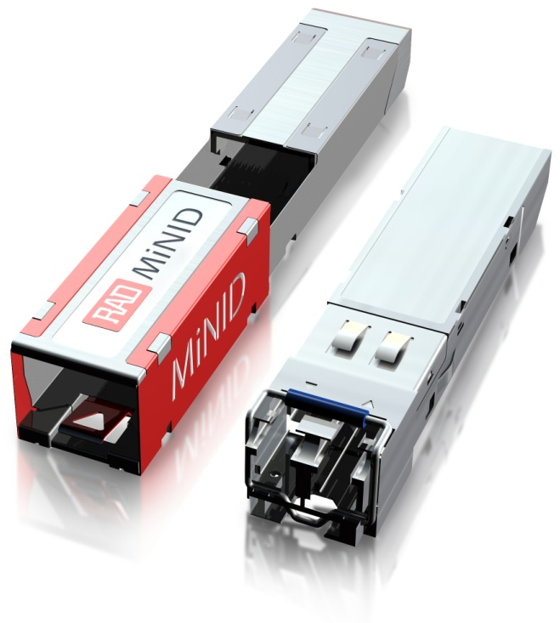
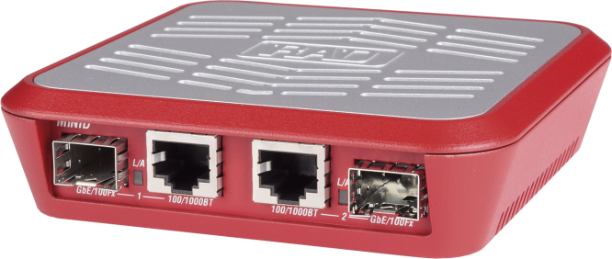
MiNID Preliminary
MiNID management is available through:
  CLI
  Web Browser
For initial configuration, you can connect to the MiNID in 2 different ways:
In this workshop we will use the direct option
Directly
Through the Housing Device
MiNID
192.168.205.1
RJ-45
PC
192.168.205.2
E-SFP
OR
Housing
Device
MiNID
192.168.205.1
SFP
MiNID SA
192.168.205.1
RJ-45
PC
192.168.205.2

Slide 67
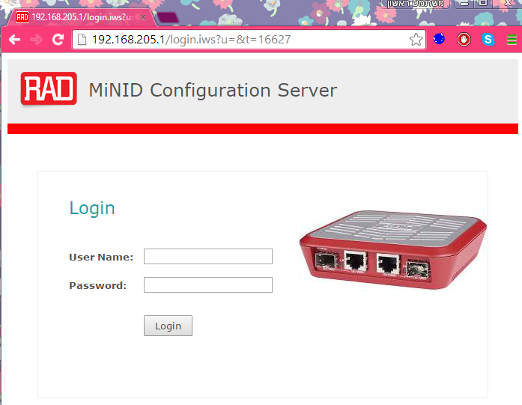
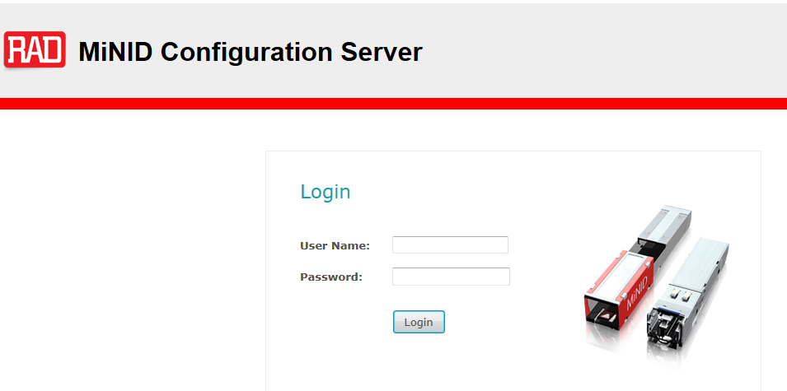
MiNID Preliminary – Config Mode
In this workshop we will work in Config Mode. Change the DIP switch to Config Mode and then continue!
In the PC browser, put MiNID default IP address
User Name: su
Password: 1234
Click on Login
1
2
2
3
3

Slide 68
Setting the MiNID IP address for Management
Initial configuration requires
  Dedicated IP address (in case of static IP)
  Predefined VLAN ID
Note: In order to reach the MiNID from RADview, it is also required to add the interface that is connected to the MiNID to the bridge with the management VLAN
This step was already done in the preliminary step.

Slide 69
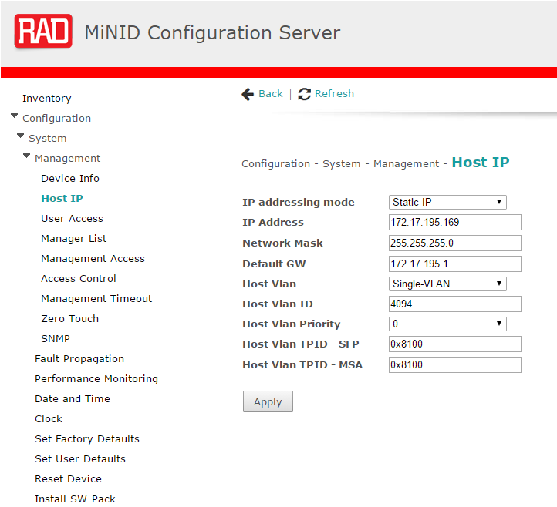

Setting the MiNID IP address for Management
4. Go to: Configuration -> System -> Management -> Host IP
5. Configure the following according to the application
6. Click Apply
4
5
If you work in “Normal” mode - After clicking the apply, the following info appears. It means that after you configure the IP address, the MiNID is no longer accessible via its default IP address. (The DIP switch is set to Normal operation)
we recommend to work in
6

Slide 70
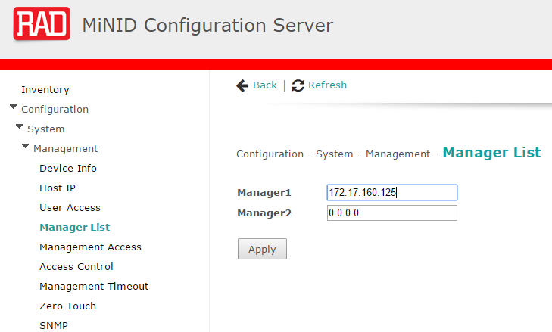


Configuring the Manager IP
10
8
7
9
7. Go to: Configuration -> System -> Management -> Manager List
8. Configure Manager IP address for SNMP traps
9. Click Apply
10. Click Save Configuration !!

Slide 71
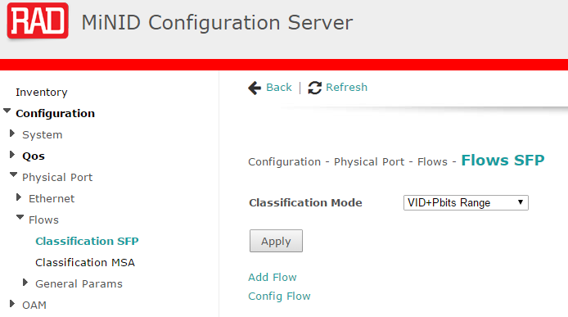
Classification Validation
In order to configure a service using the SM, the classification mode of both of the ports should be: VID + Pbits Range
This is the default mode
Port 1
Port 2
MSA
SFP
MiNID
SFP

Slide 72
Where Are We?
We finished with MiNID configuration including adding the flows to the backbone devices (we called them ”remote device”)
The next step is to configure the ETX-2i
MC-A/2
MC-A/2
ETX-5_A
MC-A/1
MC-A/1
10G
G.8032
ETX-5_B
1/3
RPL
MiNID-SA “E”
1/4
MC-A/3
MC-A/3
172.17.195.201
172.17.195.202
172.17.195.159
4/1
4/2
MiNID-SLV “F”
1/20
ETX-220A
1/1
172.17.195.203
172.17.195.169
1/2
0/1
0/1
RADview 5.0
Controller
172.17.160.125
172.17.160.202
ETX-2i
“E”
ETX-2i
“F”
172.17.195.150
172.17.195.160

Slide 73
End Units Configuration:
ETX-2i
Preliminary and Management Configuration

Slide 74
Queues Configuration – ETX-2i
In this example Q-group profile “QGN1” was created
#***************************QUEUE_GROUP*******************************
exit all
config qos queue-group-profile QGN1
exit all
config port eth 0/1 queue-group profile QGN1
exit all
config qos queue-group-profile QGN2
exit all
config port eth 0/2 queue-group profile QGN2
exit all
config qos queue-group-profile QGN3
exit all
config port eth 0/3 queue-group profile QGN3
exit all
config qos queue-group-profile QGN4
exit all
config port eth 0/4 queue-group profile QGN4
exit all
save
#***************************QUEUE_GROUP END****************************
The new profile is assigned to Ethernet port 0/1

Slide 75
ETX-2i - Default Configuration
ETX product have default management configuration:
#*************ETX-220A*************
#*******Default Configuration*******
configure
port
svi 96
no shutdown
exit
exit
#******* Classification Configuration *******
flows
classifier-profile mng_untagged match-any
match untagged
exit
classifier-profile mng_all match-any
match all
exit
#******* MNG Flows Configuration *******
flow mng_access_default_in
classifier mng_untagged
no policer
ingress-port ethernet 0/101
egress-port svi 96
no shutdown
exit
flow mng_access_default_out
classifier mng_all
no policer
ingress-port svi 96
egress-port ethernet 0/101
no shutdown
exit
exit
#******* Router Configuration *******
router 1
interface 31
address 169.254.1.1/16
bind svi 96
no shutdown
exit
exit
exit
1
2
Starting from SW version:
ETX- 2: 5.9 Onward
ETX-5: 2.6 Onward

Slide 76
Removing Default Configuration
The following command will remove the default configuration:
#*************ETX-220A*************
configure router 1
interface 31
shutdown
exit
no interface 31
exit all
#*************************************
configure flows
flow mng_access_default_in
shutdown
exit
flow mng_access_default_out
shutdown
exit
#*************************************
no flow mng_access_default_in
no flow mng_access_default_out
#*************************************
no classifier-profile mng_all
no classifier-profile mng_untagged
exit all
#**************************************

Slide 77
ETX-2i MNG Pre-Configuration
#********ETX-2i*********
#****** SVI ***************
Configure port
# Service Virtual Interface- Port Configuration
svi 1
no shutdown
exit
exit all
#************* INBAND MNG Flows ********
configure flows
classifier-profile "v4094" match-any
match vlan 4094
exit
classifier-profile "match_all" match-any
match all
exit
#**********************
#Flow Configuration
flow "mng_in"
classifier "v4094"
vlan-tag pop vlan
ingress-port ethernet 0/1
egress-port svi 1
no shutdown
exit
#**********************
flow "mng_out"
classifier "match_all"
vlan-tag push vlan 4094 p-bit fixed 0
ingress-port svi 1
egress-port ethernet 0/1 queue 0 block 0/1
no shutdown
exit all
0/1
mng_in
v4094
mng_out
v4094
all
SVI 1
Interface 1 IP 172.17.195.149
all
1
Router 1
#*************ETX-2i*************
#***** Router_Interface ****************
configure router 1
interface 1
address 172.17.195.149/24
bind svi 1
dhcp-client
client-id mac
exit
no shutdown
exit
static-route 0.0.0.0/0 address 172.17.195.1 metric 1
exit all
#*****************************************
#*************END***********
ETX-2i
MNG

Slide 78
Where Are We?
We finished with
ETX-2i configuration
The next step is to add the elements to RADview MAP and configuring Ethernet services
MC-A/2
MC-A/2
ETX-5_A
MC-A/1
MC-A/1
10G
G.8032
ETX-5_B
1/3
RPL
MiNID-SA “E”
1/4
MC-A/3
MC-A/3
172.17.195.201
172.17.195.202
172.17.195.159
4/1
4/2
MiNID-SLV “F”
1/20
ETX-220A
1/1
172.17.195.203
172.17.195.169
1/2
0/1
0/1
RADview 5.0
Controller
172.17.160.125
172.17.160.202
ETX-2i
“E”
ETX-2i
“F”
172.17.195.150
172.17.195.160

Slide 79
RADview
General Configuration

Slide 80
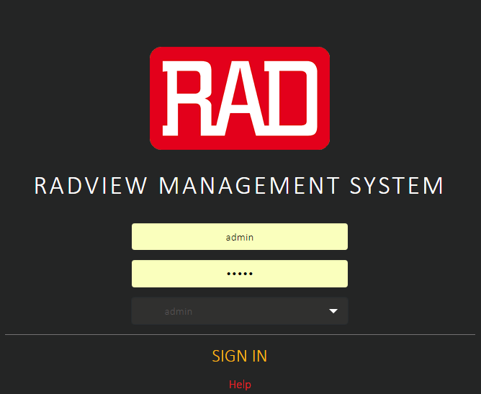
Getting started
RADview version 5.0 onward can be accessed from a web browser using the following URL:
//<ip_address>:3000/app
Write the username and the password. Then select “Admin”

Slide 81
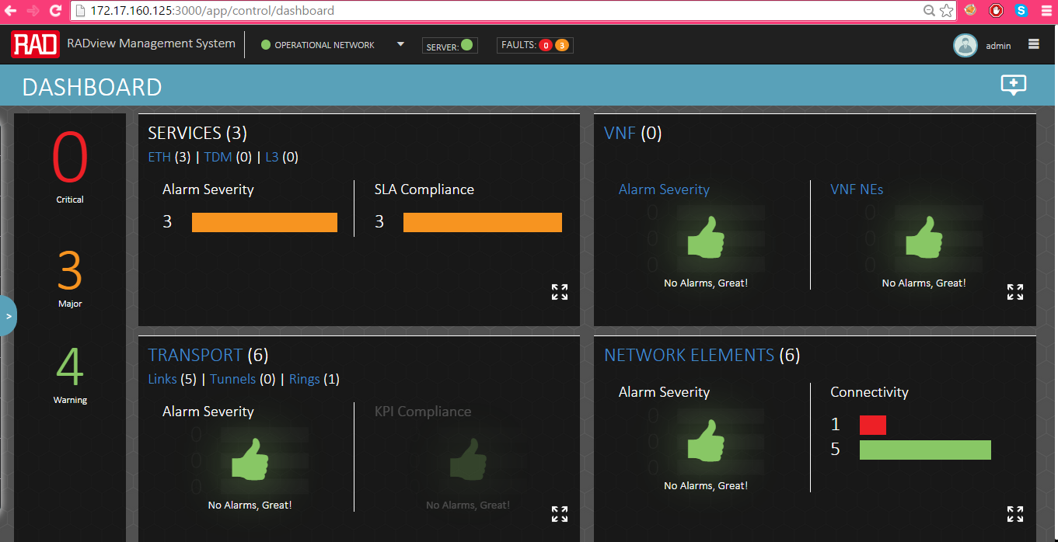
RADview Dashboard
In the dashboard section you can see the alerts, the created services, network elements
What information do we get from the Dashboard page?

Slide 82

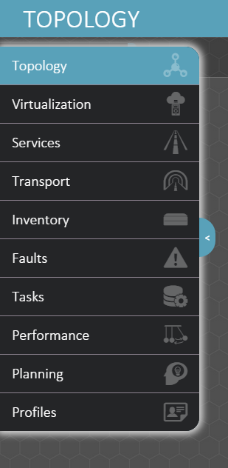
Selecting the Workspace
User can see the map Map and Elements and the physical links
To view all the virtual functions in the system, including virtual network interfaces, flavors, image repository and VNF Services
On the left side of the screen, you can find the different workspaces
Click on the relevant icon and the map will be changed according to the selected option
To view the list of all the Ethernet, VNF and TDM services and templates and also the IP Monitoring sessions (TWAMP)
To view the configured Ethernet Rings (ERP) and tunnels
To view the domains, the network elements list, the links, LAG, Cloud, customer and business entities
To view the network actives alarms, events and log
To schedule a task (Job) to run automatically and manually
To view performance information and access the PM portal
To design and create planned entities for network planning
To view and create BW profiles, Network CoS and SLA profiles

Slide 83
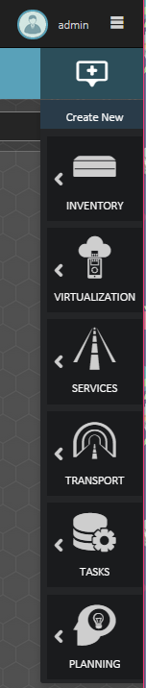

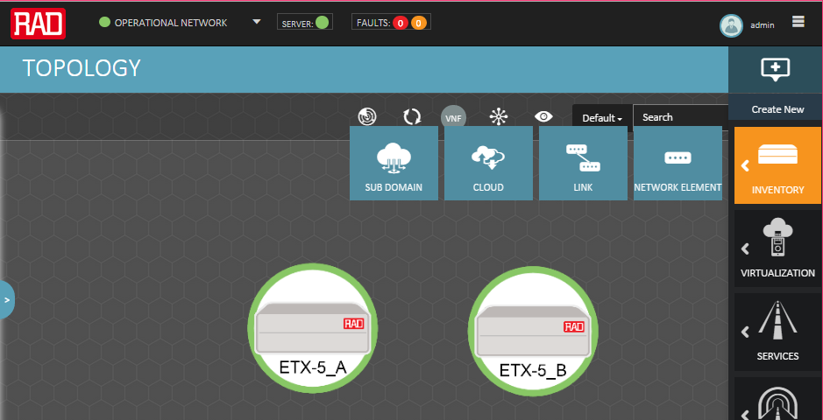
New Additions/Common attributes
On the right side of the screen you can find the sign
Once clicked a common features command will be expanded to the left
For example, clicking on the + sign and then ‘inventory’ in order to add new Network Element, links etc.

Slide 84
Creating Sub Domain
Our goal now is to create a subdomain and then create an NE for each device
In this example the default subdomain is ‘NOC’
You will then add network elements (your devices) to the newly created sublevel
1
Click the “Create New” -> Inventory -> then sub domain

Slide 85
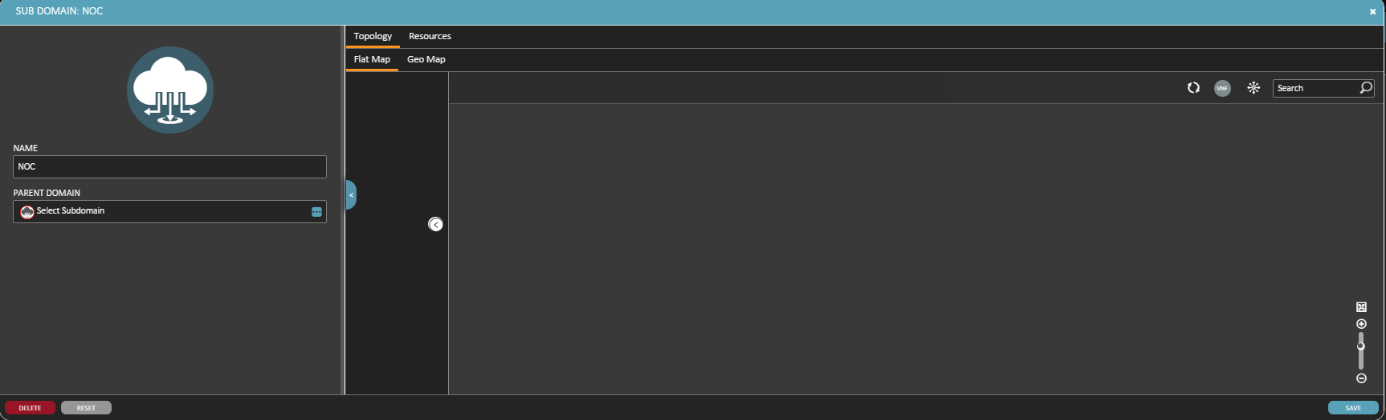
Creating Sub Domain
2. Provide a name for the sub domain
3. Click the ‘Save’ button
2
3
The Resources tab shows all the NE’s, cards, ports, clouds assigned to the specific Sub Domain and the faults regarding this Sub Domain.

Slide 86
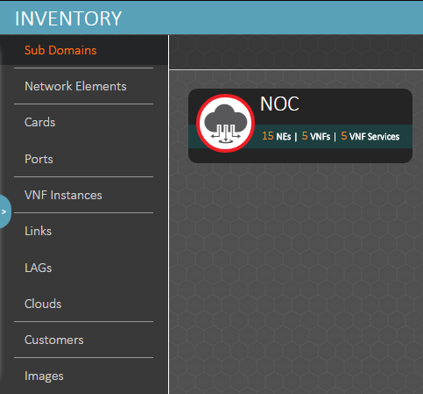
Creating Sub Domains
The result – New Sub-Domain entity under ‘Sub Domain’ tab in the inventory workspace
Under the icon you can get
information about the number
of NEs , VNF and VNF services

Slide 87
Adding New NE
In the following slides you can find an example of creating new Network Element
This can be done either by clicking the ‘ ‘ sign or:
Navigate to the left partially hidden menu (using - ) → inventory→ Network Element → Add new (+).
Click the “Create New” -> Inventory -> then Network Element

Slide 88
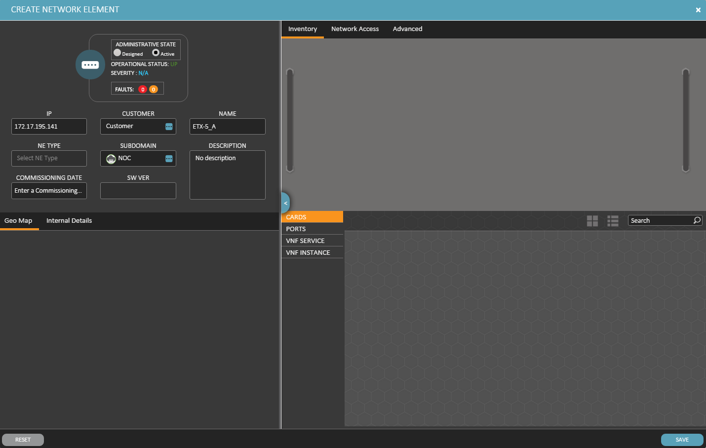
Adding New NE
1
Change the administrative state to “Active”
Set the IP address (Must be valid and unique)
Provide a name for the device
Click the ‘Save’ button
2
3
NE type is automatically configured when administrative state is ‘Active’
In case of a slot containing device – the user need to insert the cards types in each slot – the cards will be chosen from a preconfigured cards list in the Orchestrator FE
4

Slide 89


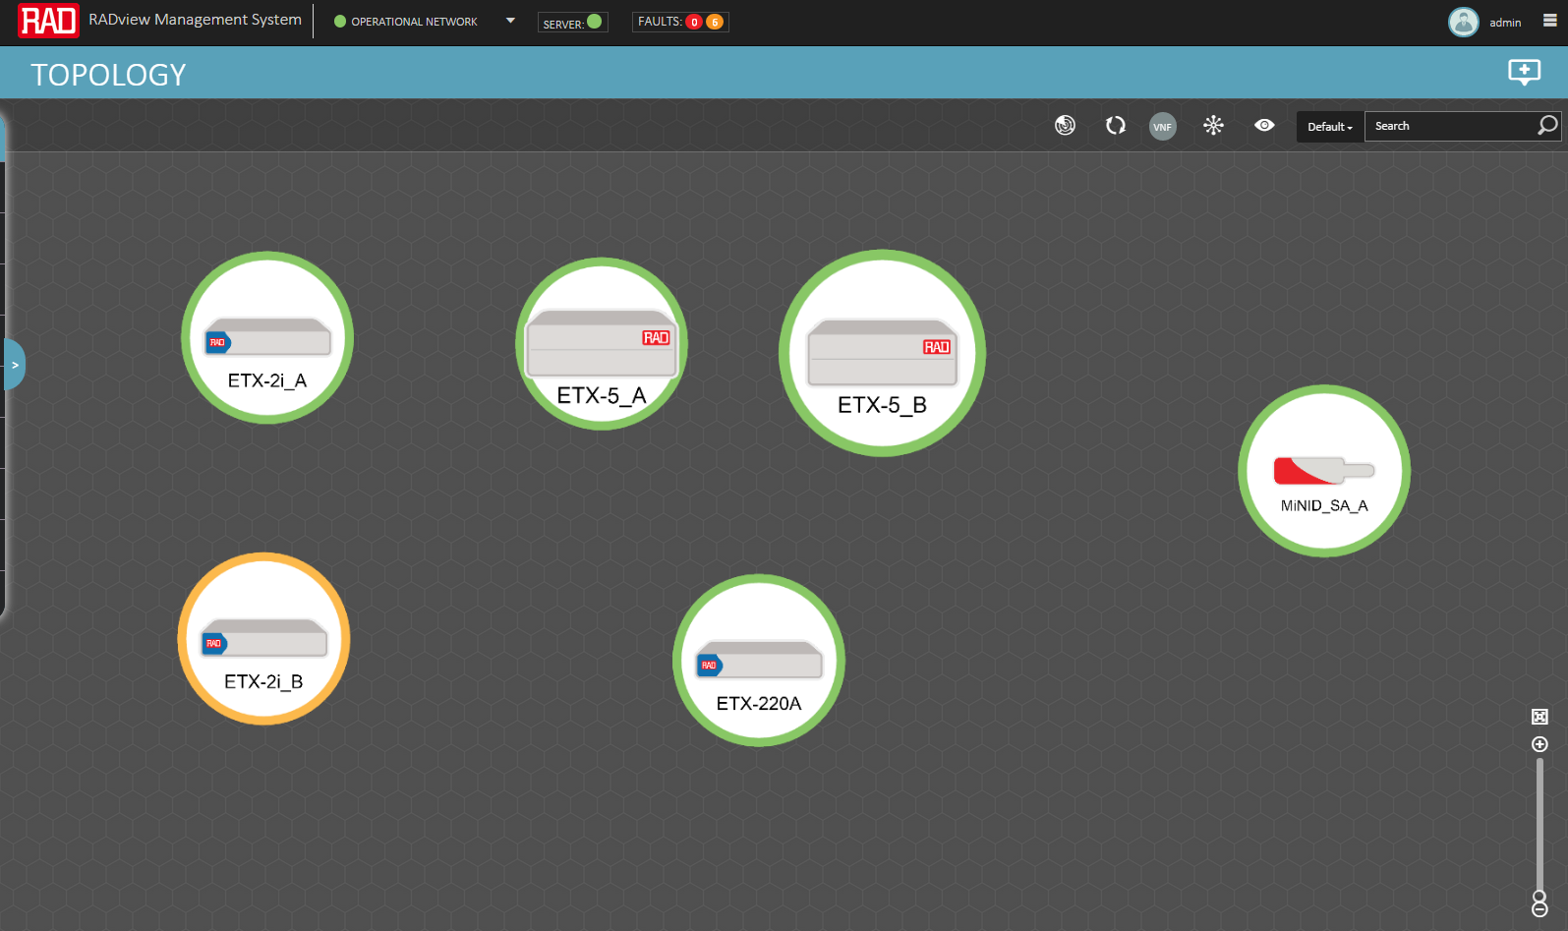

Adding New NE
The NE is added to the topology map and Network elements list, and will have symbol according to the device type
Click the element and new options are available on the upper left side:
  NEs can be edited – parameters can be saved after editing
  NEs can be deleted -
(A linked device cannot be deleted until the link connecting it is deleted)

Slide 90
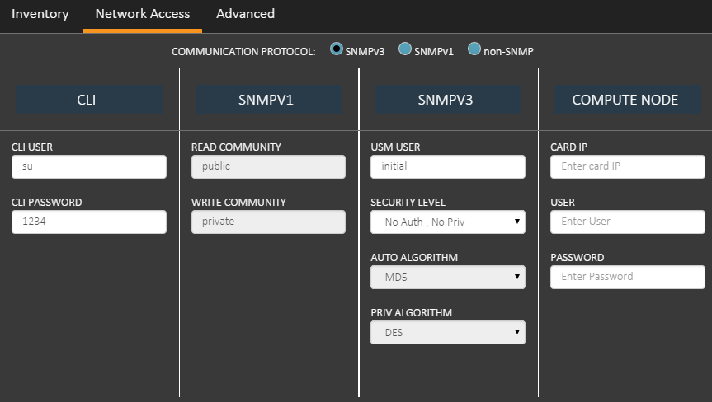
Adding New NE – Additional info
  Network Access Tab:
  CLI – credentials in order to gain access to the device using CLI
  Default credentials: USER - su, PASSWORD – 1234.
  SNMPv1/SNMPv3/non-SNMP - and the related parameters for each protocol.
  Default protocol: SNMPv3, default parameters.
  Compute node IP and credentials: devices contains compute node in it (such as x86 in case of NFV supported devices) – must accessed as well by the Orchestrator FE, and therefore these parameters must be configured.
  Default credentials are empty.

Slide 91
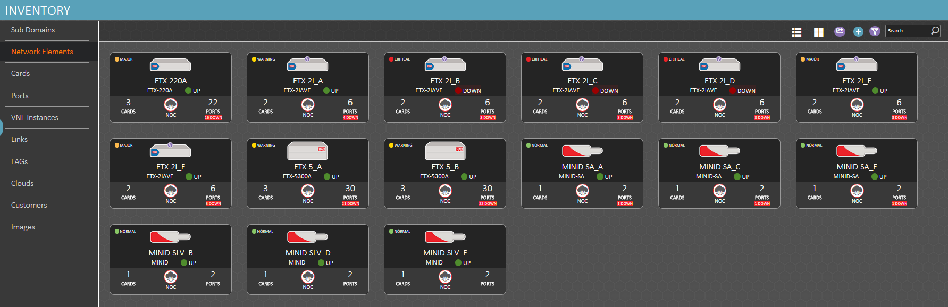
Adding New NE – Additional info
To see the list of all the element in the network:
Go to ‘Inventory’ and click the ‘Network Elements’ tab

Slide 92
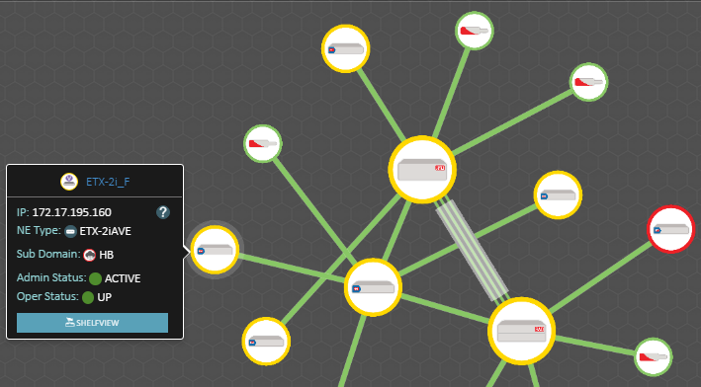
New NEs - Shelf View
In order to see the shelf view from the new GUI you need to check:
  Java version is v7.1 and higher
  Java certificate (to install the jar files) – permission for installation
On the topology map, hover the mouse over the NE
Click the “Shelf View” button

Slide 93

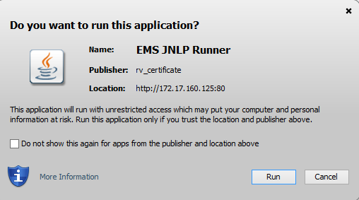
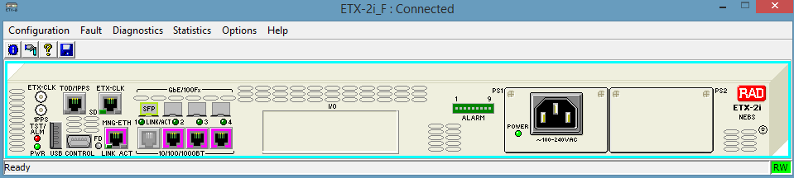
New NEs - Shelf View
The Browser is downloading a JNLP file from the EMS Server.
After running the file, the shelf view window will be opened:

Slide 94


Creating Business Entities
What is a Business Entity?
  The Business Entities work space contains data for customers and provider, such as provider type, the customer ranking, customer contact information, and resources associated with the customer.
  The Business Entities table contains the following information:
    Business Roles
    (Customer/Provider)
    Name
    Ranking
    Status
Contact Email
Creation Date
Comments
    Creation Date
    Type
    Contact Name
    Contact Role
    Contact Phone1
    Contact Phone2
Customer
Provider
EXAMPLE !
CE
ETX-5
ETX-220
ETX-5
ETX-1
CE
ETX-1
4/4
4/1
4/4
1/1/1
3
1
1/1/1
4/2
1
3

Slide 95
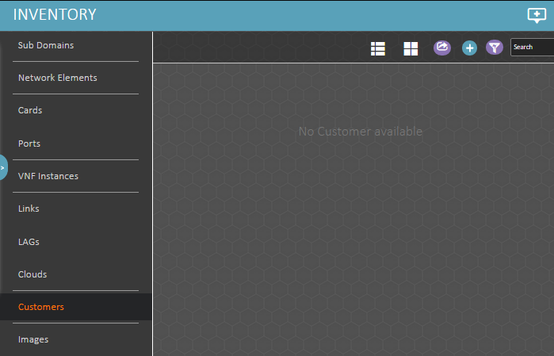
Creating Business Entities
Under Inventory -> go to Customers -> then click the + sign

Slide 96
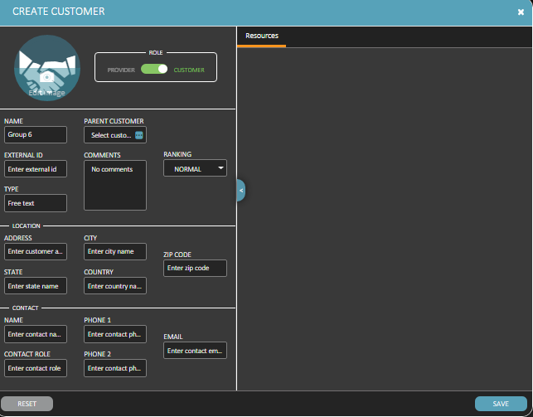
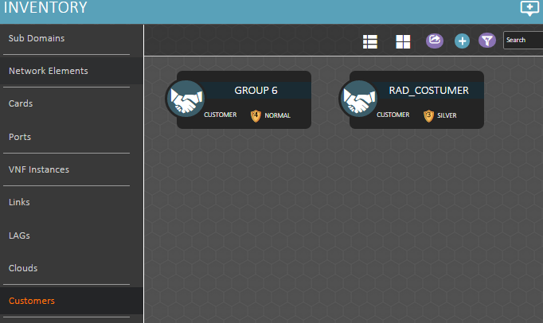
Creating Business Entities
1
The Resources tab shows all the Services, NE’s, rings and etc. assigned to the specific Costumer/Provider
2
Select the role of the business entity.
In our case we will select “Customer”
Provide a Name for the customer.
You can add additional info that describes the entity
Click the ‘Save’ button
3

Slide 97
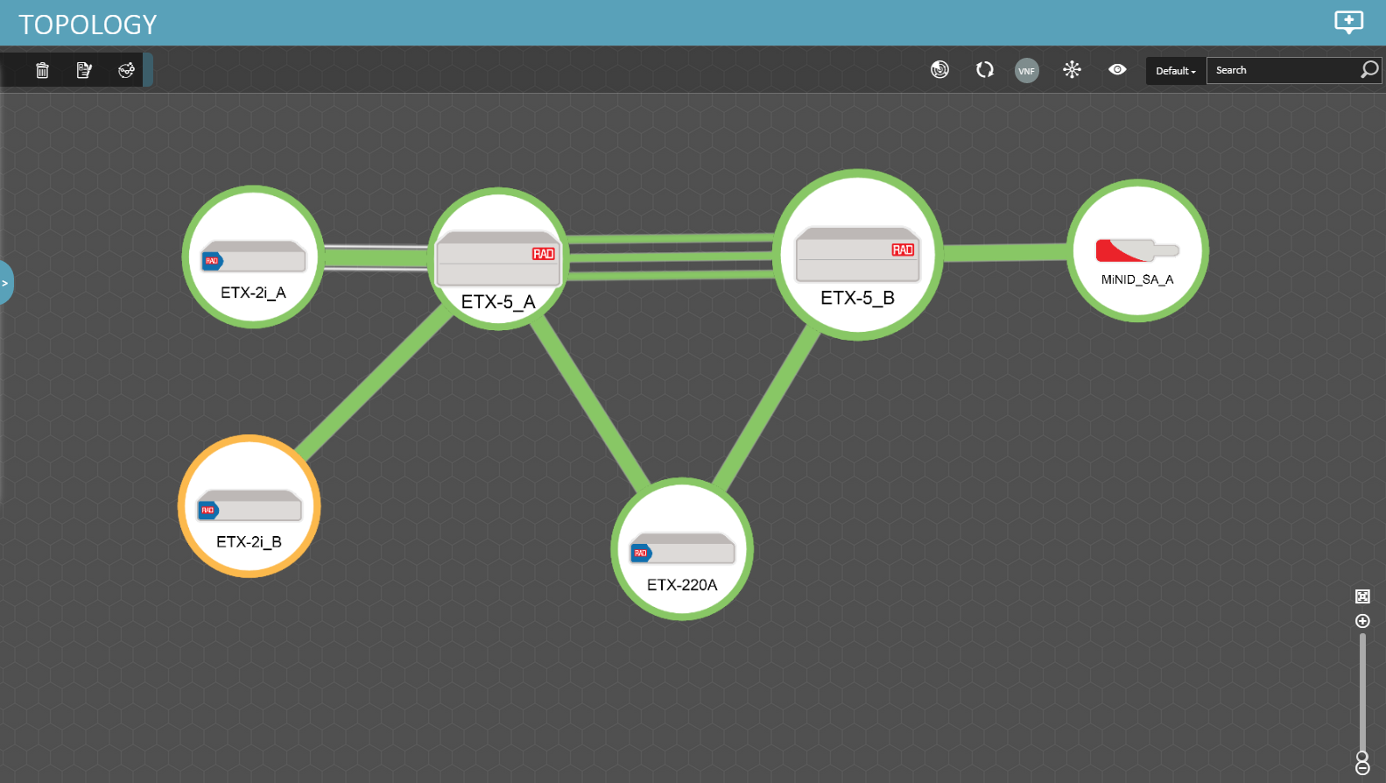
Creating New Links
The devices on the map can be connected with links which describes the physical connectivity between the NEs
The link color indicates the link alarm severity level, which is determined from the ports connected by the link.
Only unused ports can be assigned in order to configure a link
link can be edited or deleted (servicing link cannot be deleted until the service running on it will be deleted first)
If the links are connected to a managed device – it will receive its Active state accordingly.

Slide 98
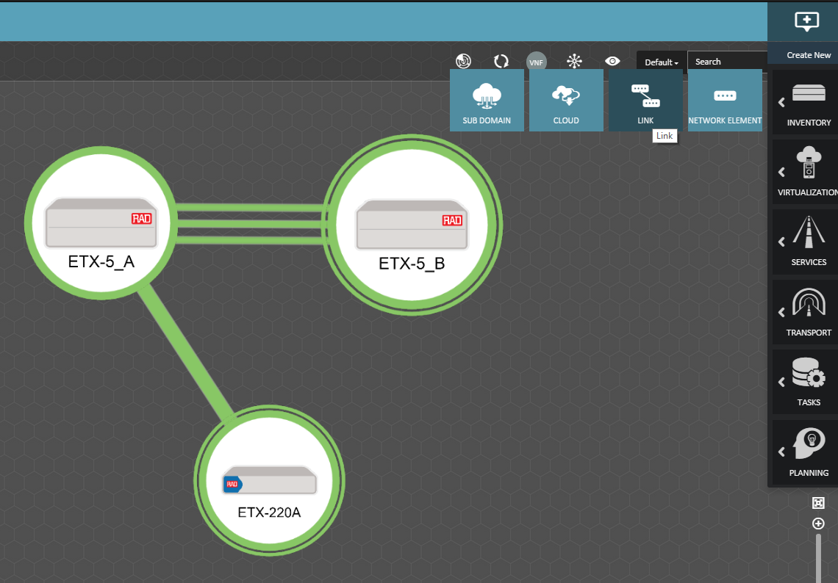
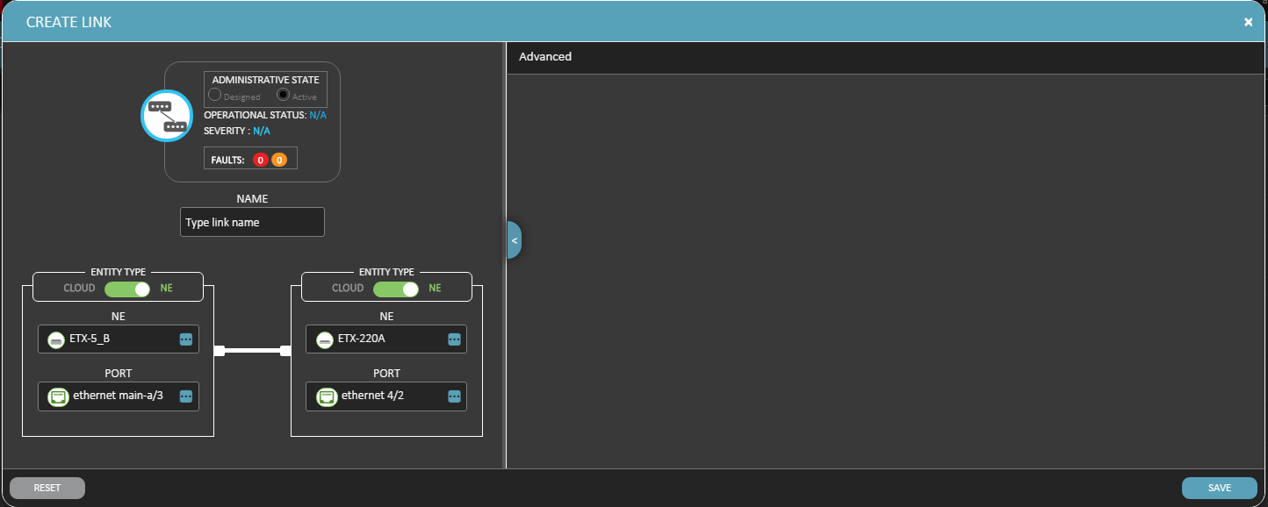
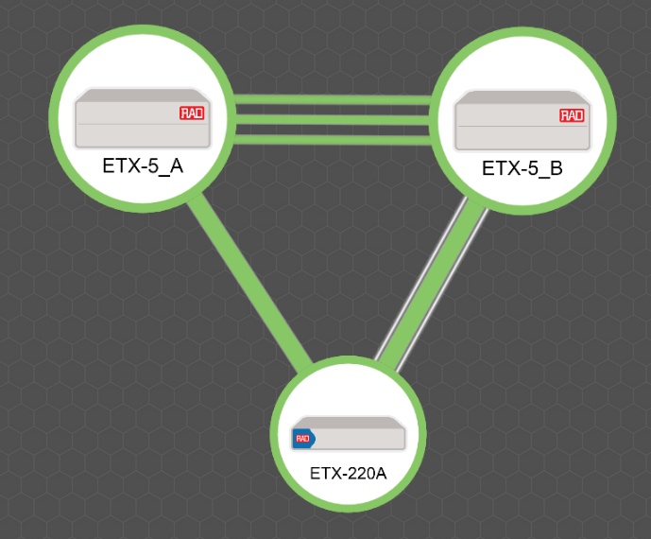
Creating New Links
Select the two elements using the ‘Ctrl’ key
Click the “Create New” -> Inventory -> then Link
Provide a Name for the link
Select the ports on each device according to the physical connectivity
Click the ‘Save’ button
2
1
3
4
5

Slide 99
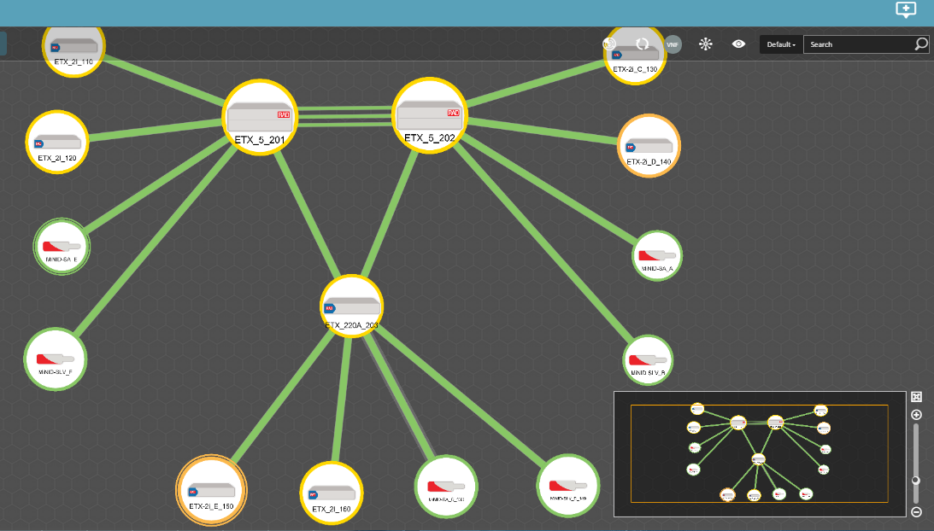
Creating New Links
After creating all the links on the map, validate that the ERP Ring was discovered successfully

Slide 100
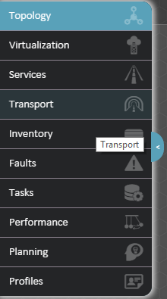
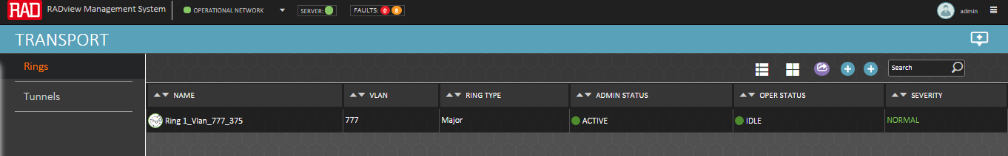
Ring Discovery
FYI
In RV 5.0 user doesn’t need to discover the RING, the ERP is automatically discovered once the ERP devices added to the topology and the links were connected between them
In the Transport workspace, Go to Rings
The line that appears describes the discovered ERP ring
In a normal state, the ring state should be ‘Idle’

Slide 101
Ethernet Services
(SM)

Slide 102

Service Management
Point-and-click end-to-end service provisioning
Continuous Monitoring and SLA assurance for provisioned services
Association of service to customers - Every alarm in the network indicates the impacted service and customer

Slide 103
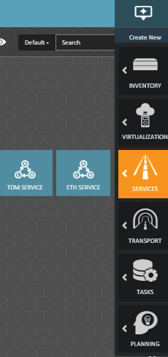
Service Configuration steps
  Define the PM SLA Profiles
  Define the catalog:
      Define the CoS:
        CoS List (Four CoS by default)
        Per P-bit
        Per queue
      Define the Ethernet bandwidth
      Define the service catalog
  Create a service between ETXs
  Define statistics collection job (For PM)
*Optional
*Optional
*Optional – Starting RV v5.0 , there’s no need to create a pre-defined service catalog. Users can directly configure a service using the ‘New ETH Service’ button

Slide 104
Service Configuration Steps
In this workshop we will use the following CoS Attributes:
CoS List | CoS to pBit | CoS to Queue | Scheduling | pBit Marking
Platinum | 7 | 0 | Strict | No Color Marking Network Default
Gold | 5 | 1 | Strict
Silver | 3 | 4 | WFQ
Best Effort | 1 | 6 | WFQ
7
Queue 0
Queue 1
SP
Queue 2
SP
5
SP
Queue 3
SP
UNI
WFQ
NNI
3
Queue 4
WFQ
Queue 5
WFQ
WFQ
Queue 6
1
Queue 7

Slide 105
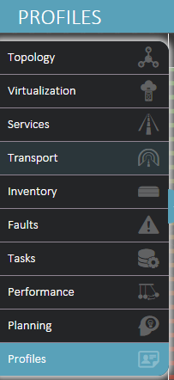
Ethernet PM SLA
What are the PM SLA Profiles?
  End-customers have several defined OAM services that
  belong to a different service grade
  Each end customer has a different SLA (Service Level
  Agreement) contract with its parameters defined
  The PM SLA define the parameters that the service will
  have to meet as its Key Performance Indicators (KPI):
    Availability
    Frame Lose Ration (FLR)
    Average Frame Delay
    Average Frame Delay Variation
Notes:
Each end-customer (group) has several defined OAM services, each of which belongs to a different service grade. Each end customer has a different SLA contract. This means that even if one endcustomer (e.g., CustomerGroup1) has a service based on pbit-7, exactly as another end-customer (e.g., CustomerGroup2), they will have different SLA contracts. Every SLA contract defines different threshold values.

Slide 106
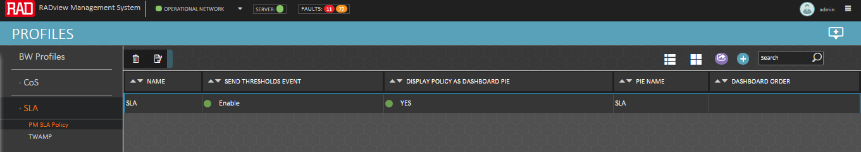
Ethernet PM SLA
In the Profiles workspace:
  Select SLA -> PM SLA Policy and then a list of the SLA profiles appears
Multiple SLA profiles can be configured, and be assigned to multiple services
In order to use the configured PM SLA profile, the user must assign the SLA to the required service template, or to the specific service
TWAMP SLA profile configuration contains an additional network parameters that are being measured, and is being used when creating new L3 IP monitoring service

Slide 107
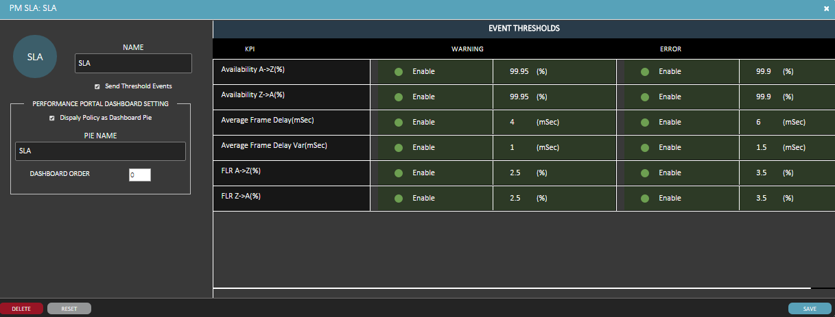
Ethernet PM SLA
1
In order to create new SLA profile, click the ‘+’
Provide a Name for the SLA Profile and the PIE Name
Set the Thresholds for the Warning and Error KPIs according to the customer SLA
Click the ‘Save’ button
2
3
4

Slide 108
Ethernet PM SLA
FYI
The warning threshold will always be higher then the Error threshold since it has to notify the NOC operator that the service is close to SLA violation
The highest availability is 100% and in this example, the notification will be generated once the service availability is degraded down to 99.95 %

Slide 109
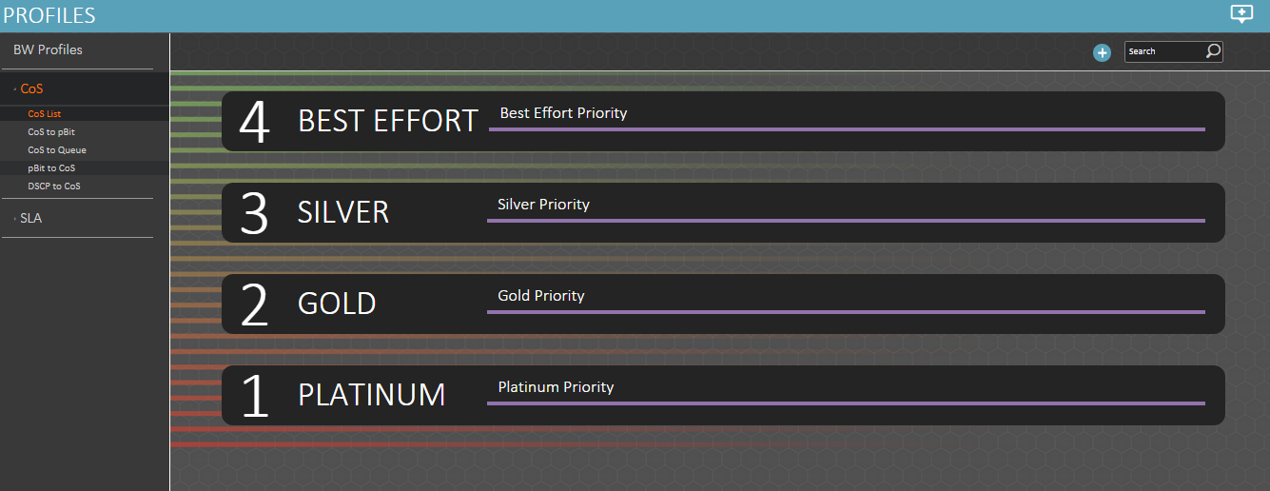
Define the CoS List
What is COS?
  Class Of Service is a parameter used in data and voice protocols to differentiate the types of payloads contained in the packet being transmitted. The objective of such differentiation is generally associated with assigning priorities to the data payload or access levels to the telephone call.
What is CoS List?
  RADview has four CoS entries built-in that describes the service type. Eventually these service types are mapped to priority bits. You can add additional CoS or remove the built-in and compile an entirely new list.
Notes:
The process of defining a catalog consists of several steps. Before defining the catalog itself, you have to first customize the CoS entries and then map the CoS entries to priority bits and priority queues.

Slide 110
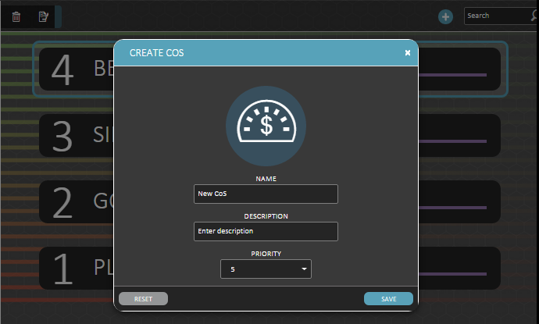
Define the CoS List
In this workshop we will use the default CoS list.
Below is an example of how to create a New CoS:
1
Click the ‘+’
Provide a Name and its indexed priority
Click the ‘Save’ button
2
The priority definition in this window is meaningless as the actual priorities of the CoS is defined by the “Cos to Pbit” and “CoS to queue” configurations
3

Slide 111
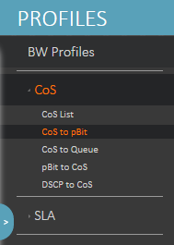
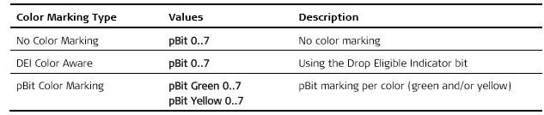
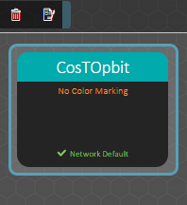
Define CoS to P-bit
What is CoS to P-bit?
  Marking profiles map the defined CoS to priority bits. The marking can also be done per color (green and/or yellow), to support color re-marking, optionally specifying the Drop Eligible Indicator (DEI) bit in the frame header.
  This section explains how to map the CoS entries to priority bits and create a CoS priority profile (Marking profile).

Slide 112
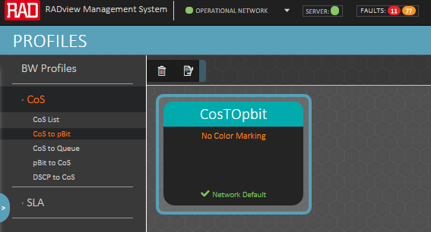

Define CoS to P-bit
Under the CoS to pBit window, Click the ‘+’
Provide a Name and its indexed priority
Define the Marking mode.
Check the ‘Network default’ If this is the network default profile that the SM will use
Set the Pbits that would be associated with the class of service. In this example we configured:
Platinum (7) , Gold (5), Silver (3), BE (1)
Click the ‘Save’ button
2
1
3
4
5

Slide 113


Define CoS to Queue
What is CoS to Queue?
  In order to facilitate congestion management, you can sort traffic by applying queue block profiles to queue block entities. A queue block profile contains entries for queues 0 –7, with the following scheduling methods:
    Strict – High-priority queues that are always serviced first. If a lower-priority queue is being serviced and a packet enters a higher queue, that queue is serviced immediately.
    WFQ (weighted fair queuing) – If one port does not transmit, its unused bandwidth is shared by the ‘transmitting’ queues according to the assigned weight.
  In configurations with Strict and WFQ queues, the WFQ frames are transmitted only after the transmission of frames associated with the Strict queues is completed.
  This section explains how to map the CoS priorities to priority queues and create a block profile.

Slide 114

Define CoS to Queue
Under the CoS to Queue window, Click the ‘+’
Provide a Name to the profile
Set the Queue number that would be associated with the class of service and the Scheduling mode
Click the ‘Save’ button
1
2
3
Notes:
The CoS to Queue profile cannot be deleted or edited if it’s assigned to a service or a service template.
The list of queues is ordered from highest to lowest: 0 (strict), 1 (strict), 2 (strict),
3 (strict), 4 (WFQ), 5 (WFQ), 6 (WFQ), 7 (WFQ).

Slide 115


Define the Ethernet Bandwidth (BW)
What is Ethernet Bandwidth?
  Ethernet BW defines a rate limit profile that later can be used as a policer on the ingress traffic or as a shaper on the egress traffic
  Defining the Bandwidth Policy
    CIR (Committed Information Rate)
    EIR (Excess Information Rate)
    CBS (Committed Burst Size)
    EBS (Excess Burst Size)

Slide 116
Define the Ethernet Bandwidth (BW)
In this workshop we will define the following BW profiles:
BW Name | CIR (Kbps) | CBS (Bytes) | EIR (Kbps) | EBS (Bytes)
Policer_10M_0M | 10000 | 64000 | 0 | 0
Policer_20M_0M | 20000 | 64000 | 0 | 0
Policer_30M_5M | 30000 | 64000 | 5000 | 64000
Policer_20M_5M | 20000 | 64000 | 5000 | 64000
Policer_10M_5M | 10000 | 64000 | 5000 | 64000
Shaper_70M_0M | 70000 | 64000 | 0 | 0

Slide 117

Define the Ethernet BW Profile
In the following example we will create a policer with the following attributes:
                CIR = 10Mbps, CBS = 64000Bytes
                EIR = 5Mbps, EIR = 64000Bytes
1
Under the BW Profile window, Click the ‘+’
Provide a Name to the profile
Set CIR and EIR parameters according to the task
Click the ‘Save’ button
2
3

Slide 118


Define a Service Catalog
Optional !
Under ‘Services’ go to ‘Service Templates’
Name: Must be unique.
Service type: can be selected from E-LAN, E-Line, E-TREE. Default is E-Line.
S-TAG Manipulation: add/ add & pop
Add CoS’s: user can add the service CoS from the pre-configured CoS List.
1
OAM parameters: MD level, CCM, MA name Format and OAM topology.
EP Shaper default: The user can assign the default shaper to each EP.
Throughput PM Mode: Can be selected from Per Service or Per CoS.

Slide 119
Ethernet Services Provision
The following section can be suitable for the following applications:
  Carrier Ethernet Services
  Wholesale Networking
  IP VPNs for International Service Providers
  vCPE
In the following section there are 3 examples of creating different Ethernet services:
  E-Line/E-LAN/E-Tree
Each service is configured according to the attributes in the table prior the procedure

Slide 120
Creating E-Line Single CoS Service
For Carrier Ethernet and Wholesale Application

Slide 121

Creating E-Line Service – Single CoS
Service | Type of Service | Customer | A Point | Z point | CoS | C-Vlan | S-Vlan | Manipulation | A Point Policer
1 | E-Line Single CoS | RAD Customer | ETX-2i_E port 0/3 | MiNID-SA_E | Platinum | 51 | 151 | Add & Pop | CIR = 10M, EIR=0
Notes: The current version of the SM doesn't support Policer configuration on MiNID. Therefore, we won't configure policer on Z-Point (MiNID) Customer: RAD Customer SLA Threshold OAM Interval: 5 Min Throughput Interval : 5 Min

Slide 122
Creating E-Line Service – Single CoS
In the topology map, select the A point and the Z point.
This step is optional. You can define the endpoints also from the service creation window.
Click the Create New (‘+’) sign -> Services -> ETH Service
2
Z
1
A

Slide 123


Creating E-Line Service – Single CoS
4
3. Select the administrative state
4. Provide a name
5. Set the service type. In this case – E-Line
In this example we are not working with service catalog, therefore, we won’t configure the service template
6. Select the customer
7. Set the service VLAN (S-TAG)
8. Set the S-TAG Manipulation: Add on Apoint and remove on Zpoint (Add & Pop S-VLAN)
9. Add the CoS of the service.
In our case: Platinum
3
5
6
9
7
8
6

Slide 124


Creating E-Line Service
10
On the left side of the window you will find the added CoS.
10. Click the CoS.
11. Set the PM parameters for the service.
12. Set the Policer for the A-Point and for the Z-Point according to the task.
13. set the classification rule per endpoint. In our application the classification rule is to receive from the client C-VLAN 51
11
12
13

Slide 125


Creating E-Line Service – Single CoS
14
On the ‘End Points’ tab you will find a small exclamation sign.
This sign indicates that some configuration is missing.
14. Click the ‘End Points’ tab.
15. Click the A point and select the specific port. In our case, the port is 0/3.
15
15

Slide 126

Creating E-Line Service – Single CoS
The result is that the port is added to the A point window and a new line is added to the service endpoints at the bottom of the window.
You can also notice that the exclamation sign from A-point is gone but we still see it on the End Points tab. This is because we are still missing the Z point configuration

Slide 127

Creating E-Line Service – Single CoS
17
16
16. Click the small arrow to move to Z point configuration.
17. select the specific port for the Z point.
In our case, the port is port 2 of the MiNID.

Slide 128


Creating E-Line Service – Single CoS
Now on the bottom left side of the windows you can see the ‘Map’ tab with the endpoints.
In this tab you can also see the exclamation sign. This means that a configuration is missing under this tab:
18. Click the ‘Compute’ button and view your results
18

Slide 129

Creating E-Line Service – Single CoS
This is a complete view of the new ETH service window:
19. Save the configuration. The action would be according to the administrative state of the service (Design/Provision/Active)
19

Slide 130
Creating E-Line Service
The result: A new service is added to the service list
Double click the Admin Status in order to move between the states:
  Designed: Planned in RV only
  Provision: Planned in RV and in the Nes but all the flows are disabled
  Active: save the configuration in RV, send the services to the devices and enable the flows to start transmitting traffic

Slide 131
Test The configuration - Success Criteria
Simultaneously transmit flows according to the traffic description for 1min
Traffic | Expected Results
S1) 100Mbps, 1500B, A -> Z, [Ethernet 0800][802.1Q][IPv4] | S1) Total RX RATE at Z-End is 10M
S1) 100Mbps, 1500B, Z -> A, [Ethernet 8100][802.1Q][IPv4] | S1) Total RX RATE at A-End is 200M, 0 Packet loss All the traffic is pass since no policer configured in the MiNID
OAM | Expected Results
Check that MEP status is OK in ETX-2i and MiNID | MEP Status in ETX and MiNID is OK

Slide 132
Creating E-Line Multi-CoS Service
For Carrier Ethernet and Wholesale Application

Slide 133

Creating E-Line Service - Multi CoS
Service attributes & diagram
Service | Type Of Service | Customer | A Point | Z point | C-Vlan & Pbit | S-Vlan | Manipulation
2 | E-Line Multi-CoS Platinum (7) Gold (5) Silver (1) | RAD Customer | ETX-2i_E port 0/3 | ETX-220 port 1/10 | Platinum = 52 (pBit7) Gold = 52 (pBit 5) Silver = 52 (pBit 3) | 252 | Add & Pop
BW configuration (Both endpoints): Platinum : CIR = 30M, EIR = 5M Gold: CIR = 20M, EIR = 5M Silver CIR = 10M, EIR = 5M Shaper: CIR= 70M, EIR=0M Customer: your group SLA Threshold OAM Interval: 5 Min Throughput Interval : 5 Min

Slide 134

Creating E-Line Service - Multi CoS
In the topology map, select the A point and the Z point.
This step is optional. You can define the endpoints also from the service creation window.
Click the Create New (‘+’) sign -> Services -> ETH Service
2
Z
1
A

Slide 135

Creating E-Line Service - Multi CoS
3
4
5
6
9
7
8
3. Select the administrative state
4. Provide a name
5. Set the service type. In this case – E-Line
6. Select the customer
7. Set the service VLAN (S-TAG)
8. Set the S-TAG Manipulation: Add on Apoint and remove on Zpoint (Add & Pop S-VLAN)
9. Add the CoS of the service.
In our case: Platinum, Gold, Silver (Multi-CoS)

Slide 136

Creating E-Line Service - Multi CoS
10
On the left side of the window you will find the added CoS.
10. Click the CoS.
11. Set the PM parameters for the service.
12. Set the Policer for the A-Point and for the Z-Point according to the task.
13. set the classification rule per endpoint. In our application the classification rule is to receive from the client C-VLAN 52 with pBit (7)
11
12
13

Slide 137

Creating E-Line Service - Multi CoS
10
Repeat the same steps for Gold and Silver traffic:
10. Click the CoS.
11. Set the PM parameters for the service.
12. Set the Policer for the A-Point and for the Z-Point according to the task.
13. set the classification rule per endpoint. In our application the classification rule is to receive from the client C-VLAN 52 with pBit (5)
11
12
13

Slide 138

Creating E-Line Service - Multi CoS
10
Repeat the same steps for Gold and Silver traffic:
10. Click the CoS.
11. Set the PM parameters for the service.
12. Set the Policer for the A-Point and for the Z-Point according to the task.
13. set the classification rule per endpoint. In our application the classification rule is to receive from the client C-VLAN 52 with pBit (3)
11
12
13

Slide 139

Creating E-Line Service - Multi CoS
14
On the ‘End Points’ tab you will find a small exclamation sign.
This sign indicates that some configuration is missing.
14. Click the ‘End Points’ tab.
15. Click the end point and select the specific port. In our case, the port is 1/10.
15

Slide 140

Creating E-Line Service - Multi CoS
17
16
16. Click the small arrow to move to Z point configuration.
17. select the specific port for the Z point.
In our case, the port is 0/3 of the ETX-2i

Slide 141

Creating E-Line Service - Multi CoS
18
Now on the bottom left side of the windows you can see the ‘Map’ tab with the endpoints.
In this tab you can also see the exclamation sign. This means that a configuration is missing under this tab:
18. Click the ‘Compute’ button and view your results

Slide 142

Creating E-Line Service - Multi CoS
This is a complete view of the ETH service:
19. Save the configuration. The action would be according to the administrative state of the service (Design/Provision/Active)
19

Slide 143
Test The configuration - Success Criteria
Simultaneously transmit flows according to the traffic description for 1min
Traffic | Expected Results
S2- stream#1) Platinum Vlan+ pBit 100Mbps, A -> Z S2- stream#2) Gold Vlan+ pBit 100Mbps, A -> Z S2- stream#3) Silver Vlan+ pBit 100Mbps, A -> Z | S2- stream#1) Received traffic at each end = 35Mbps S2- stream#2) Received traffic at each end = 25Mbps S2- stream#3) Received traffic at each end = 10Mbps
S2- stream#1) Platinum Vlan+ pBit 100Mbps, Z -> A S2- stream#2) Gold Vlan+ pBit 100Mbps, Z -> A S2- stream#3) Silver Vlan+ pBit 100Mbps, Z -> A | S2- stream#1) Received traffic at each end = 35Mbps S2- stream#2) Received traffic at each end = 25Mbps S2- stream#3) Received traffic at each end = 10Mbps
OAM | Expected Results
Check that MEP status is OK in ETX-2i and ETX-5 | MEP Status in ETX-2i and ETX-5 is OK One MEP created with 3 Services (Service Mode) while CCM is transmitted on Platinum CoS (Pbit 7)

Slide 144
Creating E-LAN Single CoS Service
For Carrier Ethernet and Wholesale Application

Slide 145

Creating E-LAN Single CoS Service
Service attributes and diagram
Service | Type Of Service | Group | Concentrator | Non Concentrator A | Non Concentrator B | CoS | C-Vlan | S-Vlan | Manipulation
3 | E-LAN Single CoS | RAD Customer | ETX-220 port 1/10 | ETX-2i_E port 0/3 | ETX-2i_F port 0/3 | Platinum | 53 | 153 | Add & Pop
BW configuration (Both endpoints): Concentrator: CIR = 20M, EIR=0M Non-Concentrator_A: CIR = 10M, EIR=0M Non-Concentrator_B: CIR = 10M,EIR=0M Customer: Your group SLA Threshold OAM Interval: 5 Min Throughput Interval : 5 Min OAM Topology: Full Mesh

Slide 146

Creating E-LAN Single CoS Service
In the topology map, select the Concentrator and the Non-Concentrator end points according to the application.
This step is optional. You can define the endpoints also from the service creation window.
Click the Create New (‘+’) sign -> Services -> ETH Service
2
1
C
NC_A
NC_B

Slide 147

Creating E-LAN Single CoS Service
3. Select the administrative state
4. Provide a name
5. Set the service type. In this case – E-LAN
6. Select the customer
7. Set the service VLAN (S-TAG)
8. Set the S-TAG Manipulation: Add and remove (Add & Pop S-VLAN)
9. Add the CoS of the service.
In our case: Platinum
3
4
5
6
9
7
8

Slide 148

Creating E-LAN Single CoS Service
On the left side of the window you will find the added CoS.
10. Click the CoS.
11. Set the Policer for the Concentrator according to the task.
12. set the classification rule. In our application the classification rule is to receive from the client C-VLAN 53
13. Select the port for the C point (Concentrator)
10
11
13
12

Slide 149

Creating E-LAN Single CoS Service
14. Click the small arrow to move to NC point configuration.
15. select the specific port for the NC point.
In our case, the port is 0/3 of the ETX-2i_E
16. Set the Policer according to the application
17. set the classification rule. In our application the classification rule is to receive from the client C-VLAN 53
16
15
14
17

Slide 150

Creating E-LAN Single CoS Service
Repeat the previous steps for the 3rd end-point (NC_B)
14
16
15
17
18
Now on the bottom left side of the windows you can see the ‘Map’ tab with the endpoints.
In this tab you can also see the exclamation sign. This means that a configuration is missing under this tab:
18. Click the ‘Compute’ button and view your results

Slide 151

Creating E-LAN Single CoS Service
This is a complete view of the ETH service:
19. Save the configuration. The action would be according to the administrative state of the service (Design/Provision/Active)
19

Slide 152
Test The configuration - Success Criteria
Simultaneously transmit flows according to the traffic description for 1min
Note: Create streams in the STC with different MAC address per stream (E-LAN services)
Traffic | Expected Results
C = Concentrator (ETX-5/ETX-220A) | N1 = Non Concentrator (ETX-2i) |N2 = Non Concentrator (ETX-2i)
S4- stream#1) VLAN (C-VLAN) 10Mbps, C -> N1 S4- stream#2) VLAN (C-VLAN) 10Mbps, C -> N2 | S4- stream#1 Total RX RATE at N1 is 10M S4- stream#2) Total RX RATE at N2 is 10M
S4- stream#1) VLAN (C-VLAN) 100Mbps, N1 -> C | S4- stream#1 Total RX RATE at C is 10M
Stopped the traffic on S4- stream#1→ N1 -> C | S4- stream#1 Total RX RATE at C is 0M
S4- stream#1) VLAN (C-VLAN) 100Mbps, N2 -> C | S4- stream#1 Total RX RATE at C is 10M
Stopped the traffic on S4- stream#1→ N2 -> C | S4- stream#1 Total RX RATE at C is 0M
S4- stream#1) VLAN (C-VLAN) 100Mbps, N1 -> C S4- stream#1) VLAN (C-VLAN) 100Mbps, N2 -> C | S4- Total RX RATE at C is 20M

Slide 153
Test The configuration - Success Criteria
OAM MEP (Full Mesh) | Expected Results
Concentrator : MEP “C” REM MEP N1 REM MEP N2 | OAM Status: C <-> N1 “OK” OAM Status: C <-> N2 “OK”
N1 (Non Concentrator) : MEP “N1” REM MEP “C” REM MEP N2 | OAM Status: N1 <-> C “OK” OAM Status: N1 <-> N2 “OK”
N2 (Non Concentrator) : MEP “N2” REM MEP “C” REM MEP N1 | OAM Status: N2 <-> C “OK” OAM Status: N2 <-> N1 “OK”

Slide 154
Creating E-Tree Service
For Carrier Ethernet and Wholesale Application

Slide 155
Creating E-TREE Service
Service Attributes & diagram
Service | Type of Service | Customer | Root | Leaf_A | Leaf_B | CoS | C-Vlan | S-Vlan | Manipulation
4 | E-Tree Single CoS | 5 | ETX-220 port 2/1 | ETX-2i_E port 0/3 | ETX-2i_F port 0/3 | Platinum | 54 | 154 | Add & Pop
Root: CIR = 20M, EIR = 0M Leaf_A: CIR = 10M, EIR = 0M Leaf_B: CIR = 10M, EIR = 0M Customer: your group SLA Threshold OAM Interval: 5 Min Throughput Interval : 5 Min OAM Topology: Root to all

Slide 156

Creating E-TREE Service
In the topology map, select the Root and the Leaf end points according to the application.
This step is optional. You can define the endpoints also from the service creation window.
Click the Create New (‘+’) sign -> Services -> ETH Service
2
1
R
Leaf
A
Leaf
B

Slide 157

Creating E-TREE Service
3. Select the administrative state
4. Provide a name
5. Set the service type. In this case – E-Tree
6. Select the customer
7. Set the service VLAN (S-TAG)
8. Set the S-TAG Manipulation: Add and remove (Add & Pop S-VLAN)
9. Add the CoS of the service.
In our case: Platinum
3
4
5
6
9
7
8

Slide 158

Creating E-TREE Service
On the left side of the window you will find the added CoS.
10. Click the CoS.
11. Set the Policer for the Root according to the task.
12. set the classification rule. In our application the classification rule is to receive from the client C-VLAN 54
13. Select the port for the root point
10
11
13
12

Slide 159

Creating E-TREE Service
14. Click the small arrow to move to Leaf point configuration.
15. select the specific port for the leaf.
In our case, the port is 0/3 of the ETX-2i_E
16. Set the Policer according to the application
17. set the classification rule. In our application the classification rule is to receive from the client C-VLAN 54
16
15
14
17

Slide 160

Creating E-TREE Service
Repeat the previous steps for the 3rd end-point (Leaf B)
14
16
15
17
18
Now on the bottom left side of the windows you can see the ‘Map’ tab with the endpoints.
In this tab you can also see the exclamation sign. This means that a configuration is missing under this tab:
18. Click the ‘Compute’ button and view your results

Slide 161

Creating E-TREE Service
This is a complete view of the ETH service:
19. Save the configuration. The action would be according to the administrative state of the service (Design/Provision/Active)
19

Slide 162
Test The configuration - Success Criteria
Simultaneously transmit flows according to the traffic description for 1min
Note: Create streams in the STC with different MAC address per stream (E-Tree services)
Traffic | Expected Results
R = Root (ETX-5/ETX-220A) | L1 = Leaf 1 (ETX-2i) |L2 = Leaf 2 (ETX-2i)
S4- stream#1) VLAN (C-VLAN) 10Mbps, R -> L1 S4- stream#2) VLAN (C-VLAN) 10Mbps, R -> L2 | S4- stream#1) Total RX RATE at L1 is 10M S4- stream#2) Total RX RATE at L2 is 10M
S4- stream#1) VLAN (C-VLAN) 100Mbps, L1 -> R | S4- stream#1 Total RX RATE at R is 10M
Stopped the traffic on S4- stream#1→ L1 -> R | S4- stream#1 Total RX RATE at R is 0M
S4- stream#1) VLAN (C-VLAN) 100Mbps, L2 -> R | S4- stream#1 Total RX RATE at R is 10M
Stopped the traffic on S4- stream#1→ L2 -> R | S4- stream#1 Total RX RATE at R is 0M
S4- stream#1) VLAN (C-VLAN) 100Mbps, L1 -> C S4- stream#1) VLAN (C-VLAN) 100Mbps, L2 -> C | S4- Total RX RATE at R is 20M
S4- stream#1) VLAN (C-VLAN) 100Mbps, L1 -> L2 S4- stream#2) VLAN (C-VLAN) 100Mbps, L2 -> L1 | Traffic in not run between leaves

Slide 163
Test The configuration - Success Criteria
OAM MEP (Root to all leaves) | Expected Results
Concentrator : MEP “R” REM MEP “L1” REM MEP “L2” | OAM Status: R <-> L1 “OK” OAM Status: R <-> L2 “OK”
L1 (Leave) : MEP “L1” REM MEP “R” | OAM Status: L1 <-> R “OK”
L2 (Leave) : MEP “L2” REM MEP “R” | OAM Status: L2 <-> R “OK”

Slide 164
Service Activation Test – Y.1564

Slide 165

Y.1564 Service Activation Test
What is a Y.1564 Catalog?
  After all the attributes that are required for the service are configured, the Y.1564 Catalog will define the parameters that are required to test the service according to its SLA definitions
Note: In order to add a service catalog, one CoS
Priority Profile (Marking Profile) entry must be
selected as Network Default

Slide 166




Y.1564 Service Activation Test
Branch A
Traffic Generation and KPI Measurement
Headquarters
PE
ETX
Real Time
UNI
EVC
Priority Data
Real Time
Best Effort
ETX
PE
Priority Data
EVC 1
PSN
Branch B
Best Effort
EVC 2
Real Time
DSLAM
ETX
Real Time
EVC
Priority Data
Priority Data
Best Effort
Best Effort
UNI
Standard for of Service Activation Test, typically performed during service commissioning, ensuring SLA and generating KPI results as reference for future use
Tests service compliance with SLA in two steps:
  Configuration test – short test, confirming proper configuration of policing, shaping and network connectivity
  Performance test – longer test, measuring FLR, FD, FDV and Availability
Notes:
The Y.1564 testing methodology allows service providers with a standard way of measuring the performance of Ethernet-based services. The tests are performed per multiple traffic streams simultaneously, confirming policing per EVC or EVC.CoS.

Slide 167
Y.1564 mode of operation
ETX Generating Y.1564 test
ETX Responding to Y.1564 test
1564 traffic
Generator
Loopback for 1564 traffic (MAC swap)
PSN
Policer
Rx flow
MEP
MEP
Rx flow
Policer
Y.1564 test based on standard OAM tests
  Seamlessly tests any L2 network
  Simple integration with 3rd party devices (acting as responders)
8 test sessions enables simultaneous tests of multiple CoS or multiple services
Test of E-Line services and E-LAN services (over bridge)
Capable of testing policer in both ends of the service
Notes:
The Ethernet service activation test provides an out-of-service test methodology to assess the proper configuration and performance of an Ethernet service prior to customer notification and delivery

Slide 168
Y.1564 Configuration
The performance and/or configuration of services can be monitored according to the Y.1564 standard and a pre-configured catalog of criteria from within the Services list
Running Y.1564 steps:
  Define test catalog
  Run the test (Create and Activate)
  Analyze the test results
Test Scope | Configure test duration | Performance test duration | Default frame size
Configuration +Performance | 60sec | 1min | 512

Slide 169

Y.1564 Configuration
In the following slide we will demonstrate Y.1564 test on Single CoS E-Line Service between ETX-2i to MiNID
This will be based on the E-Line Service that provisioned previously

Slide 170
Creating y.1564 Test Template
In the following slide we will demonstrate Y.1564 test on Single CoS E-Line Service between ETX-2i to MiNID
This will be based on the E-Line Service that provisioned previously
In order to create a new Y.1564 test:
Go to ‘Services’ -> Test Templates -> Y.1564
Click the ‘+’ sign
2
1

Slide 171


Creating y.1564 Test Template
3
3. Provide a name for the test template
Set the test scope. In our example Configuration & Performance
Set the Test Duration according to the task
4. Save the template
Y.1564 is an intrusive test, therefore the service will be down for the test duration time defined here
4

Slide 172
Before Running the Test
Before running the test from the service itself, we need to pre-configure the MiNID
Since MiNID (in its current version) is not pure Y.1564 responder we actually perform MAC-SWAP loop on the relevant service flow (RX Flow) in order to run the Test:
  Navigate to MiNID Rx Flow (MiNID-SA: Port 1) (MiNID-SLV: SFP)
  Press on the “Test”
  Select: Loop with MAC (IP) Swap and press Apply
  Navigate to MiNID Tx Flow (MiNID-SA: Port 2) (MiNID-SLV: MSA)
  Press on the “Test”
  Select: “Discard” and press Apply

Slide 173

Before Running the Test
SFP
MSA
Network Device
MiNID-SLV

Slide 174

Before Running the Test
SFP
MSA
Network Device
MiNID-SLV

Slide 175

Before Running the Test
SFP
MSA
Network Device
MiNID-SLV

Slide 176

Before Running the Test
SFP
MSA
Network Device
MiNID-SLV

Slide 177

Y.1564: Run the Test
1
2
From the ‘Edit Service’ window:
Go to ‘Test Y.1564’ tab
Click the ‘+’ sign

Slide 178

Y.1564: Run the Test
3
3. Provide a name for the test and select the test template
4. Save the test
In our case The initiator side is the ETX-2I and the responding side is the MiNID
4

Slide 179


Y.1564: Run the Test
After clicking the “Save” button in the previous step- the test is automatically running. If everything is configured OK and according to the steps – the test status would be “Success”. Check the “error” column in a case of a failure

Slide 180

Y.1564: Analyze The Test Results
You can view the general result of the test and also a detailed results in another page by clicking the “View Results” button

Slide 181
Y.1564: Analyze The Test Results
In order to check the test results, we need to compare it with the service attributes that were previously configured:
Service | Type of Service | Customer | A Point | Z point | CoS | C-Vlan | S-Vlan | Manipulation | A Point Policer
1 | E-Line Single CoS | Group_5 | ETX-2i_E port 0/3 | MiNID-SA_E | Platinum | 51 | 151 | Add & Pop | CIR = 10M, EIR=0
SLA Threshold OAM Interval: 5 Min Throughput Interval : 5 Min

Slide 182

Y.1564: Analyze The Test Results
In order to view the report in PDF, click “Export Result” sign
and select “Multi Test Report”
(Configuration and Performance)
Validate that your browser is not blocking any “pop-up”
windows, otherwise the pdf will not be shown

Slide 183

Y.1564: Analyze The Test Results
The Summary Report provides detailed information about all Y.1564 tested parameters, as defined in the test catalog
Summary of the Test, presents which device initiated/generated the test and which is the responder including an overall result of the test
Information about the tested service. What are the tested P-bits, Remote MAC (Respond side) and Local MAC (initiating side)

Slide 184

Y.1564: Analyze The Test Results
The performance test validates the quality of the services over a user-configurable period of time (1min in our WS). Traffic is generated for all services at configured CIR levels; all Ethernet performance parameters are measured simultaneously. The bandwidth test is performed according to the bandwidth profile of a policer assigned to the associated flow, or a policer assigned to the test
Success criteria: when FLR (Frame Loss Ratio), FTD (Frame Transfer Delay), FDV (Frame Delay Variation) and Availability are within SAC (Service Acceptance Criteria) limits.

Slide 185

Y.1564: Analyze The Test Results
The configuration test validates that services are configured as intended before proceeding to the service performance test.
Each service is tested individually and the Information Rate (IR), Frame Transfer Delay (FTD), Frame Delay Variation (FDV), and Frame Loss Ratio (FLR) are measured simultaneously.
The configuration tests are as follows:
• CIR (25% stepped)
• EIR
• Traffic policing
The test is declared successful if the information rate and frame counters are within the Service Acceptance Criteria (SAC).

Slide 186
Test The configuration - Success Criteria
Run The test with the Test Template you created before while:
  Initiating Side = A Side / ETX-2i
  Responding Side = MiNID
Test | Expected Results
Run Y.1564 test on service #1 | Y.1564 is running, traffic has been stopped on both sides.
Once Y.1564 test was completed traffic has restore on both sides. | Traffic restore on both sides.
Generate Y.1564 PDF report and check the results. | Y.1564 PDF report reflects the tests results.
Run Y.1564 test on service #2 (Multi-CoS Service) Initiating: ETX-2i Responding: ETX-5/ETX-220A | Y.1564 is running, traffic has been stopped on both sides.
Once Y.1564 test was completed traffic has restore on both sides. | Traffic restore on both sides.
Generate Y.1564 PDF report and check the results. | Y.1564 PDF report reflects the tests results.

Slide 187
Performance Monitoring
(PM)

Slide 188


Solution Architecture
Service Provider Network
ETX-2, ETX-5
or
MiNID plugged in
non-RAD device
Data
Collection
RADview Server
Oracle
RADview collection engine uses a binary file to efficiently collect data from the network
SFTP/TFTP is used to load data every 15 minutes from RAD devices
All data is stored in Oracle database using vast storage capacity and response time
Operator has control and visibility over the collection process
NOC User

Slide 189

PM Collection
In order to work with the portal, you need to make sure that the following items are configured:
  TFTP Server
  Collect statistics
  PM enabled

Slide 190

Preliminary Checks – TFTP Check
The TFTP storage folder must be the same as the one defined in the RADview Jobs folder in the system console.
To view the System console Job directory:
  Tools -> System Console
    Password : root
    Click on the Computer name -> Process 1
    Click on EMS Jobs Management (Back End)
    Select the TFTP tab
    Records the Home directory and make sure
    that your TFTP server indicated the same
    directory (c:\RV32\ems\udcm\be_repository\tftp\)

Slide 191
Preliminary Checks – Collect statistics
What is Statistics collection ?
  The performance monitoring portal uses the statistics that are generated by the devices that are part of the service . Statistics collection job will define a process that will be gather the statistics for the PM portal
  Per Collection cycle you can monitor what happens, success or failure
The statistics collection task requires an active TFTP server installed on the platform that runs the RADview server application
Notes:
Jobs – per collection cycle you can monitor what happens, success or failure

Slide 192



Preliminary Checks – Collect statistics
The task’s purpose is to collect statistics from one or more NEs, that will be used later to generate reports regarding the service qualities
The task can be configured in a customized way in order to include specific parameters, and can be scheduled to run in/every designated time periods
Navigate to the Tasks workspace
Click the ‘+’ sign for a new task
Select “Collect statistics”
2
3
1

Slide 193

Preliminary Checks – Collect statistics
6
4
4. Provide a name for the task
5. Click “Add Network Elements” and select the elements you want to collect the statistics from
6. Click the ‘schedule’ tab
5

Slide 194

Preliminary Checks – Collect statistics
8
8. Validate that the start and end time are according to your requirements
9. Click Run
9

Slide 195

Preliminary Checks – PM Enabled
The system supports a flexible collection engine enabling different intervals per CoS.
To optimize efficiency and robustness, RAD devices generate files containing all the raw data. RADview collects and analyzes the files that are stored in Oracle database.

Slide 196

PM Portal
The PM portal can be accessed from within RADview and also from the following url:
http://<Server IP address>/pmweb/
Unless defined otherwise:
  Username: root
  Password: root

Slide 197

This is the dashboard screen.
It summarizes the status of all the services currently being monitored by the system.
The different pies summarize the network status for the selected period of time – one month in this example.

Slide 198

PM Portal – ETH Reports
Section B
Section A
Section C
After Clicking on the Ethernet Reports
This screen is composed of 3 sections:
Section A is used to filter the content of the information shown on the right side of the window.
Section B lists monitored services by name, type, customer and (most importantly) SLA status
Section C shows details about the service selected above in Section B. You can also view the graphs of the KPI from that section

Slide 199

Port Reports
For ports report- you need to define the following from the CLI or execute a script using the task workspace:
  config reporting
  pm-collection eth interval 60

Slide 200
D-NFV Configuration
Including services for vCPE and IP-VPN for International Service Providers
Q4-2015
Technical Seminar
SAA Training
Notes:
According to ETX-2 Version v5.8

Slide 201

Agenda
D-NFV Architecture
Application diagram
Preliminary Configuration steps
VNF Configuration
Service configuration for the following applications:
  vCPE
  IP-VPN for International Service Providers

Slide 202
D-NFV Architecture

Slide 203
D-NFV Internal Connection
ETX-2i ←→ X86 internal connections
+
VNF entities and flows configurations
Port 3
VNF Instance
Port 2
Port 1
X86
Host
OVS
em2 / p4p1
em3.100 /
p4p2.100
em3.300 /
p4p2.300
em3.200 /
p4p2.200
Int eth 6 OR 0/7
Int eth 5 OR 0/8
VLAN 100
VLAN 100
Port 1
VLAN 200(2) ← S_VLAN
VLAN 200 (2) → S_VLAN
VLAN 300(1) ← VLAN 999
Port 3
VLAN 300 (1) → VLAN 999
Untagged → VLAN 100
Router 1
SVI 1
Bridge 1
Untagged ← VLAN 100
UNI Port
Port 2
VLAN 999
NNI Port
VLAN 100 ← VLAN 4094
VLAN 4094
VLAN 100 → VLAN 4094
ETX -205A OR ETX-2i D-NFV

Slide 204
Application Diagram

Slide 205
SAA Workshop - Application Layout
ETX-2i
“A”
ETX-2i “C”
0/1
0/1
172.17.195.110
LAG
172.17.195.130
ETX-2i
“B”
ETX-2i “D”
0/1
0/1
172.17.195.120
172.17.195.140
MC-A/2
MC-A/2
1/1
MC-A/1
MC-A/1
1/1
1/2
10G
G.8032
1/2
1/3
ETX-5_A
ETX-5_B
1/3
172.17.195.119
MiNID-SA “E”
1/4
RPL
1/4
MC-A/3
MC-A/3
MiNID-SA “A”
172.17.195.201
172.17.195.202
172.17.195.159
4/1
4/2
MiNID-SLV “F”
1/20
ETX-220A
1/4
MiNID-SLV “B”
172.17.195.203
172.17.195.169
1/1
1/2
1/3
172.17.195.129
172.17.195.168
MiNID-SA “C”
172.17.195.139
MiNID-SLV “D”
172.17.195.149
0/1
0/1
RADview 5.0
Controller
172.17.195.160
172.17.160.125
172.17.160.202
ETX-2i
“E”
ETX-2i
“F”
172.17.195.150

Slide 206
D-NFV IP Allocation
Group | Compute Node Hostname | ETX-2i MNG-IP | Compute Node IP (x86) | HP-Router
Group 1 | 2i-X86-A | 172.17.195.110 | 172.17.195.111 | 172.17.195.112
Group 2 | 2i-X86-B | 172.17.195.120 | 172.17.195.121 | 172.17.195.122
Group 3 | 2i-X86-C | 172.17.195.130 | 172.17.195.131 | 172.17.195.132
Group 4 | 2i-X86-D | 172.17.195.140 | 172.17.195.141 | 172.17.195.142
Group 5 | 2i-X86-E | 172.17.195.150 | 172.17.195.151 | 172.17.195.152
Group 6 | 2i-X86-F | 172.17.195.160 | 172.17.195.161 | 172.17.195.162

Slide 207
Preliminary Configuration Steps

Slide 208



D-NFV Diagram
30.0.0.1/24
User
172.17.160.125
172.17.160.202
RADview
Controller
UNT to v1300
3
ETX-203AX
1
v1300
0/4
ETX-2i
172.17.195.1x0
20.0.0.1/24
Switch
Provider
UNT to v4094
UNT to v1301
1
v1301
0/1
ETX-204
v4094
v999 MNG HP
INT-ETH 0/8
INT-ETH 0/7
x86
172.17.195.1x1
ovs
HP Router
172.17.195.1x2

Slide 209
Preliminary
Configuration
Configure the connection between the ETX-2i and the Compute node
Configuring the Compute Node
(Using pre-defined script)
Continue with “Virtualization” workspace in RADview
30.0.0.1/24
User
172.17.160.125
172.17.160.202
RADview
Controller
UNT to v1300
3
ETX
1
10.10.10.17
v1300
0/4
R1
ETX-2i
172.17.195.1x0
20.0.0.1/24
Switch
Provider
I/F 1
SVI
UNT to v4094
UNT to v1301
2
Bridge 1
v1301
1
ETX
1
0/1
v4094
3
v999 MNG HP
INT-ETH 0/8
INT-ETH 0/7
x86
172.17.195.1x1
ovs
GbE 2 20.0.0.254
HP Router
172.17.195.1x2
GbE 3 30.0.0.254

Slide 210
ETX-2i - Configure the connection to the Compute node
#********ETX-2i*********
#****** SVI ***************
#******* Bridge Ports *************
configure bridge 1
port 1
no shutdown
exit
port 2
no shutdown
exit
port 3
no shutdown
exit
exit all
#***** Classification Profiles**********
configure flows
classifier-profile "v4094" match-any
match vlan 4094
exit
classifier-profile "match_all" match-any
match all
exit
classifier-profile "v100" match-any
match vlan 100
exit
classifier-profile "untagged" match-any
match untagged
exit
#**********************
R1
ETX-2i
172.17.195.1x0
I/F 1
SVI
2
Bridge 1
1
3
INT-ETH 0/8
INT-ETH 0/7
x86
172.17.195.1x1
ovs

Slide 211
ETX-2i - Configure the connection to the Compute node
#********ETX-2i*********
#******INBAND MNG Flows ****
flow "mng_4094_mark_100"
classifier "v4094"
no policer
mark all
vlan 100
exit
ingress-port ethernet 0/1
egress-port bridge-port 1 1
reverse-direction block 0/1
no shutdown
exit
#**************************
flow "mng_etx"
classifier "untagged"
no policer
vlan-tag push vlan 100 p-bit fixed 0
ingress-port svi 1
egress-port bridge-port 1 2
reverse-direction
no shutdown
exit
#****************************
flow "mng_host_x86"
classifier "v100"
no policer
ingress-port int-ethernet 0/8
egress-port bridge-port 1 3
reverse-direction block 0/1
no shutdown
exit
R1
ETX-2i
172.17.195.1x0
I/F 1
SVI
2
Bridge 1
1
0/1
3
INT-ETH 0/8
INT-ETH 0/7
x86
172.17.195.1x1
ovs

Slide 212

X86 - Preliminary configuration
In order to enter the x86 via the ETX-2i CLI, type the following command:
The login user and password:
  User: rad
  Password: rad123
ETX-2i# configure chassis ve-module remote-terminal

Slide 213
X86 - Preliminary configuration
The next step is to configure the IP address of:
  compute node
  subnet mask
  local default gateway
  Openstack controller
In this example, there is a pre-defined script that will configure the IP addresses of the relevant interfaces and will change the hostname as well:
rad@2i-x86:~$ dnfv-conf --ip={According to the Gr#} --mask=255.255.255.0 --gw=172.17.195.1 --ip-ctrl=172.17.160.202 --hostname={Gr# hostname}

Slide 214

X86 - Preliminary configuration
The script will update the internal files and interfaces according to the inputs the user configured in the script
After the updates are done the system will automatically reboot itself

Slide 215


X86 - Preliminary configuration
Type the command ‘Ifconfig’ to view the x86 interfaces. Validate that the compute IP address is configured under p4p2.100 (interface p4p2 with internal VLAN 100)

Slide 216

X86 - Preliminary configuration
Verify Ping connectivity to:
  The default GW
  The Openstack controller
  In order to go back to the ETX-2i CLI use press the following keyboard keys at once:
    Ctrl + shift + -

Slide 217

VNF Configuration

Slide 218
Virtualization Components Dependencies
Instance – Contains Image and assigned Flavor, downloaded to the ETX-2i Device + MNG flows. Contains only single image and a specific flavor.
VNF Instance (virtual machine)
Image
Flavor
Flavor
Network
Port
Network
Port
Network
Port
VNF Service
Image – contains the Image file + set of HW parameters that will be assigned from the VNF flavor capabilities
Multiple Flavors can be assigned to a single VNF image.
Service – contains the instance, downloaded to the device and creating traffic flows (Depends on S_VLAN, C_VLAN and UNI/NNI ports configurations)
Networks – assigned to the Instance in order to connect it to the UNI, NNI and MNG ports. Networks contains logical ports in the X86 + Logical MAC and IP addresses in the X86 Interfaces configuration.
Flavor – Set of HW parameters that the will be assigned by the X86 In order to manage the VNF Image (Depends on the X86 HW capabilities)

Slide 219

VNF Configuration Steps
The following presents the new GUI and the steps that are taken to configure the VNF:
  Topology : Adding the NE and links to the map and define the Compute Node IP
  VNF Network : Define the subnets (UNI, NNI, Management)
  VNF Flavors : Configure the HW resources options
  VNF Repository : Add the VF to the orchestrator (must have flavor)
  VNF Instance : configure the NE with the VF repository and Network
  VNF Service : configure the Data (user & provider traffic via the VF) based on the configured instance
1
2
3
4
5
6
Topology

Slide 220

Topology
Click the NE and then:
Click the “Edit” sign
1
1
After adding the NE and the link to the map, we van see all the NEs in the inventory. The RV is not aware to the NFV function until we will configure the Compute node IP address within the element
Topology

Slide 221


Topology
2
1
Topology
Go to the “Network Access” tab:
2. Under “Compute Node”, configure the IP address of the compute node
3. Save the configuration
3

Slide 222

Topology
If the NE wasn’t updated Click the “Sync Device” sign
1
Topology
Now we can see that the compute node was added. The NE now has 2 cards and also the “v” sign on the shelf indicate the VF module

Slide 223


VNF Networks
1
The next step is to configure the Network Interfaces. Networks are the logical ports inside the instance. VNF Networks are quite essential to the usability of any deployed VNF. Later those networks will be attached to a vNIC for the VNF (in the controller).
In this workshop we will configure 3 types of interfaces:
User (UNI)
Provider (NNI)
Management (MNG)
2
To add the network interfaces:
1. Under “Virtualization” -> Go to ‘Network’ and click the ‘+’ sign

Slide 224



VNF Networks
2. Configure the Name (must be unique) and the Type
3. Configure the subnet name (must be unique) and IP address of the SUBNET with the subnet mask.
Repeat these steps for the other network interfaces.
Note: these IP subnets are only for the use of the controller. They are not related to any traffic that will enter the ETX or the VF
2
3
2
2
2
3
3

Slide 225


VNF Flavors
Flavor configuration sets the resources in the x86 that will be used by the Instance. These resources will be dedicated only to hold and manage the Image and all its subservices and process running on the x86
In this workshop we will configure the following HW requirements:
vCPU - 2
RAM – 1500 MB
Root Disk – 10 GB
Swap disk – 0
1
2
2
3
Under Virtualization, go to “Flavors” and click the “+” sign:
Provide a Name for the Flavor
Set the HW parameters according to the application
Save

Slide 226


VNF Repository
The following configuration creates the VNF image in the repository according to the following parameters:
Image Name – Must be unique
Minimum HW parameters
Image Format
Import image file
Flavor (Maximum HW parameters)
1
4
2
3
Under Virtualization, go to “Image Repository” and click the “+” sign:
Provide a Name for the Image
Set the image format to “qcow2”
Container – None
Import the image file
For HP Router instance, Set the following parameters
  Min disk space: 10GB
  Network ports: 3
  Min RAM: 1500MB
Add the flavor from the previous step
Save
6
4
5
7

Slide 227

VNF Repository
After saving the configuration, verify that the image was loaded successfully:
It appears with green symbol it in the image repository tab
4

Slide 228

VNF Instances
The VNF instance ties up the VNF image and Flavor configurations, with Network parameters and dedicated NE. There are two modes for the configuration:
  Managed: configuration of the instance is being uploaded to the device and flows are created accordingly in order to direct the data being sent to / from the x86 processor which holds the VNF instance
  Planned: configuration is saved on the FE server and saved to the device but no flows are provisioned to the device
5

Slide 229

VNF Instances
2
5
3
1
Under Virtualization, go to “VNF Instance” and click the “+” sign:
Select the Network Element from the list
Change the administrative state to ‘Active’
Set the following parameters:
  Provide a Name for the Instance
  Select the image that was previously configured
  Select the flavor that was assigned to the image
Set the provision state to Yes and configure the instance MNG VLAN 999 and the port that the instance will be manage through
Configure the instance ports:
  MNG
  Provider
  User
Save the configuration
6
4
5

Slide 230


VNF Instances
After saving the configuration, verify that instance is saved and the both operation status and Admin status are RUNNING and ACTIVE
The user can verify the current instance state in the controller by navigating to Admin→ System → instances, and observe the current status of each instance accordingly
5

Slide 231

VNF Service
In the orchestrator there is an option to create ETH service, that including inside of it a VNF service in an Un-provisioned state.
This configuration requires first to create the VNF service including the HPVSR, and then assigning this service in the configuration of the ETH service.
0/4
R1
ETX-2i
172.17.195.1x0
I/F 1
SVI
2
Bridge 1
1
0/1
3
6
INT-ETH 0/8
INT-ETH 0/7
x86
172.17.195.1x1
ovs
GbE 2 20.0.0.254
HP Router
172.17.195.1x2
GbE 3 30.0.0.254

Slide 232

VNF Service
2
Under Virtualization, go to VNF Service and click the + sign:
Select the NE
Set the administrative state to “Active”
select Provision to “NO”.
Provide a name for the service
Drag and drop the Instance between the user port and the network port
Save the configuration
3
4
1
5
Drug & Drop
6
6

Slide 233
Service configuration for: vCPE and IP-VPN for International Service Providers

Slide 234
Ethernet Service
Previously we saved the VNF service configuration when provision mode is set to NO.
This means that the configuration WILL NOT create flows in the ETX from the UNI/NNI ports to Int-eth 0/7 and 0/8 respectively.
These flows will be created automatically when the user will create the End to End ETH service, including the VNF service

Slide 235

Ethernet Service
The Ethernet Service will be configured according to the following table and diagram:
Service | Type of Service | Customer | A Point | Z point | CoS | C-Vlan | S-Vlan | Manipulation | A Point Policer
1 | E-Line Single CoS | RAD Customer | ETX-2i_D port 0/3 | MiNID-SA_D | Platinum | 1300 | 1301 | Add & Pop | CIR = 10M, EIR=0
SLA Threshold OAM Interval: 5 Min Throughput Interval : 5 Min

Slide 236

Ethernet Service
In order to create E2E ETH service Navigate to service → ETH services and add new service. Configure the new service and in the DNFV end point (the end point that includes the VNF service) – add the VNF service as described in the screenshot below:

Slide 237

Configuring the HP Router
This section will describe how to configure the management parameters of the HP router, and the IP configuration of its interfaces:
In order to configure the initial management IP address and enabling the telnet session to it, the user must start a console session to the instance using the RADview FE. Navigate to Virtualization→ instances → edit the required instance → console → send ‘ControlAltDel’

Slide 238
Configuring the HP Router
system-view
interface gi 1/0
undo ip address 172.17.191.111 255.255.255.0
ip address 172.17.195.112 255.255.255.0
quit
undo ip route-static 0.0.0.0 0.0.0.0 gi 1/0 172.17.191.1
ip route-static 0.0.0.0 0.0.0.0 gi 1/0 172.17.195.1
interface gi 2/0
undo ip address 20.0.0.254 255.255.255.0
ip address 11.11.11.11 255.255.255.0
description NNI-Provider
quit
interface gi 3/0
undo ip address 30.0.0.254 255.255.255.0
ip address 10.10.10.10 255.255.255.0
description UNI-User
quit
undo ip route-static 20.0.0.0 24 GigabitEthernet2/0 20.0.0.254
undo ip route-static 30.0.0.0 24 GigabitEthernet3/0 30.0.0.254
quit
save force
When the prompt is ready hit on ‘Enter’ and continue as described - The IP configuration of the HP router shall be done according to the tested application

Slide 239

Configuring the HP Router
In order to verify that the instance can communicate with the local default gateway – verify that the ping is successful (from the instance CLI).
Once the HP router has connectivity to default GW, it can access thru telnet or SSH sessions (telnet is enabled by default in the pre-configured image demonstrated in this section).

Slide 240
TWAMP
Q4-2015
Technical Seminar
SAA Training
Notes:
According to ETX-2 Version v5.8

Slide 241

Agenda
TWAMP Overview
TWAMP Configuration
PM Controlled session - IP Monitoring

Slide 242
TWAMP Overview

Slide 243





Introducing TWAMP –
Two-Way Active Measurement Protocol
802.1ag and Y.1731 are blocked in L3 networks
TWAMP allows PM over L3 networks
  ETX and MiNID implementation: RFC-5357 TWAMP light
TWAMP also operates over L2 networks
Customer Premises
Access
Core/Metro
Access
Customer Premises
Router
ETX-2
PE
PE
MiNID
Router
Ethernet
IP/MPLS
Ethernet
IP PM (TWAMP*)
IP PM Generator
Based on TWAMP
IP PM Reflector
Based ion TWAMP
RADview PM Portal
Notes:
L3 networks are used for L3 VPN and for MBH
L2 OAM is blocked in L3 networks
MTS
Hot Mobile
L3 PM allows simple (L2) demarcation for L3 services
Existing solutions in routers are IPPM such as Ping, UDP echo & more
TWAMP is the latest addition to IPPM suites
The measured parameters:
Packet delay
Packet Delay Variation
Packet Loss Ratio
Throughput Measurements (available already based on P4.5)
Based on Two Way Active Measurement Protocol (TWAMP)
Comparable to Ethernet OAM
Initially TWAMP light implementation
Ping & UDP echo responder implemented in MiNID
Enhancing the ETX-2 capabilities
Both generation and response (refection) of the measurement traffic
SW based enhancement – SW upgrade to exiting ETX-2xxA devices

Slide 244
“TWAMP Light” (RAD’s implementation)
Controller
Responder
No TWAMP-Control
Reflector IP address and UDP port number is a-priority fixed and known
Whenever the Session-Reflector receives a legal TWAMP packet it immediately reflects it back to the IP/UDP of the sender
Session-sender
TWAMP-Test
Session-reflector

Slide 245
TWAMP Configuration

Slide 246
TWAMP Configuration
#***** ETX-2i - TWAMP controller ******#
#*** Enabling the TWAMP Configuration**#
exit all
admin license
license-enable twamp
exit all
save
#**TWAMP svi and interface Configuration ****#
configure port
svi 2 twamp
no shutdown
exit
exit all
configure router 1
interface 2
address 11.11.11.100/24
bind svi 2
management-access allow-ping
dhcp-client
client-id mac
exit
no shutdown
exit
exit all
#***** ETX-2i - TWAMP controller ******#
#*** pm-collection Reporting configuration ****#
Configure reporting
pm-collection twamp interval 60
exit
exit all
#**** TWAMP controller and OAM configuration *****#
configure oam
# Configure TWAMP
twamp
# TWAMP - Profile Configuration
profile "1" 1
transmit-rate 1
exit
# TWAMP - Controller Configuration
controller "1" 1 light l2-probe
bind ethernet 0/1
vlan-tag vlan 1300
router-entity 1
local-ip-address 11.11.11.100/24
no shutdown
# TWAMP - Controller Peer Configuration
peer 11.11.11.200
test-session 1 name "1" udp-port 500 test-profile "1" dscp 21
activate continuous
exit
exit
exit all
2
1

Slide 247


MiNID Configuration
The following steps must be performed in the MiNID HTTP GUI, in order to configure and assign the TWAMP responder to the service
Navigate to Configuration → OAM→ TWAMP responder, and click on “Add new TWAMP responder session”. Configure all required parameters and click on apply
Enable the session by clicking on “Enable session”:

Slide 248



MiNID Configuration
Assign the TWAMP responder to the flow from the Network side (ETH service includes the DNFV service).
Navigate to Configuration→ Physical Port→ Ethernet→ Flows→ Port 1 → ”Config flow”.
Obtain the required service flow to be modified, and click on “In-Serv L3/L4 Loops”:
Configure the required responder from the drop-down menus and click on apply
Click on “Save Configuration” twice, wait until the option to save disappears

Slide 249
TWAMP – Configuration Verification
The following must be done on the TWAMP peer that is configured in the controller. Open CLI session to the ETX-2i (TWAMP controller) and use the following commands
The output of the “show status” command will display the total amount of tx and rx TWAMP packets transmitted and received by the controller to the designated responder.
In this example below – these amount are equal.
configure oam twamp controller 1 1 light l2-probe
peer 11.11.11.200
show status
IPPM Type : TWAMP Light
Activation Mode : Continuous
Calculation Mode : round-trip
Start Time : 1970-01-01 06:28:48
Controller Test Name Peer UDP Status Tx Packets Rx Packets
-----------------------------------------------------------------------------
1 500 In Progress 277 277

Slide 250
OAM TWAMP Report
The output of the following command displays a list of measured parameters of the TWAMP session:
configure oam twamp
controller 1 1 light l2-probe
peer 11.11.11.200
show report 1 current

Slide 251
Test Name : 1
IPPM Type : TWAMP Light
Controller IP Address : 11.11.11.100 / 59667
Responder IP Address : 11.11.11.200 / 500
IP DSCP : 21
Payload Length (bytes) : 256
Calculation Mode : round-trip
Start Time : 1970-01-01 06:28:48
Test Interval : Current
Time Stamp : 1970-01-02 00:00:00
Elapsed Time (sec): 240
Tx Packets : 240
Loss Packets : 0
Loss Ratio : 0
Availability Count (sec): 240
Duplicate Packets Fwd / Back : 0 0
Duplicate Ratio Fwd / Back : 0 0
Reordered Packets Fwd / Back : 0 0
Reordered Ratio Fwd / Back : 0 0
Fragmented Packets Fwd / Back : 0 0
Delay Threshold Crossing Count : 0
Delay Min / Max / Average (ms) : 0.098 0.119 0.101
PDV Max / Average (ms) : 0.021 0.003
IPDV Max / Average (ms) : 0.020 0.001
IPDV-Fwd Max / Average (ms) : 0.024 0.005
IPDV-Back Max / Average (ms) : 0.022 0.005

Slide 252
PM Portal – TWAMP Configuration process
Use the following steps for TWAMP statistics results on RAD PM Portal:
  Define TWAMP SLA Polices for TWAMP Error/ Warning Threshold
  Run collect statistics for the relevant NEs using collect statistics task
  Add TWAMP session to L3 service
  TWAMP statistics results in the PM Portal

Slide 253

  Define TWAMP SLA Thresholds

Slide 254

Collect Statistics
Run task to collect statistics in the Orchestrator, add the required NEs in it

Slide 255

Collect Statistics
Click on the “Schedule” tab and configure it to run every 15 minutes, as displayed below

Slide 256

  Add TWAMP session to L3 service
After the task run for the first time – It will collect the TWAMP session from the controller.
Mark the desired sessions and then click on “Add TWAMP session To L3 Service”

Slide 257


Add TWAMP session to L3 service
Configure the L3 TWAMP service and assign the monthly/real-time SLA
Save the L3 service and verify it was added successfully to the L3 services list

Slide 258

TWAMP Statistic Results
Follow the next steps in order to observe the statistics results in the PM Portal:
Open a web browser, type the IP address of the RV server and click enter.
PM portal login page will be opened – user password is root/root.
Click on IP Reports→ IP services, select the required costumer name and the specific NE to monitor. After all selected – click on the “SHOW REPORTS” button.

Slide 259


TWAMP Statistic Results
In the right section of the screen the PM portal will display the IP services reports and the PM table with all measured parameters from the session
Scroll the bottom bar to right and obtain the parameters in the table

Slide 260

TWAMP Statistic Results
On each one of the parameters in the table – the user is able click on the ( ) – graph icon. This will redirect the web browser to new tab, and will display a graphical form
of the measured parameter

Slide 261
Test The configuration - Success Criteria
Simultaneously transmit flows according to the traffic description for 1min
Traffic | Expected Results
S1) 100Mbps, 1500B, A -> Z, [Ethernet 0800][802.1Q][IPv4] | S1) Total RX RATE at Z-End is 10M
S1) 100Mbps, 1500B, Z -> A, [Ethernet 8100][802.1Q][IPv4] | S1) Total RX RATE at A-End is 15M, 0 Packet loss Since there is no policer configured in the MiNID the expected result is limited due to the VF performance
OAM TWAMP | Expected Results
Check that the TX and the RX are equal | TX = RX
IPPM Type : TWAMP Light
Activation Mode : Continuous
Calculation Mode : round-trip
Start Time : 1970-01-01 06:28:48
Controller Test Name Peer UDP Status Tx Packets Rx Packets
-----------------------------------------------------------------------------
1 500 In Progress 277 277

Slide 262
Testing the setup and Success Criteria

Slide 263
Test Procedure and Success Criteria
Once the application has been setup, use the following test procedures to confirm that all is working correctly
For each of the following application, click the link in order to get to the Test and Success criteria:
Application | Service Configuration Parameters | Test Criteria
Carrier Ethernet Services | E-Line E-LAN E-TREE | E-Line E-LAN E-Tree
Wholesale Networking
IP VPN for International Service Providers | Service Parameters | Test & Success Criteria
vCPE

Slide 264
Appendix
The Script

Slide 265
Appendix – the Script
For SM, ERP, D-NFV and management traffic:
For TWAMP Controller:
Device | SM Scripts | ERP, D-NFV and Management Scripts
ETX-5_A
ETX-5_B
ETX-220A
ETX-2i
Device | TWAMP Controller
ETX-2i

