Slide 1
Airmux-400 General Availability Releases 2.8
Presented by:
Ariel Cohen
Product Line Manager – Airmux Family

Slide 2
New and Modified Products

Slide 3
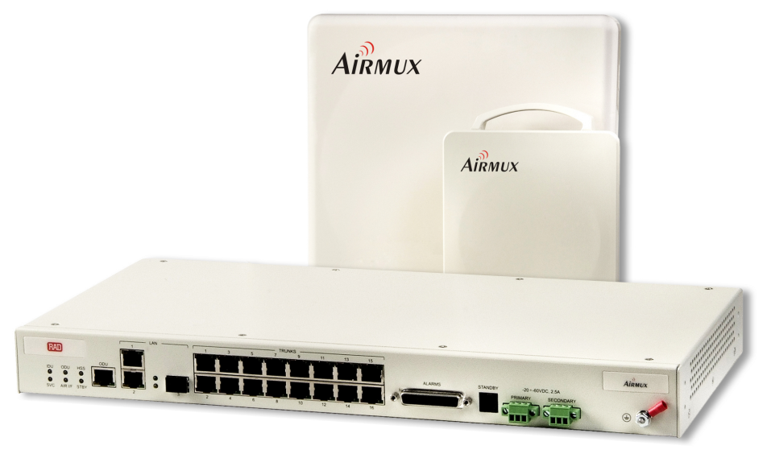
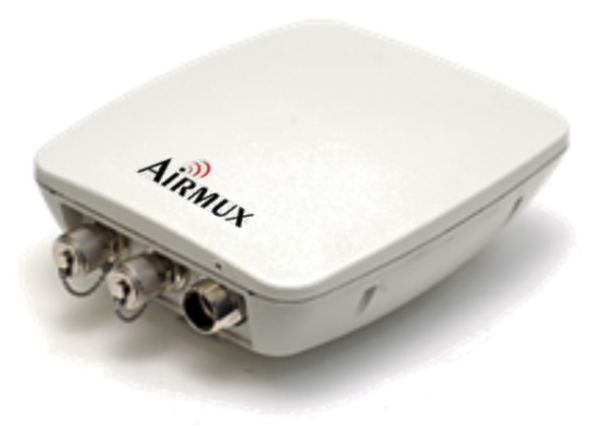
Airmux-400 Products Portfolio
Product | Max. Throughput | Form Factor | What’s New?
Airmux-400 | 200 M Aggregate | Connectorized Integrated (23 dBi) | 2.4GHz Support HazLoc Support
Airmux-400L | 50 M Aggregate | Embedded Connectorized Integrated (23 dBi) | 2.4GHz Support 2.5GHz Support
Airmux-400LC | 10 M Aggregate 25 M Aggregate | Connectorized Integrated (15 dBi) | 2.4GHz Support FCC Certified Capacity Upgrade

Slide 4
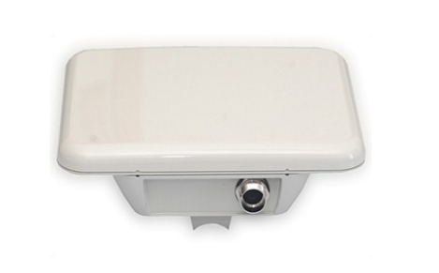
Airmux-400LC MiMO solution for The last Mile
The best PtP solution in the market for access applications:
MiMO / Diversity – double capacity per given channel, Better nLOS performance
Rich feature set of well known Airmux-400
Very competitive price
Two Models:
Up to 25 Mbps Ethernet + 4E1/T1
Up to 10 Mbps Ethernet
Small form factor unit case
Integrated antenna (15.5dbi)
Connectorized unit
Ideal successor for Airmux-200 family
Integrated
External

Slide 5
Airmux-400LC Specification Highlights
Parameters | Airmux-400LC 25 Mbps | Airmux-400LC 10 Mbps | Comments
Aggregated Ethernet capacity | 25 | 10
TDM Service | 4 | None | Supports IDU-E and IDU
Configuration | External Integrated |  | 15.5 dBi for integrated 15° Azimuth / Elevation 30°
TX power [dBm] | -5 to +25
Range | Up to 120km |  | With external antenna
Channel BW [MHz] | 5/10/20
QoS | Supported |  | Similar to Airmux-400
Asymmetric TDD
VLAN
Radio Mode | MIMO/Single/Diversity
Cable free HSS | Supported |  | From H/W 3.0

Slide 6
New Features

Slide 7
Capacity Upgrade – License Key
Applicability:
Airmux-400LC upgrade path:
From 10 Mbps to 25 Mbps
Capacity Upgrade keys are valid for all bands, regulations and configurations
Product Name | Capacity Upgrade
Capacity/P1025/Airmux-400LC/SU/10M-25M | 10 Mbps -> 25 Mbps

Slide 8
FIPS-197 Support
FIPS-197 Federal Information Processing Standard -Publication 197
A U.S. government computer security standard that specifies approved cryptographic algorithm to protect electronic data.
FIPS-197 Certified products:
Airmux-400:
Airmux-400LC
Airmux-400L 5.x GHz, WPC and Universal regulations – HW Rev. 7 and above
Airmux-400 5.xGHz ,WPC and Universal regulations – HW Rev. 7 and above

Slide 9
HAZLOC Certification
Applicable for Airmux-400 and Lightning Protection Unit (LPU)
HAZLOC certification primarily concerns North America. It aims to control the risks related to explosion in certain environments. It comprises two elements:
Testing and evaluation of products being used
Inspection of the factory
Standard
ANSI/ISA (USA) | Non-incendive Electrical Equipment for Use in Class | and ||, Division 2 and Class |||, Division 1 and 2 Hazardous (Classified) Locations; 12.12.01-2010
CAN/CSA (Canada) | Non-incendive Electrical Equipment for Use in Class |, Division 2 Hazardous Locations; C22.2 No. 213-M1987

Slide 10
Improved Capacity vs. Range
Product | Description | Benefits
Airmux-400L
Airmux-400L/ODU/F54U/EMB | Support 40 MHz CBW | Provide higher capacity for a given range
Performance Graph 20MHz vs. 40MHz (15dBi, 5.8 GHz FCC):
Distance [Km]

Slide 11
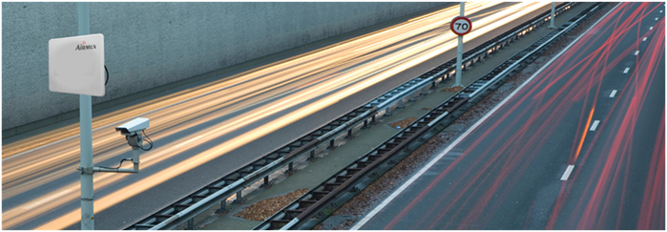
Summary
Reliable & Robust
Wireless Mobility
Long Ranges
Flexible & Scalable
Cost Effective
Simple
OFDM/MIMO
Technology
enables NLOS
deployment
Up to 200Mbps
Aggregate
throughput
Up to 120Km
between ODU’s
multi frequency
band– 4.8 to 6GHz,
3.3 to 3.8 GHz
Simple radio
planning, training,
installation and
maintenance
High capacity
ODU reduces the
tower space
needed

