Slide 1
Airmux-5000 General Availability Releases 3.4

Slide 2
Airmux-5000 Typical applications

Slide 3
Fixed, Nomadic & Mobility modes
Fixed:
Fixed SU is permanently installed on specific location
SU synchronizes and registers only to a specific BS
Administrator manually allocates service and registers the SU to the BS only after the SU synchronized to BS
BS – Base Station
SU – Subscriber Unit

Slide 4
Fixed, Nomadic & Mobility modes
Nomadic:
Nomadic SU may move from one BS to another BS but gets service only while on stationary position
ETH service is provided when user is in stationary position only
Service is pre-configured on SU
HBS1
No Service
HBS2

Slide 5
Fixed, Nomadic & Mobility modes
Nomadic:
Nomadic SU may move from one BS to another BS but gets service only while on stationary position
ETH service is provided when user is in stationary position only
Service is pre-configured on SU
Service Available
HBS1
HBS2

Slide 6
Fixed, Nomadic & Mobility modes
Nomadic:
Nomadic SU may move from one BS to another BS but gets service only while on stationary position
ETH service is provided when user is in stationary position only
Service is pre-configured on SU
No Service
HBS1
HBS2

Slide 7
Fixed, Nomadic & Mobility modes
Nomadic:
Nomadic SU may move from one BS to another BS but gets service only while on stationary position
ETH service is provided when user is in stationary position only
Service is pre-configured on SU
Service Available
HBS1
HBS2

Slide 8
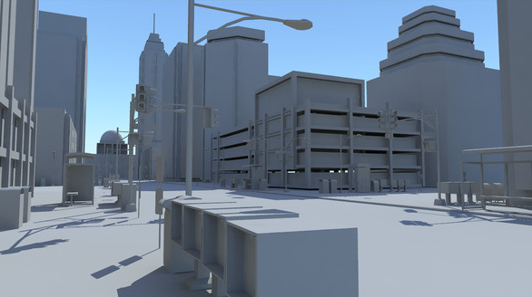
Fixed, Nomadic & Mobility modes
Mobility:
Mobile Unit (SU-MOB) enjoys continuous service while in motion from different Base Stations (BS-MOB) in the network
Service is pre-configured
Stronger Signal
Weaker Signal

Slide 9
Fixed, Nomadic & Mobility modes
Mobility:
Mobile Unit (SU-MOB) enjoys continuous service while in motion from different Base Stations (BS-MOB) in the network
Service is pre-configured
Weaker Signal
Stronger Signal

Slide 10
New and Modified Products

Slide 11
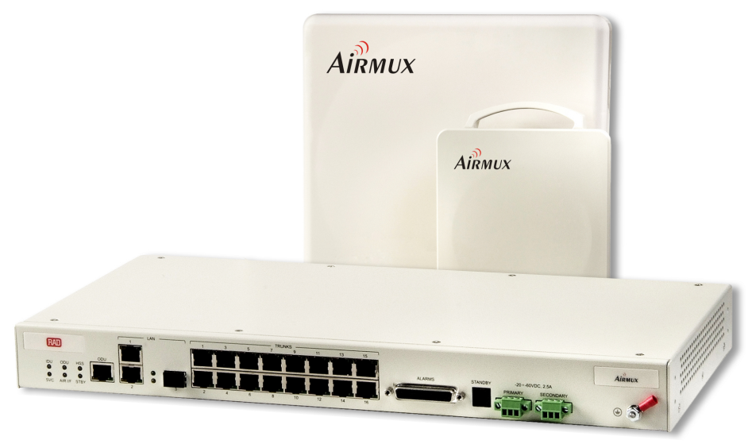
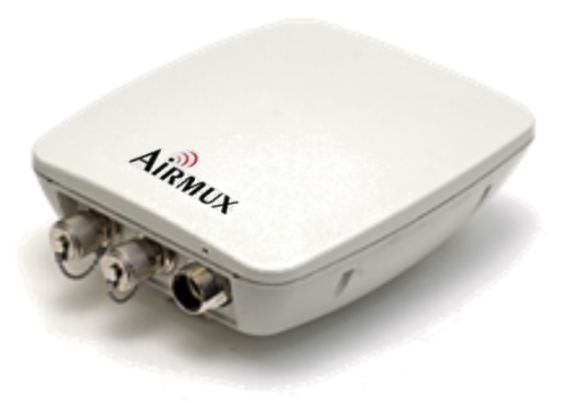
Base Stations – Product Portfolio
Product | Max. Throughput | Form Factor | What’s New ?
BS-200 | 250M Aggregate | Connectorized for External antenna | 25% increased capacity Base Station for Japan
BS-100 | 100M Aggregate | Connectorized for External antenna | Base Station for Japan
BS-50 | 50M Aggregate | Connectorized for External antenna Integrated (90 degrees)
BS-25 | 25M Aggregate | Connectorized for External antenna Integrated (90 degrees) | Low Cost Base Station

Slide 12
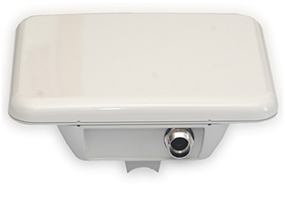
BS-25: New Base Station
Products highlights:
Small form factor 25Mbps with integrated antenna (11dBi, 90°) or Connectorized for external antenna
Complies with ETSI, Universal, FCC/IC regulations
Supports up to 16 Nomadic/Fixed SUs, 64 time-slots
Works with all Airmux SUs (SU-50/25/20/10/5)
Support 5, 10, 20 and 40 MHz Channel BW
Power consumption < 12 Watt
Operates with PoE devices
GbE interface, HW ready for new HSS concept

Slide 13
Subscriber Units - Products Portfolio
Product Name | Max. Throughput | Form Factor | What’s new?
SU-50 | 50 Mbps Aggregate | Integrated (23dBi) Connectorized for External antenna
SU-25* | 25 Mbps Aggregate | Integrated (15dBi) Connectorized for External antenna | Low Cost Subscriber Unit
SU-20 | 20 Mbps Aggregate | Integrated (23dBi)
SU-10* | 10 Mbps Aggregate | Integrated (15dBi) Connectorized for External antenna | Capacity Upgrade to 25Mbps
SU/POE | 10 Mbps Aggregate | Integrated (15dBi) | Subscriber Unit with POE port
SU-5* | 5 Mbps Aggregate | Integrated (15dBi) Connectorized for External antenna | Capacity Upgrade to 10 or 25Mbps
* Small-form-factor

Slide 14
New Features

Slide 15
Increased Sector Capacity
Increased sector capacity from 200M to 250M (25% improvement)
Adaptive short/long Guard-Interval upon Link conditions
Enhanced spectrum efficiency: 6.25bps/Hz
Relevant for all products and frequency bands
Provides more capacity per given range
Supported by installed base through software upgrade to release 3.4.0 GA
CBW [MHz] | Rel. 3.3.0 Capacity [Mbps] | Rel. 3.4.0 Capacity [Mbps] | Improvement [%] | Products
5 | 16.8 | 19.2 | 14% | BS-200, BS-100, BS-50, BS-25
10 | 47.5 | 50.9 | 7% | BS-200, BS-100, BS-50
20 | 100 | 114 | 14% | BS-200, BS-100
40 | 200 | 250 | 25% | BS-200

Slide 16
Increased Sector Capacity
Capacity [Mbps]
Distance [Km]
Assumptions:
15dBi HBS antenna
23dBi HSU antenna
40MHz Channel BW
Adaptive rate, MiMo
5.x GHz FCC/IC

Slide 17
Capacity Upgrade – License Key
Applicability:
Airmux-5000: Small-form-factor SU-5/10/25, upgrade path:
From 5 Mbps to 10 Mbps
From 5 Mbps to 25 Mbps
From 10 Mbps to 25 Mbps
Capacity Upgrade keys are valid for all bands, regulations and configurations
Capacity Upgrade Procedure:
Capacity upgrade can be performed for each ODU or SU individually or for all the SUs in the sector via the BS
Product Name | Capacity Upgrade
Capacity/S0510/Airmux-5000/SU/5M-10M | 5 Mbps -> 10 Mbps
Capacity/S1025/Airmux-5000/SU/10M-25M | 10 Mbps -> 25 Mbps
Capacity/S0525/Airmux-5000/SU/5M-25M | 5 Mbps -> 25 Mbps

Slide 18
FIPS-197 Support
FIPS-197 Federal Information Processing Standard -Publication 197
A U.S. government computer security standard that specifies approved cryptographic algorithm to protect electronic data.
FIPS-197 Certified products:
Airmux-5000:
Small-form-factor SU-5/10/25
BS-25
BS-200 5.x GHz, Universal regulations – HW Rev. 7 and above
BS-50 5.x GHz, Universal regulations – HW Rev. 7 and above

Slide 19
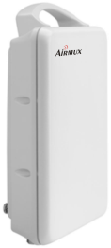
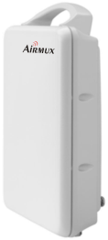
QinQ VLAN Configurable TPID Values
Applicable for Airmux-5000 SUs only
Enables interoperability with legacy switches (e.g. Cisco) that supports TPID of 0x8100 only
TPID (Tag Protocol Identifier) value in Provider Mode can be configured to:
0x9100 (default)
0x8100
0x88A8
TPID value can be configured per each SU in the Sector
Supported by installed base through software upgrade to release 3.4 GA
Cisco Switch
Double Tagged (QinQ) with TPID 0x8100
Untagged / Tagged
HBS
HSU

Slide 20
SU Time-Slots Assignment
Feature highlights:
A single SU can now be assigned up to 63 time slots (out of 64 time slots)
Enables providing more than half of the HBS capacity to a certain SU
Supported by all BSs (200/100/50/25)
Supported by installed base through software upgrade to release 3.4.00
Applicable cases:
Long distance SU’s that require more/high capacity
SU that requires more than half of the BS capacity
SU that requires lower latency
SU under nLOS and NLOS cases
100 Mbps
46 Time slots
50 Mbps
20 Mbps
7 Time slots
10 Time slots
30 Mbps

Slide 21
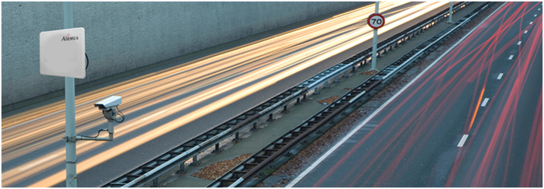
Summary
Reliable & Robust
Wireless Mobility
Long Ranges
Flexible & Scalable
Cost Effective
Simple
OFDM/MIMO
Technology
enables NLOS
deployment
Up to 100Mbps
for vehicles on
the move with
seamless handover
Up to 40Km
between BS and
SU’s
multi frequency
band– 4.8 to 6GHz,
3.3 to 3.8 GHz
Simple radio
planning, training,
installation and
maintenance
High capacity
base station
reduces the
tower space
needed

