Slide 1
ETX-2
Ver. 5.0 Beta
July 2013
PLM Desktop

Slide 2
Outline
Service Assured Access
Product highlights
New features and capabilities in version 5.0
Ordering information
Value proposition

Slide 3
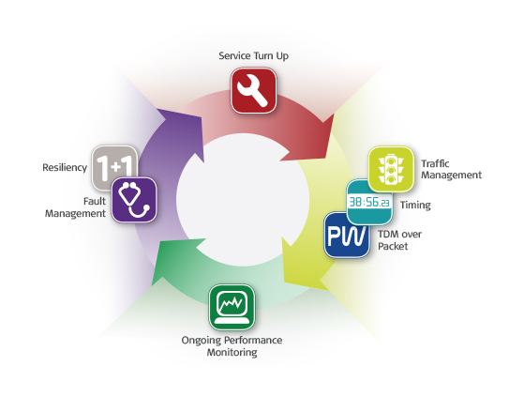
Service Assured Access (SAA) Throughout the Service Lifecycle
A comprehensive set of tools making it easier to plan, deploy, provision, and maintain Carrier Ethernet services
SAA Video:
“Who is the best?”
Notes:
Increase Revenues:
SLA/Premium service introduction
Up-selling opportunities
Fast TTM
Customer stickiness & reduced churn
Reduce TCO:
Enhanced network utilization
Reduce truck rolls with Zero touch configuration
Reduce trouble ticket handling
Space and power savings
Minimize integration, training and inventory investments through modular and multi-functional products

Slide 4
Service Assured Access (SAA) Comprehensive Carrier Ethernet Toolset
Zero-touch configuration
Auto install & inventory discovery
One-touch service validation
→ Reduces truck rolls / reduces TCO
Per flow policing & shaping
Oversubscription by managing priority and congestion
Ensures service performance
Improves efficiency / reduces TCO
LAG / LACP
EVC Protection (G.8031)
Ring protection (G.8032v2)
Improves availability / improves revenue
Built-in GPS
SyncE
1588v2, PTP GM, Slave, TC
Frequency, phase & ToD
→ Improves revenue / reduces TCO
Automated fault detection
EVC alarm propagation
HW-based fault mgt, OAM
Wire-speed loopback testing
→ Reduces trouble tickets / reduces TCO
TDM legacy migration
MEF8, SAToP, CESoPSN
2G/3G support
→ Increases revenue / reduces TCO
Scalable long-term KPI collection engine
One-way delay measurements
PM dashboard (policies, correlation, violations)
End user PM Portal
→ Up-selling opportunity / Increases revenue
Notes:
Increase Revenues:
SLA/Premium service introduction
Up-selling opportunities
Fast TTM
Customer stickiness & reduced churn
Reduce TCO:
Enhanced network utilization
Reduce truck rolls with Zero touch configuration
Reduce trouble ticket handling
Space and power savings
Minimize integration, training and inventory investments through modular and multi-functional products

Slide 5
Service Assured Access Benefits
Service assurance has become a “must have” in order to increase service provider revenue and decrease TCO
Increase Revenues:
Faster service setup time
Premium SLA based service offerings with optional MultiCOS
Improved Customer QoE, reduced churn
Up selling opportunities
SLA reporting as a service
Standards based wholesale services across multiple service provider networks
Reduce TCO:
Automated PM/FM/TM operations
A single network for various services, access technologies and topologies
Enhanced bandwidth utilization
Reduce truck rolls, minimize technician dispatches

Slide 6
ETX-2 for Service Assured Access
Access Network
Flexible customer reach
Same service look & feel
Reliability & Protection
Advanced H-QoS
Synchronization over Packet
Service visibility
Performance monitoring
SLA reporting
Metro/
Core
Access Aggregation
MiNID
First Mile
Management
FE/GbE
1/10 GbE
ETX-2
Cell-
Site
ETX-5
ETX-2
SDH/
SONET
PDH/ SDH
IP / MPLS
ETX-5
ETX-2
10GbE
Ring
GbE
DSL
MSAN
ETX-2
ETX-5
1/10 GbE Ring
Customer
Premises
Service Assured Access
ETX-2 –Demarcation and aggregation for SAA
Notes:
Demarcation and aggregation
Same service profile over:
fiber and copper
Eth, DSL, PDH, SDH
Linear and ring
All managed under RADview

Slide 7
Service Assured Access : Beyond Access
Access Network
Core Services
Metro/
Core
Access Aggregation
MiNID
First Mile
Internet
Access
Management
FE/GbE
Cloud/ Data Center
ETX-2
1/10 GbE
Cell-
Site
ETX-5
ETX-2
Carriers Interconnection
SDH/
SONET
PDH/ SDH
ETX-5
IP / MPLS
ETX-5
ETX-2
10GbE
Ring
GbE
DSL
RAN Controller Site
MSAN
ETX-2
ETX-5
1/10 GbE Ring
Customer
Premises
FE/GbE /10GE
ETX-2
Service Assured Access
Service Assurance – End to End
Service Assurance – End to End (VPN)
Complete Access solution with full service visibility

Slide 8
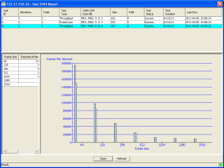
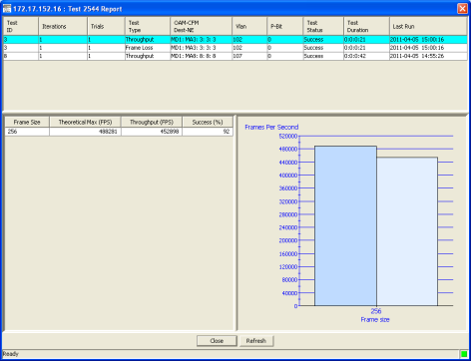
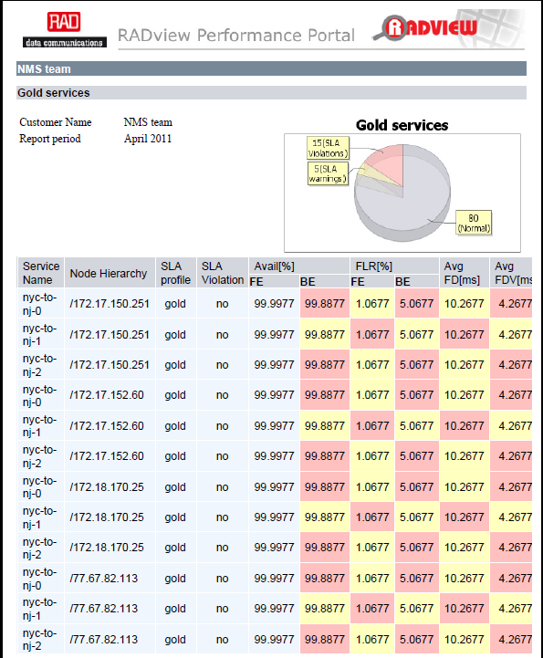
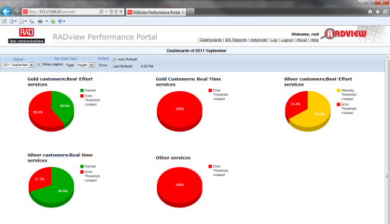
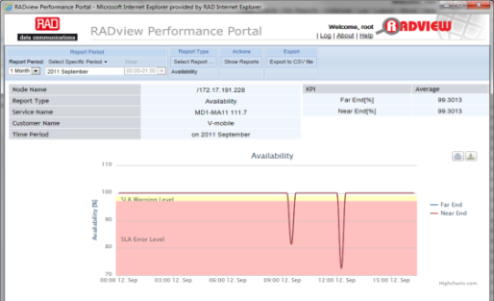
Managing ETX-2 Service Life Cycle
RFC-2544\Y.1564
Configuration
Turn-up
Performance Monitoring
Troubleshooting
Scheduled Reports

Slide 9
Product Highlights - Features and Applications
Increase Revenues, Reduce TCO

Slide 10
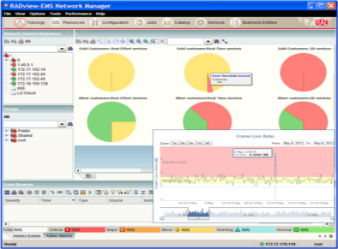
RAD Service Assured Access Portfolio
Performance
Port, service and card protection with hitless upgrades
Redundant GE/10GE Demarcation, Aggregation and Grandmaster
ETX-5
Best-in-Class Aggregation
Port and service protection
Winner
2012
GE/10GE Demarcation
and Aggregation
ETX-2
GPS / Timing / PWE
Combo / RDNT PS / Hardened
Best-in-Class Mobile
Backhaul
RADview
Configuration, automation and Inventory maintenance with PM Portal and Reports
Modular / Combo
Winner
2011
Univ. AC/DC
Best-in-Class Demarcation
Winner
2011
Low-Cost, Specialized
ETX-1
Most Innovative Telecom Product
MiNID
Winner
2013
FE
GE
10GE
Scale
Notes:
the second straight year, RAD Data Communications has won a prestigious Carrier Ethernet award at the Carrier Ethernet World Congress, which is meeting this week in Barcelona. Besting competing offerings from Cisco and Telco Systems, RAD's ETX-5 Ethernet Service Aggregation Platform won the award for "Best Carrier Ethernet Aggregation Product EMEA". Read/download the full press release [PDF] The award was presented under the auspices of IIR Telecoms & Technology, organizer of the event, and in the presence of the Metro Ethernet Forum (MEF). Judges included executives from leading industry analyst firms Ovum and Infonetics, along with a panel of telecom operator representatives from around the world.
RAD Wins Best Carrier Ethernet Aggregation Product
Award at Carrier Ethernet World Congress
ETX-5 Ethernet Service Aggregation Platform Chosen by Judges from
Telus, Colt, Oi Brasil, NTT Japan, Infonetics, and Ovum

Slide 11
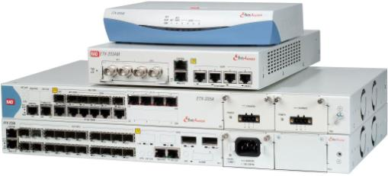
ETX-2 Product Highlights
Optimized for premium Ethernet and TDM PWE services
Flexible customer reach over 1/10G Ethernet, SHDSL, PDH and SDH
Carrier-grade design offering Linear, Ring (G.8032) and Dual Homing support
Advanced HQOS, offering per EVC.CoC shaping
HW based OAM offering fault monitoring and performance management
Service activation tests (RFC2544 and Y.1564) with “birth certificates”
Advanced synchronization combining Synchronous Ethernet and 1588v2 Slave, Boundary Clock, Transparent Clock
Distributed 1588v2 Grand Master support with integrated GPS receiver
MEF CE 2.0 certified for E-Line and E-LAN services

Slide 12
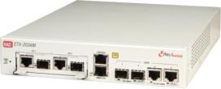
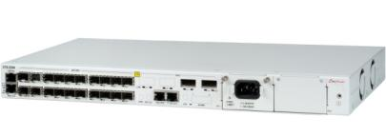
ETX-2 configurations
Carrier Ethernet Demarcation Device
ETX-203AX - Cost optimized for pure Ethernet services
Universal Carrier Ethernet Demarcation Device
ETX-203AM - Modular uplink interfaces for Ethernet, SHDSL, E1/T1 & T3
Advanced Ethernet/Mobile Demarcation Device
ETX-205A–High-end design with redundant PS, All-Combo ports and multiple options for routing, Synchronization and integrated E1/T1 ports
10G Ethernet Demarcation/Aggregation Device
ETX-220A - Multiple 10G and 1G interfaces
New

Slide 13
Intelligent Demarcation Solutions
Customer Premises
RADview – EMS & Service Center
SHDSL
ETX-2
Customer HQ
IP DSLAM
ETX-2
ETX-5
PDH/SDH
Nx1/10GbE
Service Provider Network
ETX-2
FE/GbE
RNC/4G Gateway
ETX-2
2G, 3G, 4G LTE eNB
1/10GbE
ETX-2
GE
GbE
Service Assured Access (SAA) Service Activation, PM, FM, Resiliency, Synchronization
E1
Solution benefits
Unified service offering over any access infrastructure
FE, GE, 10G as well as E1/T1/T3 user interfaces (Integrated or with Smart SFPs)
HW based SAA tools for Accurate and scalable SLA assurance
Painless integration and operation – simple provisioning and network management
Variety of units and ordering options for reduced Total Cost of Ownership (TCO)

Slide 14
Access and Aggregation Network
ETX-2
1 GbE
ETX-2
PE
10 GbE
LAG
ETX-2
1 GbE
ETX-2
PE
PE
ETX-2
1 GbE
10 GbE
ETX-2
IP/MPLS
10 GbE
1 GbE
PE
Dual Homing
ETX-2
ETX-2
ETX-5
G.8032 10GE
10 GbE
ETX-2
Solution benefits
Flexible topologies with Hub & Spoke and G.8032 Rings
Protected interconnections with Link Aggregating (LAG) and Dual Homing
HW based fault management for fast protection
Advanced Traffic Management (TM) for SLA enforcement
Scales up with ETX-5 for higher capacities and TDM aggregation
One stop shop for reliable End to End solution

Slide 15
Mobile Backhaul Service provider Service Assured Access & timing distribution
E2E SLA Assurance, Circuit Validation,
Traffic Management , TDM PWE
Macro or Small Cells
ETX-2
ETH
NB
RADview with
PM Portal
TDM
BTS
RNC/aGW
Router
ETX-5
PE
PE
MiNID
eNB
Packet Switched
Network
ETX-2
BSC
N x OC3 / STM-1
G.8032v2
GE/10GE
Ring
APS
ETX-2
ETH
eNB
TDM
BTS
Timing
(1588PTP/SYNC-E)
Mobile Network
Transport Network
Mobile Network
2G, 3G, LTE-A in same device with Ethernet and TDM services
Service visibility to small cells & radio extension based in integration with MiNID smart SFP
Hbrid Sync - SyncE, IEEE-1588v2 Slave, BC, TC, and Distributed GM (phase and frequency)

Slide 16
New Features and Capabilities in Version 5.0
Increase Revenues, Reduce TCO

Slide 17
New in Version 5.0
General features:
Service Activation Tests per Y.1564 (to be supported in ETX-220A in future version)
Extending 1:1 LAG support to include protection on user ports
Improved management support - IPv6 addressing and /31 mask
1588v2 enhancements (in 1588v2 supporting products) : slave and boundary clock per G.8265.1 Telecom Profile
New ordering options:
ETX-220A 10G demarcation device
ETX-205A with integrated L3 static router
ETX-205A with integrated GPS receiver for Distributed Grandmaster applications with SyncE and 1588v2

Slide 18
Multiple 1GbE Port & 10GE Ports
New
Flexible 10G demarcation and aggregation device for:
SLA-based retail and wholesale services
Mobile backhauling Ethernet demarcation
Up to 3x10GE and up to 20xGE ports
CE 2.0 compliant Ethernet services
E-Line, E-LAN, E-TREE, E-NNI
SyncToP™ synchronization combining:
Synchronous Ethernet
IEEE-1588v2 PTP Slave and Transparent Clock
Carrier grade design
Service and port level redundancy
Ring and linear protection G.8032v2, G.8031
Redundant power supplies

Slide 19
205A with Integrated L3 Static Router
New
4xGE ports: 2 NNIs and 2 UNIs
HW based, 1G (full duplex) static router
L2 and L3 with multiple VRF support
IPv4 and IPv6 dual stack support with static routing
Hierarchical QoS (H-QoS) per VPN/EVC per CoS
Access Control List (ACL)
64 rules for queue mapping, DSCP remarking or packet filtering
Identify by single or range of SIP/DIP addresses, source/destination TCP/UDP ports
Single hop IPv4/v6 BFD for continuity check and protection
Notes:
Review the points

Slide 20
Mobile Backhaul Service Provider Timing Distribution with 1588-GM in Hub-Sites
New
E2E SLA Assurance
E2E Circuit Validation
Macro or Small Cells
RADview with
PM Portal
GbE
eNB
Low-cost
Small-scale
PTP-GM
GbE
eNB
Low-cost
Small-scale
PTP-GM
ETX-2
RNC/aGW
Router
ETX-5/ETX-2
PE
Packet
Switched
Network
PE
BC/TC
eNB
ETX-2/5
Agg +PTP-GM
BC/TC
MW
eNB
Timing (1588PTP/SYNC-E)
Mobile Network
Transport Network
Mobile Network
Distribution of IEEE-1588 “islands” is the best approach allowing:
Cost effective – no need for GPS on every cell-site or end-to-end BC/TC
Best Timing quality with possible backup scenarios: Backup from Sync-E/PTP
Option A: Dedicated PTP-GM (ETX-2) for existing installations
Option B: Part of Access aggregation solution (ETX-5/ETX-2)

Slide 21
Y.1564 Service Activation Test
New
Branch A
Traffic Generation and KPI Measurement
Headquarters
PE
ETX
Real Time
UNI
EVC
Priority Data
Real Time
Best Effort
Priority Data
ETX
PE
EVC 1
PSN
Best Effort
EVC 2
Branch B
Real Time
DSLAM
ETX
Real Time
EVC
Priority Data
Priority Data
Best Effort
Best Effort
UNI
Standard for of Service Activation Test for service commissioning and for future reference
Tests service compliance with SLA in two steps:
Configuration test – short test, confirming proper configuration of policing, shaping and network connectivity
Performance test – longer test, measuring FLR, FD, FDV and Availability.

Slide 22
Y.1564 Mode of Operation
New
ETX Generating Y.1564 test
ETX Responding to Y.1564 test
1564 traffic
Generator
Loopback for 1564 traffic (MAC swap)
PSN
Policer
Rx flow
MEP
MEP
Rx flow
Policer
Y.1564 test based on standard OAM tests
Seamlessly tests any L2 network
Simple integration with 3rd party devices (acting as responders)
8 test sessions enables simultaneous tests of multiple CoS or multiple services
Test of E-Line services and E-LAN services (over bridge)
Capable of testing policer in both ends of the service

Slide 23
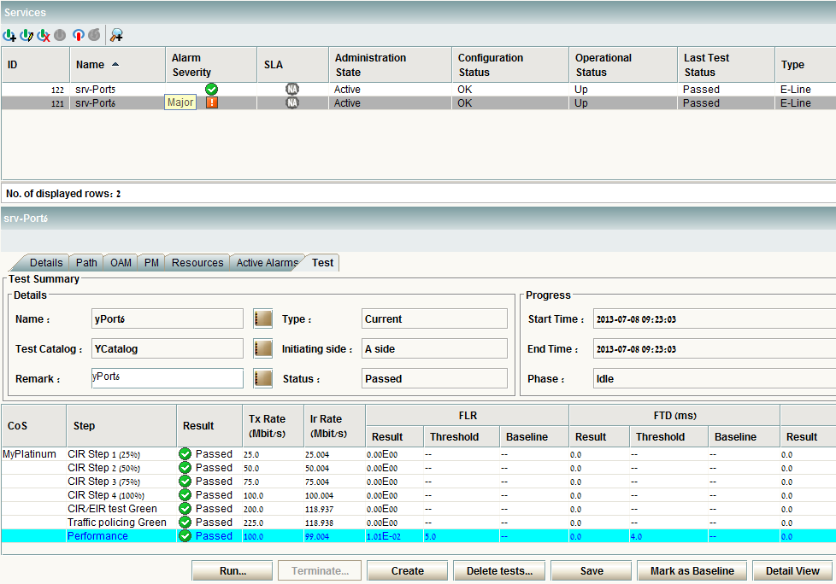
Y.1564 test results
New

Slide 24
ETX-2 Ordering Information
Increase Revenues, Reduce TCO

Slide 25
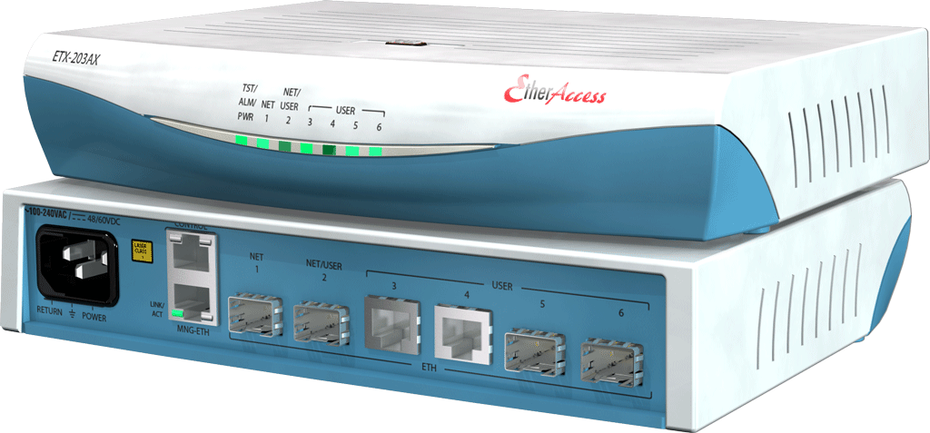
ETX-203AX Ordering Information
Model | Description
ETX-203AX/2SFP/4UTP | 6 FE ports (2 SFP network ports, 4 copper user ports), 2 shaped services, AC/DC power supply in ½ 19” plastic enclosure
ETX-203AX/2SFP/2UTP2SFP | 6 FE ports (2 SFP network ports, 2 UTP and 2 SFP user ports), 2 shaped services, AC/DC power supply in ½ 19” plastic enclosure
SW options | Description
ETX-203AX-SW/GE | Upgrade all ports to GbE
ETX-203AX-SW/GE30 | Upgrade all ports to GbE, allow 30 shaped services
Notes: Complete list of ordering options available in RAD catalog

Slide 26
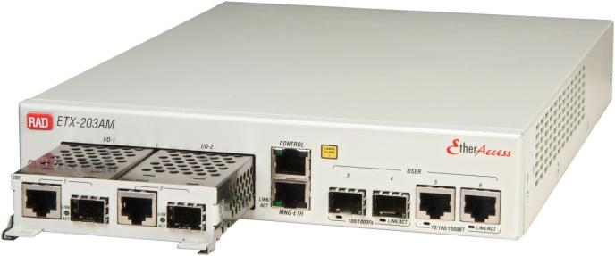
ETX-203AM Ordering Information
Model | Description
ETX-203AM/AC/2ETH/4SFP | ETX-203AM with AC PS, 2xGbE combo uplink module, 4 FE/GbE SFP user ports, 2 shaped services
ETX-203AM/AC/SH8W/4UTP | ETX-203AM AC, 8W SHDSL uplink module, 4 copper user ports (FE/GE, per software license), 2 shaped services
ETX-203AM/DC/SH4W/2SFP2UTP | ETX-203AM DC, 4W SHDSL uplink module, 2 copper user ports, 2 SFP user ports (FE/GE, per SW license), 2 shaped services
SW options | Description
ETX-203AM-SW/GE | Upgrade all ports to GbE
ETX-203AM-SW/GE30 | Upgrade all ports to GbE, allow 30 shaped services
Notes: Complete list of ordering options available in RAD catalog

Slide 27
ETX-205A Ordering Information
Model | Description
ETX-205A/AC/19 | 6 combo GE ports, single AC power supply, 19” metal enclosure
ETX-205A/AC/19/GPS | 6 combo GE ports, single AC power supply, 19” metal enclosure, with integrated GPS receiver for 1588v2 GM functionality.
ETX-205A/DCR/19/RTR | 4 combo GE ports, 2 DC power supply (redundant), 19” metal enclosure with integrated 1G router.
ETX-205A/AC/19/4E1T1/PTP | 6 combo GE ports, single AC power supply, 19” metal enclosure, 4 E1/T1 ports, Sync-E and 1588v2 support.
Notes: Can be ordered with one or two, AC or DC power supplies
Can be ordered with different combinations of E1/T1 and SyncE/PTP
Complete list of ordering options available in RAD catalog

Slide 28
ETX-220A Ordering Information
P/N | Description
ETX-220A/AC/2XFP/20S/SYE/ESK | ETX-220A, AC 2xXFP ports, 20x1GbE SFP, Sync-E, ESK full blown key
ETX-220A/AC/3XFP/10S/SYE/ESK | ETX-220A, AC 3xXFP ports, 10x1GbE SFP, Sync-E, ESK full blown key
ETX-220A/AC/3XFP/10S/PTP/ESK | ETX-220A, AC 3xXFP ports, 10x1GbE copper, Sync-E, 1588v2, ESK full blown key
ETX-220A-PS/N/DC | DC power supply. Up to 2 PS per shelf
ETX-220A-PS/N/AC | AC power supply. Up to 2 PS per shelf
SW options | Description
Basic Software | Basic SW pack , Reduced TM and OAM scale
ETX-220A/ESK | Full-blown
Notes: Complete list of ordering options available in RAD catalog
Notes:
Review the points

Slide 29
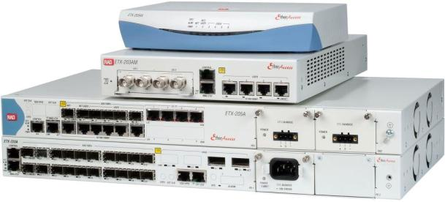
ETX-2 Value Proposition
The access layer of RAD’s SAA
Maintain customer base by offering legacy services together with new services
Ensure customer satisfaction with reliable service offering
Reduce churn and develop customer intimacy with tailored SLA reports
Reduce Total Cost of Ownership with advanced management system

Slide 31
Appendix A: Product Details
Notes:
Use the following slides as alternative slides to introduce the SAA framework in a more technical way

Slide 32
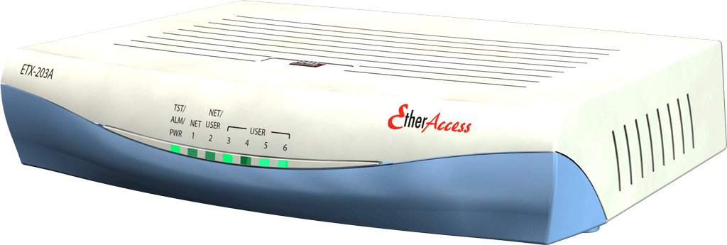
ETX-203AX configuration
Fixed Carrier Ethernet Demarcation Device for:
SLA-based retail and wholesale Ethernet services
Flexible port selections:
1 or 2 FE/GE network ports: SFP based
4 or 5 FE/GE user ports: SFP or UTP
Cost effective design
Universal AC and DC PS, reducing inventory
Carrier grade design
Liner, Ring (G.8032) and Dual Homing support
MEF CE 2.0 certified for E-Line and E-LAN services

Slide 33
ETX-203AX Physical View
Power
Universal wide-range AC and DC PS
Management
Out of Band FE port
Local RS-232
Network and User Interfaces
1 or 2 network SFP interfaces (redundancy)
Up to 4 or 5 user ports

Slide 34
ETX-203AM configuration
Modular Carrier Ethernet Demarcation Device for:
SLA-based retail and wholesale Ethernet services
Uniform service offering over Copper, Fiber, SHDSL and PDH/SDH access networks
Flexible port selections:
Modular based network ports
2 GbE combo interfaces: SFP/UTP
4 or 8 wire SHDSL uplink module
4 FE/GE user ports: SFP or UTP
Carrier grade design
Liner, Ring (G.8032) and Dual Homing support
MEF CE 2.0 compliant E-Line and E-LAN services
Certification scheduled for Q3/2013

Slide 35
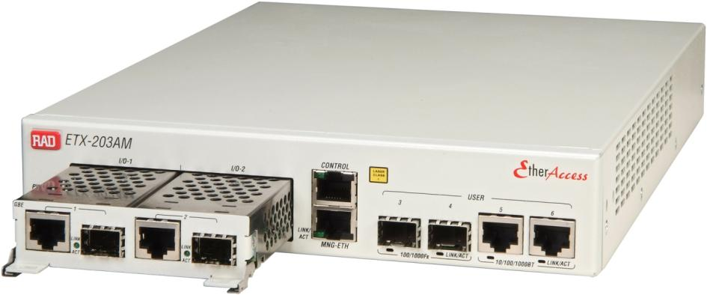
ETX-203AM Physical View
FE/GbE Combo port uplink module
SHDSL EFM uplink module
Ethernet over PDH uplink module
2 x 10/100/1000BT
2 x 100/1000Fx (SFP)
4wire – 11.4 Mbps
8wire – 22.8 Mbps
4/8xE1/T1
1/2xT3
GFP/VCAT/LCAS
Management
Out of Band FE port
Local RS-232
User interfaces:
4 FE/GE interfaces
SFP or UTP
Modular Uplink
ETH
SHDSL
ETH Over PDH/SDH

Slide 36
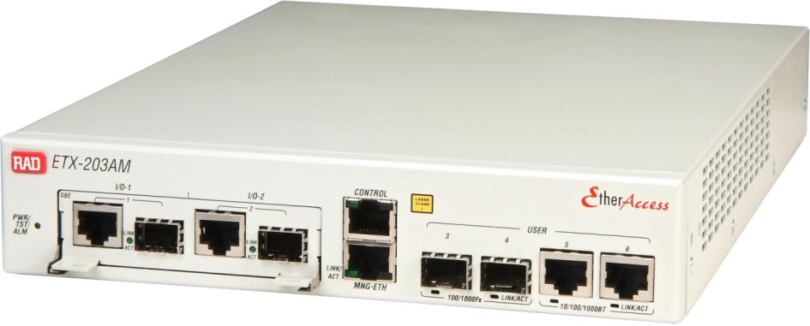
ETX-203AM - All-In-One
Modular design advantages:
Service uniformity across network technologies
Management integration
Smooth migration from copper for fiber
Reduced inventory for lower OPEX
Shorter training and expertise

Slide 37
ETX-205A configuration
Advanced Carrier Ethernet Demarcation Device for:
SLA-based retail and wholesale L2 Ethernet services and L3 VPN
2G/3G/4G-LTE Mobile backhauling demarcation
Migration to packet networks with integrated Ethernet and E1/T1 services
Carrier-grade design
Liner, Ring (G.8032) and Dual Homing support
Redundant power supplies
SyncToP™ synchronization combining:
Synchronous Ethernet
IEEE-1588v2 PTP Slave, Boundary Clock and Transparent Clock
IEEE-1588v2 PTP Grand Master with integrated GPS receiver
MEF CE 2.0 certified for E-Line and E-LAN services

Slide 38
ETX-205A Physical View
SyntTop™ synchronization ports:
External in/out (T3/T4)
1PPS and ToD
GPS antennal port
4/8 E1/T1 PWE interfaces:
SAToP, CESoPSN (with CAS)
UPD/IP and MEF8 encapsulation
Flexible and accurate timing
Management ports
Out of band - Ethernet port
Local craft terminal - RS-232
6 FE/GE combo interfaces*:
2 Network ports
4 User ports
Redundant power supplies:
AC: 100–240VAC, 50-60Hz
DC: 24/48VDC
19”, 1RU shelf, Rack and wall mount
Environmentally Hardened Option: -20 to +65C
* Note: When ordered with integrated router, 4 GE ports are active

Slide 39
ETX-205A D-GM
SyntTop™ synchronization ports:
GPS RF input (from antenna)
1588 TC/GM/Slave/BC*
Management ports
Out of band - Ethernet port
Local craft terminal - RS-232
6 FE/GE combo interfaces:
2 Network ports
4 User ports
Redundant power supplies:
AC: 100–240VAC, 50-60Hz
DC: 24/48VDC
19”, 1U shelf, rack and wall mount
Embedded GPS receiver (supporting a standard GPS antenna)
Full Sync-E and Hybrid PTP-Sync-E support
Full G.8265.1 Telecom Profile support
Up to 64 simultaneous unicast slaves (@ 128 PPS each)
Automatic fallback to SyncE or PTP-BC under a GPS failure (future versions)
Supports the same functional capabilities of the standard ETX-2

Slide 40
ETX-220A Layout Medium 10G Demarcation/Aggregation
Available Options:
20x1GbE Fiber
10x1GbE Copper, 10x1GbE Fiber
(The 2 first GbE ports can serve as UNI/NNI ports)
2 x 10GE XFP Based Ports
2 NET 1:1 mode
1 NET, 1 User
Management ports
Out of band - Ethernet port
Local craft terminal - RS-232
SyncTop™ synchronization ports:
RJ-45 and BNC i/f
External in/out (T3/T4)
ToD and 1PPS
Redundant power supplies:
AC: 100–240VAC, 50-60Hz
DC: 48VDC
19”, 1RU shelf, Rack and wall mount

Slide 41
ETX-220A Layout Medium 10G Demarcation/Aggregation
Available Options:
10x1GbE Fiber
10x1GbE Copper
(The 2 first GbE ports can serve as UNI/NNI ports)
3 x 10GE XFP Based Ports
2 NET 1:1 mode, 1 User
1 NET, 2 User
Management ports
Out of band - Ethernet port
Local craft terminal - RS-232
SyncTop™ synchronization ports:
RJ-45 and BNC i/f
External in/out (T3/T4)
ToD and 1PPS
Redundant power supplies:
AC: 100–240VAC, 50-60Hz
DC: 48VDC
19”, 1RU shelf, Rack and wall mount

Slide 42
Appendix B: MEF Certificates
Notes:
Use the following slides as alternative slides to introduce the SAA framework in a more technical way

Slide 43
Service Assured Access RAD is MEF CE2.0 Certified
Advancing CE networks and services by a generation
Eight Ethernet services (CE1.0 defined 3 service types)
3 new features:
Multi-CoS (up to 8 CoS)
Interconnect (E-NNI , E-Access)
Managed Services (FM & PM)
Notes:
Eight services refer to 4 major (E-Line, E-LAN, E-TREE, E-Access) each of them with two “flavors” – port-based or flow based (e.g. E-Line : EPL, EVPL).
Our SAA solution is structured on a solid MEF cerified, Carrier Ethernet 2.0 offering

Slide 44
MEF CE 2.0 Highlights
CE 2.0 Service Manageability
E2E service and performance monitoring
Circuit validation and fault isolation
Benefit: Reduces service costs (OPEX)
PSN
eNB
E2E SLA Assurance
CE 2.0 Multi-CoS – Multiple Classes-of-Service
Leverages TM tools for better QoS and Network Performance
Benefit: Efficient BW utilization avoids infrastructure over-build
Benefit: improve QoE by setting CBS per CoS (e.g. reduce queue length (CBS) for high priority, delay and jitter sensitive traffic while increasing CBS for bursty, low priority traffic).
CE 2.0 Interconnect - Integrates autonomous CE networks
Accelerates delivery of off-net UNI-to-ENNI services
E-Access: New Wholesale Service
Benefit: Standardized Ethernet Access
Benefit: Minimizes quantity of custom Interconnect agreements
E-Access
UNI
ENNI
UNI
EVC

Slide 45
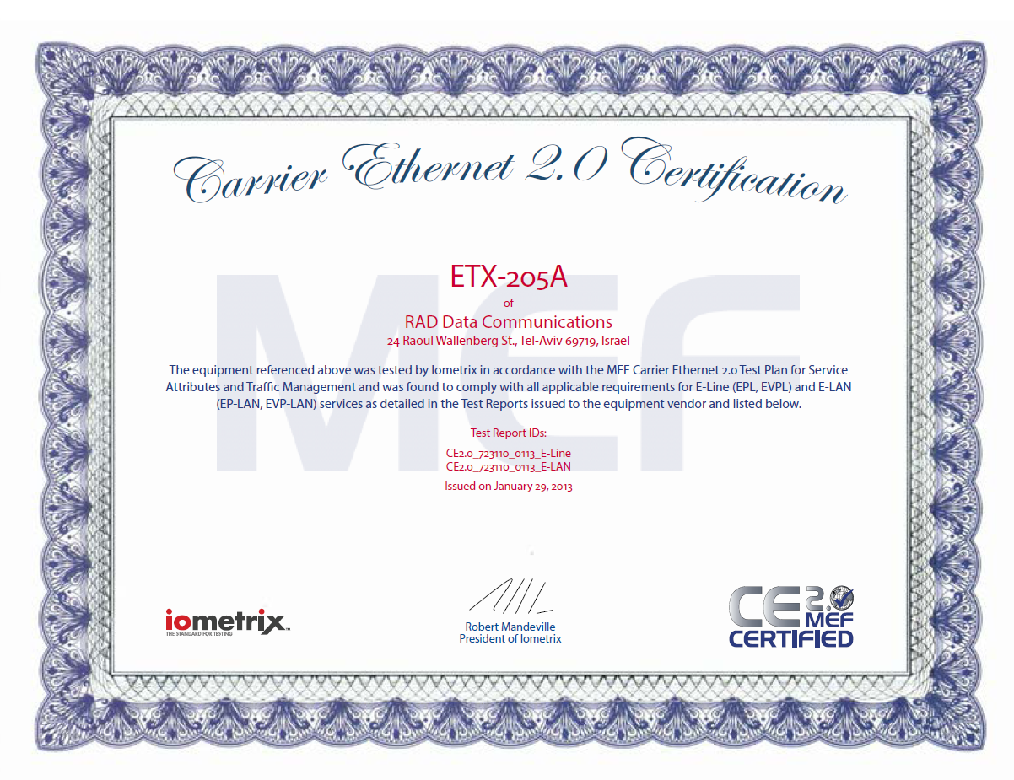
ETX-205A CE2.0 certificate
Notes:
Detailed information on MEF certification including RAD certification anouncmencan be found in the link.

Slide 46
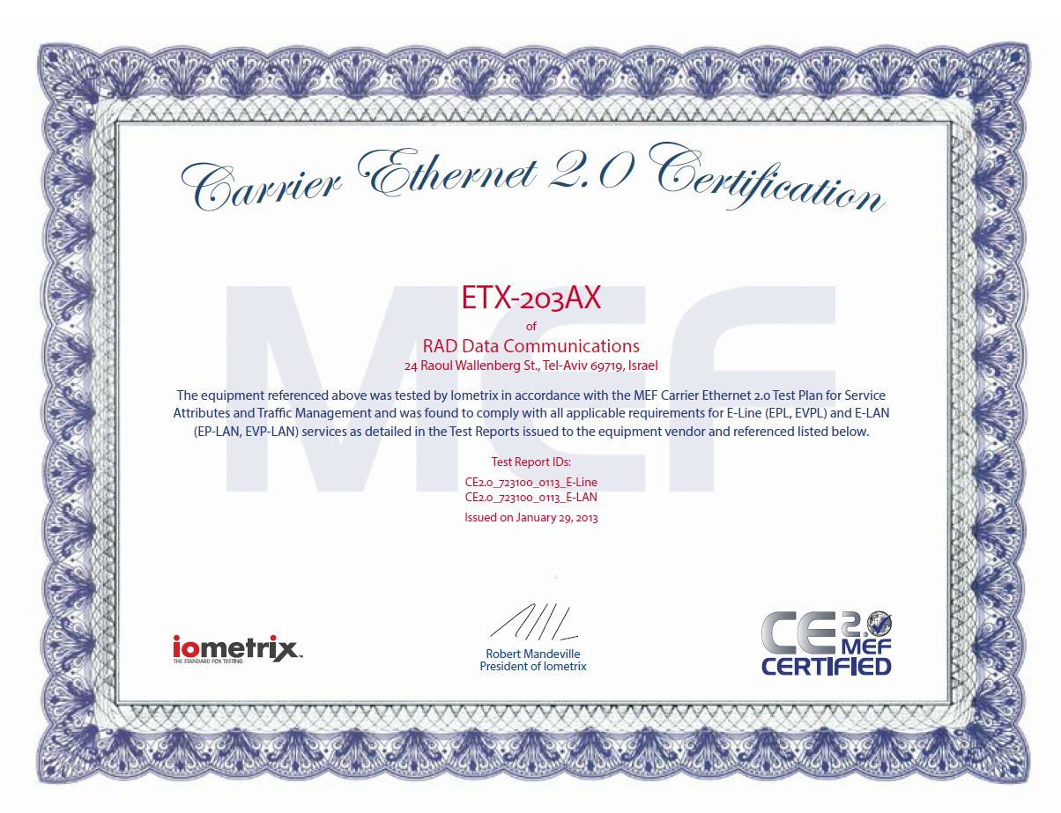
ETX-203AX CE2.0 certificate
Notes:
Detailed information on MEF certification including RAD certification anouncmencan be found in the link.

