Slide 1
IPmux-24, IPmux-216
Version 3.5 General Availability
November 2010

Slide 2
Outline
Pseudowire/TDMoIP Concept
IPmux/Gmux Product Line
Ipmux-24, Ipmux-216 Product Description
Applications
Features Details
Market Overview
Success Stories

Slide 3


RAD’s TDM Pseudowire
Product Offering
Carrier-grade TDM voice or data over packet networks
Uniform TDM access across all first-mile infrastructure types
Preserves investment in legacy equipment in migration to PSN
Lowers OpEx of TDM service by utilizing packet infrastructure
Carrier-grade voice quality (no compression, no silence suppression)
Packet Network
POP/HUB/CO
TDM
Service
CE
PE
PE
TDM
Service
Last Mile
Pseudowire

Slide 4
RAD’s TDMoIP Technology
TDMoIP technology comes to solve these challenges:
“Packetization” of TDM traffic
The TDM traffic has to be “packetized” and encapsulated before being sent to the PSN
Attenuate Packet Delay (Latency) and Packet Delay Variation (PDV)
Packet networks create latency and more important PDV
Resistance to Frame Loss and Re-sequencing
Packet networks experience loss and mis-order of frames, which may disrupt the TDM service
Recover Clock and Synchronization
Legacy TDM devices require synchronized clock to function, this clock has to be re-generated across packet networks
RAD’s Technology:
  First deployed in 1998
  ASIC based technology for true wire-speed and minimal delay.

Slide 5
How Does TDMoIP Work?
TDM
Frame
Ethernet/IP Packets
TDM
Frame
Ethernet/IP Packets
Packet
Switched
Network
The synchronous bit stream is segmented
Headers are added to each segment to form the packet
Packets are forwarded to destination over the PSN network
At destination, the original bit stream is reconstructed by removing headers, concatenating frames and regenerating the timing
Notes:
Lets have a look at the idea behind TDMoIP as it is implemented in the IPmux products
The TDM continuous bit stream is being segmented (cut into pieces) and then each segment is given a TDMoIP header
These frames are sent over the PSN to the remote site
The gateway over the remote end receives the frames removes the header and reconstruct the original bit stream
The synchronous TDM bit stream is segmented
Control word is added
PSN (IP/MPLS) headers are added
Packets are transported over PSN to destination
PSN headers are utilized and stripped
Control word is checked, utilized and stripped
Original TDM bit stream is reconstructed by concatenating frames and regenerating the timing

Slide 6





TDMoIP - Typical Application
Application: Carrying PBX traffic over Ethernet network
Benefits:
  Using existing Ethernet infrastructure to provide voice services
  Saving costs of leased line
  Preserving legacy TDM equipment, features and functionalities
Building 1
Building 2
PBX
PBX
Leased Line
GbE
LAN
LAN
Notes:
A typical scenario: Campus environment requires both voice and data connectivity between site 1 and site 2.
Data is currently running over GbE ETH
Voice over a leased line
Using the TDMoIP gateway we can use the GbE ETH network for transporting the voice traffic.
Avoid the use of the expensive leased line

Slide 7
IPmux/Gmux Products

Slide 8







IPmux/Gmux Solutions Overview
Aggregation
RADview
UP TO:
196 T1/E1,
7 Chan. DS3,
7 OC-3/STM-1
Gmux-2000
GbE
IPmux-1E
4 FXS/FXO/
E&M/BRI
PSTN
PDH
SDH/
SONET
Ethernet,
IP or MPLS
Network
IPmux-2L/4L
Serial 1, 2 or 4 E1
IPmux-155L
2 x Fast Ethernet
IPmux-24
1, 2 or 4 E1/T1
P2P
Fiber, xDSL, Wireless,
DS3 or OC3 (via MiRIC)
2 x FE / GE
Topologies
P2P
(Link Redundancy)
Interfaces
Daisy Chain
IPmux-216
8/16 E1/T1,
2 x FE / GE
Megaplex
120 analog phones
and more…
Ring
ML-IP

Slide 9
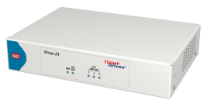

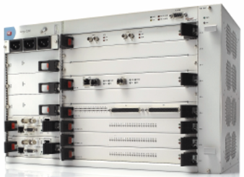


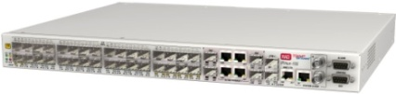
TDM Pseudowire Product Portfolio
IPmux-24
IPmux-216
Gmux-2000
IPmux-1E
IPmux-2L
IPmux-4L
IPmux-155L
Entry Level
CPE/CLE
Access/Aggregation
PoP/CO/Hub

Slide 10
TDM Pseudowire
Available Product Line
Products | TDM Service | Ethernet User Ports | Network Link | PWE Standards
MiTOP | T1/E1 or E3/T3 | SFP | SFP | CESoPSN (E1/T1 only) SAToP
IPmux-1E | FXS/FXO/E&M BRI | 1 x User | 1 UTP/Fiber Fast Ethernet | TDMoIP
IPmux-2L /4L | E1 Nx64 Serial port (only 2L) | 2 x Users | 1x FE UTP/SFP | TDMoIP CESoPSN SAToP
IPmux-24 IPmux-216 | T1/E1 | 1 x User, 1xNet/User (UTP or SFP) | 2x FE/GE, UTP/SFP | TDMoIP CESoPSN SAToP
IPmux-155L | STM-1 or E1 | 32 x FE user ports (UTP or SFP) | 4 GbE ports (UTP or SFP) with LAG | SAToP
Gmux-2000 | 196x E1/T1 or 7x C.OC-3/STM-1 or 7 x C.T3 | No user port | 2 UTP or SFP GE | TDMoIP CESoPSN SAToP

Slide 11
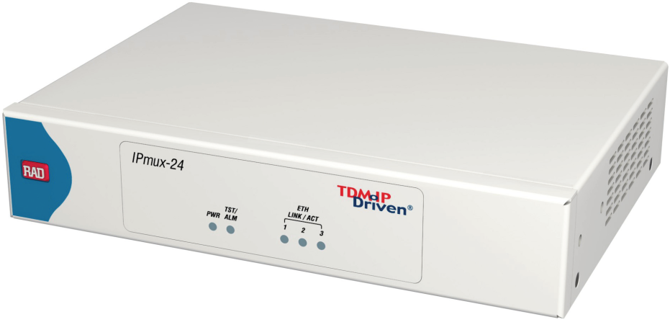
IPmux-24
TDM Pseudowire Access Gateway
TDM Ports
Power Inlet
Terminal craft port
3x Auto-FE/GE SFP Ports
EXT CLK, Alarm relay
Supports TDM, HDLC-based and Ethernet services over Ethernet, MPLS or IP networks with pseudowire technology
Ideal solution for mobile backhaul, PSTN access and TDM trunking
Provides cost-effective solution for converging new and legacy services over packet infrastructure

Slide 12
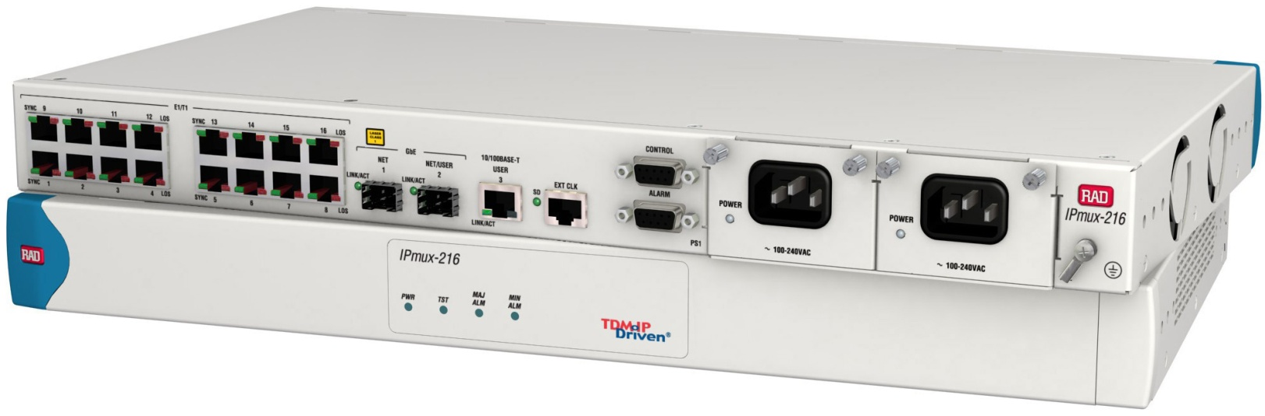
IPmux-216
TDM Pseudowire Access Gateway
16 x E1/T1 ports
3x GbE/FE Ports
External Clock Port
Terminal craft port, Alarm relay
2xAC, 2xDC, AC/DC PSU
Supports TDM, HDLC-based and Ethernet services over Ethernet, MPLS or IP networks with pseudowire technology
Ideal solution for mobile backhaul, PSTN access and TDM trunking
Provides cost-effective solution for converging new and legacy services over packet infrastructure

Slide 13
Version 3.5 - Additional Features
SNTP protocol to get the time and date from a SNTP server
Standard Ethernet ring based on G.8032
Standard PW bundle numbering

Slide 14
New Features in this Release
Feature | Description | Customer Benefits
New: Giga Ethernet Ring G.8032 | Ring has up to 16 nodes, with sub‑50 ms switching time Ring control messages run over a dedicated reserved VLAN Stand-by ports on the ring prevent broadcast storms and loops If ring failure is detected, the standby ports become operational for automatic fault recovery | High resiliency Easy replacement of obsolete SDH access ring without fiber re-layout
New: SNTP | Protocol for retrieving time and date from an SNTP server | Operators need all their units in the network to have one clock to track problems on the network (alarm time-stamping). Drifting of the clock prevents accurate troubleshooting. The operator needs to program the clock on each installation of a new device in the network Each time the clock is changed to daylight saving time the operator needs to update all stations.
New: Standard PW bundle numbering | Standard CESoPSN and SAToP UDP/IP PW bundle numbering | Allows interoperability with 3rd party

Slide 15
Features Details

Slide 16
Recent Releases
IPmux-24/216 Version 1.5 /1.6 and 2.1
  SNMPv3
  Adaptive-adaptive clocking mode
  MEF-8 implementation
  802.3ad LAG (for link redundancy)
  Dual homing
  802.1ag and Y.1731 Ethernet OAM
  802.3ah
  PW redundancy (1+1, 1:1)

Slide 17
Legacy Services
TDM Service
  4 framed or unframed E1 with CAS and CCS signaling and up to 63 DS0 (timeslot) bundles
  Fully transparent emulation of TDM circuit
  Conforms to G.823/4 jitter and wander requirements
  Pseudowire support in unframed/framed mode: SAToP, CESoPSN and TDMoIP
Pseudowire Features
  Encapsulation: UDP/IP, MPLS, MEF 8
  Pseudowire OAM: RAD proprietary OAM protocol
  Up to 64 pseudowires supported

Slide 18
Pseudowire Technology
Complies with leading pseudowire standards
  TDMoIP/RFC5087 and CESoPSN/RFC5086 – for structured TDM service
  TDMoIP/RFC5087 or SAToP/RFC4553 – for unstructured TDM service
  HDLCoPSN / RFC4618 – for HDLC-based services
Supports packet networks as transport
  IP – Each pseudowire is assigned a destination IP address
  MPLS – Each pseudowire is statically assigned an MPLS label
  Ethernet – Each pseudowire is assigned per MEF8
Performance and flexibility
  Minimum of intrinsic delay with ASIC based architecture
  Up to 480 concurrent pseudowires with TDM DS0 level grooming
  Each pseudowire can be assigned any number of timeslots (bundles)
  Pseudowires are individually configured for TDMoIP, CESoPSN, SAToP or HDLCoPSN
Notes:
18

Slide 19
Clock Recovery and Timing
Timing
  TDM ports can be configured for timing as any standard TDM device
    LBT – Loopback timing
    Internal – Using the IPmux-4L internal oscillator
    External – Using a dedicated clock port with external clock source
Adaptive Clock Recovery
  Remote IPmux units can recover the original transmitting clock over the packet network with great accuracy
  Independent clock recovery mechanism per TDM port
  16 ppb frequency accuracy with 1 ppb/day holdover for cellular backhaul
  G.823/G.824 synchronization mask for high quality E1 circuit
  G.8261 synchronization over packet networks conformant

Slide 20
Switching and Bridging
Working modes:
  VLAN-unaware bridging
  VLAN-aware bridging (802.1Q and 802.1p)
MAC entries: 8K
Static and/or dynamic learning
Frame support up to 2048 bytes
Transparent to all Ethernet control protocols except
  Flow control can be peered or discarded
Passive mode of link layer OAM (802.3ah), responds to loopback requests

Slide 21
QoS – Traffic Classification and Prioritization
Rate Limitation: A means to provide CIR
  Per subscriber port
Classification: Distinguish between classes of service
  Physical port
  P bit
  DSCP/ToS
Mapping and Queuing
  4 queues per port, for 4 classes of service (CoS) according to strict priority or HQP+WRR
  SP+WRR gets a priority: 3
  Strict priority; packets are transmitted according to queue priority 0, 1, 2

Slide 22




Resilient Ethernet Ring
n x E1 or
C.STM-1
Ethernet
TDM
E1
PSN
Gmux-2000
IPmux-155L
IPmux-155L
GbE Ring
IPmux-155L
E1
Target Customers:
Telecoms, incumbent and alternative, selling TDM over PSN services to enterprises and to cellular operators
Benefits:
High resiliency
Easy replacement of obsolete SONET access ring without fiber re-layout
Ethernet
Notes:
22

Slide 23

PWE OAM Connectivity Verification
Challenge:
PSN networks have no inherent connectivity verification mechanism between two end points
Solution:
Provide path fault detection for an emulated PW over PSN
Detect faults occurring on the remote end in order to prevent IP/ETH network flooding
Needed for E2E redundancy mechanisms

Slide 24
TDM PW – TDMoIP OAM*
TDM PWs generate constant traffic over the PSN (regardless of the TDM traffic)
Therefore, no need for “keep-alive” messages during steady state
During device failure condition, traffic transmission must be stopped to prevent PSN flooding
The PW GW initiates “keep alive” messages based on TDMoIP OAM protocol when a failure is detected
Wait 10 sec
Failure
5 OAM messages
PW
PSN
PW-GW
PW-GW
Wait 2 sec for an answer
and then stop transmission
* TDMoIP OAM – RAD’s proprietary Operation Administration and Maintenance protocol

Slide 25
CESoETH (MEF-8) Support
TDM encapsulation method for framed and unframed E1 according to MEF-8
Benefits
  Supporting efficient TDM PW connectivity over pure Metro Ethernet (L2) networks
  Enhanced interoperability with remote TDM PW gateways from other vendors
Notes:
25

Slide 26


Management
RADview-EMS is a unified carrier-class management platform for
RAD devices using a variety of access channels,
such as SNMPv1/3, HTTP/S, TFTP and Telnet/SSH.
In addition, it features third-party device monitoring capabilities
Broad Perspective. Direct Control.

Slide 27
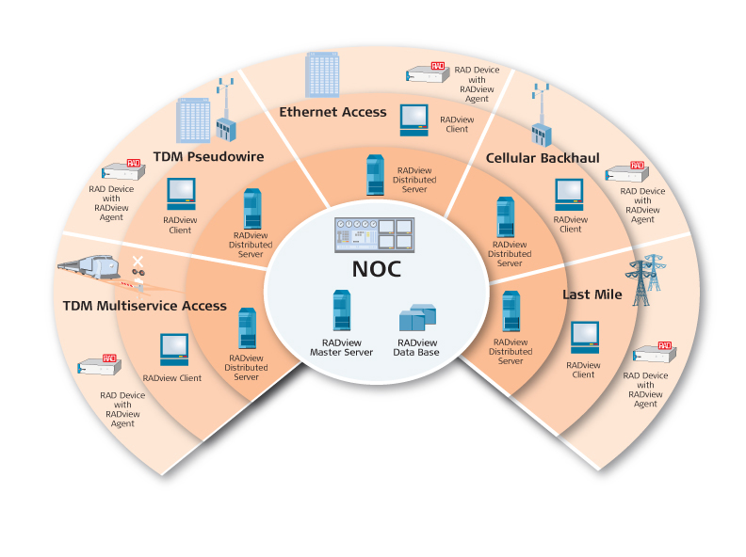
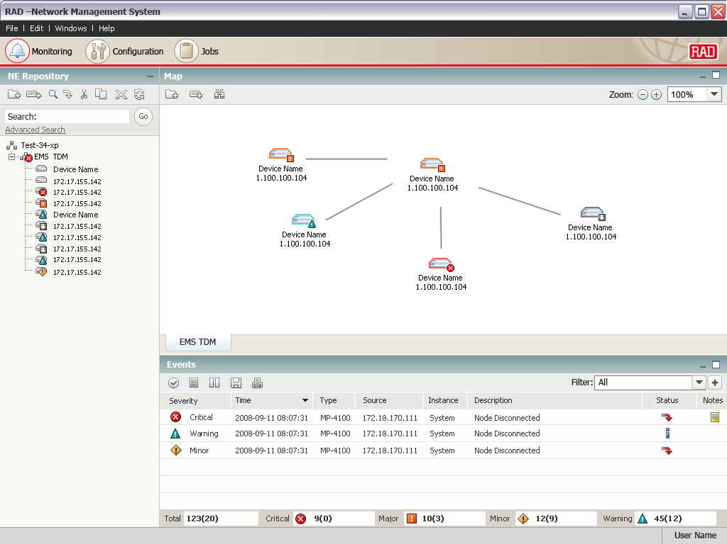
Management, Benefits & Features
Benefits
Turnkey system including hardware and software!
Fully compliant with TMN standards
Client/server architecture with multi-user support
Interoperable with third-party NMS and leading OSS systems
IBM Tivoli’s Netcool®/OMNIbus™ plug-in
Minimize integrations costs associated with new NE additions
Key features
Ensures device health and congestion control
Topology maps and network inventory
Advanced FCAPS functionality
Software and configuration management
Business continuity – high-availability and disaster recovery
Handover between operators

Slide 28

Device Management
RAD products support the following management capabilities
Device Management
SNTP
CLI/menu-driven terminal
TFTP
SNMP v1 and SNMP v2c
Statistics collection
Out-of-band management port
In-band management

Slide 29
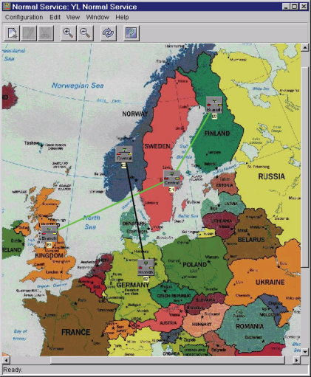
RADview-SC/TDMoIP
Network Management System for Pseudowire Applications
    Easy configuration of the IPmux and Gmux TDM pseudowire gateways
    Effortless end-to-end provisioning of TDM and HDLC pseudowire connections
    Centralized management of TDM pseudowire services
    Intuitive GUI for discovery and status indication of pseudowire connections
    Client-server architecture with northbound CORBA interface for easy integration with 3rd party systems

Slide 30
Market Overview

Slide 31
Target Customers
Enterprises, government and public institutions
  Preserving investment in legacy TDM equipment
  Reducing monthly transport cost
Carriers
  Alternative carriers can increase revenue by selling TDM services
  Incumbents can reduce OpEx – one transport network

Slide 32
Market Trends
Growing availability of PSN with QoS and traffic engineering in the WAN
Growing fiber deployment to the Business (xPON)
Incumbents are pressed to reduce OpEx and evaluating TDM PW
Standardization
RAD is considered the market leader in TDM PW, with best of breed PW gateways (70% of the market)

Slide 33
Summary
TDM PW – Value Proposition
Saves money
  Preserves investment in legacy equipment in migration to PSN
  Lowers OpEx of TDM service by utilizing packet infrastructure
  Simple configuration
Carrier-grade TDM voice or data
  Highly accurate clock recovery
  OAM, NMS and security capabilities
Transparency
  No compression, no silence suppression
Uniform TDM access
  All first mile infrastructure types are supported
Standardized solution
Over 110,000 TDMoIP ports installed since 2000
Over 50,000 TDMoIP ports installed alone in the last two years

Slide 34
TDM PW
Success Stories

Slide 35







PSTN Access over Packet - QSC, Germany
Customer Benefits:
Cost efficient backhaul over PSN
  Replacing expensive leased STM-1 link
OpEx reduction
  No local maintenance team for remote PABX
Enables competitive long distance phone service
RAD Advantages:
Proven experience in TDM over IP deployments
Remote
Voice Switch
IPmux-14
4 E1
FE
ADM
Gmux-2000
Remote
Voice Switch
IPmux-14
4 E1
SDH
STM-16
STM-1
GbE
IP
FE
ADM
Remote
Voice Switch
IPmux-14
4 E1
FE
E1’s
PSTN

Slide 36

Bank Application in UK- STM-1 Trunking over PSN
Customer Benefits:
Offering TDM services with low transport cost
RAD Advantage:
High port density and best price per port
Production Systems
Turret Connections
Gmux-2000
Gmux-2000
196 x E1
GbE
GbE
196 x E1
MPLS
GbE
196 x E1
Gmux-2000
Back-up Systems

Slide 37



North American Cable MSO Mobile Backhaul Application
Benefits
Multiple mobile operators per tower, each adaptively timed from own source
Network reliability and redundancy with sub 50ms failover
“Important considerations were T1 density, Ethernet switching, fiber interfaces and reliable long term partner,” Major Cable MSO
Mobile Operator A
Transport Provider
T1s
OC-3
GE
Gmux
IPmux-16
BSC
Fiber
T1s
Metro Ethernet
MPLS
Mobile Operator B
IPmux-16
OC-3
Multiple Towers
Multiple Operators Per Tower
Gmux
GE
T1s
BSC
Fiber
IPmux-16

Slide 38
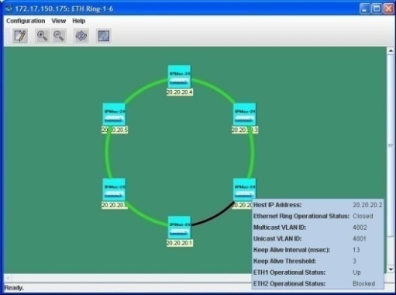






Promitel –Cellular Backhauling for TIGO Colombia
Customer Benefits:
High resiliency
Re-use of obsolete SDH access ring
  Without fiber re-layout
RAD Advantage:
Up to 16 nodes in a ring, with
sub 50ms switching time
BSC
Gmux-2000
E1
n x E1/
STM-1
Metro Ethernet
MPLS
IPmux-24
E1
IPmux-24
GbE Ring
IPmux-24
IPmux-24
E1

Slide 39




Leased Lines over GPON – Latin America
Customer Benefits:
Offering TDM services over PON infrastructure
RAD Advantage:
Multiple clock domains
Very low intrinsic delay (ASIC based)
ONT
PBX
FE
IPmux-216
n x E1
Gmux-2000
OLT
GbE
Passive Splitter
n x E1/T1 or
C.STM-1
PSTN
ONT
IPmux-24
PBX
FE
n x E1

