Slide 1
TDM Pseudowire Gateways
Product Presentation
Updated: 22-Nov-2011

Slide 2
Outline
Introduction to Pseudowire/TDMoIP
Market, Customers
RAD’s TDM Pseudowire Product Line
IPmux-L Product Family:
  IPmux-2L & 4L (v1.x)
  IPmux-4LGE (v2.0)
  IPmux-16L (v1.0B)
  IPmux-155L (v2.1)
  Common Features
Typical Applications
Success Stories
Value Proposition

Slide 3




RAD Products Strategy
Access That Lasts
Services/CPE
Access
Networks
Legacy Services Existing Equipment
ATM DSLAM
Legacy
Networks
SONET/SDH, ATM
2G BTS
3G NodeB
Legacy
Serial
New Services and Equipment
New
New
Packet-Switched
Networks
Ethernet, IP/MPLS
IP DSLAM
IP RAN
4G eNodeB
Ethernet
Continued support of legacy services and traffic over legacy networks
Legacy services and traffic over NGN - Ethernet/MPLS/IP infrastructures
New IP/Ethernet services over existing (PDH/SDH/ATM) networks
Carrier Ethernet access and aggregation for NGN

Slide 4


What is TDM Pseudowire?
Pseudo = Simulated, Seemingly
Protocol for extending TDM circuits over Packet Switched Networks (PSN)
The PSN can be ETH, IP or MPLS
Supports voice, data and video
Provides a transparent tunnel through the PSN
Provides clock distribution and synchronization over PSN
PW Tunnel #1
PW Tunnel #2
PSN
CE
GW
GW
CE
TDM
TDM
Legacy Service
Pseudowire Emulation
Legacy Service
Notes:
Challenges:
Throughput and Delay
Controlling the PW bandwidth utilization and delay
Fault Propagation
Forwarding alarms between the native TDM network and the PSN
Synchronization and Clock Distribution
Enabling recovery of the TDM clock across packet networks
PSN Quality of Service
Maintaining QoS for TDM services over the PSN

Slide 5
How Does TDM PW Work?
TDM
Frame
Ethernet/IP Packets
TDM
Frame
Ethernet/IP Packets
Packet
Switched
Network
The synchronous bit stream is segmented
Headers are added to each segment to form the Packet
Packets are forwarded to destination over the PSN network
At destination, the original bit stream is reconstructed by removing headers, concatenating frames and regenerating the timing

Slide 6


TDM Pseudowire – Main Benefits
Carrier-grade TDM voice or data over packet networks
Uniform TDM access across all first mile infrastructure types
Preserves investment in legacy equipment in migration to PSN
Lowers OpEx of TDM service by utilizing packet infrastructure
Carrier-grade voice quality (no compression, no silence suppression)
POP/HUB/CO
TDM
Service
CE
Last Mile
PE
Packet
Network
PE
TDM
Service
Pseudowire

Slide 7





TDM PW – Typical Application
Application: Carrying PBX traffic over Ethernet network
Benefits:
  Using existing Ethernet infrastructure to provide voice services
  Saves leased line costs
  Preserving legacy TDM equipment, features and functionalities
Site/Building 1
Site/Building 2
PBX
PBX
Leased Line
E1/T1
E1/T1
GbE
LAN
LAN

Slide 8
TDM PW – Main Challenges
Throughput and Delay
  Controlling the PW bandwidth utilization and delay
Fault Propagation
  Forwarding alarms between the native TDM network and the PSN
Synchronization and Clock Distribution
  Enabling recovery of the TDM clock across packet networks
PSN Quality of Service
  Maintaining QoS for TDM services over the PSN
Notes:
Additional techynological challenges:
- Attenuate Packet Delay (Latency) and Packet Delay Variation (PDV)
Packet networks create latency, and more important - PDV
- Resistance to Frame Loss and Re-sequencing
Packet networks experience loss and mis-order of frames, resulting in possible disruption of the TDM service

Slide 9
Market Trends
Growing availability of PSN with QoS and traffic engineering in the WAN
Increase in fiber deployment to the business
TDM PWE standards well established (not an emerging technology anymore)
Carriers pressed to reduce OpEx of legacy leased line service:
  Use TDM PWE to migrate LL to packet infrastructure
  Or terminate the legacy LL service (in this case end-customers may adopt TDM PWE in order to preserve legacy PBXs)
3G driving mobile transport network to packet, making TDM PWE natural choice for 2G/3G co-location
RAD market leader with best of breed TDM PW gateways

Slide 10

Customer Benefits
For the enterprise/government end user
  Preserving investment in legacy TDM equipment
  Reducing transport costs
For the carrier end user
  Alternative carriers can increase revenue by selling TDM services
  Reducing OpEx – one transport network
  Standards based
  TDM over packet using any access method

Slide 11

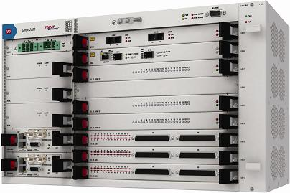
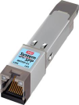
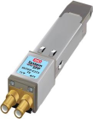
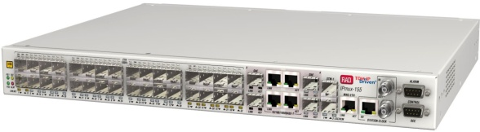

RAD Advantages
Long term experience and market leader in TDM pseudowire – since 1999
Variety of emulated services and interfaces: E1/T1, serial, analog/digital voice
Comprehensive pseudowire functionality
Most advanced synchronization capabilities
Full solution: remote and aggregation devices

Slide 12
RAD’s TDM PW Product Line

Slide 13









IPmux/Gmux Solutions Overview
Legacy Migration over Packet Networks
RADview
SHDSL.bis;
EFM
Aggregation
LA-210/PWE
E1/T1
UP TO:
196 T1/E1,
7 Ch.DS3,
7 Ch.OC-3/STM-1
2 x Fast Ethernet
Gmux-2000
IPmux-1E
GbE
4 FXS/FXO/
E&M/BRI
PSTN
PDH
SDH/
SONET
Ethernet,
IP or MPLS
Network
IPmux-2L/4L
FE
Serial 1, 2 or 4 E1
2 x Fast Ethernet
IPmux-155L
IPmux-24
1, 2 or 4 E1/T1
GbE
P2P
Fiber, xDSL, Wireless,
DS3 or OC3 (via MiRIC)
2 x FE / GE
IPmux-4LGE
4 E1
Topologies
GbE
P2P
(Link Redundancy)
4 x FE, 2 x GE
GbE
IPmux-16L
8/16 E1
Interfaces
Daisy Chain
3 x FE , 2 x GE
IPmux-216/16L
8/16 E1/T1
GbE
Megaplex
2 x FE / GE
Ring
GbE
120 analog phones
and more…
ML-IP/MP-W

Slide 14
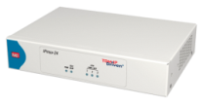

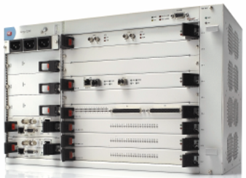

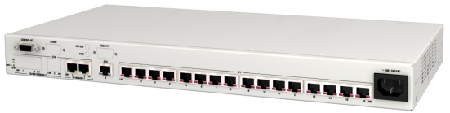

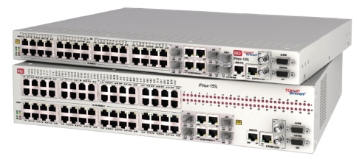

TDM Pseudowire Product Portfolio
IPmux-24
IPmux-216
Gmux-2000
IPmux-1E
IPmux-16L
IPmux-4LGE
IPmux-155L
Entry Level
IPmux-2L, 4L
CPE/CLE
Access/Aggregation
PoP/CO/Hub

Slide 15
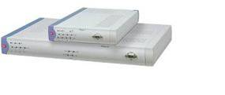






TDM Pseudowire Product Line
Product | TDM Service | Ethernet Ports | PWE Standards
MiTOP | T1/E1 or T3/E3 | 1 GbE SFP | CESoPSN (E1/T1) SAToP
IPmux-1E | FXS/FXO/E&M BRI 1 echo cancelled T1/E1 | 1 FE (user) 1 FE (net) | TDMoIP
IPmux-2L/4L | 1/2/4* E1 + Serial (Nx64k)** *IPmux-4L only **IPmux-2L only | 3 FE (user/net) 2 UTP + 1 SFP (or 3 UTP - IPmux-4L only) | CESoPSN SAToP TDMoIP
IPmux-4LGE | 4 E1 | 4 FE + 1 or 3 GbE (user/net)
IPmux-16L | 8/16 E1 | 3 FE + 3 GE (user/net)
IPmux-24 | 1/2/4 T1/E1 | 3 FE or GbE (1 user, 1 user/net, 1 net)
IPmux-216 | 8/16 T1/E1
IPmux-155L | 1+1 Ch.STM-1 or 32 E1 | 4 GE (combo UTP+SFP, user/net) 32 FE (UTP or SFP, optional)
Gmux-2000 | 196 x T1/E1 ports or 7x Ch.OC-3/Ch. STM-1 or 7 x C.T3 | 2 GbE (net)

Slide 16
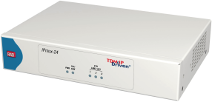
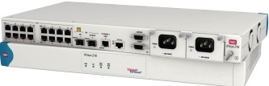
IPmux-24/216 – Product Overview
Pseudowire Access Gateways
3 x GbE/FE user and network ports
1,2,4 x E1/T1 (IPmux-24) and 8,16 x E1/T1 (IPmux-216)
TDM PW multi-standard support
Management security
Support standard G.8032 GbE Ring
EPL MEF certified
Temperature hardened

Slide 17
Gmux-2000 – Product Overview
High-Capacity Pseudowire Access Gateway
Up to 2 protected GbE ports
Up to 196 x E1/T1 ports
Up to 7 protected channelized OC-3/STM-1 ports (ver 4.0)
Up to 7 channelized T3 ports
TDM PW multi-standard support
Management security
GbE module redundancy
1:N module redundancy

Slide 18

MiTOP Pseudowire SFP
Common Features
TDM circuit emulation over packet-switched networks (PSN)
MPLS, MEF and UDP/IP addressing and encapsulation
QoS Marking: 802.1p (VLAN), DSCP/ToS (IP), EXP bits (MPLS)
ASIC-based architecture minimizes processing delay
Internal, loopback or adaptive clock recovery conform to G.823/824 traffic interface
Management through I2C bus or in-band via WEB browser over Ethernet
Comprehensive OAM incl. connectivity verification, PWE3 config. Mismatch, fault propagation, performance monitoring and diagnostics loopbacks and alarms
Hot-swappable with special release mechanism for easy extraction from SFP socket
Environmentally hardened option: -40 to 80°C case temperature
MiTOP-T1E1
  SAToP (RFC 4553) and CESoPSN (RFC 5086) payload Encapsulation
  Supports standard T1/E1 interfaces:
G.703/704 framed/unframed modes
SF and ESF framing (T1).
  Jitter buffer (0.5 – 256ms)
MiTOP-T3E3
  SAToP (RFC 4553) payload Encapsulation
  Supports standard T3/E3 interfaces:
B3ZS, AMI (T3) & HDB3 (E3) line codes
M23, C-bit framing (T3).
  Jitter buffer (0.2 – 45ms)
Notes:
18
Here we show a few of RAD’s popular Pseudowire gateways that we will using in the next few solution slides.
On the left hand side…
On the right hand side…

Slide 19
IPmux-2L, 4L, 4LGE

Slide 20

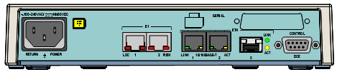
IPmux-2L, IPmux-4L (FE)
TDM Pseudowire Access Gateway
Compact 1U, ½19” plastic enclosure
Serial user data port (optional, IPmux-2L only)
Control port
Wide-range (AC/DC) PS
E1 ports
IPmux-2L: 1 or 2 E1
IPmux-4L: 4 E1
2 x Fast Ethernet (UTP)
1 x Fast Ethernet
IPmux-2L: SFP
IPmux-4L: SFP or UTP
Main Features:
Up to 3 FE user and network ports
Up to 2/4 E1 ports plus optional serial port (V.35/V.36/RS-530/RS-232/X.21 – IPmux-2L only)
TDM PW multi-standard support
Adaptive clock recovery (advanced +16 ppb OCXO option available for IPmux-4L only)
EMS and service center management system (RV-EMS + RV-SC/TDMOIP v5.1)

Slide 21
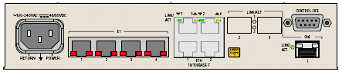
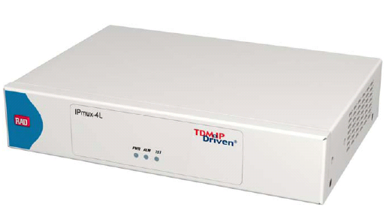
IPmux-4LGE
TDM Pseudowire Access Gateway (GbE)
Terminal Control
4 user E1
4 Fast Ethernet
1 or 3 GbE
Main Features:
TDM User: 4 E1 ports
Ethernet User/Net (S/W configurable):
  4 FE UTP ports
  1 or 3 GbE UTP/SFP ports (ordering option)
Pseudowire Encapsulation: All standards supported (SAToP, CESoPSN, TDMoIP)
Advanced clock recovery (OCXO): Available by ordering option
Ethernet Ring Protection: G.8032 standard protocol supported
Management: EMS + Service Center (from RV-SC/TDMoIP v5.1)
Power Supply: internal, wide-range AC/DC
Enclosure: compact 1U, ½19”, metal
Note: IPmux-4LGE introduces GbE capabilities, while the previous IPmux-4L version 1.x remains available for Fast Ethernet-only applications

Slide 22
IPmux-4LGE
New Features in v2.0
Feature | Description | Customer Benefits
New: GbE/FE Interfaces | 1 or 3 GbE ports (SFP/UTP) 4 Fast Ethernet ports (UTP) All ports may serve as either network or user traffic ports (software configuration) | Flexibility of user and network equipment: GbE/FE, SFP/UTP Port versatility: support different customer-network topologies
New: Ethernet Ring Protection (G.8032) | Up to 16 nodes in a ring Sub-50ms traffic switching (fiber) Ring control messages run over a dedicated reserved VLAN Broadcast storms and loops are prevented by blocking standby ports on the ring, and activating them only when detecting a ring failure | High resiliency, standard protocol Easy replacement of obsolete SDH access Ring topology without deploying new fiber

Slide 23
IPmux-4LGE
New Features in v2.0 (cont.)
Feature | Description | Customer Benefits
New: SNTP | Simple Network Time Protocol support for retrieving time & date from an SNTP server | Network-wide time reference for effective troubleshooting No need for manual time configuration of each new device on the network Centralized management of daylight saving time changes
New: Net Inventory | Net inventory support per RFC-4133 | Device inventory management via RADview or any other RFC-4133 compliant NMS/OSS
New: Dying Gasp | SNMP trap sent is sent to management station upon power failure | Allows network operator to monitor and take immediate action in the event of site/device power failures
New: Syslog | Alarms may be sent to a remote Syslog server | Easy integration into a standard centralized alarm logging system

Slide 24
IPmux-4LGE
Main Features
Feature | Description | Customer Benefits
Multi-standard TDM Pseudowire ASIC Processor | Supports all types of TDM Pseudowire standards in the market Minimal processing delay | Optimized hardware-based pseudowire and synchronization performance
Pseudowire Capacity | 64 PW connections | Point-to-multipoint topology with up to 64 remote pseudowire gateways
Advanced Adaptive Clock Recovery | High quality TDM service under changing network loads | New Adaptive Clock Recovery algorithm, greatly improving the ability to maintain high accuracy synchronization
Packet re-ordering | Increased resiliency to misordered packets | Ability to operate under dynamic IP network conditions
Ethernet Switching and Bridging | 802.1D switching (VLAN unaware) 802.1Q switching (VLAN aware) 802.1QinQ (VLAN stacking) | Flexible bridging configuration supporting any Layer 2 network

Slide 25
IPmux-4LGE
Main Features (cont.)
Feature | Description | Customer Benefits
Individual TDM Pseudowire Configuration | Each pseudowire can be configured individually as TDMoIP, CESoPSN or SAToP | Service granularity for point-to-multipoint applications
Bundle Granularity | Each E1 may be split into up to 16 different PW connections | Different timeslots or groups of timeslots can be assigned with different QoS profiles in the packet-switched network Channel granularity in point-to-multipoint topologies
TDM Pseudowire OAM Connectivity | OAM connectivity for detecting a valid connection with remote IPmux | Ensures traffic continuity Prevents network traffic load in case of connectivity loss
Network Management | Supported by RADview-EMS | User-friendly device management and TDM pseudowire provisioning

Slide 26


Feature Comparison
IPmux-2L/4L vs. IPmux-24
Feature | IPmux-24 (v3.5) | IPmux-2L, 4L (v1.x) | IPmux-4LGE
E1/T1 ports | 1,2,4 E1 or T1 | 1,2,4 E1 | 4 E1
Net/User Ethernet ports | 3 GbE or 3 FE | 3 FE | 4 FE + 1 or 3 GbE
MEF-14, MEF-9 (EPL), OAM-CFM (802.1ag/Y.1731), Link OAM (802.3ah) | + | - | -
Advanced clock recovery option (OCXO) | + | + (4L only) | +
Temperature hardened option | + | - | + ***
Metal enclosure | + | - | +
Real-time clock, alarm port, external clock | + | - | -
G.8032 Ethernet Ring Protection | + | - | +
Serial port (Nx64k, X.21/V.35/V.36/V.24) | - | + (2L only) | -
Uplink port redundancy (802.3ad-LAG) | + | - | -
Pseudowire redundancy | + | - | -
Management | RV-SC/TDMOIP; RV-EMS* SNMPv3 | RV-SC/TDMOIP**; RV-EMS SNMPv1/v2c | RV-SC/TDMOIP**; RV-EMS SNMPv1/v2c
SSH, SSL, RADIUS | + | - | -
Syslog | + | - | +
*Basic shelf-view support
**RV-SC/TDMOIP ver 5.1
***available per project

Slide 27
IPmux-16L

Slide 28
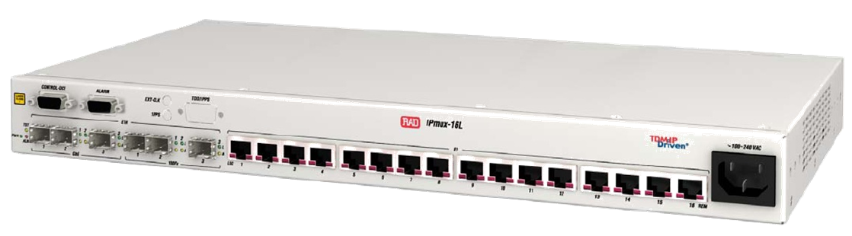
IPmux-16L (v1.0B)
TDM Pseudowire Access/Aggregation Gateway
Terminal Control
Alarm Relay
3 GbE
(UTP or SFP)
3 Fast Ethernet
(UTP or SFP)
8 or 16 user E1
Main Features:
TDM User: 8/16 E1 ports (ordering option)
Ethernet User/Net (S/W configurable): up to 6 ports (3 FE + 3 GbE, SFP/UTP - ordering option)
Pseudowire Encapsulation: All standards supported (SAToP, CESoPSN, TDMoIP)
Advanced clock recovery (OCXO): Available (ordering option)
Ethernet Ring Protection: G.8032 standard protocol supported
Management: EMS-based
Enclosure: 1U, 19”, metal

Slide 29
IPmux-16L (v1.0B)
Main Features
Feature | Description | Customer Benefits
Multi-standard TDM Pseudowire ASIC Processor | Supports all types of TDM Pseudowire standards in the market Minimal processing delay | Optimized hardware-based pseudowire and synchronization performance
Pseudowire Capacity | 256 PW connections | Point-to-multipoint topology with up to 256 remote pseudowire gateways
Advanced Adaptive Clock Recovery | High quality TDM service under changing network loads | New Adaptive Clock Recovery algorithm, greatly improving the ability to maintain high accuracy synchronization
Packet re-ordering | Increased resiliency to misordered packets | Ability to operate under dynamic IP network conditions
Ethernet Switching and Bridging | 802.1D switching (VLAN unaware) 802.1Q switching (VLAN aware) 802.1QinQ (VLAN stacking) | Flexible bridging configuration supporting any Layer 2 network
New: Ethernet Ring Protection (G.8032) | Up to 16 nodes in a ring Sub-50ms traffic switching (fiber) Ring control messages run over a dedicated reserved VLAN Broadcast storms and loops are prevented by blocking standby ports on the ring, and activating them only upon ring failure | High resiliency, standard protocol Easy replacement of obsolete SDH access Ring topology using existing fiber

Slide 30
IPmux-16L (v1.0B)
Main Features (cont.)
Feature | Description | Customer Benefits
Individual TDM Pseudowire Configuration | Each pseudowire can be configured individually as TDMoIP, CESoPSN or SAToP | Service granularity for point-to-multipoint applications
Bundle Granularity | Each E1 may be split into up to 16 different PW connections | Different timeslots or groups of timeslots can be assigned with different QoS profiles in the packet-switched network Channel granularity in point-to-multipoint topologies
TDM Pseudowire OAM Connectivity | OAM connectivity for detecting a valid connection with remote IPmux | Ensures traffic continuity Prevents network traffic load in case of connectivity loss
Network Management | Supported by RADview-EMS | User-friendly device management and TDM pseudowire provisioning
SNTP | Simple Network Time Protocol support for retrieving time & date from an SNTP server | Network-wide time reference for troubleshooting No need for manual time configuration of each new device Centralized DST management

Slide 31


Feature Comparison
IPmux-16L vs. IPmux-216
Feature | IPmux-216 (v3.5) | IPmux-16L (v1.0B)
E1/T1 ports | 8/16, E1 or T1 | 8/16, E1 only
Ethernet ports | 3 GbE | 3 GbE / 3 FE / 3GbE + 3 FE
GbE support | + | +
MEF-14, MEF-9 (EPL), OAM-CFM (802.1ag/Y.1731), Link OAM (802.3ah) | + | -
Advanced clock recovery option (OCXO) | + | +
Temperature hardened option | + | -
Redundant power supply | + | -
+24VDC option | + | -
Real-time clock, external clock port | + | -
Alarms relay port | + | +
G.8032 Ethernet Ring Protection | + | +
Uplink port redundancy (802.3ad-LAG) | + | -
Bundle redundancy | + | -
NMS | RV-SC/TDMOIP; RV-EMS* SNMPv3 | RV-SC/TDMOIP**; RV-EMS SNMPv1/v2c
SSH, SSL, RADIUS | + | -
*Basic shelf-view support
**RV-SC/TDMOIP ver 5.1

Slide 32
IPmux-155L

Slide 33
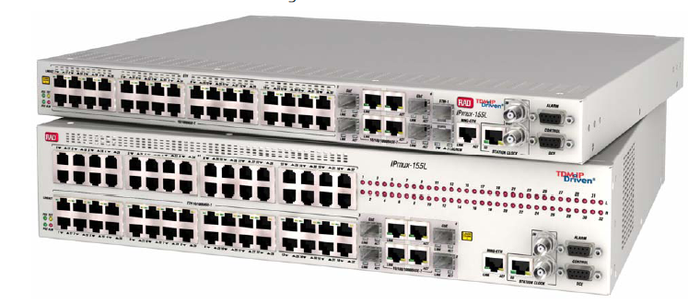
IPmux-155L (v2.1)
STM-1 ports
(1+1)
Station clock (in/out)
Alarm relay
32 FE
UTP or SFP
STM-1 Option
Optional:
32 Fast Ethernet
UTP or SFP
E1 Option
32 E1 ports
4 GbE
Combo UTP/SFP
Control Port
MNG-ETH
Hub-site Pseudowire Access Gateway (“Mini-Gmux”)
32 FE user ports (UTP or SFP)
4 GbE network ports (combo UTP+SFP) with LAG
1+1 channelized STM-1 ports or 32 E1 ports
Multi-standard PW support: SAToP, CESoPSN and TDMoIP
EMS based management (RV-SC/TDMOIP support from v5.1)
1U/2U (STM-1/32E1), 19” enclosure (300mm depth), hot-swappable power supply & fan modules

Slide 34




IPmux-155L Multi-Service Solution over Fiber in the Last Mile
IPmux
FE
E1
POP/CO
ETH
E1
IPmux
FE/GbE
4 x GbE
IPmux-155L
Fiber
ETH
PSN
Fiber
1+1 STM-1
IPmux
E1
FE
ETH
SDH
Benefits:
Reduce Opex/Capex by Multiservice aggregation device at the PoP
Both E1 and Eth services over single Fiber
Complete Last Mile solution
Economical, compact and high port density TDM gateway
Eliminates the need for extra Ethernet switch

Slide 35




IPmux-155L STM-1 Trunking Application
PBX
IPmux-155L
IPmux-155L
SDH
STM-1
GbE
PSN
GbE
STM-1
PSTN
Class 5 Switch
Benefits:
Save on STM-1 leased line cost
Small footprint and low power consumption
Redundancy with 1+1 STM-1 and GE LAG

Slide 36




IPmux-155L
Aggregation Switch
IPmux-155 Aggregation Switch
Mobile
Operator
Gmux
IPmux
CT3/OC3
CSTM-1
Carrier Ethernet
MPLS
FE
E1/T1
MSC
IPmux
ETH
FE
E1/T1
ETH
GbE
(LAG)
IPmux-155L
IPmux
FE
E1/T1
ETH
Enterprise HQ
FE/GbE
G.8032 GbE Ring
(Sub 50ms failover)
T1/E1
ETH
IPmux
T1/E1
nxE1/T1
ETH
Benefits
Compact aggregator for GbE ring (G.8032) and FE fiber connections
Ideal for small POPs with 802.3ad (LAG) connections to PE
Eliminates the need for extra Ethernet switch

Slide 37
Main Features
Feature | Description | Customer Benefits
Standard PWE | Supported Pseudowire encapsulation standards: SAToP , CESoPSN and TDMoIP PSN type: UDP/IP, MPLS, Ethernet (MEF-8) PW OAM: RAD proprietary protocol | Multi-standard interoperability for both framed and unframed applications TDM PW support over Metro Ethernet connections (L2)
E1 Interfaces | New ordering option: 32 E1 interfaces (32 balanced RJ-45 connectors or single high-density 160-pin connector with optional external patch panel) Transports up to 32 E1s over a packet-switched network | TDM interface flexibility
Channelized STM-1 Ports | 1+1 channelized TM-1 ports (SFP) | Port redundancy
GbE Network Ports | 4 GbE network ports (UTP/SFP Combo) 802.3ad compliant link aggregation (LAG), with/without LACP | Network ports resilience
Fast Ethernet Network/User Ports | Optional ordering option: 32 Fast Ethernet ports (SFP or RJ-45) VLAN support: 802.1Q, 4k entries, port-based, double tagging Programmable Broadcast, Multicast, and Unknown Unicast storm control | Connectivity to remote PW gateways (e.g. IPmux over dedicated fiber/copper interfaces Co-location of Ethernet and TDM services Save on external Ethernet switch

Slide 38
Main Features
Feature | Description | Customer Benefits
Ethernet Ring Protection (G.8032) | Up to 16 nodes in a ring, with sub-50ms switching Ring control messages run over a dedicated reserved VLAN Broadcast storms and loops are prevented by blocking standby ports on the ring, and activating them only when detecting a ring failure | High resiliency, standard protocol Easy replacement of obsolete SDH access Ring topology using existing
802.3ah OAM | Ethernet link OAM based on 802.3ah (IEEE 802.3-2005) | Conformity with other network equipment Passive link layer OAM, responds to loopback requests
Pseudowire Capacity | 480 PW connections | Point-to-multipoint topology with up to 480 remote pseudowire gateways
Timing Options | External input/output BITS station clock interfaces (RJ-45 and BNC connectors) Adaptive clock recovery (per E1) System Clock from STM-1/E1, GbE (Sync-E), external clock input or remote CPE E1 service | Flexibility to support different clock synchronization schemes

Slide 39
Gmux-2000 vs. IPmux-155L Comparison Table
Feature | Gmux-2000 | IPmux-155L
E1/T1 ports | 196 x E1/T1 | 32 x E1
GbE ports | 2+2 (SFP) | 4 (Combo)
Ch. STM-1/OC-3 | 7 (ver. 4.0) | 1+1
Ch.T3 ports | 7 | None* (*T3 supported via MiRIC/MiTOP; full integration with MiRIC-T3(FE) v2.5)
FE user port aggregation | None | 32
LAG (802.3ad) | + (between ports/modules, without LACP) | + (with/without LACP)
Hardware Redundancy | Full (all HW modules can be protected) | Partial (PS & fan hot swap)
CESoPSN/SAToP/TDMoIP/ CESoETH encapsulations | + | +
RV-EMS, RV-SC/TDMOIP | + (RV-EMS: basic shelf view) | +
SSH, RADIUS, SNMPv3 | + | + (except SSH)
Chassis dimensions | 6U | 1U (SDH) / 2U (E1)

Slide 40
IPmux-155L Ordering Information
Standard configuration options:
TDM Interface | TDM Framing | Fast Ethernet Ports (in addition to default 4xGE) | Standard Configurations
Channelized STM-1 (1+1, SFP slots) | Framed VC-12 | None | IPMUX-155L/ACR/N/FR/NULL/4N
 | Unframed VC-12 | None | IPMUX-155L/ACR/N/UNFR/NULL/4N
 |  | 32 SFP slots | IPMUX-155L/ACR/N/UNFR/NULL/4N/32N
32 x E1 (balanced RJ-45) | Framed & Unfr. E1 (user configurable) | None | IPMUX-155L/ACR/NULL/32E1/4N
 |  | 32 SFP slots | IPMUX-155L/ACR/NULL/32E1/4N/32N
 |  | 32 UTP | IPMUX-155L/ACR/NULL/32E1/4N/32UTP
All of the above configurations include two AC power supply modules (incl. fans), and four combo GE network ports (UTP + SFP slot)

Slide 41
IPmux-L Product Family
Common Features

Slide 42
TDM Pseudowire
TDM Service
  4 framed or unframed E1 with CAS and CCS signaling
  Fully transparent emulation of TDM circuit
  Conforms to G.823/4 jitter and wander requirements
Pseudowire Features
  Pseudowire support unframed/framed mode: SAToP, CESoPSN and TDMoIP
  Encapsulation: UDP/IP, MPLS and TDMoIP
  Multi-pseudowires support
  Pseudowire OAM: RAD proprietary OAM protocol
TDM PWE encapsulation according to MEF-8
  Supporting efficient (smallest overhead) TDM PW encapsulation over Metro Ethernet (L2) networks
  Enhanced interoperability with remote TDM PW gateways from other vendors

Slide 43
Clock Recovery and Timing
  TDM ports can be configured for timing as any standard TDM device:
  LBT – Loopback timing
  Internal – Using the IPmux-4L internal oscillator
  External – Using a dedicated clock port with external clock source
Adaptive Clock Recovery:
  The remote IPmux units can recover the original transmitting clock over the packet network with great accuracy
  Independent clock recovery mechanism per TDM port
  16 ppb frequency accuracy with 1 ppb/day holdover for cellular backhaul
  G.823/G.824 synchronization mask for high quality E1 circuit
  G.8261 synchronization over packet networks conformant

Slide 44
Switching and Bridging
Operation modes:
  VLAN-unaware bridging
  VLAN-aware bridging (802.1Q and 802.1p)
VLAN stacking, Q-in-Q – limited for Egress port
3 X Ethernet wire speed + TDMoIP non-blocking switching capacity
Egress and ingress rate limiting
MAC table size: 1024
Static and/or dynamic learning
Frame support up to 2048 bytes

Slide 45

PWE OAM Connectivity Verification
Challenge:
Packet-switched networks have no inherent connectivity verification mechanisms between two endpoints
Solution:
Provide path fault detection for an emulated PW over PSN
Detect faults occurring on the remote end in order to prevent IP/ETH network flooding
Needed for E2E redundancy mechanisms

Slide 46
TDM PW – TDMoIP OAM*
TDM PWs generate constant traffic over the PSN (regardless of the TDM traffic)
Therefore, there is no need for “keep-alive” messages during steady state
During device failure condition, we need to stop traffic transmission in order to prevent PSN flooding
The PW GW will initiate a “keep alive” messages based on TDMoIP OAM protocol, just in case a failure was detected
Wait 10 sec
Failure
5 OAM messages
PW-GW
PW
PSN
PW-GW
Wait 2 sec for an answer,
then stop transmission
* TDMoIP OAM – RAD’s proprietary Operation Administration and Maintenance protocol

Slide 47
Support for HDLC Based Services: HDLCoPSN
HDLCoPSN encapsulation in addition to TDM encapsulation.
  Supports HDLCoMPLS or HDLCoIP (RFC 4618)
  Service configurable per bundle
HDLC data characteristics:
  Bit oriented (stuffing)
  HDLC frame must be smaller than 1468 bytes
Applications are for data or HDLC based voice:
  Port mode frame relay connecting FRAD or routers
  Transparent X.25
  Transparent PPP connecting routers or other devices
  Additional HDLC protocols: SS&, LAPB, LAPD, SDLC
Benefits:
  Support for HDLC data services over packet networks
  Bandwidth efficiency: no user traffic = no bandwidth used on network link

Slide 48


Management
RADview-EMS is a unified carrier-class management platform for RAD devices using a variety of access channels as SNMPv1/3, HTTP/S, TFTP and Telnet/SSH. In addition, it features third-party device monitoring capabilities
Broad Perspective. Direct Control.

Slide 49
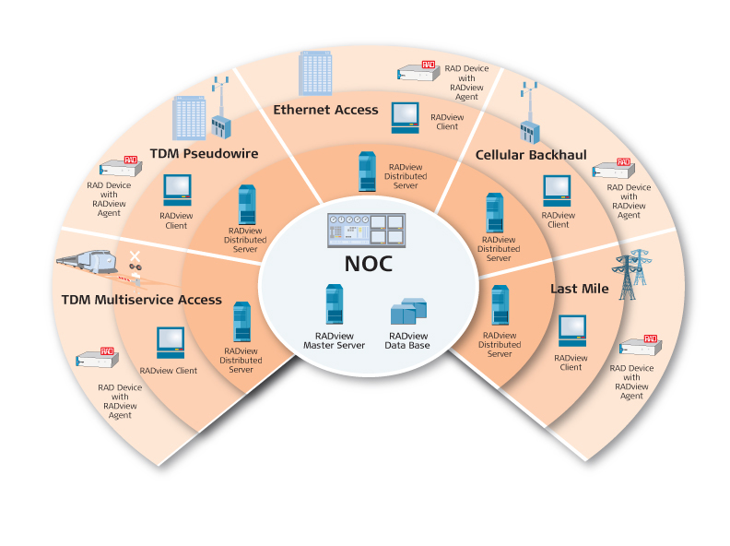
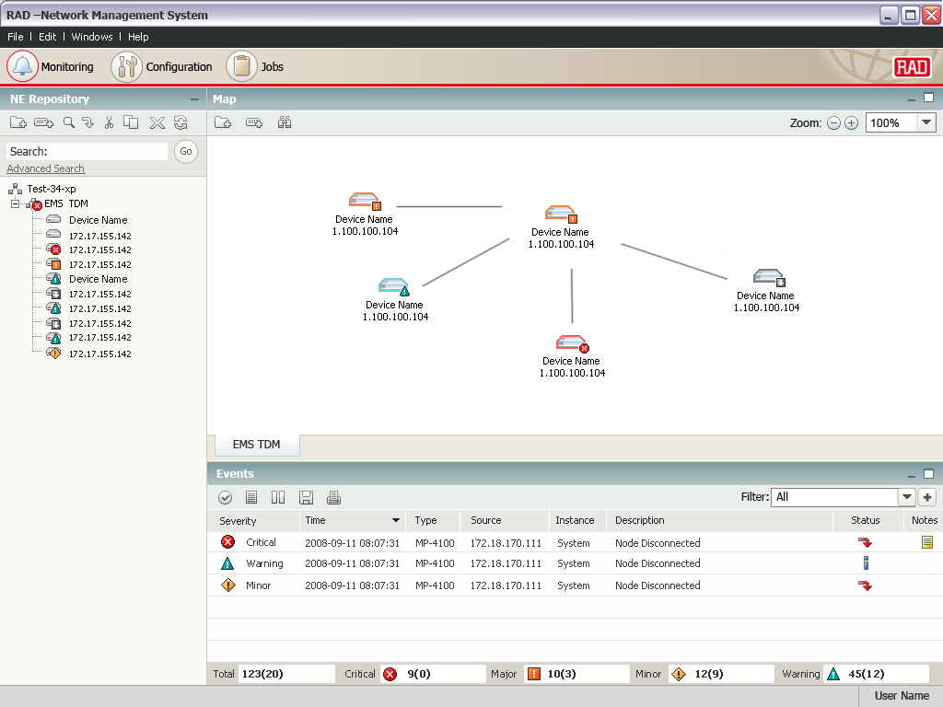
RADview-EMS
Benefits & Features
Benefits
Turnkey system including hardware and software!
Fully compliant with TMN standards
Client/server architecture with multi-user support
Interoperable with third-party NMS and leading OSS systems
IBM Tivoli’s Netcool®/OMNIbus™ plug-in
Minimize integrations costs associated with new NE additions
Key features
Ensures device health and congestion control
Topology maps and network inventory
Advanced FCAPS functionality
Software & configuration management
Business continuity - High-Availability and Disaster Recovery
Handover between operators

Slide 50
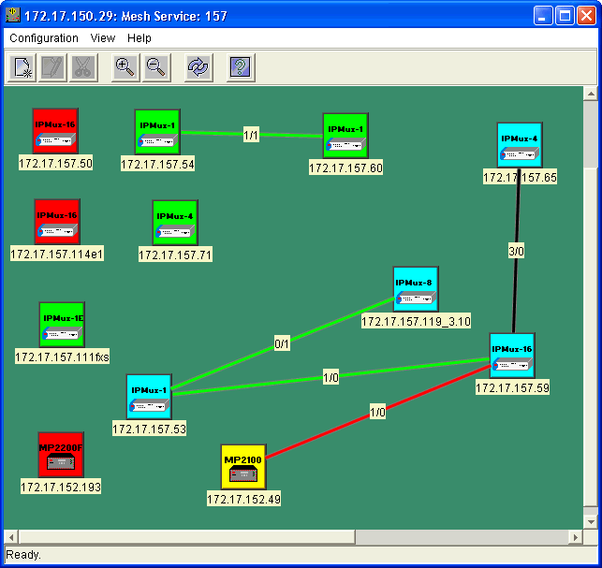
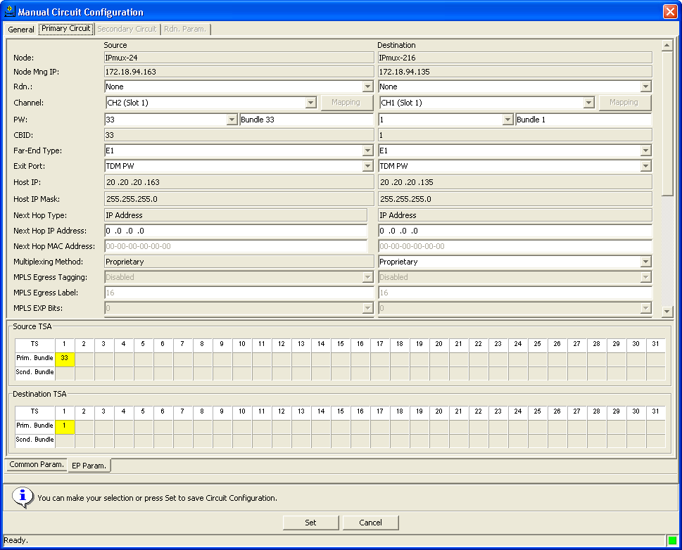
Service Management
RADview-SC/TDMoIP
Network Management Service Center System for TDM PW Applications:
    Easy configuration of IPmux and Gmux TDM PW gateways
    End-to-end provisioning of pseudowire connections
    Centralized management of TDM pseudowire services
    Intuitive GUI for discovery and status indication of connections
    Client-server architecture with northbound CORBA interface enabling integration with 3rd party systems

Slide 51
Typical Applications

Slide 52
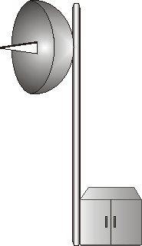


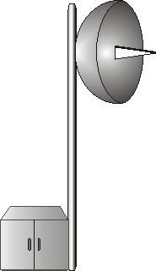




Legacy Leased Lines over Any Packet Access Technology
Serial
PBX
Fixed
Wireless
IPmux-2L/4L
n x E1
ETH
PBX
GbE/FE over Fiber (Pt-2-Pt, xPON)
IPmux-216
n x E1/T1
ETH
Gmux-2000 /
IPmux-155L
PBX
GbE
ETH/IP/MPLS
Core Network
Cable HFC
Infrastructure
Ethernet
over Cable
IPmux-24
n x E1/T1
ETH
n x E1/T1 or
Ch.T3 or
Ch.STM-1/OC-3
PBX
FE / GbE
xDSL
IPmux-24
n x E1/T1
PSTN
ETH
PBX
LA-210
n x E1/T1
Typical Customers:
Alternative Carriers
Incumbents in migration or out of their network reach
Benefits
Unified TDM over packet solution regardless of access technology
Enables Ethernet and TDM service on the same infrastructure
Alternative carriers can increase revenue by selling lucrative TDM services
SHDSL
ETH

Slide 53

Private Line/Leased Line over Packet
PBX
HQ
Branch Office
PBX
IPmux-16L/4L
FE/GbE
FE/GbE
IPmux-4L/2L
Ethernet/
MPLS/IP
GbETH
GbETH
E1
E1
FE/GbE
FE/GbE
LAN
LAN
Typical Customers:
Business customers: small, medium and large enterprises
Incumbents migrating services from TDM leased lines to Ethernet links (LAN inter-connect, IP-VPN, Internet service)
Benefits:
Customer does not need to replace hardware
Reduced leased line costs by using a single line for voice and data
Reduced OpEx by using Ethernet instead of PDH/SDH networks

Slide 54



Resilient GbE Ring (G.8032)
n x E1 or
C.STM-1
Ethernet
TDM
E1
PSN
Gmux-2000 /
IPmux-155L
IPmux-4LGE
IPmux-4LGE
GbE Ring
IPmux-4LGE
E1
Target Customers:
Telecoms, incumbent and alternative, selling TDM over PSN services to enterprises and to cellular operators
Benefits:
High resiliency
Easy replacement of obsolete SONET/SDH access ring without investing in new fiber
Ethernet
Notes:
54

Slide 55


TDM Backhaul/Trunking over Packet
IPmux-4L/16L
IPmux-2L/4L
SDH
E1
FE/GbE
Ethernet/
MPLS/IP
FE/GbE
E1
PBX
Class 5 Switch
Typical Customers:
Alternative carriers provisioning IP based services without leasing capacity from incumbent carrier
Incumbent carrier providing IP services
Benefits:
Grooms fractional E1s for efficient use of E1 ports on the central and remote site devices
Supports 64/256 pseudo-wires (IPmux-4L/16L)

Slide 56




Mobile Backhaul over Packet
BTS
E1
IPmux-155L/
Gmux-2000
IPmux-4L
32/196 E1
Ch.STM-1
BSC
FE/GbE
Ethernet/
MPLS/IP
GbE
Clock
BTS
E1
Typical Customers:
Telecoms, incumbent and alternative, selling services to cellular operators
Benefits:
Supports multiple operators at the same tower
Provides reliable replacement for cellular backhaul comparable to TDM, with jitter and wander conforming to G.823 and 16ppb clock accuracy
CapEx savings: Eliminates the need for accurate clock source at every base station

Slide 57









Mobile Backhaul
RAD Cell Site Gateway Solution
BTS
n x SHDSL
ACE-3105/3220
E1/T1 TDM
ADSL2+
ETH
Node B
IP DSLAM
BTS
Controller Site
E1 TDM
RNC
Router
VDSL
LA-210
ETX-5300*/
Gmux-2000
ETH
Node B
BSC
ETH
1/10 GbE
PSN
Access
Network
N x Ch. STM-1/
OC-3
BTS
ETX*
E1/T1 TDM
FE/GbE
Node B/eNB
ETH
E1/T1+ETH
IPmux
IPmux
E1/T1+ETH
FE/GbE
GbE Ring
IPmux
IPmux
E1/T1+ETH
            Wide range of products supporting multiple backhaul technologies
            *TDM PW in ETX roadmap
Notes:
2G/3G Backhaul over IPmux Ring
Customer Benefits
OPEX/CAPEX savings by backhauling 2G over Ethernet ring
Savings in external sync sources by using built-in synchronization solution over PSN
Minimized OPEX by having Ethernet OAM capabilities to enable performance monitoring
Winning Points
Market leader in TDM PWE
Advanced and in-band clock distribution/recovery
Ethernet OAM capabilities
Dual homing and enhanced redundancy
Cost effective solution

Slide 58
TDM PW
Success Stories

Slide 59







StarHub, Singapore – Leased Line over NC PSN Network
Customer Benefits:
Extend Starhub Coverage/Customer reach
for leased line services (E1/V.35) via the
new Nucleus Connect network (whole
Singapore coverage)
RAD Advantages:
Variety of User/Network interfaces (E1, V35,
STM-1,FE,GbE) with PWE support
  Advanced NMS with Traps notification/forwarding
  via email
  Supports AC/DC source in same unit
Router
IPmux-2L
IPmux-2L
Router
Serial/V35
FE
FE
Serial/V35
ETH
ETH
IPmux-2L
Nucleus
Connect
Core Network
StarHub
Access
Network
IPmux-2L
Router
FE
FE
Router
E1
E1
PABX
IPmux-2L
IPmux-2L
PABX
E1
FE
GbE
FE
E1
IPmux-155L
n x E1 or
Ch. STM-1
EMS
Users in
TARHUB CO
Management

Slide 60





HCMC Telecom Vietnam – Leased Line Services over Dark Fiber
HCMC Telecom Vietnam – Leased Line Services over Dark Fiber
Customer Benefits
Simple and reliable solution to simultaneously transport Ethernet, E1 and V.35 (nx64k) over dark fiber
Optimal footprint
Fast and easy deployment
RAD Advantages
Simple solution perfectly matching customer requirements
High reliability
Smooth migration to transport over PSN
E1
1,000 units deployed
E1
Phase #1
IPmux-2L
IPmux-2L
ETH
FE
(Fiber)
FO
FE
(Fiber)
ETH
V.35
Expansion & migration
V.35
Phase #2
ADM
IPmux-2L
E1
FO
ETH
Gmux-2000/IPMUX-155L
ADM
ADM
Up to
128 x E1
V.35
TDM
Network
GbE
Metro
Ethernet
IPmux-2L
E1
RV-EMS
ETH
ADM
FO
V.35

Slide 61







PSTN Access over packet – QSC, Germany
Customer Benefits:
Cost-efficient backhaul over PSN
  Replacing expensive leased STM-1 link
OpEx reduction
  No local maintenance team for remote PABX
Enables competitive long distance phone service
RAD Advantages:
Proven experience in TDM PWE deployments
Remote
Voice Switch
IPmux-14
4 E1
FE
Gmux-2000
Remote
Voice Switch
ADM
IPmux-14
STM-1
GbE
IP
FE
4 E1
SDH
STM-16
ADM
Remote
Voice Switch
IPmux-14
4 E1
FE
E1’s
PSTN

Slide 62



North American Cable MSO Mobile Backhaul Application
Benefits
Multiple mobile operators per tower, each adaptively timed from own source
Network reliability and redundancy with sub 50ms failover
“Important considerations were T1 density, Ethernet switching, fiber interfaces and reliable long term partner,” Major Cable MSO
Transport Provider
Mobile Operator A
T1s
Fiber
BSC
Gmux-2000
IPmux-16
OC-3
GE
T1s
Metro ETH
MPLS
Fiber
Mobile Operator B
IPmux-16
BSC
Gmux-2000
OC-3
GE
T1s
Multiple Towers
Multiple Operators Per Tower
Fiber
IPmux-16

Slide 63
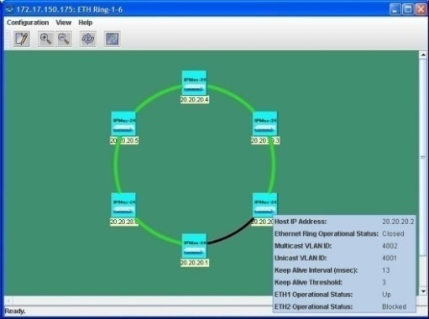





Promitel – Cellular Backhauling for TIGO Colombia
Customer Benefits:
High resiliency
Re-use of obsolete SDH access ring saving new fiber deployment
RAD Advantage:
Sub 50ms switching time with 16 nodes in a ring
E1
BSC
Gmux-2000
IPmux-24
E1
n x E1/
STM-1
Metro Ethernet
MPLS
IPmux-24
GbE Ring
IPmux-24
IPmux-24
E1

Slide 64

Summary
TDM PW – Value Proposition
Cost saving
  Preserves investment in legacy equipment in migration to PSN
  Lowers OpEx of TDM service by utilizing packet infrastructure
  Simple configuration
Carrier-grade TDM voice or data
  Highly accurate clock recovery
  OAM, NMS and security capabilities
Transparency
  No compression, no silence suppression
Uniform TDM access
  All first mile infrastructure types are supported
Standardized solution
Over 200,000 RAD TDM PW ports deployed since 2000 !
and counting..

Slide 66
Additional
Success Stories

Slide 67





MPT, Myanmar – E1 Voice Extension over Wireless Ethernet for Rural Telephone Exchange
Customer Benefits:
Reliable solution for delivering high quality
voice over low cost wireless Ethernet bridge
Transparency to telephony features
Quick and simple deployment
RAD Advantages:
Simple and cost effective solution perfectly matching customer requirements
TDM voice quality, full transparency to all signaling protocols
Low latency compared to other technologies
MPT Local Exchange
Rural Area
Telephone Exchange
TrangoLink Wireless Ethernet Bridge
PABX
45 Mbps
E1
E1
IPmux-2L
IPmux-2L
Notes:
67

Slide 68






Signaling over IP for
China Telecom CDMA
Customer Benefits:
Transport TDM based services over
low cost PSN infrastructure
Saving E1 lines for signaling backhaul while maintaining signaling integrity
RAD Advantages:
Advanced clock recovery for mission critical and
extremely delay sensitive signaling traffic
Bundle redundancy feature provides added
failsafe backup of MMC (CDMA RNC) site
Scalable solution fit customer requirements
Strong local support to Alcatel Shanghai Bell (ALU)
Central Primary
Remote
IPmux-216 (1)
Ethernet/IP
(CN2)
IPmux-24(1)
MMC
MGW
E1
FE
FE
E1
IPmux-216 (2)
IPmux-24(2)
Central Backup
IPmux-216 (1”)
FE
E1
MMC (2)
IPmux-216 (2”)

Slide 69




Binh Duong PTT - Leased Line Services over IP Network
Customer Benefits:
Leveraging the PSN (Metro) Access network in order to provide managed E1, nx64K and Eth services, via fiber access.
Increase Revenues
RAD Advantages:
Cost effective CPE, for Multi service over Fiber with built in pseudo-wire technology.
Powerful central solution (Gmux) support up to 128xE1’s over GbE
NODE-1
IPmux-2L
E1
Up to
128E1
Fiber Ethernet
V.35
Gmux-2000
FE
GbE
IPmux-2L
E1
Fiber Ethernet
V.35
NODE-2
FE
BD PTT
TDM Network
Up to
128E1
IPmux-2L
E1
Gmux-2000
GbE
Fiber Ethernet
V.35
Metro-Eth
FE
IPmux-2L
E1
NODE-3
GbE
Fiber Ethernet
V.35
Up to
128E1
FE
Gmux-2000
IPmux-2L
E1
RV-EMS
Fiber Ethernet
V.35
100 IPMUX-2L
units
FE

Slide 70

Branch Connectivity for UK Bank – STM-1 Trunking over PSN
Customer Benefits:
Offering TDM services with low transport cost
RAD Advantage:
High port density and best price per port
Production Systems
Turret Connections
Gmux-2000
Gmux-2000
196 x E1
GbE
GbE
196 x E1
MPLS
GbE
196 x E1
Gmux-2000
Back-up Systems

Slide 71

Leased Lines over GPON – Latin America
Customer Benefits:
Offering TDM services over
PON infrastructure
RAD Advantage:
Multiple clock domains
Very low intrinsic delay (H/W based)
ONT
IPmux-216
n x E1
PBX
FE
Gmux-2000
OLT
GbE
Passive
Splitter
n x E1/T1 or
Ch.STM-1
ONT
IPmux-24
n x E1
PBX
PSTN
FE

