Slide 1

Megaplex-4100
Version 3.06
General Availability
Presented by:
Raz Korn
Product Line Manager
raz_k@rad.com

Slide 2
Agenda
Introduction
Product Overview
Applications
Management
Summary
Notes:
Introduction
Product Overview
Physical View
New Features
Features
Applications
1…
2…
3….
Management
Feature comparison table
Product/Portfolio Value Proposition
Sales Tools On-Line
Ordering information
Summary
Road map (Optional)

Slide 3





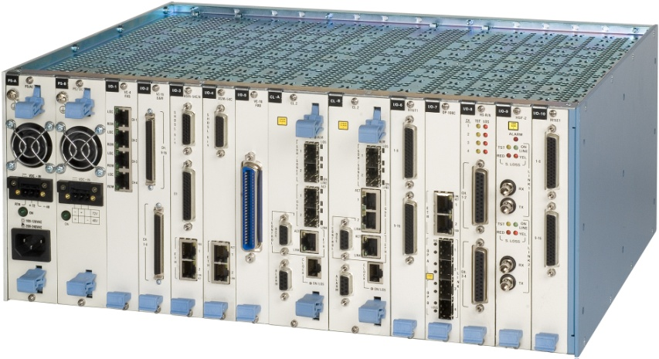




Introduction
Solution for
  Legacy services migration to PSN
  Single box simultaneously supporting native TDM/legacy and native Ethernet services
  Fiber and copper aggregation
Airports
Government
Transportation
Military
Oil & Gas
Enterprise
Utilities
PMR/TETRA
Service Providers
Mobile Operators
Carriers

Slide 4










General Application
Star, ring and daisy-chain topologies
Fiber and copper aggregation
SDH/SONET, TDM and PSN networks
Standard and industry-specific data and voice traffic
Central site solution for MAP and Last Mile products
Megaplex
Megaplex
Megaplex
NMS
Megaplex
Megaplex
Megaplex
Optimux-108
E1/SHDSL/
RFER/STM-1
PDH/SDH/
PSN
FCD-IP
Megaplex
Megaplex
ASMi
ASMi
ASMi
ASMi
Megaplex
RICi-4/8
Optimux-108
Notes:
The general Megaplex solution is based on several key aspects:
Star, ring and daisy-chain topologies
Fiber and Copper aggregation
SDH/SONET, TDM and PSN networks
Standard and industry-specific data and voice traffic
Central site solution for MAP and Last Mile products

Slide 5

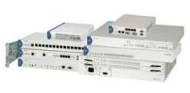



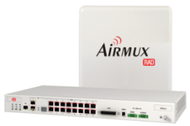


AXCESS⁺ Portfolio
Central Site
Customer Premises
Optimux
Fiber Multiplexers
Fiber
ASMi
SHDSL Multiplexers
& Modems
E1
T1
FXS
FXO
E&M
ETH
V.35
X.21
RS-530
PSN
Central Rack, Grooming,
Multiplexing & Aggregation
Megaplex
Multiservice Access Nodes
Copper
Airmux
Broadband
Wireless Radios
TDM
Wireless
IPmux
TDM Pseudowire
Gateways
Kilomux
Subrate Multiservice
Multiplexers

Slide 6
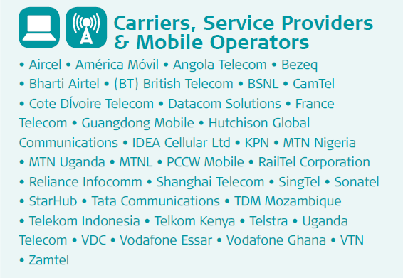

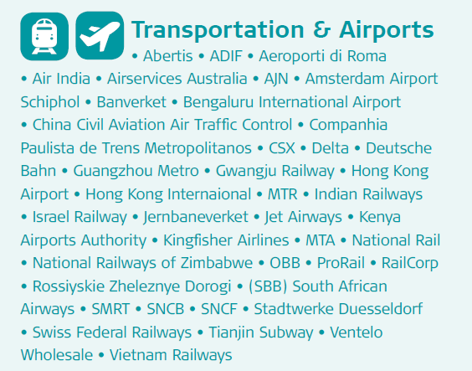
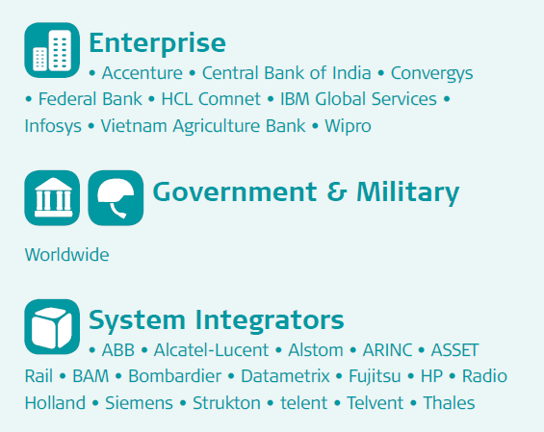
AXCESS⁺
Target Market, Major Customers

Slide 7




MP-4100 Interoperability
RAD Portfolio and Standard 3rd Party Devices
Router
E3
RICi-16
ASMi-52
n x E1
ETH
RV Station
DXC-8R
FCD-E1E
STM-1
ETX
DXC-4
8 x E1
FE
ETH
E1
PSN
IPmux-xx
FE
E1
POP
FE/GbE
ASMi-54
Megaplex-4100
SHDSL.bis
ETH
STM-1/OC-3
STM-4/OC-12
Optimux-108/34
ETH
FO
n x E1
FCD-IP
E1
ETH
SDH/
SONET
ASMi-52
ETH
SHDSL
E1
FCD-155E
E1/T1
STM-1/OC-3
ETH
MP-2104
Voice
RV Station
n x E1/T1
Serial

Slide 8

Physical View
2 Power supplies
10x IO modules
10 IO modules
4U (6.8”)
2 Common Logic Ethernet/TDM processing cards
With SONET/SDH and GbE network ports
Compact 4U high, 19” modular chassis
Redundant common logic, power supply and IO modules
Hot swappable common logic, power supply and IO modules
Separate Ethernet and TDM star topology backplane to all IO modules
DS1/DS0 Cross connect, up to 4*STM-1/STM-4 or OC-3/OC-12, Up to 4*GbE

Slide 9
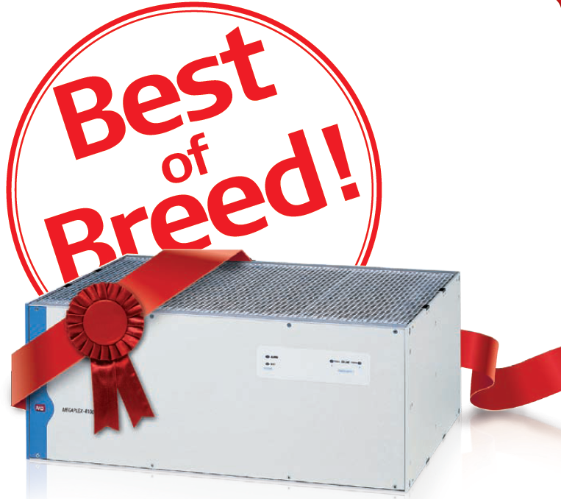
MP-4100 – Feature Highlights
Multiservice – Voice, Data, Ethernet
Fiber and copper aggregation
Bridges TDM and PSN networks (both directions!)
Powerful T1/E1 DS0/DS1 cross-connect
Carrier grade resiliency
  Common Logic (CPU) redundancy
  Power supply redundancy
  SDH/SONET and GbE uplink redundancy
  DS1 and higher level hierarchy protection
  Ring resiliency
MP-4100

Slide 10
Main Features – v3.06
Feature | Description | Customer Benefits
New feature: Remote Power Feeding for SHDSL Lines | Remote power feeding control (phantom) of 4‑wire SHDSL lines via the ASMi‑54C/ETH/E1/UTP/N module New MPF standalone power feeding device | Lower maintenance cost Lower construction expenses – fewer permits, legal issues, electricity counter installation, etc. Uninterruptable power supply
New feature: Enhanced ASMi‑54C/N diagnostics | Enhanced local and remote loopbacks and BER tests on the ASMi-54C/N module | Improved service monitoring and fault detection
New feature: Remote management of RAD’s SHDSL repeaters | Remote management of SHDSL repeaters (S-RPT) via ASMi-54C/N module | Reduced OpEx due to remote monitoring of SHDSL repeater status and statistics
New feature: Extended SHDSL rates for ASMi‑54C/ETH modules | Rates of up to 15296 kbps for ASMi‑54C/ETH modules in 64/65-Octets mode, 2W operation (range of up to 700m) | Improved data rates to the user

Slide 11
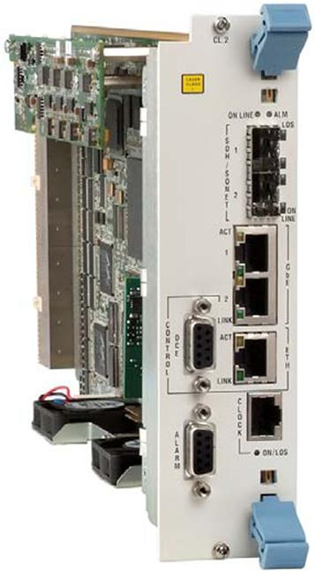
New in Version 3.06
E1/T1 ring functionality
  Higher immunity to infrastructure outages
  Minimizes service downtime
  Provides carrier-class service reliability with no single point of failure
Remote Power Feeding for SHDSL Lines
  Lower maintenance cost
  Lower construction expenses – fewer permits, legal issues, electricity counter installation, etc.
  Uninterruptable power supply
Extended SHDSL rates for ASMi‑54C/ETH modules
  Improved data rates to the user
Enhanced ASMi‑54C/N diagnostics
  Improved service monitoring and fault detection
Remote management of RAD’s SHDSL repeaters
  Reduced OpEx due to remote monitoring of SHDSL repeater status and statistics

Slide 12
Supported Cards
MP-4100 V3.06
Product | Supported by | Description | CPE (Customer Premises Equipment)
M8E1, M8T1 | MP-4100 | 8-port E1 or T1 modules with 3 Ethernet ports | Standard E1/T1, DXC, MP-210x, FCD-E1, FCD-IP
M16E1, M16T1 | MP-4100 | 16-port E1 or T1 modules | Standard E1/T1, DXC, MP-210x, FCD-E1, FCD-IP
M8SL | MP-4100 | 8-port SHDSL E1 module with 3 Ethernet ports | ASMi-52 (SHDSL modem)
MPW-1 | MP-4100 | TDM pseudowire access gateway with 3 Ethernet ports | MP-4100, MP-210x, IPMUX (pseudowire gateways)
ASMi-54C | MP-4100 | 8-port SHDSL.bis module with 2 Ethernet ports | ASMi-54 (SHDSL.bis modem)
ASMi-54C/N | MP-4100 | 8-port SHDSL/SHDSL.bis module with 2 Ethernet ports and 8 E1 ports | ASMi-52, ASMi-54 (SHDSL, SHDSL.bis modems)
OP-108C | MP-4100 | Dual 4 x E1/T1 and Ethernet multiplexer modules | OP-108 (Fiber multiplexers)
OP-34C | MP-4100 | 16 x E1/T1 and Ethernet multiplexer modules | OP-34 (Fiber multiplexers)
HS-6N, HS-12N | MP-2100/MP-4100 | 6- or 12-port n x 64 kbps high speed module | Serial interface devices
HSU-6, HSU-12 | MP-2100/MP-4100 | 6- or 12-port IDSL modules | ISDN interfaces
HS-S | MP-2100/MP-4100 | 4-channel ISDN “S”-interface module | ISDN modems
HS-703 | MP-2100/MP-4100 | 4-channel Codirectional data module | Codirectional interfaces
HS-RN | MP-2100/MP-4100 | 4-port sub-DS0 low speed module | Sub-64 kbps serial devices (V24/RS-232)
HSF-2 | MP-2100/MP-4100 | 2-port fiber optic teleprotection interface module | Teleprotection equipment (SEL, etc.)
LS-6N, LS-12 | MP-2100/MP-4100 | 6- or 12-port low speed modules | Sub 64Kbps serial devices (V24/RS-232)
VC-4/4A/8/8A/16 | MP-2100/MP-4100 | 4/8/16-port FXS/FXO/E&M PCM and ADPCM analog voice modules | POTS interfaces, telephones, PBX devices, Signaling interfaces, Voice modems
VC-4/OMNI | MP-2100/MP-4100 | 4-port PCM omnibus voice module | E&M voice phones or modems
ACM | MP-2100/MP-4100 | Alarm and diagnostics module with four outbound relays | Dry contact equipment

Slide 13
New Modules – V3.06
MP-4100M-ASMI-54C/N/PF
  MPF
MP-4100M-ASMI-54C – Extended Rate (New hardware revision)

Slide 14

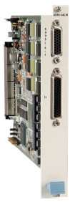
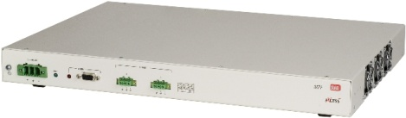


ASMi-54C/N E1+Ethernet Combo SHSDL Optional Power Feeding
Remote power feeding control (phantom) of 4‑wire SHDSL lines via the ASMi‑54C/ETH/E1/UTP/N module
Remote power feeding is enabled/disabled per line
Requires MPF standalone power feeding device
Nominal voltage – 120VDC; Up to 70mA per line
Branch
PBX
ASMi-54
E1
SHDSL.bis
Central Office
MPF
FE
NMS
PSN
120VDC
Branch
Megaplex-4100
GbE
SHDSL.bis
ASMi-54L
FE
STM-1/OC-3
STM-4/OC-12
SDH/
SONET
Branch
PBX
ASMi-52
E1
SHDSL
FE

Slide 15
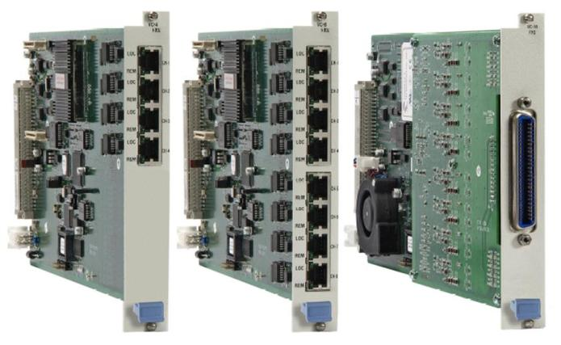
Voice Modules
Analog voice interface
FXS/FXO and E&M
ADPC and Echo canceller
Teleconference “Omnibus” module
 | VC-4/8/16 | VC-4/OMNI
Port number | 4/8/16 | 4
FXS | 
FXO | 
E&M |  | 
ADPCM | 
Local Battery
Omnibus |  | 

Slide 16
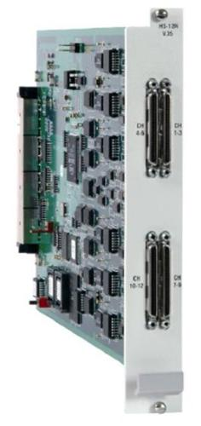
Data Modules
n x 56/64 kbps serial interface
ISDN ‘S’ and ‘U’ interfaces
G.703 co-directional 64 kbps interface
Teleprotection fiber module (IEEE C37.94)
 | HS-6N/12N | HS-U | HS-S | HS-G703 | HSF
Port number | 6/12 | 4/6/12 | 4 | 4 | 2
Interface | V.24/RS-232 V.35 V.11/RS-422 | ISDN “U” | ISDN “S” | G703 codirectional | IEEE C37.94
Data rate | N x 64kbps | 128kbps | 128kbps | 64kbps | N x 64kbps

Slide 17
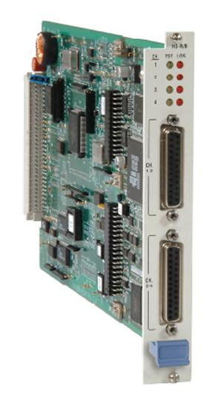
Data Modules
Sub-64 kbps interfaces
Latency optimized mode (HS-RN)
Support for bidirectional broadcast (HS-RN)
 | HS-RN | LS-6N LS-12
Port number | 4 | 6/12
Interface | V.24/RS-232 | V.24/RS-232
Data rate | 0.6 – 64kbps | 2.4 –64kbps
Multiplexing method | HDLC, V.110 | Proprietary

Slide 18



M8E1, M8T1, M8SL
8 port, E1, T1 or E1 over SHDSL
3 UTP or SFP fast Ethernet ports
Ethernet over TDM encapsulation
CPE
n x E1
RICi-4/8
POP
IP/
MPLS
CPE
Megaplex-4100
ETX-102/
ETX-202
FO
SDH/
SONET
CPE
PBX
E1/T1
ASMi-52
SHDSL
Radio Link
CPE
FCD-E1LC/
FCD-T1LC
E1/T1

Slide 19
ASMi-54C/N E1+Ethernet Combo SHSDL
E1+Ethernet over SHDSL/SHDSL.bis
Works opposite ASMi-54 and ASMi-52 (SW selectable) in various combinations over 16-wire
Allows a single module type to work opposite different remote units
Branch
PBX
ASMi-54
E1
SHDSL.bis
Central Office
FE
NMS
PSN
Branch
Megaplex-4100
GbE
SHDSL.bis
ASMi-54L
FE
STM-1/OC-3
STM-4/OC-12
SDH/
SONET
Branch
PBX
ASMi-52
E1
SHDSL
FE

Slide 20
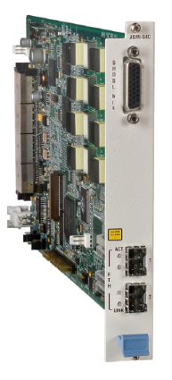
ASMi-54C G.SHDSL.bis Module
Ethernet over 16 SHDSL.bis lines
Two 10/100BaseT Ethernet ports over copper or fiber
Works opposite ASMi-54 in various combinations over 16-wire
SHDSL bonding (EFM)
Branch
Central Office
SHDSL.bis
ASMi-54
FE
NMS
PSN
Branch
Megaplex-4100
GbE
SHDSL.bis
ASMi-54
FE
STM-1/OC-3
STM-4/OC-12
SDH/
SONET
Branch
SHDSL.bis
ASMi-54
FE

Slide 21
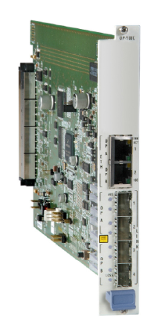
OP-108C Fiber Multiplexer Modules
Multiplex four E1/T1 channels and up to 100 Mbps Ethernet traffic over a fiber optic link (dual links per module)
Up to 10 cards in an Megaplex-4100 rack (20 remote units)
Various fiber interfaces: multimode, single-mode (up to 120 km), and single-mode over single fiber
Automatic SFP link backup with optional hot-swappable second optical link
Branch
PBX
Optimux-108
E1
Central Office
FO
FE
NMS
PSN
Branch
PBX
Megaplex-4100
Optimux-108
E1
GbE
FO
STM-1/OC-3
STM-4/OC-12
FE
SDH/
SONET
Branch
PBX
Optimux-108
E1
FO
FE

Slide 22
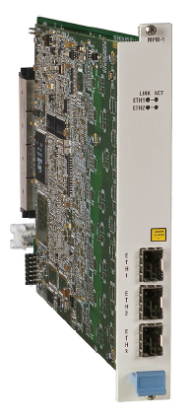
MPW-1 Pseudowire Module
Pseudowire server module for MP-4100
Support for TDMoIP, CESoPSN, SAToP and HDLCoPSN
16 Mbps TDM capacity (8*2M)
Supports 128 PW connections
3 SFP or RJ-45 onboard connectors
Megaplex-4100
GBE
Central Site
Megaplex-4100
Megaplex-2100
GBE
PSN
FE
FE/GBE
IPmux-24

Slide 23
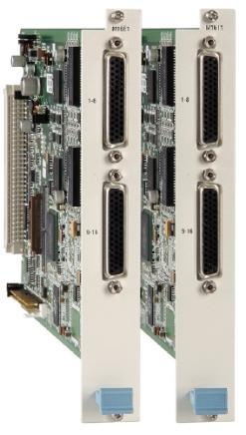
16 E1/T1 Module
Up to 16 E1 or T1 ports per module
TDM only – No Ethernet ports
Up to 160 E1/T1 links in a single MP-4100 chassis with DS0 cross connect
(DXC-160!!!)
Lower price per port (compared to M8E1/T1)
CPE
4 x E1
POP
PBXs
IP/
MPLS
CPE
Megaplex-4100
4 x E1
DXC-8R
E1
SDH/
SONET
CPE
E1
Megaplex-2100
6 x E1/T1
Voice
Data
Radio Link
CPE
E1
FCD-E1E

Slide 24
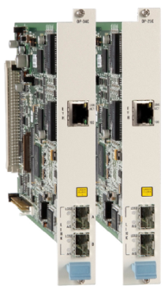
Optimux-34 Fiber Multiplexer Modules
Multiplex 16 E1/T1 channels or Ethernet traffic over a fiber optic link.
Total capacity is 34 Mbps
Up to 10 cards in a Megaplex-4100 rack (10 remote OP-34 units)
Various fiber interfaces: multimode, single-mode (up to 110 km), and single-mode over single fiber
SFP-based interface or E3 Copper link (OP-34)
Automatic SFP link backup with optional hot-swappable
second optical link
Branch
Router
Optimux-34
E1
Central Office
FO
FCD-E1E
n x E1
NMS
PSN
Branch
PBX
Megaplex-4100
Optimux-108
E1
GbE
FO
STM-1/OC-3
STM-4/OC-12
FE
SDH/
SONET
Router
Branch
Router
E3

Slide 25
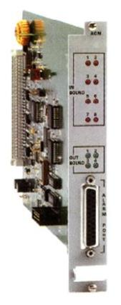
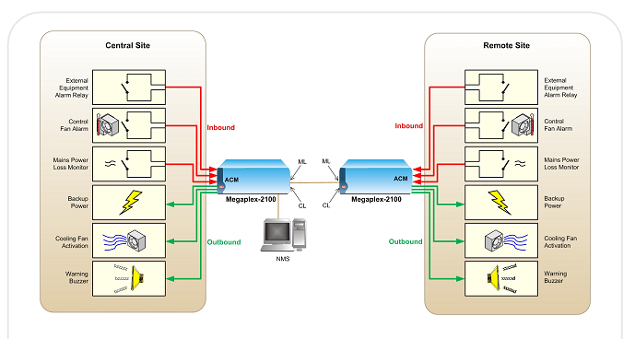
ACM (Alarm and Diagnostics)
MP-2100 ACM module support
Eight inbound relays indicating external events to the user via the management system
Four outbound relays triggered by any user-selected Megaplex alarm to outside indicators such as buzzers
Inbound
Inbound
Megaplex-4100
Megaplex-4100
ACM
ML
ML
ACM
CL
CL
Outbound
Outbound
NMS

Slide 26


Substation Multiservice Connectivity
Multiple service connectivity over any infrastructure
Lower CapEx by using a single-box solution and lower OpEx by converging services and optimizing bandwidth utilization
Migration of non-critical and mission-critical services to PSN, saving forklift costs and ensuring a future-proof solution
Continued support for legacy services and obsolete vendor replacement
Teleprotection
Megaplex-2100
PBX
Voice
Megaplex-4100
Voice
E1 Ring
SCADA
Control Center
FCD-IP
Megaplex-4100
Megaplex-4100
STM-1
GbE
Voice
Teleprotection
PSN
Megaplex-4100
STM-1/OC-3
ETH
Megaplex-4100
Megaplex-4100
SCADA
Megaplex-2100
E1/T1
SHDSL
Megaplex-2100
Airmux-200
Fiber
E1/T1
SHDSL.Bis
Airmux-200
PBX
PBX
Voice
SCADA
SCADA
ASMi-54
Optimux108

Slide 27
Substation Multiservice Connectivity
Multiple service connectivity over any infrastructure
Lower CapEx by using a single-box solution and lower OpEx by converging services and optimizing bandwidth utilization
Migration of non-critical and mission-critical services to PSN,
saving forklift costs and ensuring a future-proof solution
Continued support for legacy services and obsolete vendor
replacement
Increased SDH/SONET capacity !!!
Teleprotection
Megaplex-2100
PBX
Voice
Megaplex-4100
Voice
E1 Ring
SCADA
Control Center
FCD-IP
Megaplex-4100
Megaplex-4100
STM-1
GbE
Voice
Teleprotection
PSN
Megaplex-4100
STM-4/OC-12
ETH
Megaplex-4100
Megaplex-4100
SCADA
Megaplex-2100
E1/T1
SHDSL
Megaplex-2100
Airmux-200
Fiber
E1/T1
SHDSL.Bis
Airmux-200
PBX
PBX
Voice
SCADA
SCADA
ASMi-54
Optimux108

Slide 28

Case Study:
Utilities in Russia: Integrated Data and Voice Services over SDH
Customer Benefits:
Legacy (FXS/FXO, 4-wire, RS-232) and
Ethernet services over the SDH and Leased E1
Centralized solution with management
Scalable, typical solutions for Power Industry
RAD Advantages:
Powerful Central Node, MP-4100 -based
Ethernet traffic concentration
Support the traffic protection in the STM-1 SDH ring
Megaplex-2100
LAN #1
10/100BaseT
FXS/FXO/4W, RS-232
FXS/FXO/4W, RS-232
E1
STM-1
GbE
«NEW» remote nodes
E1
SDH
IP
Megaplex-4100
Megaplex-2100
FE1
FE1
LAN #n
10/100BaseT
n x Fractional
E1s
Megaplex-2100
Megaplex-2100
FXS/FXO/4W, RS-232
«Old» remote nodes
FXS/FXO/4W, RS-232
FXS/FXO/4W, RS-232

Slide 29
Fiber and Copper Aggregation for Carrier Applications
  Transport TDM and Ethernet from multiple branches over Fiber and/or copper to a central site, and aggregate the traffic towards SDH/SONET and/or PSN
Utilize existing copper/fiber infrastructure saving forklift expenses
  Multiplex services at the CPE to optimize bandwidth and lower CapEx and OpEx
  Aggregate Ethernet and TDM to SDH/SONET and/or PSN to optimize bandwidth towards the network
  Smoothly migrate services reducing forklift costs and network downtime
Branch
Central Office
SHDSL.bis
ASMi-54
FE
NMS
PSN
Branch
Megaplex-4100
Optimux-108
E1
GbE
FO
STM-1/OC-3
STM-4/OC-12
FE
SDH/
SONET
Branch
FCD-IP
E1
FE

Slide 30


Case Study:
Carrier: in Africa: Bank – Branches Connectivity over PSN
Customer Benefits:
Branches connectivity over any existing Last Mile
infrastructure: Copper, PDH and Wireless
Reduce CapEx/OpEx by leveraging existing infrastructure
for providing ETH/IP connectivity for the branches over new
IP-MPLS network, enabling fast delivery
RAD Advantages:
Support ETH services over any available access
infrastructure
Complete Access solution with Aggregation platform
(MP-4100), Aggregate any ETH/IP traffic coming from
DSL, PDH, Wireless towards IP/MPLS Network.
Branch
Branches
ASMi-52
2/4W SHDSL
ASMi-52
E1
E1
ASMi-52
2/4W SHDSL
ASMi-52
ETH
ETH
PDH
POP
POP
PDH
Router
Megaplex-4100
Megaplex-4100
Router
VLANz
2W SHDSL
ASMi-52
Router
E1
GbE
VLANy
GbE
E1
ETH
VLANx
E1
Branch
GT-IP/MPLS
ATM
ASMi-52
2W SHDSL
PDH
ETH
E1
Branch
ETH
ATM
Router
Airmux
RICi-E1
Router
ETH
Airmux
ATM

Slide 31



Case Study:
Carrier in Africa: Ethernet and TDM Services over Copper or Fiber
Customer Benefits
Reduce OpEx/CapEx by Multiservice
aggregation device at the PoP
Both E1 and Eth services over single Fiber
Ensure SLA by providing advance ETH
services with QoS
RAD Advantage:
Wide range of interfaces (SHDSL/E1/ETH)
MP-4100 high capacity. STM-1 and legacy
services on single BOX.
Multirate support
Single multi-functional platform
Internet
Customer A
Customer A
E1
Optimux-108
Optimux-108
E1
FO Link
FO Link
FE
NMS
GE
FE
Customer B
GE
Customer B
ASMi-54
STM-1
ASMi-54
FE
SHDSL
STM-1
SDH
Network
SHDSL
FE
Customer C
Megaplex-4100
Megaplex-4100
Customer C
RICi-4E1
n x E1
n x E1
RICi-4E1
FE
FE

Slide 32




TDM to PSN Migration
Smoothly migrate Legacy services from SDH/SONET to PSN
Utilize existing copper/fiber infrastructure saving forklift expenses
Multiplex services at the CPE to optimize bandwidth and lower CapEx and OpEx
Aggregate Ethernet and TDM to SDH/SONET and/or PSN to optimize bandwidth towards the network
Smoothly migrate services reducing forklift costs and network downtime
Airmux
Wireless
FE
Video
Airmux
Remote Sites
ASMi
E1
TAC
FE
SHDSL.bis
Ticketing
E&M
Megaplex-2100
FE
ETH
E1/T1
POP
Megaplex-4100
Megaplex-2100
FXS
RS-232
GbE
PSN
E1/T1
SCADA
V.35
FXS
FCD
Central Office
E1/T1
Megaplex-4100
Optimux
E1/T1
X.21
FO
FE
E1/T1
ASMi
VoIP
SHDSL.bis
E1
FE
POP
SHDSL.bis
ASMi
VoIP
NMS
Megaplex-4100
FE
STM-1/
OC-12
SDH/
SONET
E1/T1
Optimux
Servers
E1/T1
FE
FO
FO
Optimux
FE
Video

Slide 33


Management
RADview-EMS is a unified carrier-class management platform for RAD devices using a variety of access channels, such as SNMPv1/3, HTTP/S, TFTP and Telnet/SSH. In addition, it features third-party device monitoring capabilities
Broad Perspective. Direct Control.

Slide 34
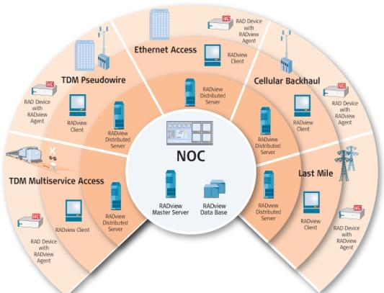
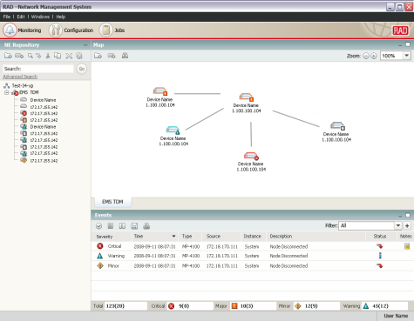
Management Benefits & Features
Benefits
Turnkey system including hardware and software!
Fully compliant with TMN standards
Client/server architecture with multi-user support
Interoperable with third-party NMS and leading OSS systems
IBM Tivoli’s Netcool®/OMNIbus™ plug-in
Minimize integration cost of adding network elements
Key features
Ensures device health and congestion control
Topology maps and network inventory
Advanced FCAPS functionality
Software & configuration management
Business continuity - High-Availability and Disaster Recovery
Handover between operators

Slide 35
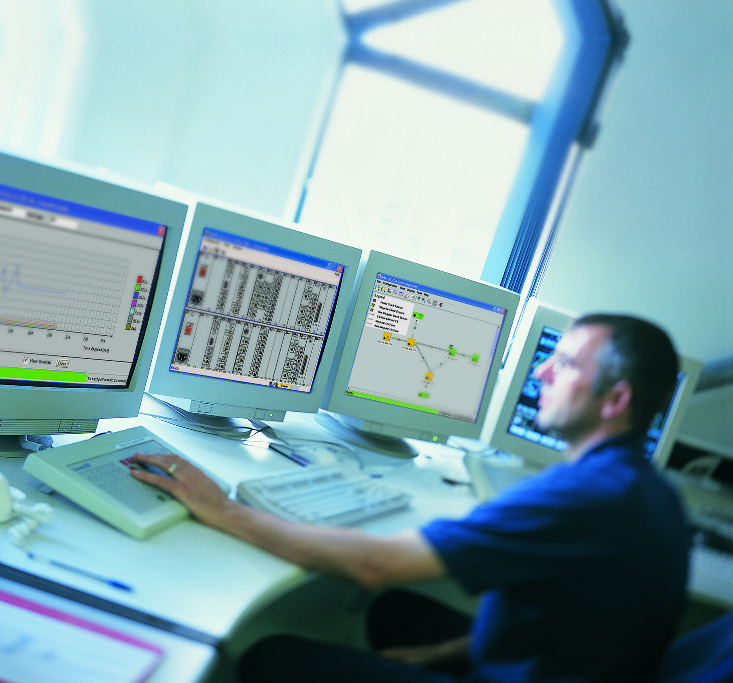
RADview-EMS Advanced FCAPS
Fault management
Detects and isolates faults in network devices, initiates remedial actions and distributes alarm messages to other management entities in the network.
Configuration management
Enables operators to configure, install and distribute software to all devices across the network. In addition, the system tracks version changes and maintains software configuration history.
Accounting management
Manages individual and group user accounts and passwords, generating network usage reports to monitor user activities.
Performance management
Supports real-time monitoring of QoS and CoS, producing real-time and periodic statistics. The statistics collector compresses data to minimize bandwidth use for management traffic and exports CSV files to OSS or third-party management systems
Security management
Allows network administrators to track user activities and control the access to network resources with a choice of security features

Slide 36
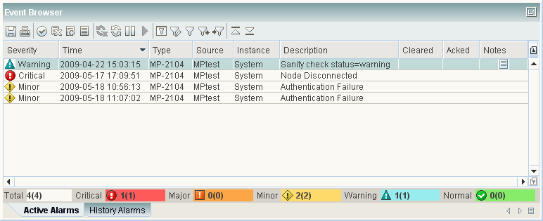
RADview-EMS
FCAPS
Fault
Configuration
Administration
Performance
Security
Manage Event Log parameters
Manage Events display in the Event Browser
Manage system response upon occurrence of specific Events.
Trap Synchronization upon connection failure between RADview-EMS and NE (supported devices only)
Modify – Mask, Severity, Duplication, Forwarding, Threshold, Clearing, Formatting

Slide 37
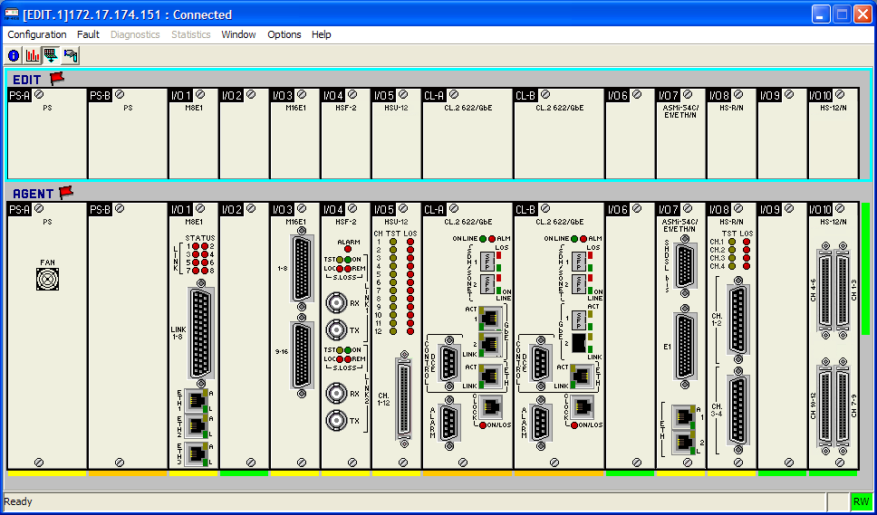
RADview-EMS
FCAPS
Fault
Configuration
Administration
Performance
Security
Realistic representation of the devices (shelf-view)
Tracks configuration changes
Configures, installs, and distributes software and configuration files across the network
Viewing and/or modifying configuration (system, ports, and alarms)
Enables viewing the diagnostics and status information
Shelf-View

Slide 38
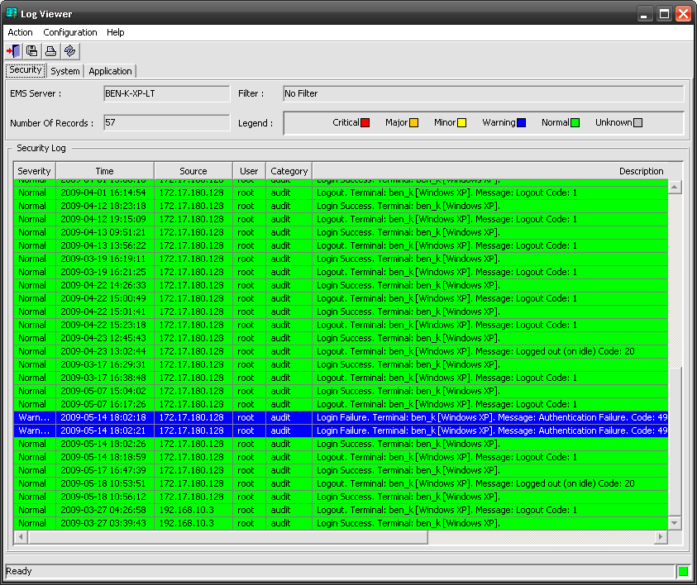
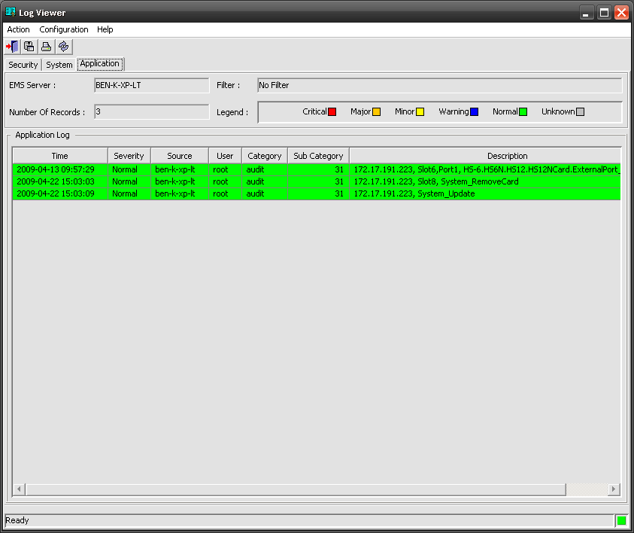
RADview-EMS
FCAPS
Fault
Configuration
Administration
Performance
Security
Audit trails for Security, System and Application activities
Tracks and logs the shelf-view user activity
Create and manage user accounts and groups
Manage various server settings
Security logs
Applications activities

Slide 39
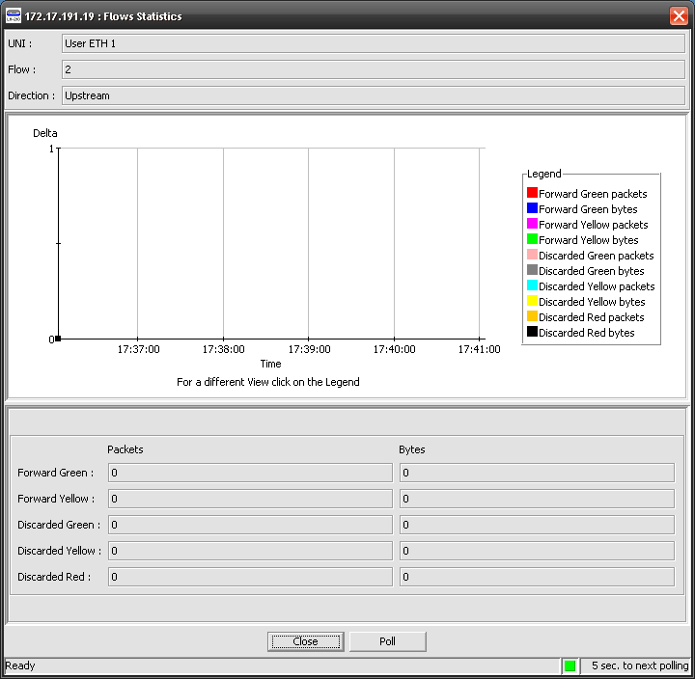
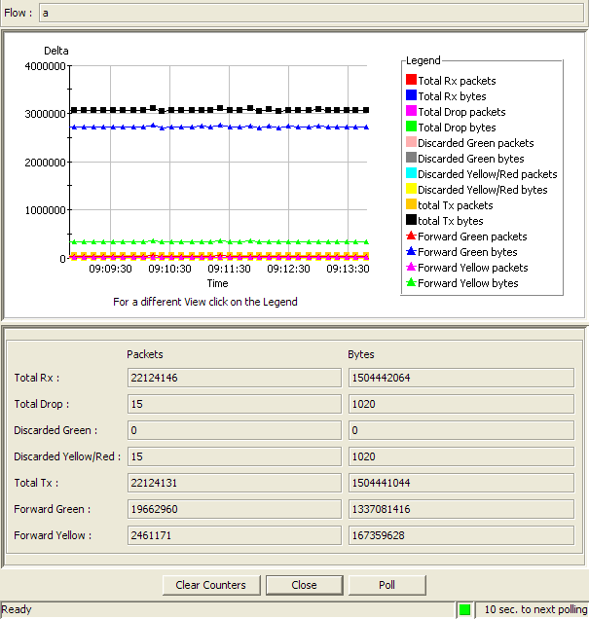
RADview-EMS
FCAPS
Fault
Configuration
Administration
Performance
Security
Monitors network performance (QoS, CoS)
Current statistics (real-time)
Interval statistics
Reflects Agent statistics
RADview statistics collector (supported devices only)
  Collects and compresses the data
  Retrieves lost data upon connection failure
  Minimizes management traffic
  Exports CSV ASCII files for OSS
Statistics

Slide 40
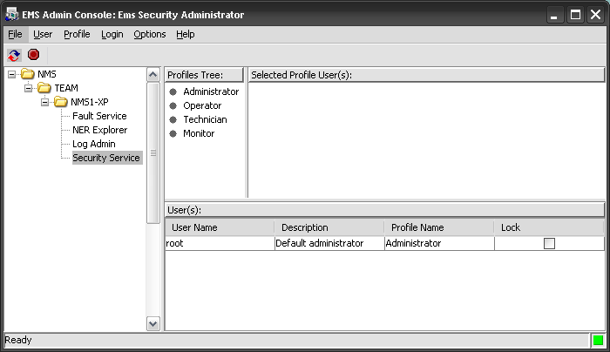
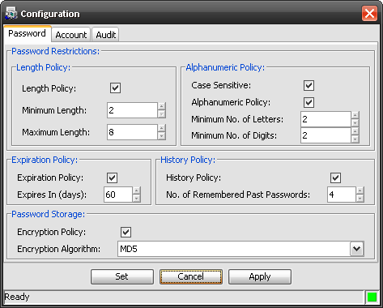
RADview-EMS
FCAPS
Fault
Configuration
Administration
Performance
Security
View and manage EMS Security profiles in a graphical interface.
Create and edit security profiles.
Create Common/Private view profiles per user/group
Collects accounting data and generates network usage reports
Define password policies
Security profiles
Password policy

Slide 41

Device Management
Megaplex-4100 supports the following management capabilities
Device Management
CLI driven terminal
(MP-4100 V3.x CLI, V2.x menu)
Radius
TFTP
Web-GUI (4100 V2.x)
SSL (MP-4100 V2.x)
SSH
SNMP v1, v3
Out-of-band mgt port
In-band mgt

Slide 42





Feature Comparison
Product | Height | IO Slots | TDM Capacity | Ethernet Capacity | PS, CL Redundancy | LS, HS, PW, Voice | SDH/ SONET | Fiber Copper Aggregation
MP-2104 | 2U | 5 | 4 x E1/5 x T1 | FE
MP-2100 | 4U | 12 | 4 x E1/5 x T1 | FE
MP-4100 | 4U | 10 | STM-4/OC-12 | GbE

Slide 43
Value Proposition
All in one multiservice platform
Reduce CapEx with a single device for all your communication needs
Support multiple services over diverse infrastructure with fine granularity
Optimize bandwidth consumption by grooming
Central site solution for MAP and Last Mile
Complete solution with unified management
Interoperable with DXC, Megaplex, FCD, ASMi, and Optimux
(as well as ETX RICi and IPmux)
Any service over any transport
Fiber and copper aggregation
High flexibility supporting Ethernet over TDM and TDM over Ethernet (with VCAT and Pseudowire)
Interoperable with 3rd party devices
Reduce OpEx by converging services over shared media
Future-proof
Offers a migration path from TDM network to PSN networks

Slide 44
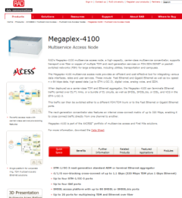
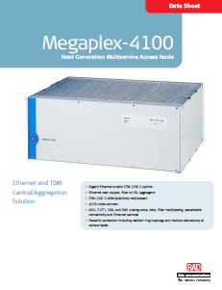

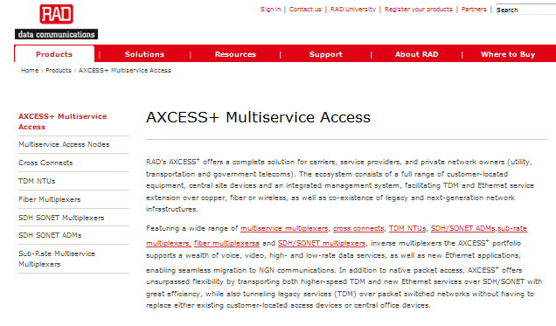



Sales Tools On-Line
MP-4100 web page
AXCESS+ web page
MP-4100 Datasheet
AXCESS+ brochure
Customer testimonial video
Railway communications brochure
Power Grid communications brochure

Slide 45
Summary
Even though the market is changing there is still a need for legacy equipment
Co-existence of network technology requires hybrid solutions
The Megaplex platform answers both legacy and future needs with its unique value proposition:
  Lower CapEx using a single box solution
  Lower OpEx by bandwidth optimization and low TCO
  Support for legacy and for new services
  Fiber and copper aggregation in the same box!
  Clear migration path to PSN saves forklift upgrade costs
  Unified solution as a central solution for multiple types of CPE
  Powerful management
  Clear roadmap with State of the Art innovations

Slide 46
Raz Korn
Product Line Manager
raz_k@rad.com

Slide 47
Backup Slides

Slide 48
Hybrid TDM and Ethernet Architecture
STM-1/4
OC-3/12
GBE
STM-1/4
OC-3/12
STM-1/4
OC-3/12
GBE
GBE
STM-1/4
OC-3/12
GBE
CL.2
Powerful DS0 cross connect for all IO slots
CL.2
Packet Engine
TDM Engine
Packet Engine
TDM Engine
Native Ethernet connectivity and aggregation for all modules
TDM and Ethernet cross connectivity capabilities
IO
IO
IO
Dual
functionality modules
Ethernet
Switch
TDM Interface
10 x IO
Ethernet
Switch
TDM Interface
Ethernet
Switch
TDM Interface
Ethernet ports
TDM ports
Ethernet ports
TDM ports
Ethernet ports
TDM ports
Ethernet ports
TDM ports
Ethernet ports
TDM ports
Ethernet ports
TDM ports

Slide 49
Main Features
Feature | Description | Customer Benefits
Common Logic (CL.2) with hybrid Ethernet and TDM architecture | New and enhanced hardware with increased SONET/SDH capacity and Ethernet over SONET/SDH capacity Based on Dual Star Connection architecture with separate Ethernet and TDM engines Future upgradable carrier Ethernet capabilities. | Lower price Future upgradable NG Ethernet mapping over SDH/SONET networks Optimal bandwidth utilization and minimal encapsulation delays Dual TDM-Ethernet mode modules Native Ethernet aggregation from a variety of interfaces—fiber, copper, etc.
Cross-Connect | Up to 8384 DS0 for E1 Up to 7296 DS0 for T1 Up to 1168 DS1 for E1 Up to 1504 DS1 for T1 | Bandwidth optimization using grooming Maximum flexibility between ports
SDH/SONET NG ADM | SW configurable ports STM-1/STM-4 as well as OC‑3/OC-12 Up to 32 VCG per Common Logic | Add-and-Drop services High capacity with configuration flexibility Increased number of remote sites Standard and interoperable with 3rd party devices
Command Line Interface (CLI) | Command line interface similar to other new RAD devices Text-based configuration database | Easy database configuration and manipulation (ease of support) Mass configuration update Support for configuration scripts, automated processes and predefined configurations Easy integration to 3rd party NMS
Transparent E1/T1 over SDH/SONET | E1/T1 streams can be mapped to SDH/SONET transparently The individual E1/T1 clock “floats” over the SDH/SONET network | Multiple sites can have different clock domains Different customer services can be transported without synchronization

Slide 50
Main Features (continued)
Feature | Description | Customer Benefits
Central Solution for CPE Devices | Interoperability with MAP and Last Mile products: DXC, MP-210x, FCD, ASMi, and Optimux; as well as ETX, RICi and IPmux | Provides a complete solution with a unified management platform
Smooth Migration of TDM to PSN | Multi-standard TDM Pseudowire: TDMoIP, CESoPSN, SAToP | Provides a balanced migration path to packet switched networks while ensuring TDM service quality Features standards-based, enhanced pseudowire performance with minimal processing delay
Multiservice Node | Compact node with high port density: 160 x E1/T1 160 x analog voice 120 x serial ports 80 x DSL 20 x Fiber 34 x Ethernet | Reduces CapEx with a single device handling all enterprise communication requirements Standard protocols allow easy interoperability with 3rd party devices Supports multiple services over diverse infrastructure with fine granularity, including DS0, sub-DS0, E1/T1, SHDSL, SHDSL.bis, EFM, analog voice, data and Ethernet services
Carrier Class Service Reliability | Hot-swappable modules, Common Logic and power supply redundancy Link redundancy (GbE, SDH/ SONET, E1/T1, Fiber, xDSL) Path protection for E1/T1, VC12, VT1.5 Ring support: E1/T1, TDM over xDSL, TDM over Fiber | Minimizes service downtime Provides carrier-class service reliability with no single point of failure

Slide 51

STM-4/OC-12 Uplink
SDH/SONET uplink can be STM-1/OC-3 or STM-4/OC-12 (user configurable)
A single chassis can participate in an STM-1/OC-3 and an STM-4/OC-12 ring
All of the services (sub-64 kbps to GbE) can be mapped directly over the SDH/SONET
Ethernet over SDH/SONET capacity is enhanced (up to STM-4/OC-12 with 32 VCG)
Megaplex-4100
E1/T1/SHDSL
Rings
Megaplex-4100
SDH/SONET
STM-4/OC-12
Ring
SDH/SONET
STM-1/OC-3
Ring
Megaplex-4100
Teleprotection
SCADA
Megaplex-4100
Voice
Optimux-108
E1/T1
Fiber

Slide 52
Transparent E1/T1 over SDH/SONET
E1/T1 streams can be mapped to SDH/SONET transparently
The individual E1/T1 clock “floats” over the SDH/SONET network
Multiple sites can have different clock domains – suitable for carriers or service providers with multiple customers
Site A
n x E1/T1
NMS
Aggregation
Site
Megaplex-4100
Site B
PBX
SDH/
SONET
Optimux-108
T1
FO
Router
FE
Site C
Optimux-34
FO

Slide 53
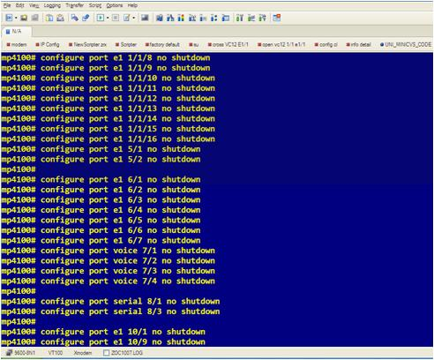
Command Line Interface (CLI)
Text file for easy configuration manipulation
Mass configuration update
Support for configuration scripts, automated processes and predefined configurations
Easy integration to 3rd party NMS
Uniformity with RAD CLI based products

