Slide 1
Cabinets – ROC-19 July 2013
Name : Meira Erez
Title : PLM

Slide 2
ROC-19/19L – Ruggedized Outdoor Cabinet
Outdoor cabinet for one 19”-wide RAD unit, with integrated fiber splicer and guides
Corrosion resistant, IP-56-or IP-66, NEMA-4-rated metal enclosure
Effective grounding and over-current protection
2- or 3-point door locking
Intake fan with replaceable filters, or passive cooling
Wall or pole mounting
Notes:
Introduction
Product Overview
Physical View
New Features
Features
Applications
1…
2…
3….
Management
Feature comparison table
Product/Portfolio Value Proposition
Sales Tools On-Line
Ordering information
Summary
Road map (Optional)

Slide 3
ROC-19 – Ruggedized Outdoor Cabinet
Feature | ROC-19
Outdoor cabinet for 19” RAD’s device with 2-point door locking | N/A
Outdoor cabinet for 19” RAD’s device with 3-point door locking | Yes
Passive ventilation | N/A
Fan unit with 2 field replaceable air filters, thermostat controlled | Yes
24VDC | Yes
48VDC | No
Metal enclosure, IP-56 degrees of protection , NEMA-4 rating | Yes
Metal enclosure, IP-66 degrees of protection , NEMA-4 rating | N/A
Size: H 636[mm]x W 657[mm]x D 232[mm] | Yes
Rain hood | Yes
Metal Fiber Optic termination box, with 6 x LC SM Duplex adapters and Splice protection tubes holder | Yes
3A GMT fuses terminal | Yes
Two power circuit brackets | No
Notes:
Introduction
Product Overview
Physical View
New Features
Features
Applications
1…
2…
3….
Management
Feature comparison table
Product/Portfolio Value Proposition
Sales Tools On-Line
Ordering information
Summary
Road map (Optional)

Slide 4
ROC-19L – Ruggedized Outdoor Cabinet
Feature | ROC-19 | ROC-19L
Outdoor cabinet for 19” RAD’s device with 2-point door locking | N/A | Yes
Outdoor cabinet for 19” RAD’s device with 3-point door locking | Yes | No
Passive ventilation | N/A | Yes
Fan unit with 2 field replaceable air filters, thermostat controlled | Yes | No
24VDC | Yes | Yes
48VDC | No | Yes
Metal enclosure, IP-56 degrees of protection , NEMA-4 rating | Yes | Yes
Metal enclosure, IP-66 degrees of protection , NEMA-4 rating | N/A | Yes
Size: H 636[mm]x W 657[mm]x D 232[mm] | Yes | Yes
Rain hood | Yes | Yes
Metal Fiber Optic termination box, with 6 x LC SM Duplex adapters and Splice protection tubes holder | Yes | Yes
3A GMT fuses terminal | Yes | No
Two power circuit breakers | No | Yes

Slide 5
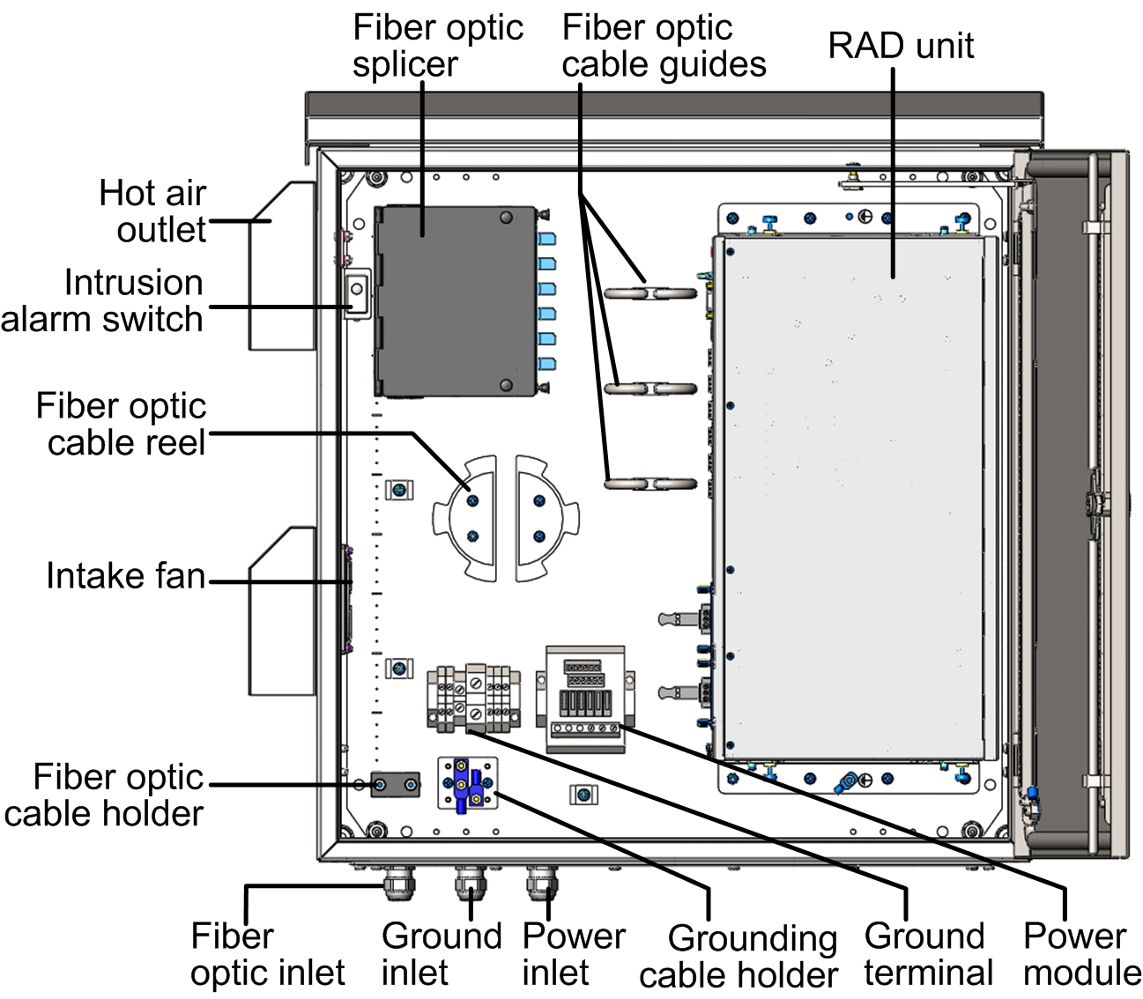
ROC-19 – Physical View

Slide 6
ROC-19L – Physical View
ROC-19L

Slide 7
New Features
Features | Description | Customer Benefits
IP56-66/ NEMA-4 Rating | IP56 (ROC-19) and IP66 (ROC‑19L) degrees of protection/NEMA-4 rating | Protection against dust, rain and external ice formation
Effective Grounding and Over-Current Protection | Two holes grounding terminal GMT fuses terminal or Circuit breakers | Protection against short-circuit and overload conditions
Cable Splicing and Guide System | Quick released modular fiber box | Convenient cable routing inside the cabinet
Door Locking and Intrusion Detection | 2-point (ROC‑19L) or 3-point (ROC‑19) door locking mechanism Intrusion alarm switch | Secure maintenance access
Efficient Ventilation | Intake fan with replaceable air filters (ROC-19). Passive convection (ROC‑19L). | Protection against overheating
Notes:
Legacy and ETH services
E1, V35 and Fast Ethernet extension
multiple SHDSL.bis lines – up to 2 pairs (11.4Mbps)
Standards-compliant SHDSL (ITU-T G.991.2 and ETSI 101524)
Advanced ETH capabilities
VLAN prioritization and Ethernet QoS support enable better provisioning and monitoring of the ETH services
EFM bonding enable high reliability in case of failure of one of the DSL lines
SHDSL EOC management channel (inband)
Functions as CPE opposite central devices (LRS-102/Megaplex-4100, HONET Huawei)

Slide 8
Ordering Options
Option | Description
ROC-19L | Outdoor cabinet with 2-point door locking and passive ventilation
ROC-19/24V | Outdoor cabinet with 3-point door locking and thermostat-control intake fan, 24 VDC input

Slide 9
Meira Erez
Last mile PLM
Email: meira_e@rad.com

