Slide 1
Solution Note:
Railway Crossing Accident Prevention
Customer Type:
Intercity train
Strategic Sales Development

Slide 2
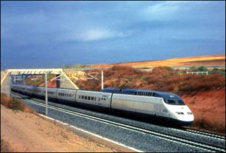
Customer Requirements
Customer
Intercity train
Customer requirements
Automatic and real-time warning system for notifying train driver and control center of rail and crossroads’ related events (e.g. stuck vehicles)
Video streaming from crossroad area towards approaching trains and Control center
Approaching train will get real time video communications starting at 5km’ ahead of any crossroad
Crossroad traffic lights and Barriers

Slide 3
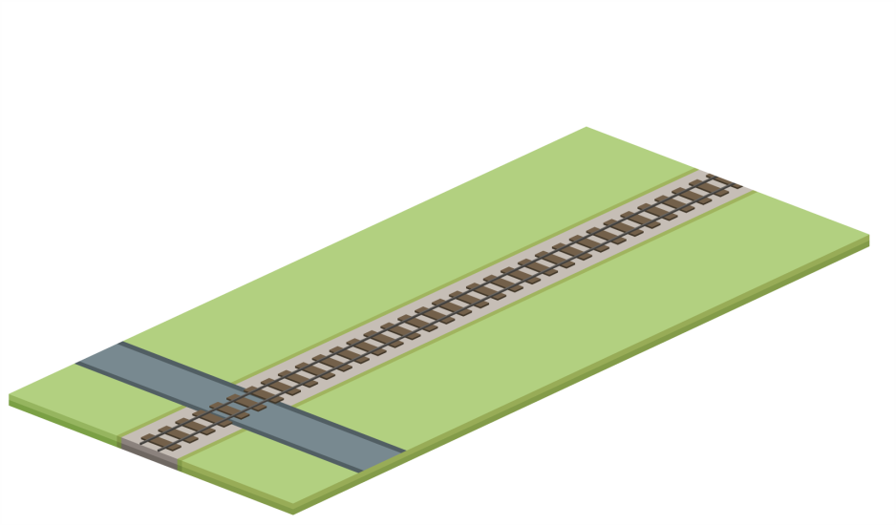



Railway Crossing Accident Prevention
Single surveillance camera

Slide 4

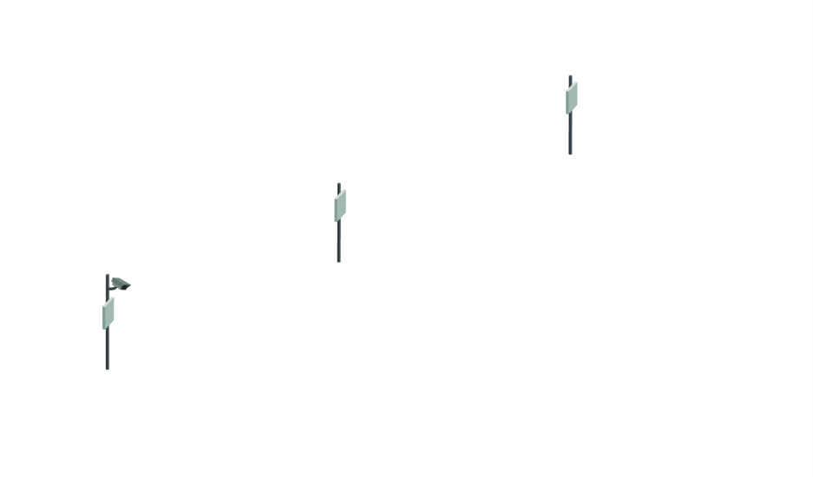

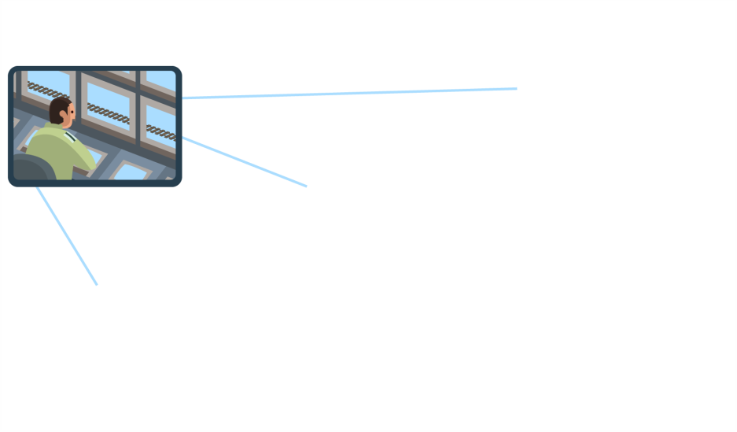


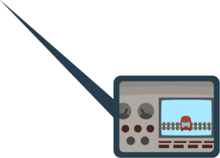

Railway Crossing Accident Prevention
Command Center
Approaching
train alerted
Radios without camera
Real time video
& data transmitted
to train monitor
Car on railway line detected using video streaming

Slide 5


Railway Crossing Accident Prevention
Ongoing transmission to
train is secured using
handover capabilities
Train stops in time
to prevent an accident

Slide 6
Solution Highlights
Wireless system, Airmux-5000 Mobility, covers Railway track in proximity to Crossroads
Video information is streamed from cameras located at each crossroad to Control Center and towards approaching trains
Wireless Handover capability to secure communication
Fixed or Wireless backhauling
Central Video Management system

Slide 7

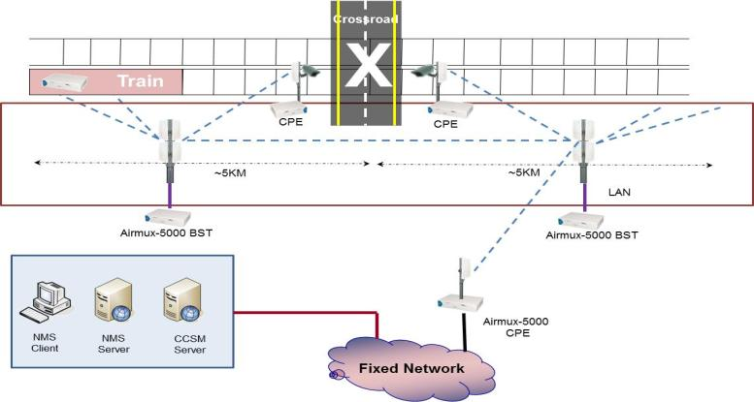

Typical Architecture

Slide 8
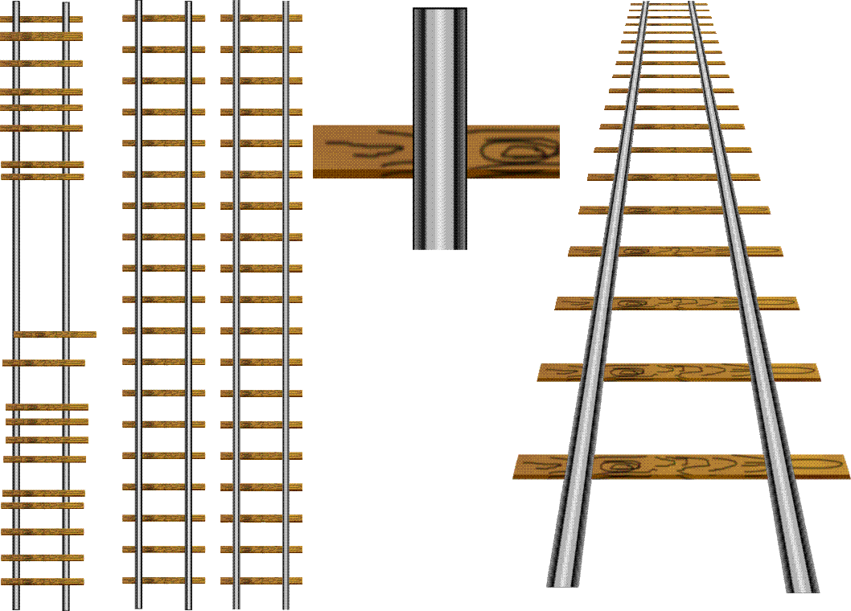



Track Side Architecture
ETX-26 for Radio Backhaul (Protected GbE ring over Fiber Optics)
Airmux-Mobility - Radio connectivity Train to Track-side
Central management solution
Mobile Radio
Mobile Radio
Radwin
RADview-EMS
ETX-26
ETX-26
Ethernet Fiber Optic Ring

Slide 9
Solution Description
A wireless communication system is installed alongside the rail road in proximity to each crossroad providing RF coverage along the rail.
The system enables the capability for moving trains (in speeds of up to 300KM/hr.) to view and send real time streaming video signal as well as TCP data from and to the command and Control Center.
The system enables bi-directional communications to both the vehicle and fixed elements (i.e. video surveillance cameras).
Cameras installed on each crossroad are connected to the wireless system BST and constantly transmit live video streaming to the Command & Control Center.
As the train enters the BST coverage area, the video streams of the cameras are displayed at the locomotive cockpit using a dedicated portable device.
The wireless system allows seamless handover as the train passes through one BST coverage area to the next BST coverage area.
Central video management system allows live view and control over the video streams with optional capabilities of GIS, video analytics, connection to the CRM system and integration to any 3rd party system.
All video streams can be reordered on both the C&C Center and locally on the train.

Slide 10
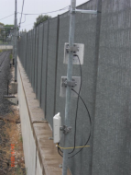
Solution Architecture
Base Station
  2 x BST, located ~2KM from each side of the crossroad along the rail side.
  High BW connectivity to the moving train, and backhauling to both the cameras
  and the rail fixed network.
  Coverage area of the 2 BST is expected exceed the 5Km’ range from the crossroad
Cameras
  At least 2 Cameras to cover the entire crossroad area and provide backup to each other.
  Each Camera will be connected to the network by an Airmux-5000M SU unit
Command & Control Center
  Video management system which will control all crossroad camera feeds.
  Hierarchy model enables the same system to run at the nearest branch of the crossroad (on duty point) and also on central office with 24/7 recording.
Train
  Single Airmux-5000M SU enables constant connection to the nearest BST and seamless handover when moving between BST.
  Each SU will be connected to 2 aerodynamic antennas (shark style) using space diversity technology.
  A rugged laptop will be mounted in the locomotive cockpit for viewing video streaming.

Slide 11
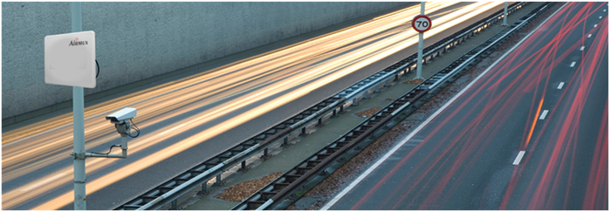
Solution Benefits
    High Uplink/Downlink Throughput – Enables 2-way Broadband services e.g. High-Definition (HD) video traffic between BS and Train
    Redundancy - Designed for complete system redundancy that guarantees continuous connection and operation
    Sub-6GHz Frequencies Supported – Un-Licensed frequency band
    High bandwidth – 30MB aggregated bandwidth that can be defined as symmetrical or unsymmetrical
    Turn-Key solution (including crossroad barriers and traffic lights)

Slide 12

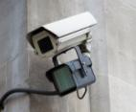



Communications Related Products
Wireless system
  RAD Airmux-5000M series
IP cameras
  UDP Technology IPE series
Tactical computer
  Panasonic Toughbook CF-31 w GPS
Video Management system
  Bynet BHLS system inc. HW and Video analytics
Ethernet switches (Crossroad and/or fixed backhauling)
  RAD ETX-26

