Slide 1
Ethernet Access over SDH/PDH
Presented by:
Sarit Carmelli
Professional Services Engineer
sarit_c@rad.com

Slide 2









Variety of Ethernet Access Solutions – Implementation Scenario
Branch
Ethernet over PDH
Ethernet over SDH/SONET
Branch
RICi-E1
RICi-622GE
STM-4/OC-12
RICi-622GE
GbE
10BT
GFP
GbE
Branch
Branch
RICi-4/8E1
MLPPP
GbE
RICi-155GE
STM-1/OC-3
RICi-155GE
GbE
10BT
Branch
EoPDH
ADM
100BT
RICi-16
Ethernet over DSL
Branch
GFP-VCAT
SDH
IPDSLAM
LA-210
F.ETH
STM-1/OC-3
GbE
EFM
Bonding
GbE
IPDSLAM
Branch
Egate
Service Provider
Packet Switched
Network
GbE
LA-110
ATM
F.ETH
Ethernet over Fiber
F.ETH
ETX-202
GbE
ASMi-54
ASMi-54
Headquarters
GbE
ETX-202A
GbE
Metro
Ethernet
GbE
Branch
Extending the reach of the provider’s network over a variety of access technologies
Consistent Ethernet service across different access technologies

Slide 3
Agenda
Basic Ethernet Access Features
Applications
OAM- Operation, Administration and Maintenance
Flow based traffic concept
Products line overview
  RICi Family
  Egate Family
  Summary

Slide 4
Ethernet Access
Features

Slide 5
Ethernet Access Characteristics
Features
VLAN
Fault Propagation
QoS – Quality Of Service
Protocols
GFP, VCAT, LCAS
HDLC and MLPPP

Slide 6


VLAN Tagging/Stacking/Stripping
w tag
w/o tag
w tag
tagged
w tag
tagged
w tag
w/o tag
Tagging
LAN
SDH/
SONET
LAN
Stacking
tag
w/o tag
double tag
tagged
double tag
tagged
tag
w/o tag
Name | Configuration | IN | OUT
Tagging | Vlan Aware mode + Accept frame type= All | ETH FRAME | ETH FRAME + V.TAG
 |  | ETH FRAME + TAG | ETH FRAME + TAG
Stacking | Ingress Tag Handling= Stacking | ETH FRAME | ETH FRAME + V.TAG
 |  | ETH FRAME + TAG | ETH FRAME + TAG + V.TAG
Stripping | Egress Tag Handling= Stripping | ETH FRAME + TAG + V.TAG | ETH FRAME + TAG
 |  | ETH FRAME + V.TAG | ETH FRAME

Slide 7

Fault Propagation
Backup
ETH
ETH
LAN
LAN
SDH/
SONET
ETH Link is down
ETH Link is down
AIS

Slide 8
Quality-of-Service
Different Types:
802.1p
DSCP (TOS Byte)
IP Precedence
Per Port
Traffic Class (Priority) Queue
Traffic Class (Priority) Queue
MNG
3
MNG
3
Highest
Highest
2
2
VLAN Priority
1
1
VLAN Priority
MNG
7
Data
0
Lowest
Lowest
0
Data
MNG
7
LAN
SDH/
SONET
LAN
Data
3
Data
3
VLAN Priority
VLAN Priority
VLAN Priorities 0-7
7
6
5
Queue
4
3
2
User Stacks VLAN ID
User maps VLAN Priority to required queue
3
1
2
0
1
0
Notes:
There are several types of quality of services:802.1p, DSCP, IP Precedence, Per Port. In the example infront of us we will talk about 802.1p.

Slide 9
Protocols – Carrying Traffic over Single Link Vs Multi-link
Single E1 link: PPP, HDLC, GFP
LAN
4
3
2
1
SDH/
SONET
4
3
2
1
LAN
Multilink (E1 Bonding): MLPPP, GFP VCAT
4
3
2
1
SDH/
SONET
4
3
2
1
LAN
LAN
Reordering Feature
4 x E1
4 x E1
Reordering Feature
MTU Fragmentation
    Fine Tuning Delay Vs. Throughput
MTU = Maximum Transfer Unit

Slide 10
GFP – Generic Frame Procedure
VCG1
TDM framer
of Link 1
in VCG 1
Ethernet Frame
GFP
Encapsulation
LCAS & BONDING
Mechanism
To PDH
TDM framer
of Link N
in VCG 1
Standard protocol
Allow interoperability between different vendors
Reduced latency, for time-sensitive services, Byte by byte transmission
Fixed overhead (unlike HDLC):
Improved line utilization
Predictable throughput regardless of data transmitted

Slide 11
GFP Types
TS 0
GFP over PDH network
RICi-E1/T1, RICi-16
Standard – GFP (G.8040)
GFP frame
E1
STM-1
VC-12
VC-12
header
DATA
header
DATA
GFP over SDH network
RICi-622GE, RICi-155GE
FCD-155
Standard - GFP (G.7041 )
GFP frame
DATA
DATA
DATA
DATA
DATA
DATA
STM-1
VC-12
VC-12
header
TS 0
header
TS 0
GFP over E1 over SDH
Egate-100
Standard – GFP (G.8040)
GFP frame
E1
E1

Slide 12
Applications

Slide 13



Ethernet Access over PDH
Customer Premises
ETX-202 with
MIRICi-E1/T1
E1/T1
ETH
Customer Premises
E1/T1
RICi-E1/T1
ETH
Provider’s Node
Customer Premises
Egate-20
n x E1/T1
RICi-4/8
FE
ETH
Egate-100
8 x E1/T1
Customer Premises
PSN
ETH/IP/MPLS
GE
STM-1/OC-3/
3 x DS3
RICi-16
PSN
n x E1/T1/
2 x DS3
SDH/
SONET
n x E1/T1
ETH
FE
RICi-16
Customer Premises
n x E1/T1
RICi-16
ETH
Control Room

Slide 14


Egate and RIC
Service Delivery Concept
Carrier CO
Customer Premises
Egate-20
Egate-100
RICi-16
SDH/
SONET
RICi-E1/T1
Ethernet
Traffic
F.Ethernet
PSN
TDM
Management
Up to 248 CPEs
NMS
RICi-E1/T1
F.Ethernet
VLAN tagging/stacking at customer edge or provider edge
Secured separation of customer Data and management traffic
Up to 256 Bridge Ports

Slide 15

Carrier Application
3rd Party Point to Point Devices
Ethernet
E1
E1
Ethernet
Ethernet
E1
E1
Ethernet
Ethernet
E1
E1
Ethernet
Ethernet
E1
TDM
Network
E1
Ethernet
Ethernet
E1
E1
Ethernet
Ethernet
E1
E1
Ethernet
Ethernet
E1
E1
Ethernet
Ethernet
E1
E1
Ethernet
Disadvantages:
  Not Managed
  A lot of products

Slide 16
Carrier Application New Solution
Egate-100 Vs RICi-E1, Point to Multi Point
Ethernet
RICi-E1
E1
Ethernet
E1
Ethernet
E1
Ethernet
E1
Ethernet
E1
STM-1
Egate-100
G. Ethernet
PSN
Network
TDM
Network
Ethernet
E1
Ethernet
E1
Ethernet
E1
PSN
Network
Advantages:
  All products Managed
  Less products in the application
  RICi-4/8/16 support, for increased Bandwidth

Slide 17






Egate-100: Split Horizon
CPE
Two ways to use the Split Horizon:
    Per Logical Port
    Per VLAN
DSL
CPE
IP-DSLAM
RIC
n x T1
DSL
ETH
CPE
Broadcast
VLAN A
DSL
CPE
DSL
CPE
IP-DSLAM
Egate-100
BRAS
RIC
SDH/SONET
Network
IP/ETH
Network
DSL
ETH
n x T1
GBE
CPE
Broadcast
VLAN A
VLAN A
DSL
Split Horizon
CPE
DSL
CPE
IP-DSLAM
RIC
DSL
ETH
n x T1
CPE
Broadcast
Benefits:
  Security
  Avoid broadcast storms
VLAN A
DSL
Notes:
split

Slide 18





Egate-100: TDM Loop Detection
Remote Branch
Headquarters
E1
FETH
Egate-100
ADM
ADM
PSN
GbE
STM-1
SDH
Remote Branch
E1
FETH
CO/POP
NMS
Once TDM loop is detected, the specific port is shut down
Avoids Broadcast Storms

Slide 19
OAM

Slide 20


Standards OAM:
Operations Admin. & Maintenance
Customer Premises
Customer Premises
CPE
E-NTU
E-NTU
CPE
Operator B
Operator A
802.3ah
(Access Link ME)
802.1ag/ Y.1731
(UNI-N to UNI-N ME)
A summary of available Ethernet OAM Mechanisms
 | End-End/Last Segment | Performance Monitoring | Type | Fault Propagation | Implementation
IEEE 802.3ah (Clause 57) | Single Segment | No | Link | No | Standard
IEEE 802.1ag | End-to-End | No | Connectivity | No | Standard
ITU-T Y.1731 | End-to-End | Yes | Service | Yes | Standard
Notes:
OAM-

Slide 21
OAM Tools – Summary
OAM Function | Tools | Comments
Connectivity Verification | 802.3ah heartbeat | Heartbeat rate is 1 second
 | 802.1ag CC pre-stand. | 1 sec today - 100 msec in v3.8
 | 802.1ag LB pre-stand. | Can be used continuously as CC
Fault Detection & Isolation | 802.1ag LT | Trace route like functionality
 | 802.1ag LB | Ping like functionality
 | Virtual Cable Test (VCT) | Discover copper faults and locate them
 | L3 Ping and Trace route | Limited as troubleshoots IP connectivity
Fault Propagation | Subscriber port shutdown | Effective currently since no CE with OAM
 | 802.3ah Dying Gasp Trap | Send trap upon power failure
Diagnostic Loopbacks | L1 loopback | Does not traverse L2 Bridge
 | L2 loopback | Line rate per VLAN or port
 | 802.3ah loopback | Entire port. L2 no MAC Swap
Performance Monitoring | Y.1731 based, proprietary | RT measurements, +/- microsec
 | Per VLAN/EVC Statistics | On actual data (no sampling)
 | Etherstats* per RMON | RFC 2819

Slide 22
Flow based traffic concept

Slide 23




Supported Service Topologies:
Port based service:
Different user ports
Customer Premises
POP
VoIP
4 Mbps
RAD
Edge
Device
RAD
GE
PSN
ETH/IP/MPLS
Premium data
16 Mbps
Ethernet
Aggregator
Best Effort data
Flow based service : ‘Service multiplexing‘
Same user port
Different flows (e.g VLAN)
Customer Premises
POP
VoIP
Edge
Device
4 Mbps
RAD
RAD
16 Mbps
GE
PSN
ETH/IP/MPLS
Premium data
Best Effort data

Slide 24
Increase Revenue –
Oversubscribe Business Customers
How much bandwidth can you sell on a 10Mbps WAN port?
A. 10 Mbps
B. 20 Mbps
Committed Rate=Peak Rate=10
Monthly=4x$500=$2000
Committed Rate=10. Peak Rate=20
Monthly=4x$500+4x$250=$3000
PIR=CIR + EIR
CIR:
2.5 Mbps
EIR:
2.5 Mbps
50% Revenue Increase
10 Mbps
EIR:
2.5 Mbps
CIR:
2.5 Mbps
10 Mbps
CIR:
2.5 Mbps
PIR:
5.0 Mbps
Traffic Management
CIR:
2.5 Mbps
EIR:
2.5 Mbps
EIR:
2.5 Mbps
CIR:
2.5 Mbps
CIR:
2.5 Mbps
CIR:
2.5 Mbps
CIR:
2.5 Mbps
PIR:
5.0 Mbps
EIR:
2.5 Mbps
CIR:
2.5 Mbps
CIR:
2.5 Mbps
EIR:
2.5 Mbps

Slide 25





Bridge concept & configuration
Enclosure
Layer 2 Bridge
Aware/Unaware
Ethernet
E1s
NMS
RICi-E1
PC1
ST/ST
ST/ST
F.ETH
⇒ B.P
VLAN ID #2
Data
PHY E1
⇒ Logical Layer
⇒ B.P
VLAN ID #1
MNG
Web Server
RICi-E1
PC2
ST/ST
ST/ST
F.ETH
⇒ B.P
PHY E1
⇒ Logical Layer
⇒ B.P
Host
B.P
B.P #1 ⇒ Host
Logical Layer
ST/ST = Stacking/Stripping
B.P = Bridge Port
Physical Layer

Slide 26

EtherAccess Feature-set
  EPL/EVPL services
  Flow based
  MEF 9 & 14 EPL, EVPL certified
  Traffic classification and mapping
    CE VLAN ID, P-bit, DSCP, IP Precedence
  Enhanced QoS
    Policing per service
    Dual leaky bucket supporting CIR+CBS, EIR+EBS
    Scheduling – Queues according to Strict priority or WFQ
    Rate limit on the egress port - Conforms egress traffic to specific rate
  OAM
    IEEE 802.3-2005 (formerly 802.3ah) – Single Segment
    IEEE 802.1ag – End-to-End
    ITU-T Y.1731 – End-to-End & PM

Slide 27
Products Line
Overview

Slide 28
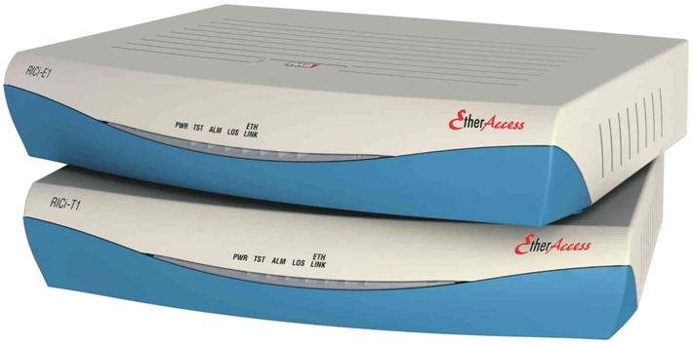
RICi-E1, RICi-T1
New standard encapsulation: GFP-G.8040
Extreme temperature: -22–70°C (7.6–158°F)
24 VDC metal box enclosure support extreme temperature
Physical E1/T1 port changed
Flow control support at 100 Mbps
New!!!
Version 2.10

Slide 29
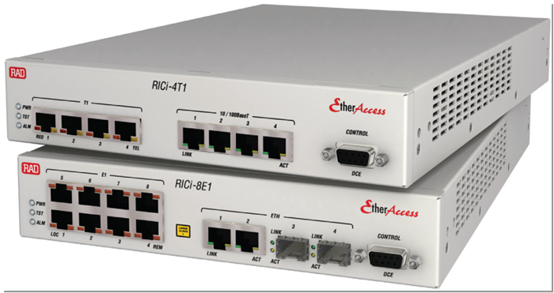
RICi-4E1/T1 / RICi-8E1/T1
OAM & Diagnostics
  802.1ag/Y.1731 OAM
  E1/T1 BERT
Management:
  Secure Web session (SSL)
  Secure Telnet session (SSH)
  Radius authentication system

Slide 30
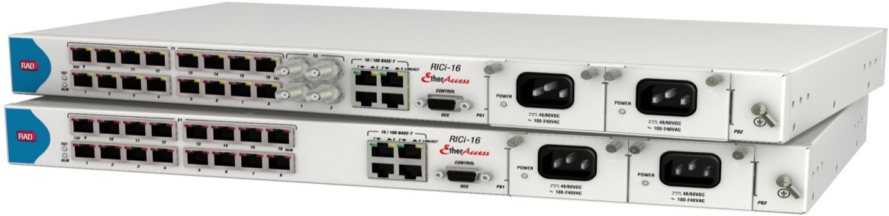
RICi-16
MEF 9 & 14 Certified for EVPL/EVPLAN
PDH interfaces
  4,8 or 16 E1/T1 framed ports
  Two Channelized or Un-Channelized T3 uplinks
  Encapsulation and bonding:
    GFP (G.8040), VCAT (G.7043) & LCAS (G.7042)
Ethernet interfaces
  4*10/100BaseT interfaces
  1 SFP based 10/100 port
  Ethernet OAM 802.3ah, 802.3ag, Y1731

Slide 31
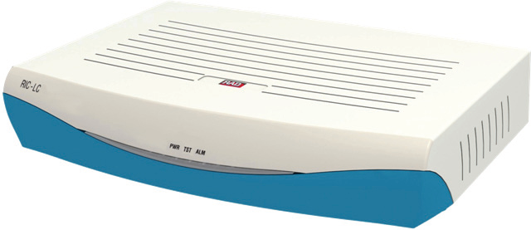
RIC-LC
Ethernet traffic up to 16 bonded E1 ports using Ethernet
over NG-PDH protocols
VLAN tagging and stacking for full separation of Ethernet
user traffic from management data
  Encapsulation and bonding:
    GFP (G.8040), VCAT (G.7043) & LCAS (G.7042)
Management
  In-band Management & Out of band Management
New!!!

Slide 32
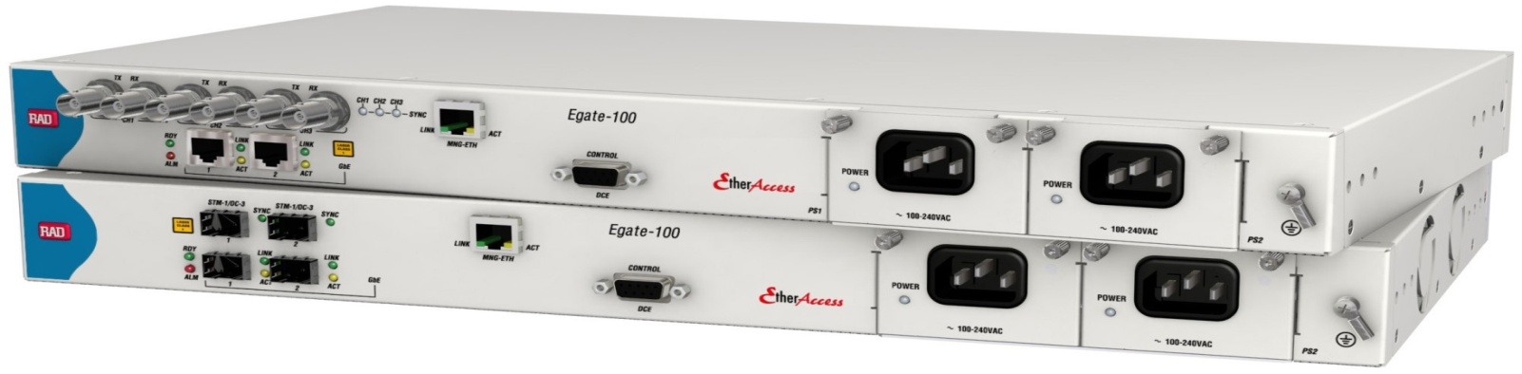
Egate-100 main features
Gigabit Ethernet over TDM Aggregation Gateway
Aggregates and switches Ethernet traffic to a single STM‑1/OC-3 port, or to three channelized T3 ports
aggregation capacity:
  42 bonded nxE1/T1 lines (GFP VCAT, MLPPP)
  Connects up to 84 remote LANs over E1/T1 (GFP, PPP, HDLC) or
  126 remote LANs over fractional E1 or T1 lines (GFP, HDLC)
Phase 4.0

Slide 33
Bridge capabilities
Bridging function between Ethernet over PDH remotes and GbE
Up to 130 ports
Bridge modes:
  VLAN unaware mode
  Full VLAN aware mode
Per port optional tag stacking/double tagging ( 802.1q tunneling or Q in Q)
Support for 64,000 MACs and 1024 VLANs
Per port ingress filtering Enable/Disable
Per port egress tag/untag
Per port MAC learning limitation

Slide 34

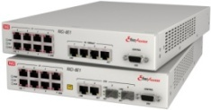
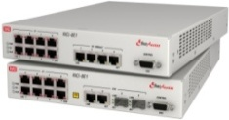
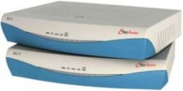
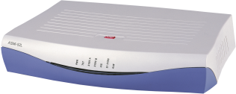
ETHoPDH Product Line
 | TDM Interfaces | Ethernet Interfaces | Supported Protocols | Services
RICi-16 | 4/8/16xE1/T1 2 x T3 | 4 x 10/100BaseT or 2 x 10/100BT and 2 x GbE *(SFP or UTP) | GFP (G.8040) VCAT (G.7043) LCAS (G.7042) MLPPP* | EPL/EVPL
RICi-8E1/T1 | 8 x E1/T1 | 4 x 10/100BaseT or 2 x 100FX 2 x 10/100BaseT | MLPPP (BCP) | EPL
RICi-4E1/T1 | 4 x E1/T1 | 4 x 10/100BaseT or 2 x 100FX 2 x 10/100BaseT | MLPPP (BCP) | EPL
RICi-E1 RICi-E3/T3 | E1/FE1 or T1/FT1 E3 or T3 | 10/100BaseT | GFP (G.8040) RAD proprietary HDLC Cisco HDLC | EPL
RIC-LC | 1/4/8/16xE1 | 4x10/100BaseT or 2 x 10/100BT and 2 x 100Fx | GFP (G.8040) VCAT (G.7043) LCAS (G.7042) | EPL
Premium NTU
Basic NTU
Basic Converter
* Next version

Slide 35
RICi-4E1/T1
RICi-8E1/T1 new h/w
 | TDM Interfaces | Ethernet Interfaces | Supported Protocols | Services
RICi-4E1/T1 RICi-8E1/T1 | 4E1/T1 8E1/T1 | 4 x 10/100BaseT or 2x10/100BT and 2xGE (SFP or UTP) | GFP (G.8040) VCAT (G.7043) LCAS (G.7042) MLPPP | EPL/EVPL
New H/W for RICi-4E1/T1 and RICi-8E1/T1
Plastic box. Metal box is available for hardened version
Same feature set as current platform – MLPPP
New RICi-16 features – GFP/VCAT/LCAS
Advanced EVPL features under s/w license
  Ethernet Flows
  Enhanced traffic classification
  QoS

Slide 36
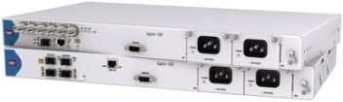


ETHoPDH Aggregation
 | TDM Interfaces | Ethernet Interfaces | Supported Protocols | Functionality
Egate-100 | 2 x ChSTM-1/OC-3 3 x Ch- T3 | 2 x GbE (Electrical/SFP) | GFP (G.8040) VCAT (G.7043) LCAS (G.7042) MLPPP (BCP) RAD proprietary HDLC | EPL/EVPL
RICi-16 | 16 x E1/T1 | 4 x 10/100BaseT or 100FX 2 x 10/100BaseT | GFP (G.8040) VCAT (G.7043) LCAS (G.7042) | EPL/EVPL
Egate-2000 | 1 x Ch. STM-4/16 4 x Ch. STM-1/4 | 8xGbE | GFP (G.8040) GFP (G.7041) VCAT (G.7043) LCAS (G.7042) | EPL/EVPL
new

Slide 37
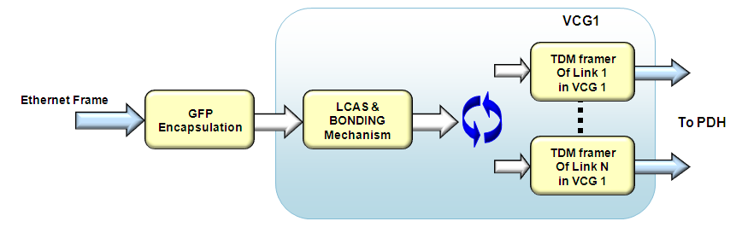
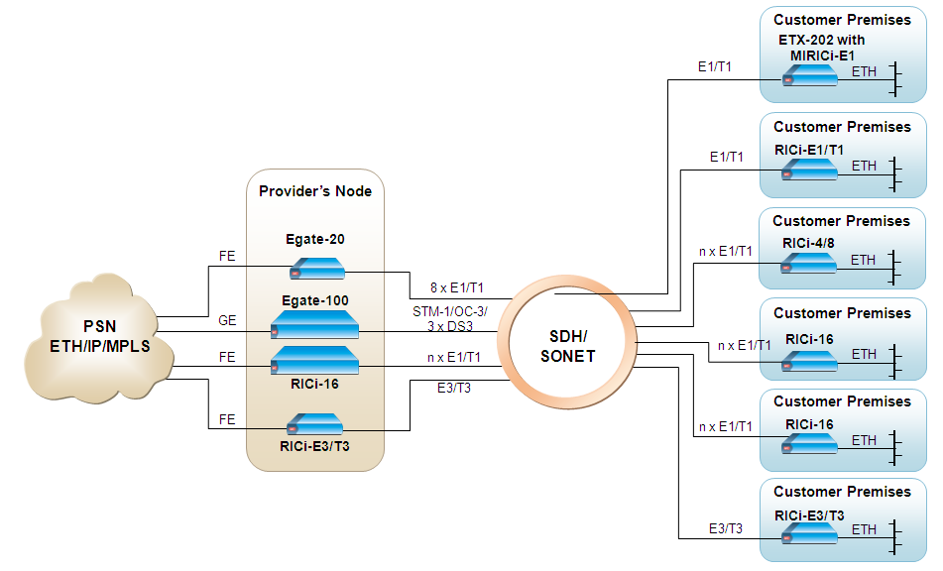
Summary
Makes use of widely available SDH/SONET infrastructure to provide customer Ethernet or Ethernet backhauling services
Very versatile service rate offering starting from E1/T1 up to STM-4/OC-12 (622 Mpbs)
GFP, VCAT, LCAS
Egate and RIC families

Slide 38
Sarit Carmeli
Professional Services Engineer
merav_s@rad.com

