Slide 1
Ethernet Access
Products Overview
Technical Seminar, Moscow 2011
Presented by:
Kfir Gerti
Technical Support Engineer

Slide 2

Agenda
Carrier Ethernet introduction
RAD product portfolio:
  ETHoFiber
  ETHoDSL
EtherAccess Feature-set
ETX Product Line Overview
  ETX-203A,ETX-204A and ETX-1002
LA-210 Product Overview
RAD’s EtherAccess Value proposition and advantages

Slide 3
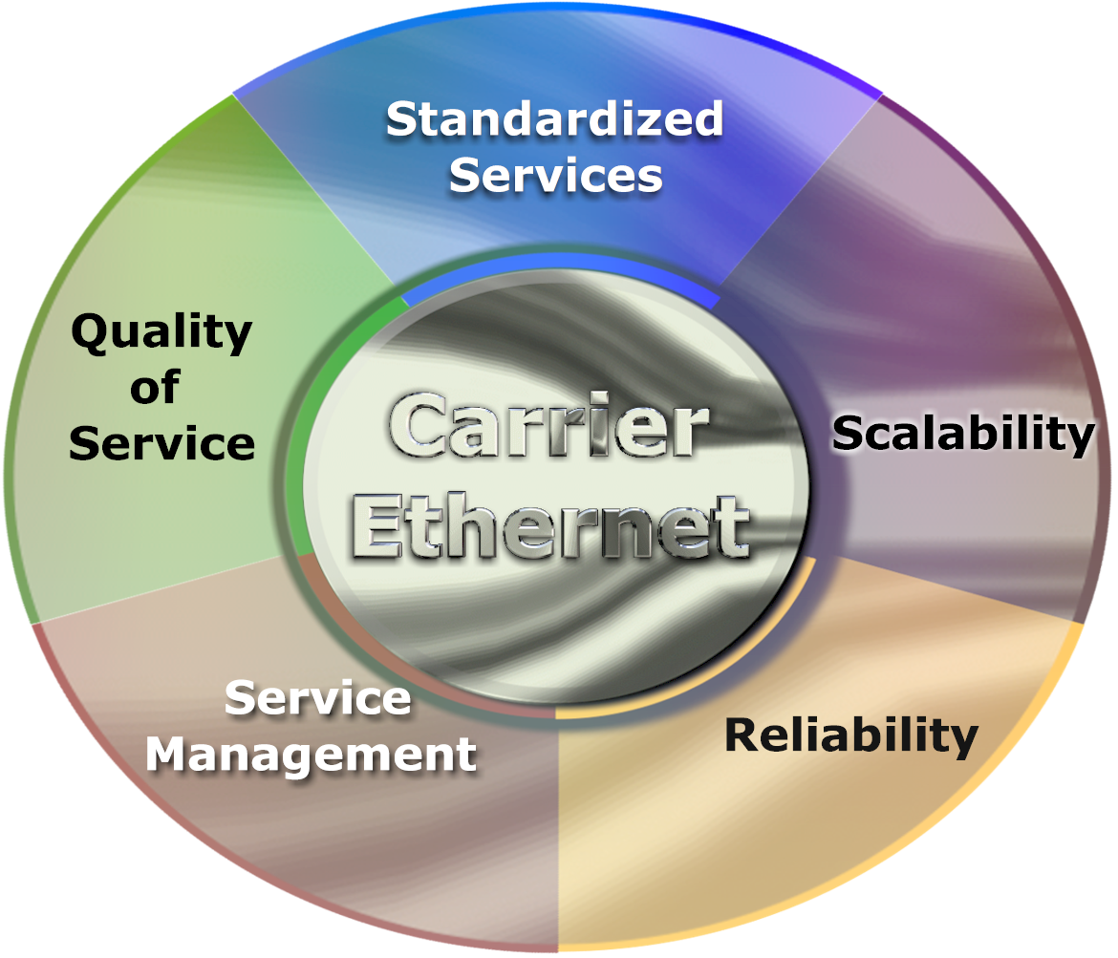
Carrier Ethernet is a Service
Carrier Ethernet Defined
Carrier Ethernet
Carrier Ethernet is a standardized,
carrier-class SERVICE defined by five
attributes that distinguish Carrier Ethernet
from familiar LAN based Ethernet
It brings the compelling business
benefit of the Ethernet cost model
to achieve significant savings
Carrier Ethernet Attributes
Standardized Services
Scalability
Service Management
Reliability
Quality of Service

Slide 4












RAD’s EtherAccess
Ethernet Services – Any Access
Branch
Ethernet over PDH
Ethernet over SDH/SONET
Branches
10BT
RIC
RIC
RICi-155GE
RICi-155GE
EoPDH
GbE
STM-1/OC-3
Branch
SDH/SONET
RICi-622GE
RICi-622GE
RIC
STM-4/OC-12
GbE
10BT
Branch
EoPDH
GbE
GbE
RIC
100BT
SDH
n x EoPDH
Bonding
STM-1/OC-3
Ethernet over DSL
Branch
GbE
Service Provider
Packet Switched
Network
DSLAM
Egate
n x 2W
Bonding
LA
GbE
10/100BT
Ethernet over Fiber
Branch
DSLAM
LA
Metro
Ethernet
ETX
GbE
2W
10BT
GbE
FE
100BT
Branch
GbE
ETX
1000Sx
Headquarters

Slide 5


EtherAccess Feature-set
EtherAccess – Enhanced L2 Ethernet capabilities over any access infrastructure
Connectivity Options
  EPL/EVPL services (MEF certified)
  Flow based
Traffic classification and mapping
  CE VLAN ID, P-bit, DSCP, IP Precedence
Enhanced QoS
  Policing per service
  Dual leaky bucket supporting CIR+CBS, EIR+EBS
  Scheduling – Queues according to Strict priority or WFQ
  Rate limit on the egress port - Conforms egress traffic to specific rate
Enhanced service creation & assurance OA&M
  IEEE 802.3-2005 (Link OAM)
  IEEE 802.1ag/Y1731 End-to-End (CFM/PM)
  Powerful L2/L3 loopback Allow multiple independent SLA monitoring instances
  Integrated RFC-2544 Generator
Resiliency:
  Linear protection based on G.8031
Synchronization over Packet
  Mature Sync-E and 1588-2008

Slide 6




























Services Option
E-Line: point-to-point
EVPL support service multiplexed UNI for point
to point connections
EPL connection replaces a TDM Private line
EVPL connection replaces ATM and FR
UNI
UNI
Carrier Ethernet Network
CE
CE
UNI
Point-to-Point EVC
UNI
CE
E-Tree: point-to-multi point
Point to multipoint connectivity –
Internet access and/or IP TV services
No connection between leafs
UNI
CE
Carrier Ethernet Network
CE
UNI
UNI
Point-to-Multipoint EVC
CE
E-LAN: any-to-any
Single bridge instance per UNI (EPLAN)
Several (virtual) bridge instances per UNI
(EVPLAN)
UNI
UNI
CE
Carrier Ethernet Network
CE
UNI
UNI
Any-to-any EVC
CE

Slide 7
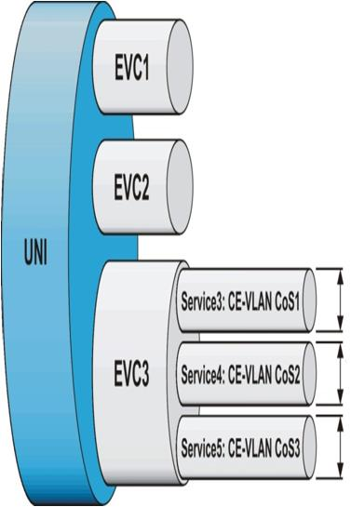
Service Differentiation
Port Based:
Single Service per UNI (EVC 1)
  Function: Map all incoming traffic from UNI port to single EVC
  Service: Ethernet Private Line (EPL);
  MEF Terminology: ‘All to one bundling’
Flow Based:
Multiple Services per UNI (EVC 1/2)
  Function: Map incoming traffic from UNI port to several EVCs according to some classifier
  (e.g. customer VLAN)
  Service: Ethernet Virtual Private Line (EVPL);
  MEF Terminology: ‘Service Multiplexing’
Multiple Services per EVC (Service 3/4/5)
  Function: Map incoming traffic from UNI port to several EVCs and mark different priorities per EVC
  Service: Ethernet Virtual Private Line (EVPL);
  MEF Terminology: EVC.CoS

Slide 8
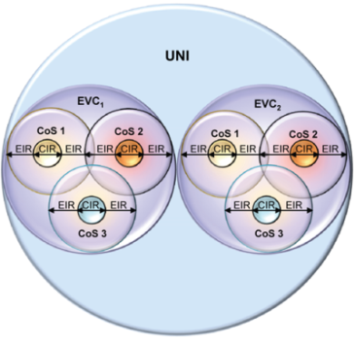
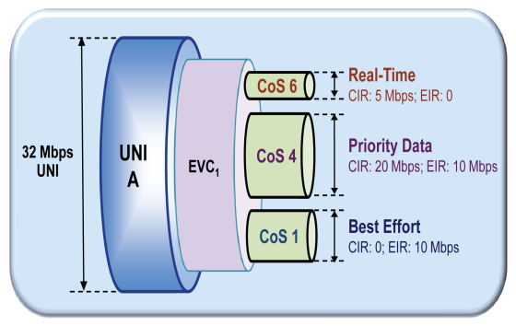
Traffic Management and
Bandwidth Control – Ensuring SLA
Tools
Traffic Classification
Multiple QoS/CoS
Hierarchical Scheduling
Per EVC shaping
CIR+EIR policing
Per service Performance
Benefits
Sell a port twice - EVC
Sell bandwidth twice - EIR
Differentiated services – CoS
SLA per serviceance

Slide 9
Increase Revenue –
Oversubscribe Business Customers
How much bandwidth can you sell on a 10Mbps WAN port?
A. 10 Mbps
B. 20 Mbps
Committed Rate=Peak Rate=10
Monthly=4x$500=$2000
Committed Rate=10. Peak Rate=20
Monthly=4x$500+4x$250=$3000
PIR=CIR + EIR
CIR:
2.5 Mbps
EIR:
2.5 Mbps
50% Revenue Increase
10 Mbps
EIR:
2.5 Mbps
CIR:
2.5 Mbps
10 Mbps
CIR:
2.5 Mbps
PIR:
5.0 Mbps
Traffic Management
CIR:
2.5 Mbps
EIR:
2.5 Mbps
EIR:
2.5 Mbps
CIR:
2.5 Mbps
CIR:
2.5 Mbps
CIR:
2.5 Mbps
CIR:
2.5 Mbps
PIR:
5.0 Mbps
EIR:
2.5 Mbps
CIR:
2.5 Mbps
CIR:
2.5 Mbps
EIR:
2.5 Mbps

Slide 10


Standards: OAM – Operation Administration & Maintenance
Delay, Jitter, Packet Loss, Availability
Operator A
Operator B
ITU-T Y.1731 (PM)/
802.3ag (CFM)
IEEE 802.3ah (EFM)
 | Type | Span | Scope | Standard Status | RAD Implement.
IEEE 802.3ah (Clause 57) | Link | Single Segment | Per UNI | Finalized | ☑
IEEE 802.1ag-D8 | Connectivity | End-to-End | Per EVC | Finalized | ☑
ITU-T Y.1731 | Service | End-to-End | Per EVC.CoS | Finalized | ☑

Slide 11
OAM – Operations Admin. & Maintenance
End-to-end
Connectivity Fault Management 802.1ag
Continuity check
Loopback
Link trace
Service
Performance Measurement Y.1731
Frame Delay
Frame Delay Variation
Frame Loss
Single segment (link)
IEEE802.3-2005 (802.3ah)
Discovery
Connectivity check
Remote loopback
Availability
Traps and 15 min PM statistics
Fault propagation

Slide 12
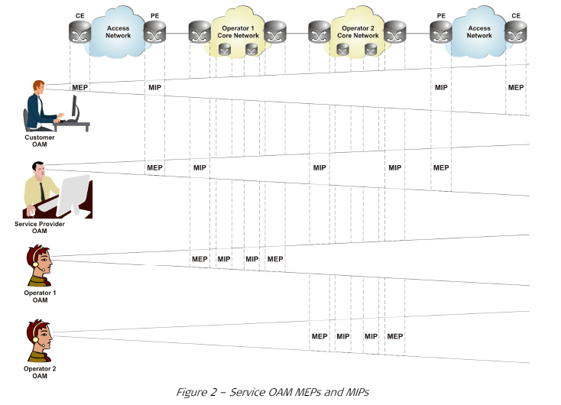
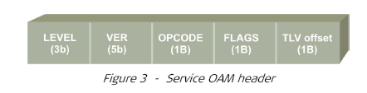
802.1ag/Connectivity Fault Management
MEP = Maintenance-End-Point
MIP = Maintenance-Intermediate-Point
8 OAM levels
MEP/MIP
Main messages:
  CC
  LB
  LT
  AIS
  RDI
  Lock
  (performance measurements)
Service OAM MEPs and MIPs
Service OAM Header

Slide 13
RAD’s EtherAccess
Ethernet Services – Any Access
Branch
Ethernet over PDH
Ethernet over SDH/SONET
Branches
10BT
RIC
EoPDH
RIC
RICi-155GE
RICi-155GE
STM-1/OC-3
GbE
Branch
SDH/SONET
RICi-622GE
RICi-622GE
10BT
RIC
STM-4/OC-12
GbE
Branch
EoPDH
GbE
GbE
RIC
100BT
SDH
n x EoPDH
Bonding
STM-1/OC-3
GbE
Service Provider
Packet Switched
Network
Ethernet over DSL
Branch
Egate
DSLAM
n x 2W
Bonding
LA
GbE
10/100BT
Ethernet over Fiber
Branch
DSLAM
LA
Metro
Ethernet
ETX
GbE
2W
10BT
GbE
FE
100BT
Branch
GbE
ETX
1000Sx
Headquarters

Slide 14







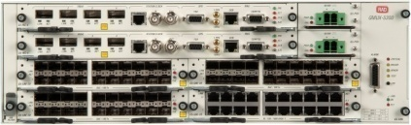
ETX Product Line Overview
Product | Net Port | User Port | T1/E1 PWE Timing | Service Topology | Class of Service
ETX-102/202 | 2xGE/FE | 4xGE/FE | - | EPL, EPLAN Per port | Strict Priority, WRR
ETX-204A/203A/ ETX-205A* | 2xGE | 2/4xGE | SyncTop (ETX-204A) | EVPL, EVPLAN PER EVC.COS | Strict Priority + WFQ 8 CoS
ETX-212A (Modular)* | 2xGE | 8xGE | TDM-PW SyncTop | EVPL, EVPLAN PER EVC.COS | Strict Priority + WFQ 8 CoS
ETX-220A* | (1:1) 10GbE | 1x10GbE |  | EVPL, EVPLAN PER EVC.COS | Strict Priority + WFQ 8 CoS
ETX-1002 | 24GbE, 4x10GbE |  |  | EPL, EVPL | Strict Priority + Weighted Round Robin
ETX-5300* (Full Redundancy) | 80xGbE / 16x10GbE |  | SyncTop 16xCh-STM1/OC3 | EPL,EVPL, EPLAN, EVPLAN PER EVC.COS | Strict Priority + WFQ 8 CoS
Ethernet Private Line (EPL) Support
CIR/CBS bandwidth profile per port
Ethernet Virtual Private Line (EVPL) Support
CIR/CBS, EIR/EBS bandwidth profile
per EVC.COS
Aggregation, Hub & Spoke, Ring
* Future

Slide 15
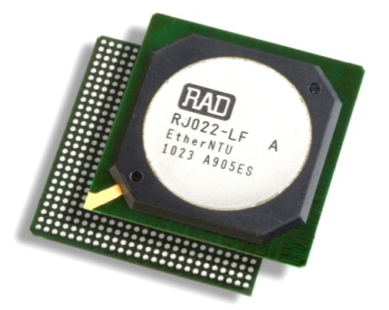

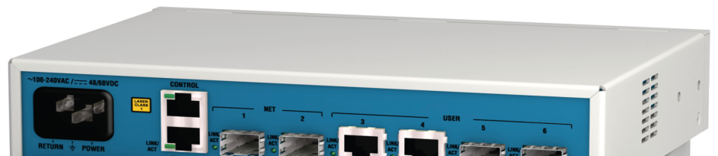
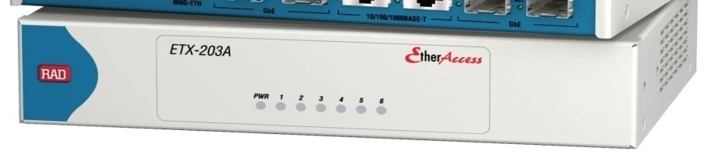
ETX-203A – ASIC Based NTU
Advance Services
SLA-enabled EPL/EVPL
Efficient BW control and Traffic Management
HW based OAM
15 SLA tools
End to End PM
Power
Built In AC&DC (48v) power supply
Low power consumption 6 to 8W

Slide 16
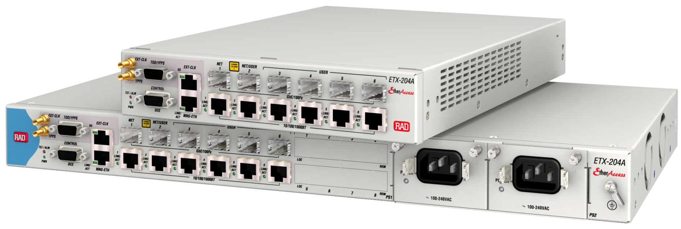
ETX-204A
Ethernet & Mobile Demarcation Device
Environmentally Hardened Option: (-20 to +65C)
2 network ports SFP/UTP combo
Timing from any port
  SYNC-E, external and master
  1588-2008, slave and TC
DB-9 (RS-232)
Local Management
4 user ports SFP/UTP combo
Modular AC/DC
(optional redundancy):
  100–240 VAC, 24/48V
Ethernet out of band management port

Slide 17






ETX-204A Mobile Demarcation Device (MDD)
Provide a clear demarcation between the service domain and the transport with proactive service monitoring and easy fault localization
Reduce OpEx with automatic fault management and end-to-end network visibility
Enhanced Timing capabilities
  SyncE
  1588v2
SyncE
SyncE
ETX-204A
ETH
eNB
POP site
RNC
PE
PE
ETX-204A
PSN
Transport
Network
GbE
ETH
eNB
ETX-204A
ETH
eNB
Transport Provider OAM
Mobile Operator Edge to Edge SLA Monitoring and Diagnostic
Notes:
17

Slide 18
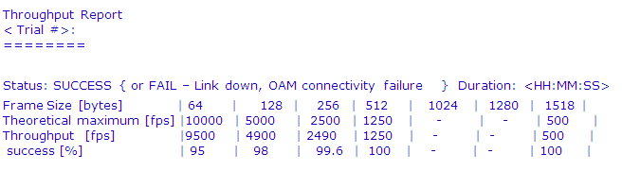
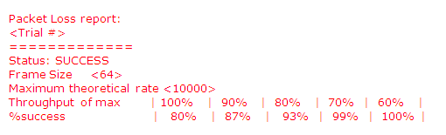

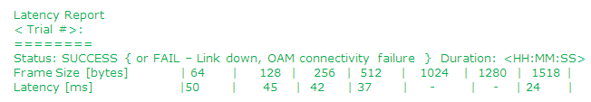
Integrated RFC-2544
While turning up a new Ethernet service, it is vital to provide performance metrics of the Ethernet network under test
ETX-203A integrated RFC-2544 generator contains the following functionalities:
  Unidirectional or bidirectional tests
  Measurements of throughput, latency, frame Loss
  Test report creation
  Frame type: OAM messages
RFC-2544
Retail
Wholesale

Slide 19



Service Availability –
Port and Linear Protection
Customer Premises
Port
Protection
ETX
CPE
ETH
PE
PE
Ethernet Linear
Protection Switching G.8031
Customer Premises
ETX
CPE
ETH
PE
PSN
ETH/IP/MPLS
PE
Customer Premises
PE
ETX
CPE
ETH
50ms protection, comparable to SDH/SONET
Combine physical port protection and EVC/logical link protection
Protection can be triggered on physical failures or OAM CC

Slide 20
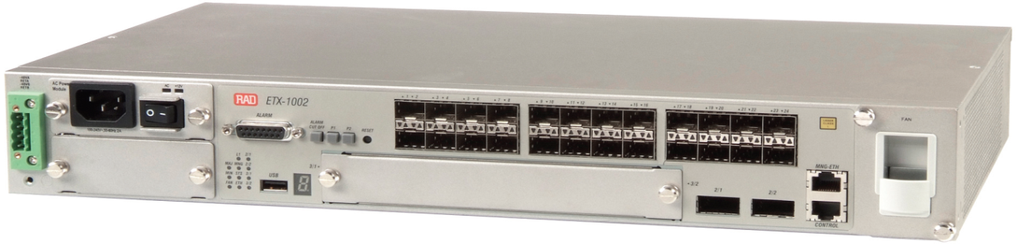
ETX-1002 Highlights
10 GbE Ethernet, wire speed Layer-2 switching non-blocking carrier Ethernet aggregation switch
24 x GbE/FE SFP ports (configurable User or Network)
2 x 10GbE XFP Network ports
Additional 2 x 10GbE via extension module
2 x Power supply AC/DC, redundant hot-swappable
Hot-swappable fan tray
Operating Temperature at -20°c to 65°c (-4°f to 149°f)
1.5 U high ETSI compliant

Slide 21



Ethernet Access Resiliency
Customer Premises
CE
ETX
ETX-1002
FE
FE/GbE
Edge
Device
CE
ETX
ETX-1002
FE
FE/GbE
ETH Ring
GbE/10GbE
PSN
CE
ETX
FE
FE/GbE
CE
ETX
FE
FE/GbE
GbE/10GbE
CE
ETX
ETX-1002
ETX-1002
FE
FE/GbE
ETH Ring
GbE/10GbE
CE
ETX
FE
FE/GbE
Ethernet ring comprise of ETX-1002 or other edge devices
Fast Ring protection mechanism – sub 50ms convergence time
Ling aggregation according to 802.3ad for GbE or 10 GbE

Slide 22
RAD’s EtherAccess
Ethernet Services – Any Access
Branch
Ethernet over PDH
Ethernet over SDH/SONET
Branches
10BT
RIC
EoPDH
RIC
RICi-155GE
RICi-155GE
STM-1/OC-3
GbE
Branch
SDH/SONET
RICi-622GE
RICi-622GE
10BT
RIC
STM-4/OC-12
GbE
Branch
EoPDH
GbE
GbE
RIC
100BT
SDH
n x EoPDH
Bonding
STM-1/OC-3
Ethernet over DSL
GbE
Service Provider
Packet Switched
Network
Branch
Egate
DSLAM
n x 2W
Bonding
LA
GbE
10/100BT
Ethernet over Fiber
Branch
DSLAM
LA
Metro
Ethernet
ETX
GbE
2W
10BT
GbE
FE
100BT
Branch
GbE
ETX
1000Sx
Headquarters

Slide 23

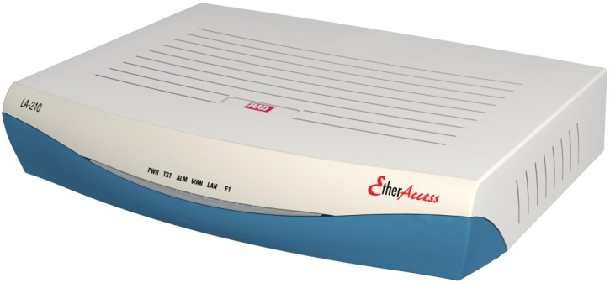
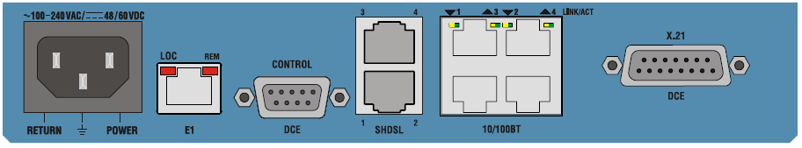
ETHoDSL – LA-210
Ethernet Access device supporting:
  SHDSL EFM:
    2wire – 5.7 Mbps
    4wire – 11.4 Mbps
    8wire – 22.8 Mbps
  VDSL2 (Phase 2.6)
    100 Mbps DS and 50 Mbps US
    Supporting VDSL2 profiles
      8a, 8b, 8c, 12a, 12b, 17a
MEF 9/14 certified product
Up to 4 Fast Ethernet
Serial data interface
(X.21, V.35)
E1/T1 port
WAN interfaces
SHDSL EFM (1,2 or 4 pairs)
VDSL2
Control port

Slide 24




Mid-Band Ethernet Services over DSL Infrastructure
Branch A
PBX
LA-210
SHDSL
E1/T1
Headquarters
IP DSLAM
ETH
LAN
ETX
IP DSLAM
ETH
Packet
Switched
Network
LAN
Branch B
PBX
LA-210
VDSL2
E1/T1
IP DSLAM
ETH
LAN
Description
EFM standards-based G.SHDSL.bis supports Ethernet, E1/T1 or serial services over 22 Mbps pipe (based on up to four bonded pairs of copper)
Customer Benefits
Ethernet “all-the-way” over DSL allows end-to-end Ethernet-based OAM
Eliminating ATM “cell tax” improves network resources utilization
Single access link for both Ethernet and legacy E1/T1/serial services

Slide 25




Cellular Backhauling over IP DSLAMs with Clock Distribution
Customer Benefits:
Reduces costs by leveraging DSL infrastructure for mobile backhauling
CAPEX savings by getting clock interface from the DSL modem
Increases 3G service coverage area for regions with no FO infrastructure
RAD Advantages:
Efficient & advanced EFM technology, supporting up to 22 Mbps over copper infrastructure
Full OAM/QoS feature set to maximize revenues & minimize Opex
Ethernet and E1 interfaces in the same device
NTR* Clock over SHDSL
RNC
IP DSLAM
3rd party
Cell Site GW
LA-210
PSN
ETH
E1
BTS /
NodeB
* NTR – Network Timing Reference

Slide 26
EtherAccess Value Proposition
Service Reach
Service Validation & Assurance
Control and Monitoring
SLA assurance
Traffic Management
ETHoFiber
ETHoPDH
ETHoSDH/SONET
ETHoDSL
Classification
Policing (CIR/CBS, EIR/EBS)
Scheduling
Rate Limit/Shaping
Services
EPL/EVPL
EPLAN
802.3-2005
802.1ag
Y.1731
RFC 2544
EVPLAN
Frame Delay
Delay variation
Frame Loss
Availability
G.8031

