Slide 1
Multiservice Access Platform & Last Mile Solutions
Presented by:
Meni Sasson
RAD Technical Support
Notes:
RAD AXCESS+ offers a complete solution for carriers, service providers and network owners. It includes customer-located equipment, central site devices and integrated management system for support of both legacy and next generation network infrastructure for deployment of both TDM and Ethernet services.
A part of AXCESS+ portfolio based mostly on TDM technology is named MAP – Multiservice Access Platform.
Time-division multiplexing was first developed in the 1870s (140 years ago) for the telegraph machine.
Pulse-code modulation was added in 1943 (SIGSALY encryptor).
In 1962 engineers from Bell Labs developed the first D1 Channel Banks, which combined 24 digitized voice calls over a 4-wire copper trunk (now we call it T1).
Almost half a century of effective live is quite greatly for communication technology.
While many vendors terminate their legacy TDM products, RAD continues to offer winning TDM service deployment strategy that enables to return their investments in access network, and facilitate a variety of new services.

Slide 2
Technologies in Transition
Background & Trends
SDH/ SONET Network
Traditional Services
Voice,
Data (LS, HS)
Copper,
Microwave,
Fiber
PSN Network
Ethernet Services
Traditional Services over SDH/SONET
Any services, over Any Media, to Any Network
Service Ethernet clients next to traditional ones over SDH/SONET
Carrying High bandwidth Ethernet traffic and traditional services over PSN network
Notes:
So the first task fulfilled by this equipment is to provide the access to traditional services over the different media and SDH transport network.
At the same time the basic tendency of the modern telecommunications development is Ethernet fast growing as the dominating transport technology.
Even when there are no Ethernet services sold, there may very well be an Ethernet transport network.
Adding customers to the network may eventually harm the existing customers. Performance management can establish a benchmark and indicate when capacity has to be added.
Here too all Access Media should be supported both on fault management and performance management.

Slide 3








MAP Target Customers & Applications
Target Customers:
Carriers & alternative carriers and service providers
Cellular operators
Private networks owners: Airports, Military and government
Utilities & Transportation
Main Trends
  NG-DLC (TDM based) is declining while MSAP (Ethernet based) is growing
  Ethernet over fiber is the major driver for MSAP
Target Applications:
Multiservice traffic for utility and transportation networks
Integrated data and voice solutions for private networks
Legacy services transport over packet switched networks
Ethernet and E1/serial over DSL/fiber aggregation
Service Provider
Enterprise
Utilities
Oil & Gas
Transportation
Airports
Government
Military
Notes:
As it follows from the MAP access abilities, it can be used in a wide range of different telecommunications applications.
This make it a winning solution for the large list of TC customers.

Slide 4

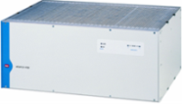




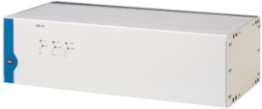



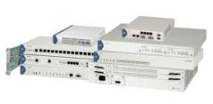
MAP Portfolio
Central Site
Customer Premises
DXC
Cross Connect
Grooming
Broadcast
Central Rack: Grooming
Multiplexing Aggregation
Fiber
E1
Megaplex
Multiservice Access Nodes
T1
FXS
PSN
FXO
Copper
FCD
E1/T1 access units
E&M
Megaplex
DXC
FCD-155
ETH
V.35
ASMi SHDSL Multiplexers
& Modems
TDM
X.21
Wireless
RS-530
Optimux
Fiber Multiplexers
Notes:
Some of MAP products are mostly dedicated for customer premises use and provide interface for wide variety of user’s traffic .
Another products are mainly developed for central site requirements.
At the same time both groups of solutions can be used at any segment of access network depending on the application.

Slide 5
Next Generation SDH/SONET ADM & Terminal (FCD-155x)

Slide 6
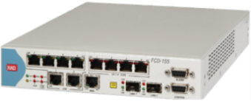
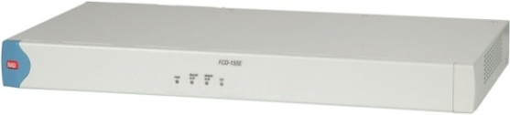
FCD-155, FCD-155E
Feature Highlights
NG STM-1/OC3 Terminal (155) or Add Drop Multiplexer (155E)
for grooming LAN and PDH traffic over SDH/SONET networks
Fast Ethernet and GBE services
GFP, VCAT and LCAS support
FCD-155: 4 or 8 E1/T1 ports, or E3/DS3 port PDH services
FDC-155E: 8 or 21 E1/T1 ports or E3/DS3 or Combination of 21 x E1/28 x T1 plus E3/T3
Management via DCC, IP tunneling or dedicated VC-12
Modular power supplies with optional redundancy
Station clock port
Notes:
The FCD-155/FCD-155E is a family of STM-1/OC-3 terminal multiplexers (TM) and add-drop multiplexers (ADM) for use in SDH and SONET networks.
The FCD-155/FCD-155E can provide the following services over SDH/SONET
networks:
• Layer 1 (transparent) transport of 10/100 Mbps Ethernet traffic, with configurable bandwidth
• Layer 2 switching of Ethernet traffic up to the GbE level, with configurable QoS
• Support for link aggregation to increase the bandwidth available to Ethernet traffic
• Transparent transport of legacy TDM (PDH) traffic at the E1, E3, T1, and T3 levels
For efficient bandwidth utilization, FCD-155/FCD-155E support LO and HO virtual
concatenation, including GFP (Generic Framing Procedure) encapsulation or LAPS (Link Access Procedure – SDH). For reliable transmission, FCD-155/FCD-155E also support LCAS (Link Capacity Adjustment Scheme).
Installing FCD-155/FCD-155E on customer’s sites allows a cost-effective deployment of the SDH/SONET infrastructure for Internet access and LAN connectivity, while providing continued support for all legacy services. It also provides a cost-effective means for expanding and consolidating intra-organizational communication services over existing infrastructures.

Slide 7




Multiservice Access over NG SDH/SONET
Central Office
Voice
Switch
POP
FCD-155E
E1/T1
PSTN
E1/T1
ADM
10/100/1000 BaseT
OC-3/STM-1
SDH/
SONET
FCD-155
POP
FCD-155E
E1/T1
IP
Ethernet Switch/
Router
10/100/1000 BaseT
Notes:
This example shows an FCD-155 with quad PDH interfaces, however the same applications are also supported by the 8 and 21E1/28T1 PDH interfaces.
In this application, FCD-155 units provide broadband connectivity for both voice and LAN services between the Central office and the remote POP:
• The CO’ voice switch connects to the FCD-155 E1 or T1 interfaces. Its traffic is transparently transported over the network to each POP. Separate trails can be defined for connection to the PBX of each POP. Moreover, the POP can also connect to the PSTN
through CO voice switch, irrespective of their geographical location.
The total bandwidth needed is one VC-12 per E1 trunk (or one VC-11 per T1
trunk), therefore most of the STM-1 link bandwidth is free to carry LAN traffic.
• The remaining link bandwidth can be used to carry broadband LAN traffic, and
management.

Slide 8
Next Generation Multiservice Access Nodes (Megaplex)

Slide 9

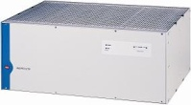
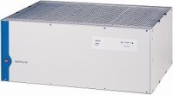
Megaplex Product Line
Product | Height | IO Slots | TDM Capacity | Ethernet Capacity | PS, CL Redundancy | LS, HS, PW, Voice | SDH/ SONET
MP-2104 | 2U | 5 | 8 /16Mbps (4/8 E1s) | Up to 100 Mbps | - | √ | -
MP-2100 | 4U | 12 | 8 /16Mbps (4/8 E1s) | Up to 100 Mbps | √ | √ | -
MP-4100 | 4U | 10 | 160 Mbps (80 E1s) | Up to 2 Gbps | √ | √ | √
Notes:
The MP product line has an enhanced scalability. User can select the chassis that comply his exact requirements and not keep large and expensive box for simple application.

Slide 10

MP-4100 Feature Highlights
Multiservice – Voice, Data, Ethernet
Fiber and copper aggregation
Bridges TDM and PSN networks (both directions)
Powerful T1/E1 Non Blocking DS0/DS1 Cross connect
GBE and SDH/SONET (with VCAT support)
Hardware redundancy (CL, PS)
Traffic protection switching within 50 ms
Hot swap for all supported modules
Wide range of management support
MP-4100
Notes:
Briefly review the MP-4100 product highlights

Slide 11







MP-4100 – Central Solution for MAP and Last Mile
Networks
Infrastructures and Services
Router
NMS Station
E3
MIRIC-E3
ASMi-52
RICi-8E1
n x E1
ETH
PSN
DXC-8R
FCD-E1E
STM-1
ETX
DXC-4
8 x E1
FE
ETH
E1
IPmux-xx
FE/GbE
FE
E1
POP
ASMi-54
Megaplex-4100
SHDSL.bis
ETH
Optimux-108
ETH
FO
4 x E1
Optimux-106
ETH
STM-1/
OC-3
FO
4 x T1
FCD-IP
E1
ETH
SDH/
SONET
ASMi-52
ETH
SHDSL
E1
FCD-155E
E1
STM-1
ETH
NMS Station
Notes:
This slide illustrates how these features allows to MP-4100 provide the access to the different services over the different infrastructure and the different transport network.

Slide 12







Transportation
Single box solution for multiple services
SDH reliability
Suitable for high capacity needs
Single box solution for every node
MP-4100
MP-4100
MP-4100
MP-4100
STM-1 / OC-3 Ring
MP-4100
MP-4100
MP-4100
MP-4100
Notes:
Different types of utilities may integrate their typical and special traffics over the reliable ring topology.
Different types of media (FO and copper) in the existent networks can be utilized, special SCADA, high and low speed control traffic can be integrated by the special modules (tele-protection, omni etc.)

Slide 13

Megaplex-4100
Phase 2
Versions 2.xx (GA)
MPW-1 – 8E1/T1 Pseudowire (TDMoIP)
M8SL – 8 ports of SHDSL E1
M16E1/T1 – 16 ports of E1/T1
ASMi-54C – 8 G.SHDSL.bis lines
OP-106/8C – Dual port, 4 x E1/T1 channel FO
OP-34/25C – 16 E1/T1 channels and Ethernet over fiber (E3 using SFP)
VC16 – 16 analog voice ports
Support for SSH/SSL and Radius
Additional Full fault propagation capabilities (VCG, GBE)
SNMPv3 support
Notes:
Main phase 2 modules allows connection of up to 16 x E1/T1 channels, up to 8 x E1/T1 channels over pseudowire or SHDSL lines, up to 16 x E1/T1 channels or E1 channel over FO line.
Up to 4 x STM-1/OC-3 or GBE ports are available for transport network connection.
SSH (Secure Shell) , a network protocol for remote administration of Unix computers.
Secure Sockets Layer, a communications protocol.
Remote Authentication Dial In User Service (RADIUS) is a networking protocol that provides centralized Authentication (a corresponding server is required).

Slide 14






Megaplex-4100
Phase 3 (released for beta)
New common logic hardware (requires module upgrade)
Support for STM-4/OC-12
Transparent clocking
Redesigned control – Command line interface (CLI)
MP-4100
E1/T1/SHDSL
Rings
MP-4100
SDH/SONET
STM-4/OC-12
Ring
SDH/SONET
STM-1/OC-3
Ring
MP-4100
n x E1
MP-4100
RICi-4E1/8E1
OP-106/8
E1/T1
Fiber
Notes:
Phase 3 main points:
- redesigned common logic, requires HW upgrade for existing customers
- transparent PDH clocking
- support for STM-4/OC-12
- improved Ethernet HW
Unlike the previous CL.1, in V3.0 user will only have the superset of SDH/SONET+GbE ordering option, additional ordering options will be released in future versions.
The current CL.1 will still “live” for a while to support current customers.
Application example for V3.0: MP-4100 bridges between the core STM-4/OC-12 ring and an access STM-1/OC-3 ring. You can connect a sub 64Kbps service directly to a STM-4/OC-12 node.

Slide 15
Cross Connect Solutions (DXC)

Slide 16
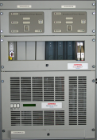
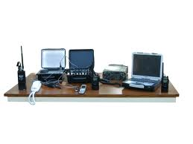
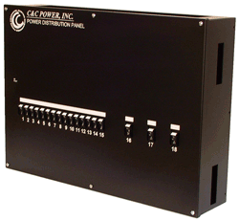
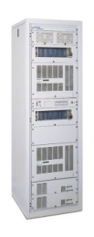

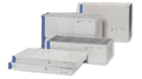
DXC family Strengths
IDSL
n x 56/64Kbps
LAN over WAN
Up to 15.7Mbps
SHDSL
E1/T1
ISDN
E3/T3
Multiservice access nodes with SNMP management
Non-blocking DS0 cross-connect services for T1, E1 (frame and unframed), n × 56/n × 64 kbps and ISDN BRI services
E3 and T3 multiplexing services
Fractional STM-1 multiplexing services
Inverse multiplexing capabilities: transparent transmission of high-speed data over up to eight E1 or T1 links
STM-1/
OC-3
Notes:
The DXC family consists of modular multiservice access nodes, providing non-blocking DS0 cross connect for up to 120 lines. Plug-in interface modules can accommodate up
to eight links each. Many services are supported, including n x 56/64 kbps, ISDN, E1, T1, E3, T3, and STM-1.
DXC modules allow maximum flexibility between ports. A user-programmable connection matrix connects any incoming 56/64 kbps timeslot to any outgoing 56/64 kbps timeslot. It supports cross connect functions, such as drop-and-insert, distribute and collect.
The DXC family enables the grooming of fractional traffic from the user side into full E1/
T1, E3/T3 or STM-1 trunks, for connection to the network.
The DXC family can broadcast any traffic combination from a single input to numerous
destinations. Channel relocating and half duplex conferencing are also supported.

Slide 17
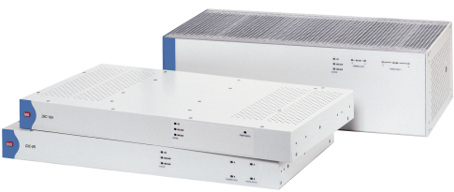


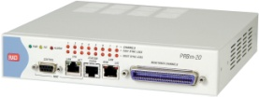
DXC Family Products
Product | Description | Picture
DXC-8R | 1U Chassis Sys Redundancy 4 I/O - Up to 32 Ports
DXC-10A | 1U Chassis 5 I/O - Up to 40 Ports
DXC-30 | 3U Chassis Optional Sys Redundancy 15 I/O- Up to 120 Ports
DXC-2 | Half 19” 1U Chassis E1/T1 converter
DXC-4 | Half 19” 1U Chassis 8 E1/T1 groomer
PRBm-20 | Half 19” 1U Chassis 8 E1/T1 SS7 monitoring probe
Notes:
All RAD digital cross-connectors support the same functionality and the difference is a number of ports and redundancy supported.
The smallest DXC-4 supports up to 8 E1/T1 ports.
The biggest DXC-100 supports up to 688 E1/T1 ports, up to 80 E3/T3 ports and up to 8 STM-1/OC3 ports.
DXC-8R supports PS redundancy.
DXC-100 supports all system modules + 1:N and 1:1 service redundancy.

Slide 18


Grooming Cellular Traffic
BTS
E1/T1
Cellular Site
BTS
E1/T1
Central Site
Cellular Site
Switch
DXC-30
BTS
E1/T1
E1/T1
DXC-8R
E1/T1
Primary and
Redundant links
Cellular Site
NMS
BTS
BTS
E1/T1
E1/T1
Cellular Site
Cellular Site
At the central site the DXC-30 can aggregate the traffic from many BTS/BSC sites as well as manage the remote DXC
Notes:
Grooming the fractional E1 traffic between BTS to MSC allows to decrease the E1 trunks rental expenses.

Slide 19
TDM NTUs
(FCD)

Slide 20

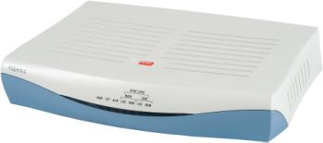
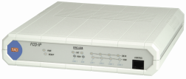
FCD
Product Line Table
Modem | Uplink | Services | Special Features | Central Solution
FCD-E1E | E1 | S.E1, V.35, ETH | LCD panel ETH management capability High ETH performance E1 bypass | DXC-30/8R/10A MP-2100/MP-4100
FCD-E1LC/ FCD-T1LC | E1/T1 | S.E1/T1, V.35, ETH | Multiplexer solution over E1 or T1 Up to two serial ports and sub-E1 services ETH supported on VLAN transparent | DXC-30/8R/10A MP-2100/MP-4100
FCD-IP | E1/T1 | 3 S.E1, Serial port (V.35, X.21), ETH, Analog ports (FXS,FXO,E&M) | Supported on ring and daisy chain application Integrated Router including OSPF support | DXC-30/8R/10A MP-2100/MP-4100
Notes:
The FCD family of compact, multiservice network termination units (NTUs) extends the E1/T1 network to the customer premises, enabling carriers and service providers to create a flexible, service independent access model while offering a competitive and wide service portfolio for voice, data and Ethernet.
FCD can be used as a remote equipment when DXC or MP are the central node.
In addition the sub-link is available that provides daisy-chain application possibility.

Slide 21


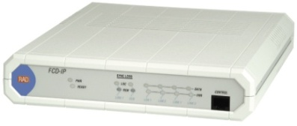


Variety of Services – FCD Family
Switch
PC
Router
FCD Family
E1/T1
Fractional E1/T1
SDH/SONET/
PDH Network
Copper
SHDSL
Fiber
LAN
PBX
Phone - Fixed
Convergence of multiple services
Centralized Management
Integrated Local Loop
Flexible Service Support
Notes:
Single FCD integrates different types of user’s data (voice, LS, HS, ETH) to the single E1/T1 uplink.

Slide 22
Last Mile Solutions

Slide 23



Product Line Table
Aggregation Rack | Height | IO Slots | TDM Capacity | Ethernet Capacity | SHDSL Ports | PS, CL Redundancy | LS, HS, PW, Voice | SDH/ SONET
MP-2104 | 2U | 5 | 8 Mbps (16 Mbps) | Up to 100 Mbps | √ ASMi-52/L | - | √ | -
MP-2100 | 4U | 12 | 8 Mbps (16 Mbps) | Up to 100 Mbps | √ ASMi-52/L | √ | √ | -
MP-4100 | 4U | 10 | 160 Mbps | Up to 2.6 Gbps | √ ASMi-52/L ASMi-54 | √ | √ | √
DXC-8/10/30 | 3U | 15 | 60 Mbps | Up to 15.7 Mbps | √ ASMi-52/L | √ | - | √
Notes:
MAP central solutions support modules that are intended to operate in a link with RAD stand-alone modems and provide connectivity solution for delivering digital data to customer’s premises over the existing twisted pair (copper) infrastructure of the distribution plant, while eliminating the need for repeaters.
Such MP modules can connect to up to eight standalone modems, however it can also operate in a link with another last mile module.

Slide 24




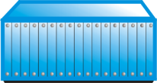
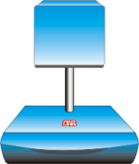
Extending Colocated 2G/3G Base Stations over Different Infrastructure
BTS Site
Node B
Fiber
Optimux
ETH
Central Office
BTS
FE
BSC
TDM
n x E1
BTS Site
LRS/Megaplex
Node B
Copper
ASMi
ETH
RNC
Airmux-200
FE
BTS
Packet
n x ETH
n x E1
Wireless
BTS Site
Node B
ETH
Airmux-200
FE
BTS
Notes:
MP with modem cards integrates the mobile voice traffic from separate 2G and 3G BTSs and connect it to the separate Mobile Switching Center s over the different transport networks.

Slide 25
Fiber Multiplexers (Optimux) – Everything Over Fiber

Slide 26
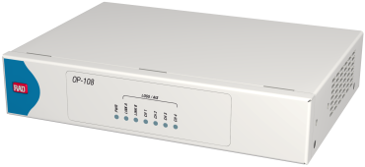
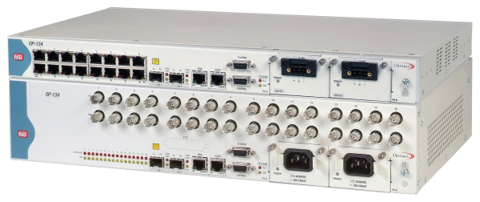
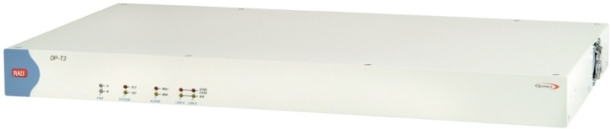
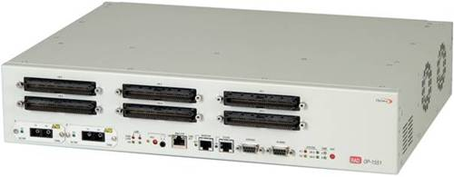
Opmux Product Line Overview
Optimux-108/Optimux-106
Uplink = 108 Mbps
4 x E1/T1
ETH 100 Mbps
Optimux-134/Optimux-125
Uplink = 134/34 Mbps (E3/T3)
16 x E1/T1
ETH 100 Mbps
Optimux-45
Uplink = 45 Mbps
21 x E1
28 x T1
FO
Coax
(T3 or Fiber)
TDM
Optimux-1551/Optimux-1553
Uplink = 155 Mbps
FO
Coax
(STM-1/OC-3 or Fiber)
63 x E1 / 84 x T1
TDM
Notes:
RAD’s Optimux fiber multiplexers enable easy Ethernet and PDH extension over fiber (up to 520 kilometers) or copper links or service port fan-out off large capacity switches and ADMs for improved access deployment flexibility. Ranging from a few E1/T1s with or without Ethernet to E3/T3 and data up to STM-1/OC-3 capacity, they offer a solution for every service extension scenario.

Slide 27

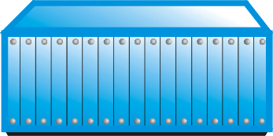





Target Applications
Multi-service
Drop & Insert
Transparency – Clocks & Services
Redundancy – Uplinks, Power Supplies, Tributaries
Simplicity – Plug & Play
POP
Branch 2
STM-1
1+1
MP-4100
FE
OP-108
SDH
F.O
PBX
OP-108C
OP-108C
OP-108C
GbE
1+1
OP-108C
1-4 E1
GbE
Branch 20
ISP
FE
PSN
Cisco
OP-108
NMS RADview
F.O
PBX
1-4 E1
Notes:
For OP-108C/OP-106C modules provide cost-effective point-to-point E1/T1 and Ethernet transport services over fiber-optic links at ranges up to 120 km
(74.5 miles) using a RAD proprietary signal format.

Slide 28
Case Study

Slide 29
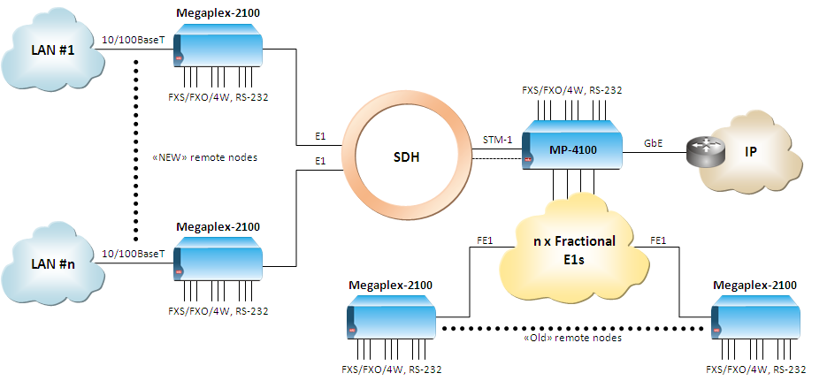
Utilities in Russia: Integrated Data and Voice Services over SDH
Powerful Central Node, MP-4100 - based
Ethernet traffic concentration
Support the traffic protection in the STM-1
SDH ring
Legacy (FXS/FXO, 4-wire, RS-232) and Ethernet services over the SDH and Leased E1
Centralized solution with management
Scalable, typical solutions for Power Industry

Slide 30
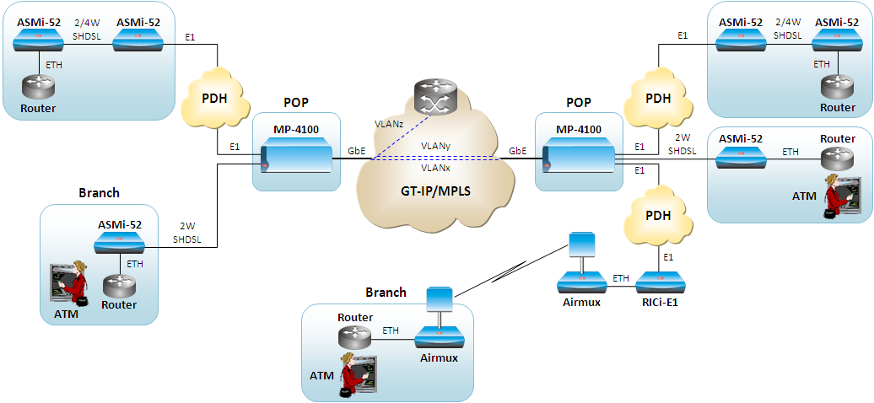
Carrier in Africa: Bank – Branches Connectivity over PSN
Support ETH services over any available access
infrastructure
Complete Access solution with Aggregation platform (MP-4100), Aggregate any ETH/IP traffic coming from DSL, PDH, Wireless towards IP/MPLS Network
Branches connectivity over any existing Last Mile infrastructure: Copper, PDH and Wireless
Reduce CapEx/OpEx by leveraging existing infrastructure for providing ETH/IP connectivity for the branches over new IP-MPLS network, enabling fast delivery

Slide 31
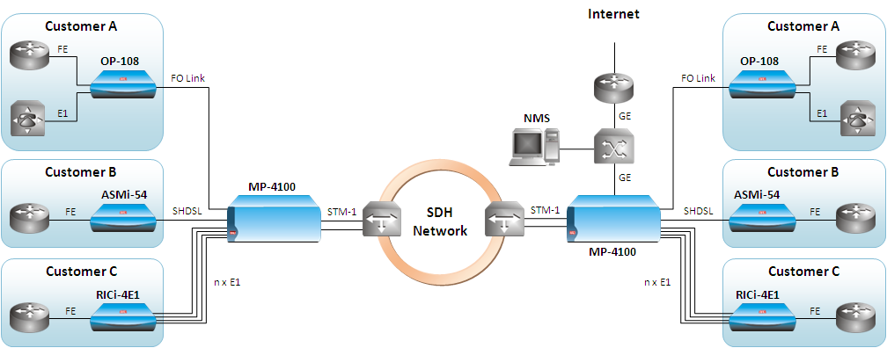
Carrier in Africa: Ethernet and TDM Services over Copper or Fiber
Wide range of interfaces (SHDL/E1/ETH)
MP-4100 high capacity. STM-1 and legacy services on single BOX.
Multirate support
Single multi-functional platform
Reduce OpEx/CapEx by Multiservice aggregation device at the PoP
Both E1 and Eth services over single Fiber
Ensure SLA by providing advance ETH services with QoS
Internet

