Slide 1

Solutions for Managing RAD Products
Presented on behalf of Ben Kapon
Network Management Systems
Product Line Manager

Slide 2

Agenda
RADview Value Proposition
Network Scheme
Market Segments
Product Line Portfolio
RADview-EMS Benefits & Features
Turnkey system
Business-Continuity Levels*
RADview-SC Family
Integrations
Device Management

Slide 3

Time on his hands?
Pressurized?
Relaxed ?
Worried?
Notes:
How does he look like?
Does he look worried? Relaxed?
Jimmy is a Network Manager which uses the right tools to manage his network.
In fact if he didn’t have these tools, he could have many reasons to be worried,
Lets see..

Slide 4

RADview Value Proposition
Unified Carrier-Class management platform for RAD devices
Optimize network operations and minimize Mean Time To Repair (MTTR)
Minimize integrations costs associated with new NE additions by using seamless OSS integrations (NetCool, TeMIP*)
Smart configuration and provisioning tools for easy network expansion
Highly scalable in managing large and growing networks
A multi-platform (PC or UNIX) Java-based system

Slide 5
Network Management Topology Scheme
BSS – Business support systems (billing and CRM)
OSS – Operation Support Systems (Service Assurance)
Resource Management
(i.e. Cramer)
Fault
Management
(i.e. NetCool)
Performance Management
(i.e. InfoVista)
Service
Activation
Integration of RADview into the OSS layer saves lots of overhead and money, due to low incremental investments for additional products and firmware upgrades.
Other vendors’ specific NMS
RADview
RADview is responsible for synchronizing missing Traps and collecting statistic information after network outage between EMS and NE
*supported devices only
Network Elements
Notes:
5
Network Management Topology (scheme)

Slide 6
Market Segments
Customers | Requirement | Description
Tier-1 | MIB | Direct integrations of RAD agents into existing NMS (Verizon Business, Telus)
 | EMS/NMS | Northbound (to OSS) and inbound (to NE) synchronize mechanism of fault and performance information, fully featured management capabilities of RAD agents including advance security. (Telstra, T-Mobile)
Tier-2/3 | MIB | Direct integration is less common, since it requires development stage
 | EMS/NMS | Easy point-and-click from topology map for creation, modification and deletion of a service. Support of all technologies enabled by managed RAD devices. Service preview and troubleshooting and customer database management
Utilities & Transportation | MIB | Very rare
 | EMS/NMS | Similar to Tier-2/3 (Colorado Springs Utilities, Baystreet)
Notes:
With various vendors in your network – do you do integration into their NMS or do you use the NMS of each vendor

Slide 7
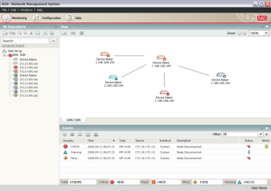
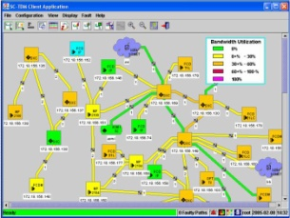
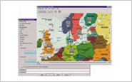
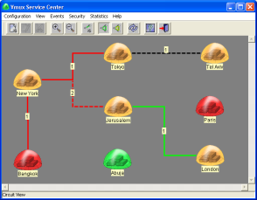
Product Line Portfolio
RADview-EMS
Carrier Class Element Management System
RADview-SC/TDM
Network Management System Service Center for TDM Applications
RADview-SC/TDMoIP
Network Management System for Pseudowire Applications
RADview-SC/Vmux
Network Management System for Voice Trunking Applications

Slide 8

RADview-EMS is a unified carrier-class management platform for RAD devices using a variety of access channels as SNMPv1/3, HTTP/S, TFTP and Telnet/SSH. In addition, it features third-party device monitoring capabilities
Broad Perspective. Direct Control.

Slide 9
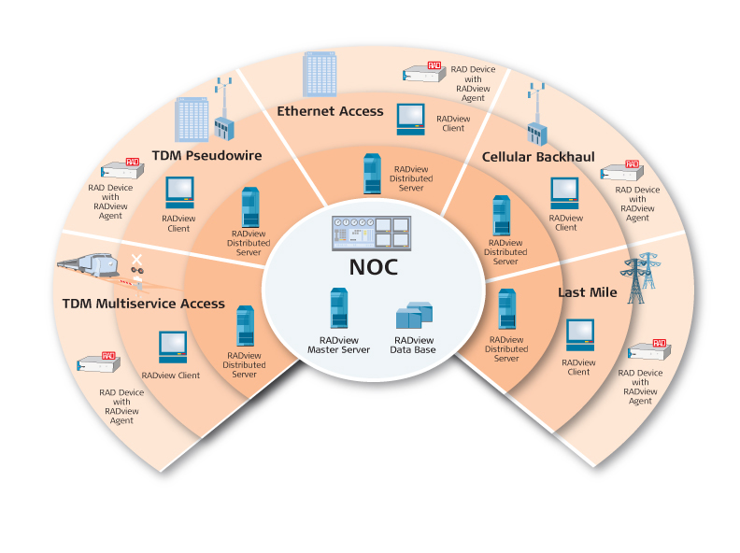
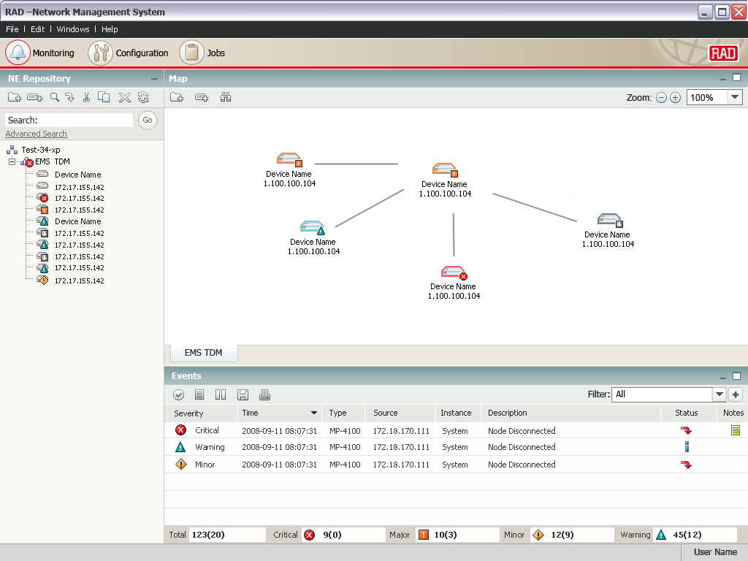
RADview-EMS Benefits & Features
Benefits
Turnkey system including hardware and software!
Fully compliant with TMN standards
Client/server architecture with multi-user support
Interoperable with third-party NMS and leading OSS systems
IBM Tivoli’s Netcool®/OMNIbus™ plug-in
Minimize integrations costs associated with new NE additions
Key features
Ensures device health and congestion control
Topology maps and network inventory
Advanced FCAPS functionality
Software & configuration management - CMDB
Business continuity - High-Availability and Disaster Recovery
Handover between operators

Slide 10

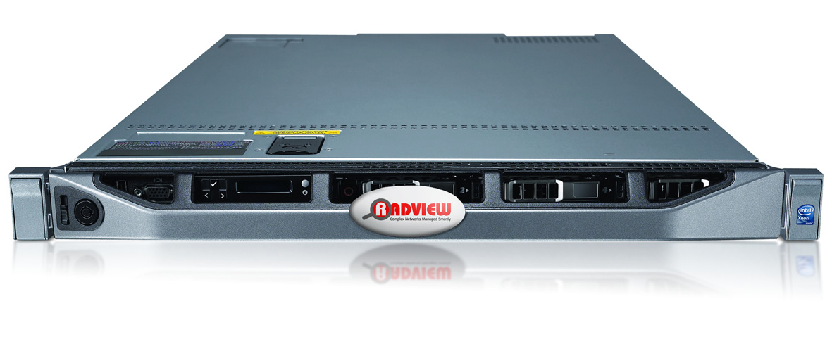
Turnkey System – Plug & Play
RADview-Server, windows based system
Based on Dell PowerEdge R610 systems
Intel® Xeon® processor 5500 and 5600 series
Reliable Dell hardware
Customized for Entry/Medium/High level
Windows Server®2008SP2 , installed
Latest releases of RADview-EMS and Oracle, installed
39 Months HW world wide warranty, NBD/RADcare
Plug & Play
Notes:
RADview-EMS version 2.7 and up.

Slide 11
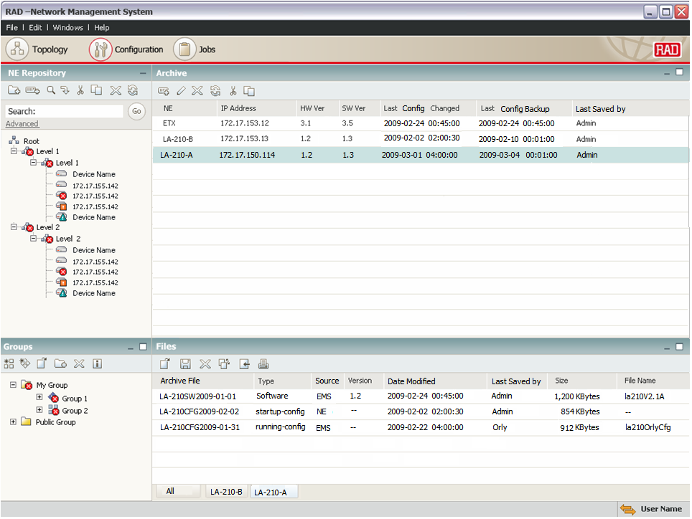
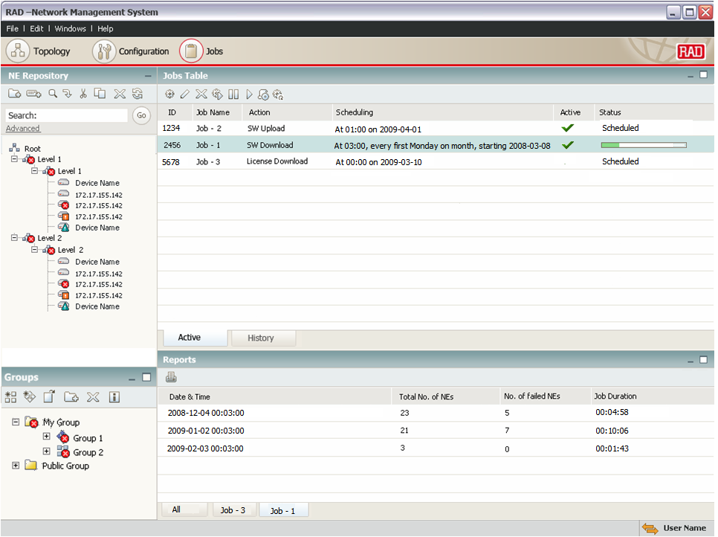
RADview-EMS v2.7
What’s new…
Change Management
Configuration management
Software management
CLI editing
Network baseline
Startup vs. running
Task Management
Configuration change history
Scheduled jobs of all the above
CLI script execution
email notifications
General
Windows 7 32bit
Windows 2008 server std 64bit
Dynamic and static group management
Notes:
RADview-EMS standalone only

Slide 12
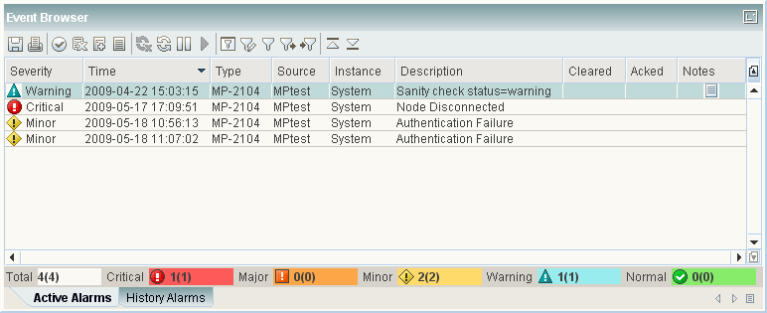
RADview-EMS
FCAPS
Fault
Configuration
Administration
Performance
Security
Manage Event Log parameters
Manage the way Events are displayed in the Event Browser
Manage system response upon occurrence of specific Events.
Trap Synchronization upon connection failure between RADview-EMS to NE (*supported devices only)
Modify – Mask, Severity, Duplication, Forwarding, Threshold, Clearing, Formatting

Slide 13
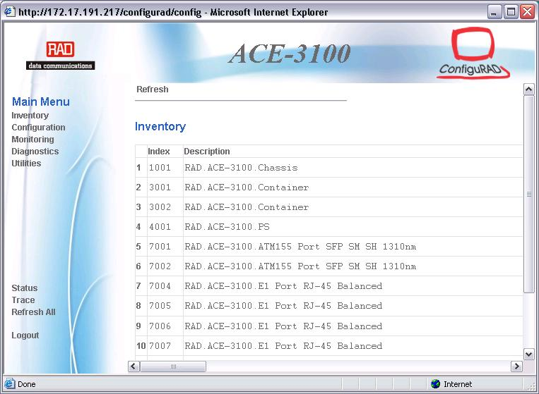
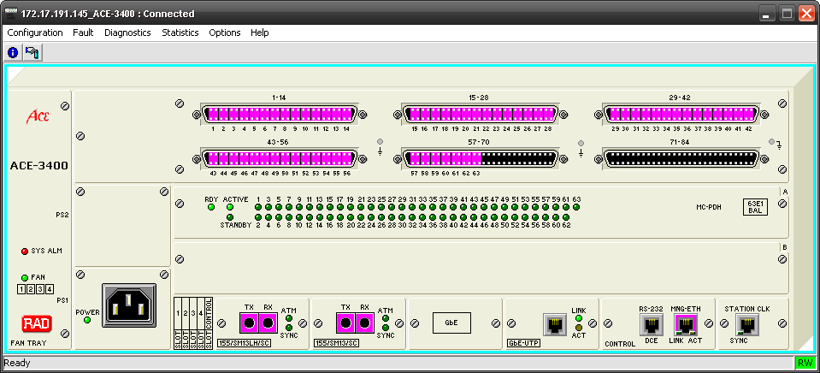
RADview-EMS
FCAPS
Fault
Configuration
Administration
Performance
Security
Realistic representation of the devices (shelf-view)
Tracks configuration changes
Configures, installs, and distributes software and configuration files across the network
Viewing and/or modifying configuration (system, ports, and alarms)
Enables viewing the diagnostics and status information
Web
Shelf-View

Slide 14
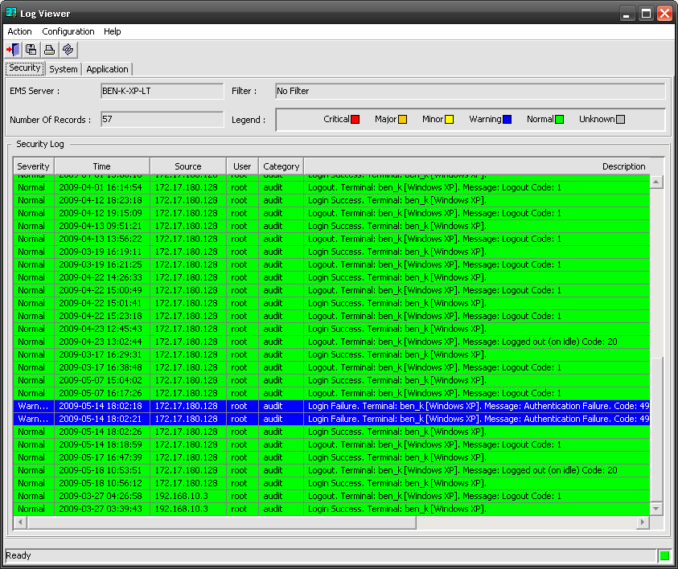
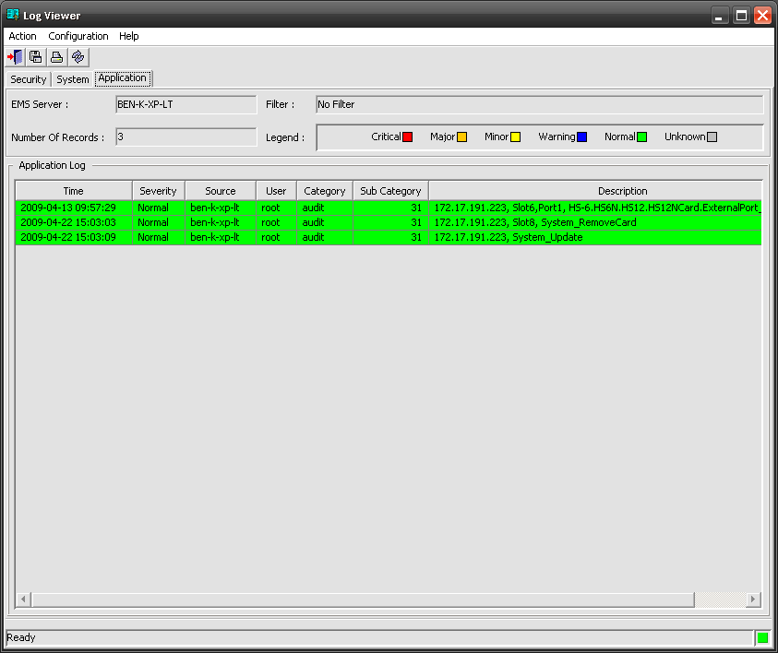
RADview-EMS
FCAPS
Fault
Configuration
Administration
Performance
Security
Audit trails for Security, System and Applications activities
Tracks and log the shelf-view user activity
Create and manage user accounts and groups
Manage various server setting
Security logs
Applications activities

Slide 15
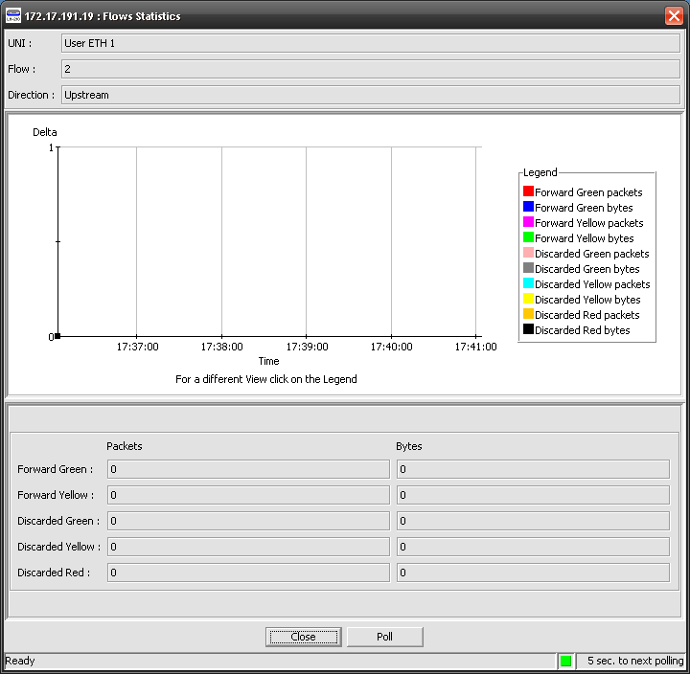
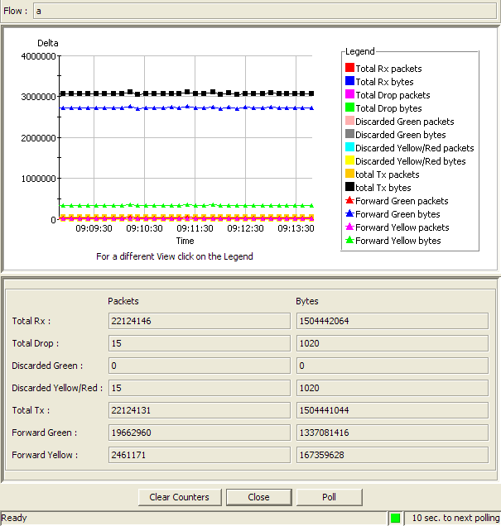
RADview-EMS
FCAPS
Fault
Configuration
Administration
Performance
Security
Monitors network performance (QoS, CoS)
Current statistics (Real-time)
Intervals statistics
Reflects Agent statistics
RADview statistics collector (*supported devices only)
  Collect and compress the data
  Retrieved lost data upon connection failure
  Minimizing management traffic
  Exports CSV ASCII files for OSS
Statistics

Slide 16
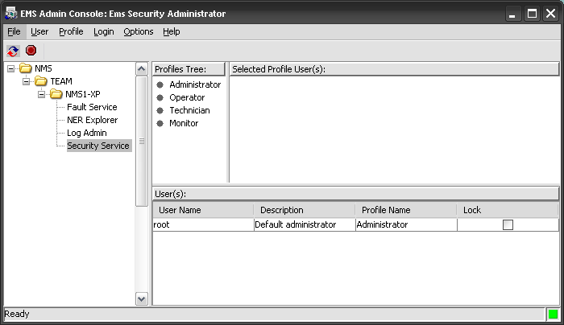
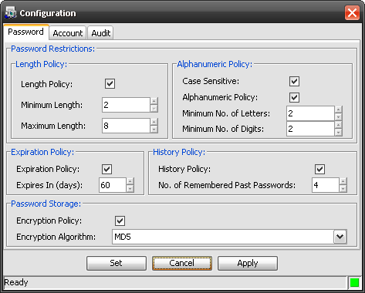
RADview-EMS
FCAPS
Fault
Configuration
Administration
Performance
Security
View and manage EMS Security profiles in a graphical interface.
Create and edit security profiles.
Create Common/Private view profiles per user/group
Collects accounting data and generates network usage reports
Define password policies
Security profiles
Password policy

Slide 17
Business-Continuity Levels
Backup and Restore
High Availability (HA) Cluster
Disaster Recovery (DR) 1+1
HA+DR (2+1)

Slide 18

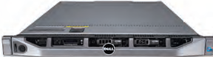

Business-Continuity Options
Backup and Restore
Primary site
Backup site
Based on RADview-EMS/<PC&Unix>Pack1/R backup and restore tool
  Backup file can be saved anywhere
  Restore from backed-up files – RPO can be very long
High Availability (HA) Cluster
Local clustering - RPO and RTO are short
Immediate recovery in the event of OS or HW failure in a single site
Automatic failover
Disaster Recovery (DR) 1+1
  Geographically separated NMS servers that are replicated constantly
  RPO and RTO are short
  Manual switchover
HA+DR (2+1)
Hi-availability (HA) + disaster recovery (DR)
The highest protection level for the RADview-EMS server
Automatic failover

Slide 19



Backup and Restore (Cold standby)
EMS-Client
X-Client
Client
OSS
Operators
Primary Site
DR site
Active
Server
Standby
Server
Run a backup process
Transfer the file
Run a restore process
Based on RADview-EMS/<PC&Unix>Pack1/R backup and restore tool
Cost effective – sold without hardware or additional software
RPO is long – since last back-up
Completely manual operation

Slide 20


High Availability (HA) Cluster
EMS-Client
X-Client
Client
OSS
Operators
Local Clustering
Turnkey system including server hardware, Cluster and RADview software
RPO and RTO are short
Instant automatic failover
Clients can keep working after few seconds
Good for large NOC with dozens of clients connected to RADview simultaneously
!

Slide 21
Disaster Recovery (DR) 1+1
EMS-Client
X-Client
Client
OSS
Operators
Primary Site
DR site
Active
Server
Standby
Server
Network Outage
Production
Data
Secondary
Data
Turnkey system including server hardware, replication and RADview software
RPO and RTO are short – storage is being replicated constantly
Semi automatic switchover by push button, good for disaster recovery scenarios
Clients are being shifted to DR site upon activation

Slide 22
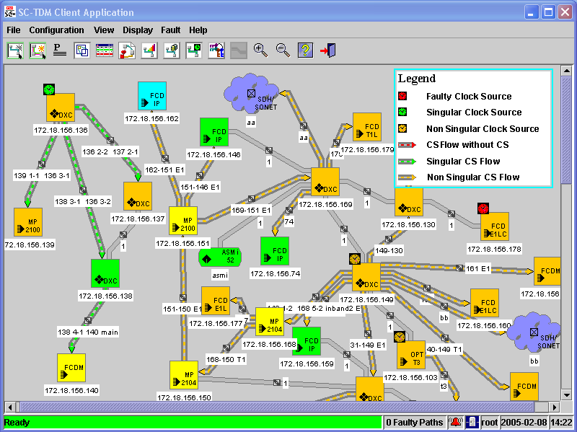
RADview-SC key features
End-2-End “Point-and-Click” provisioning & Monitoring (Mesh)
Automatic Best-Route
  Lowest cost
  Bandwidth utilization
  Routing constrains
Network Self-Healing
Service Availability Reports
Service Level Agreement (SLA)
Graphical View:
  Status Indication
  Clock Source and flow
  Network Utilization
  Path Data Reports (PDF,HTML)
Notes:
Automatic Best-Route according to:
Lowest cost
Bandwidth utilization
Path priority manually defined by the user
Network Self-Healing
Dynamic Protection: When a path fails, SC-TDM looks for an alternative path and automatically activates it instead of the failed path according to different criteria
Static Protection: Bandwidth is allocated and reserved for protected path upon creation and used if the main path fails
No Protection: There is no recovery of the failed path (the user has to manually perform Reroute for the redundancy path)
In addition there is HW protection which can be defined within the MP

Slide 23
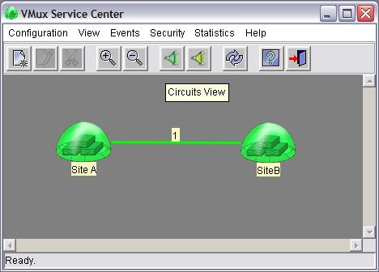
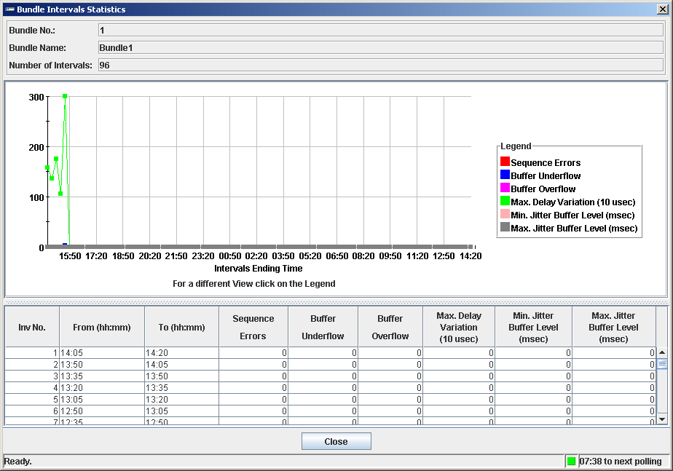
RADview-SC/TDMoIP key features
End-2-End “Point-and-Click” provisioning & Monitoring
Intuitive display of Bundles, Links and NEs status
End-to-End Service Creation
Alarm Correlation and easy fault isolation
Bundles and ports statistics
Fully integrated with RADview-EMS standalone

Slide 24

Integrations
OSS - Operation Support Systems
Fault Management – NetCool (validated by IBM) TeMIP (in process)
3rd Party EMS/NMS application
Cisco-ANA
Performance Management – InfoVista (in process)
Carrier’s in-house
Nortel-MEM
Integration tools
CORBA northbound
SNMP Fault Management northbound
CSV PM files
OSS heartbeat
ALU 5620SAM
Notes:
24

Slide 25

Device Management
RAD products support the following management capabilities
Device Management
SNTP
CLI/Menu driven terminal
Radius
TACACS+
TFTP
SFTP
Web-GUI
SSL
SSH
SNMP v1, v3
Trap sync
Syslog
Statistics collection
Out-of-band mgt port
In-band mgt
ICMP

Slide 26
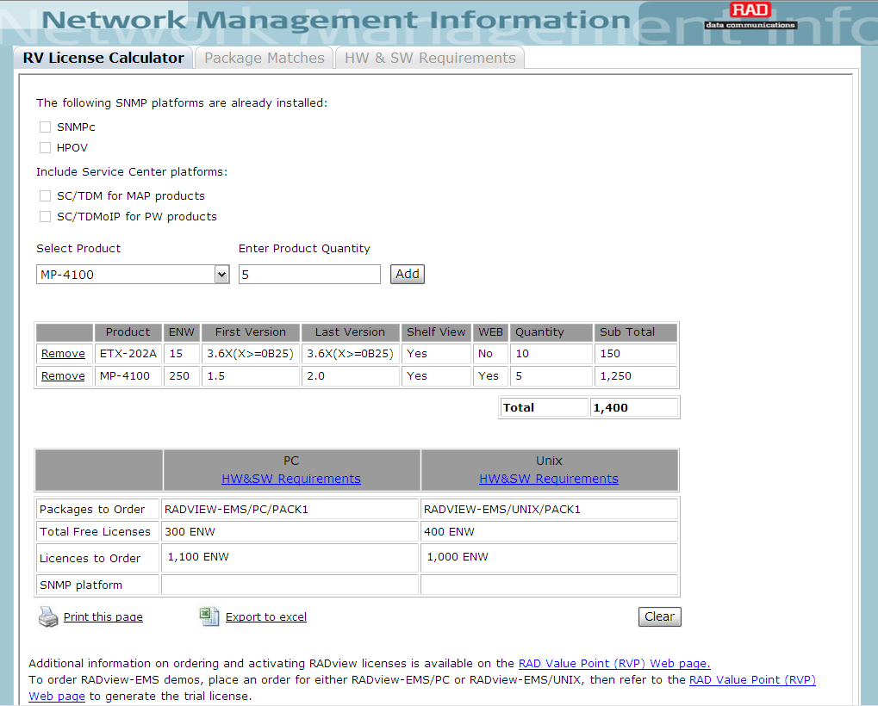
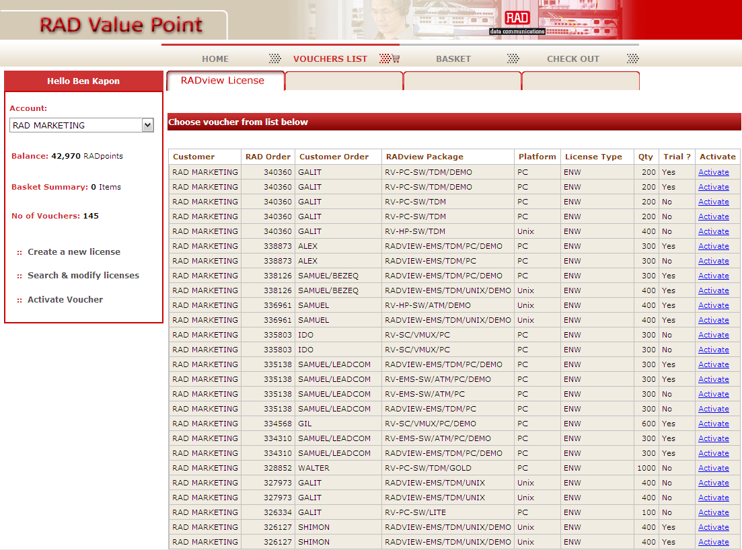

RADview ordering flow
Order
Calculate
Get RVP
Install
Order one of the RADview packages
Calculate the ENW required in the NMI application
Login to the RVP website and generate the required license
(1 ENW = 1 RVP)
Download and install the license
Notes:
raddist.rad.com>InfoCenter>Technical Resources>Guides>NMI

Slide 27
RADview Release Schedule
Release Schedule | 2010 |  | 2011
 | Q3 | Q4 | Q1 | Q2 | Q3 | Q4
RADview-EMS | v2.7 GA Add support for Windows 2008 server 64bit Add support for Windows 7 32bit New Software and Configuration management console AIRMUX-200v1.9.3 AIRMUX-400v2.5 ASMI-54v3.0 ASMI-54v3.5 IPMUX-4Lv2.0 | v2.8 GA Support FCD-E1A/T1A, FCD-E1M/T1M, OP-4/106/108 shelf-view on RADview-EMS stadnalone Warm-Standby for PC EGATE-2000 v1.0 GMUX-2000v4.0 IPMUX-16Lv1.0 IPMUX-24v3.5 LA-210v2.7 MP-4100v3.0 OP-108Lv2.0 RIC-CHv1.0 RICI-16v4.0 | v2.9 GA ETX-103Av3.0 ETX-203Av3.0 ETX-204Av3.0 LA-210v3.0 OP-1032v1.0 | v3.0 GA MP-4100v3.1 | v3.0 GA ETX-212Av4.5
* Planned version – release content/schedule is not confirmed
Unless stated otherwise are beta releases. Release marked with GA, e.g. v1.2GA signify General Availability.

Slide 28
RADview Release Schedule
Release Schedule | 2010 |  | 2011
 | Q3 | Q4 | Q1 | Q2 | Q3 | Q4
RADview-SC/TDM |  | v5.0 GA Support installation over RADview-EMS standalone map (Omit the need for HPOV) Support ASMi-52 Support ASMi-54 Support Eth L2 Services using GbE port for links Support MP-4100v3.0 STM-4 Support MP-4100v3.0 with current cards Support MP-4100v3.0 clocking options
RADview-SC/TDMoIP |  | v5.0 GA GMUX-2000v4.0 IPMUX-24v3.5 | v5.1 GA Support for IPmux-L Products
* Planned version – release content/schedule is not confirmed
Unless stated otherwise are beta releases. Release marked with GA, e.g. v1.2GA signify General Availability.

Slide 29
RADview-EMS system Roadmap
Version | Date | Main Features & Benefits
Version 2.7 GA approved | 09-10 | RADview-EMS v2.7 - Configuration Management Console Add support for Windows 2008 server 64bit Add support for Windows 7 32bit Software and Configuration management console –Change management, software and configuration archive Job Management – Manage and schedule configuration management tasks
Version 2.8 GA Date is not final | 12-10 | RADview-EMS v2.8 Supporting FCD-E1A/T1A, FCD-E1M/T1M, OP-4/106/108 shelf-view on RADview-EMS standalone (without SNMPc) Warm-Standby for PC based on Vmware Performance portal for Ethernet services
* Instructions - Beta and Limited Release are two names for RAD’s internal Beta Release term.

Slide 30
RADview-SC/TDM Roadmap
Version | Date | Main Features & Benefits
Version 5.0 GA Date is not final | 12-10 | RADview-SC/TDM v5.0 Support installation over RADview-EMS standalone map (Omit ting the need for HPOV) Support ASMi-52 Support ASMi-54 Support Ethernet L2 Services using GbE port for links Support MP-4100v3.0 STM-4 Support MP-4100v3.0 with current cards Support MP-4100v3.0 clocking options
* Instructions - Beta and Limited Release are two names for RAD’s internal Beta Release term.

Slide 31

Summary
RADview Value Proposition
Network Scheme
Market Segments
Product Line Portfolio
RADview-EMS Benefits & Features
Turnkey system
Business-Continuity Levels
RADview-SC Family
Integrations
Device Management

