Slide 1
Ethernet Access - Ethernet Over Everything
Presented by:
Yalin Arie

Slide 2


Agenda
Introduction
Value proposition
Target Applications
Product overview
Notes:
As for agenda :I will initiate with the Introduction and will continue with products overview , Target application , Value proposition

Slide 3
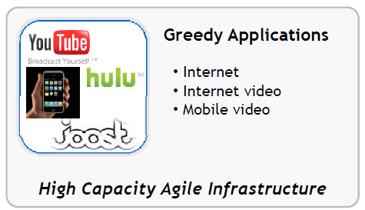
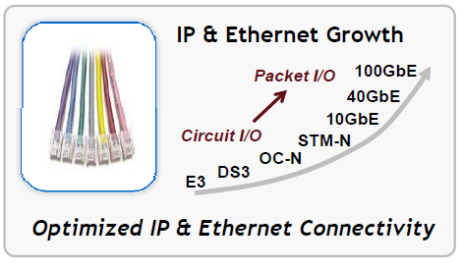
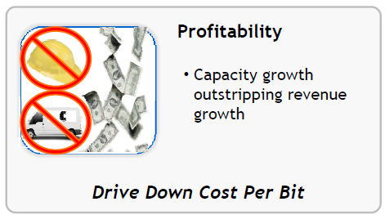

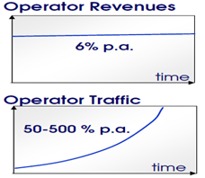






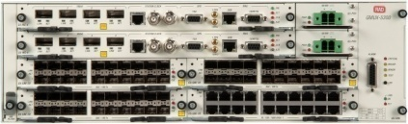



Key Drivers for Carrier Ethernet Demarcation
TCO as a driver for operator decisions
Flat revenues
+
Exponentially increasing BW
=
Cost pressure
Forces operators to look for new revenues based on different SLA levels
RAD’s Ethernet demarcation devices designed to assure different levels of SLAs
Notes:
Let make a marketing snapshot of the current perspective in the Eth carrier market
We definitely are aware on the growing demands of growing bandwidth of a new services application for internet surfing video Conf high capacity agile infrastructure
On the other hand the carrier still needs to dealing with the OPEX and trying to increase the revenue .
TCO– total cost of ownership are the driven for carrier decision , hence the consumers are required high capacity and the carrier shall deal with opex revenue
RAD Eth carrier solution provide to typical carrier to utilize the carrier ETH skills for provide abstract ETH L2 connectivity and nice tools for OPEX and SLA
Furthermore service providers are looking for and already provide SLA reports for end customer by ETH OAM and by our entire solution RAD have the ability to offer a solution with End to End SLA that we have to roll out managed Ethernet services across different transport links.
This challenge is compounded by the need to do that with end-to-end service reliability and measurable performance, at the lowest cost possible.

Slide 4
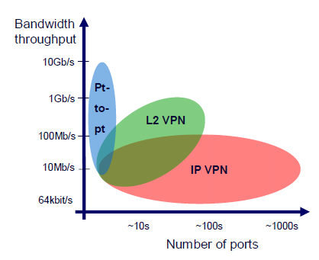
Layer 2 and Layer 3 – BT Perspective
Enterprise Interconnect
Source: British Telecom publications
Connectivity scheme depends on 2 main factors:
  Number of ports connected
  Bandwidth required
Notes:
Concerning the trend in the carrier Eth market , there is no doubt that real perspective as we have in this slide are demonstrate the aspect of BT as for the comparison between L2 and L3 and the main factor of High bandwidth required that is simplicity, scalability and cost reduction to provide in L2 versus to L3
Recently BT issued a huge RFQ for seeking a L2 VPN solution for consumers and end customer that demand high capacity like 10G

Slide 5

TDM and PSN – Service Migration
Target Application
Widespread Services
Target Application

Slide 6
Market Segments
Retail Business services
Inter office connectivity, Internet access, Storage, Data center
E-Line, E-LAN, E-Tree
Wholesale services
Transport services for service providers, E-NNI
E-Line, E-LAN, E-Tree
Mobile Backhaul - Wholesale/internal
2G, 3G, 2G+3G Mobile Backhauling
CES, Synchronization, E-Line, E-LAN, E-Tree
Notes:
Carrier ETH contain three typical common of ETH services
Retail – Business services in order to interconnect office as application of Point to point or Point to multipoint E-line and E-LAN –E-Tree
Connective between center site and remote brunches
Wholesale services – One of the growing services in carrier customer as ETH lead line for ISP or mobile operator.
Transport services of leased line that carrier provide for mobile operator for ETH traffic and Clock synchronization
Mobile Backhaul – 2G and 3G mobile backhauling will be include ETH services E-LINE and E-LAN + TDM traffic

Slide 7
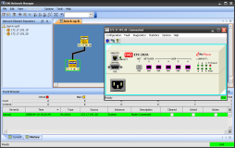








Retail Business Services
Managed CPE with Fiber and copper uplinks
L2 access solution supporting:
  L2 based office interconnections
  L2 access to L3 VPN
Flow-based differentiated
services
  Up to 8 classes of service
SLA assurance with shaping
per EVC and EVC.CoS
Customer Premises
RADview-EMS &
Service Center
ISP
ETX-205A
GbE
Service Provider L2/L3 Network
ETX-203AX
FE/GE
Customer HQ
ETX-203AX/205A
GbE
SONET/
SDH
EoPDH
ETX-205A
Notes:
Retail – Business services in order to interconnect office as application of Point to point or Point to multipoint E-line and E-LAN –E-Tree L2 VPN
Connective between center site and remote brunches .
RAD have also the possibility to provide the connectivity on a different infrastructure based on fiber , PDH and , and cooper line

Slide 8




Wholesale Services
Managed demarcation point at customer premises
Accurate SLA enforcement and measurement with HW based OAM tools
Multiple transport connections with flow-based services
  EPL and EVPL connection models with per flow shaping
Customer Premises
ETX-205A
ISP
Wholesale
Packet Network
PE
ETX-203AX
RNC/
4G Gateway
ETX-205A
Service Provider L2/L3/MPLS Network
PE
Wholesale
TDM Network
ETX-203AX/205A
ETX-205A
SONET/
SDH
EoPDH
GbE
Notes:
Wholesale services – One of the growing services in carrier customer as ETH lead line for ISP or mobile operator.
Transport services of leased line that carrier provide for mobile operator for ETH traffic and Clock synchronization
Connectivity of Cell site to RNC Gateway with Clock synchronization
Or Carrier to Carrier application of leased line to ISP in order to connect between two branch over several core network

Slide 9
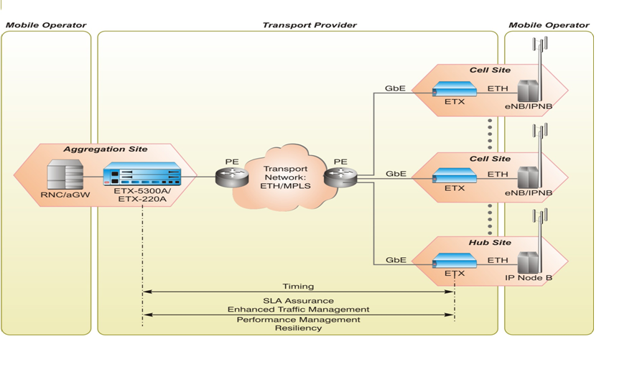


Mobile Demarcation 2G/3G Backhauling
Native ETH and TDM PW
TDM
BSC
TDM PW
TDM

Slide 10


ETX Main Benefit
SLA

Slide 11











RAD’s EtherAccess
Ethernet Services – Any Access
Branch
Ethernet over PDH
Ethernet over SDH/SONET
Branches
10BT
RIC
EoPDH
RIC
RICi-155GE
RICi-155GE
STM-1/OC-3
GbE
SDH/SONET
Branch
RICi-622GE
RICi-622GE
RIC
STM-4/OC-12
GbE
10BT
Branch
EoPDH
GbE
GbE
RIC
100BT
SDH
n x EoPDH
Bonding
STM-1/OC-3
Ethernet over DSL
Branch
GbE
Service Provider
Packet Switched
Network
DSLAM
Egate
n x EoCU
Bonding
LA
GbE
10/100BT
Ethernet over Fiber
Branch
DSLAM
LA
Metro
Ethernet
ETX
GbE
EoCU
10BT
GbE
FE
100BT
Branch
GbE
ETX
1000Sx
Headquarters
Notes:
Reach all customers – wide coverage of Ethernet Services
Offer more- High Ethernet bandwidth even on DSL and PDH infrastructure
Save more – End to End Ethernet OAM across all networks
The varieties of Eth access solution the RAD portfolio of Eth access solution that allow to offer ETH connective over any type of infrastructure as PDH xDSL and SDH
Meaning any type of access segment domain before the Packet switch network that should provide ETH connectivity’s
For instance to reach Eth over SDH we have smart convertor RICI product line
Also fiber connectivity for demarcation device and smart intelligence device based on ETX
And last the copper connectivity that allow to offer Eth connectivity offer SHDSL and VDSL terminate by IP DLAM
Using with all these technology meaning you can define the same attributes in all these product line
In term of L2 versus to L3 we are focusing on L2 our product line based on L2 services.
The first portfolio ETH Access in order to provide uniform ETH access never main which infrastructures we have we would like to reach all the customer site , you management will reduce your Opex
A lot of investments in ETH –OAM concept

Slide 12
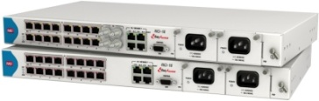

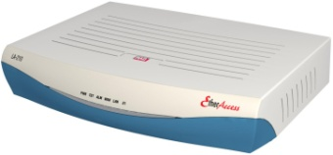
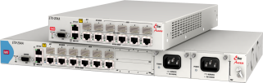
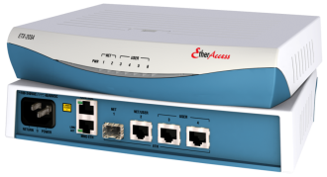
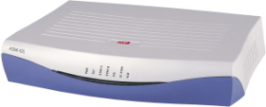

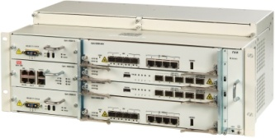
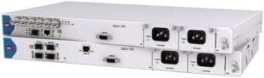
EtherAccess Portfolio
ETXs
RICi/Egate
RICi-Egate
LA-210
ETHoFiber
ETHoPDH
ETHoSDH/
SONET
ETHoDSL

Slide 13




RAD ETX Portfolio in 2012
RAD Complete Access Solutions in Demarcation & Aggregation modes
Native Ethernet in the Access
Aggregation Mode
RADview-EMS
L2 Demarcation Mode
End 2 End SLA Assurance, PM management, Resiliency
Customer Premises
Enhanced TM, OAM
GbE
ETX-203AX/ETX-205A
10 GbE
ETX-220A
10 GbE
Service Provider Network
SHDSL
GbE
ETX-203AM
ETX-204A/ETX-205A
ETX-5300A
GbE
NxE1
ETX-203AM/ETX-205A
SDH
ETX-203AM
ETX-5300A
Access Network
ETX-205A
ETX-205A
Notes:
As I mentioned I will execute the attention of the presentation of the ETH demarcation device
RAD carrier solution have a diversity of sophisticate L2 switch that can be located in the customer premises site ,
ETX-203AX with skills of ETH OAM H-QoS that appropriate for retail services based on native ETH clear demarcation point between the user and operator networks.
The device delivers Ethernet E-line services (EPL and EVPL) and is MEF 9 MEF 14 certified.
ETX-220A transports up to 20 Gbps ingress and 20 Gbps egress throughput while ensuring SDH/SONET-like performance and Five Nines reliability
And functions as a mobile demarcation device (MDD), efficiently managing mobile broadband traffic between the IP NodeB/ LTE eNodeB and the
network core with SLA assurance
There is no doubt that RAD solution can be appropriate for two market segment of Retail and Mobile B. , I proud to state that RAD narrow the gap and currently we have a entire solution end to end from the remote site to Pre-aggregation device

Slide 14


Complete Fiber Ethernet Access Solution
Access Aggregation
Access Segment
Ethernet Access
Customer Premises
PoP
FE/GbE
Demarcation
FE/GbE
ETX-203A
ETX-204A
Aggregation
10G
PE
FE/GbE
GbE/GbE
Metro
Core
ETX-205A
10G
ETX-5300A
10G
10G
ETX-220A
Complete fiber Ethernet Access solution
Customer located, Smart demarcation devices
  Variety of interfaces, capabilities and price ranges
PoP located Aggregation device
  High capacity, fully resilient
Notes:
So addition application that demonstrate the inclusive solution with sophisticate demarcation , ETX-5300 garter the Gbe or 10G interface from the remote branch and tunneling on 10G interface directly to PE , Pre aggregation device is one of the aim of the ETX-5300A as probably you know the pricing of the GbEs port in the PE are expensive so it considerable to using with Pre-aggregation as cost effective solution

Slide 15



ETX-5300A in “dumb” NTU Environment
10/100/1GbE
10/100/1GbE
ETX-5300A
PE
10/100/1GbE
10GbE
Up to 80 10/100/1000 links
MPLS/ IP
10/100/1GbE
10GbE
10/100/1GbE
10/100/1GbE
ETX-5300A performs ingress & egress traffic management (TM)
  Ingress TM is done by Ethernet service cards and has two level levels of scheduling elements
  Egress TM is done by main card and consists two queue group types with three levels of scheduling elements
This mode is used mainly when no traffic management is performed at the CPE level
Notes:
Further application for ETX-5300A , in case that carrier still using with media convertor but still willing to utilize the carrier ETH capaility , so y the ETX-5300A he will be able to define and coomit to SLA using with ETH-OAM and classify and mapped

Slide 16
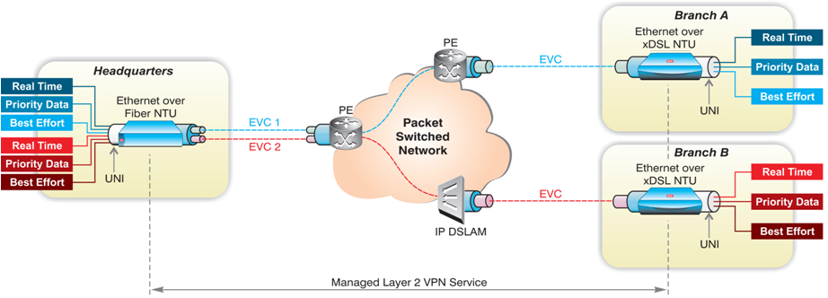
Same Ethernet Services Over Fiber and DSL Access
Providing high speed (fiber based) and low speed (DSL based) Ethernet services
Using SHDL.bis up to 22 Mbps using EFM bonding
LA and ETX have the same Ethernet capabilities – allowing for the same service definitions
Ethernet OAM can be done between LA and ETX

Slide 17
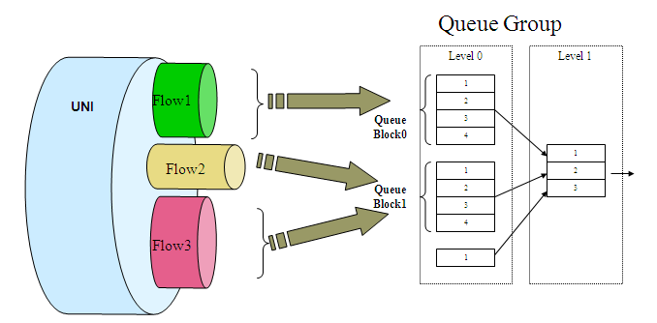

Ensuring SLA - End-to-end Traffic Management
Multiple criteria for service identification and classification:
  Port, VLAN-ID, P-bit, TOS-DSCP, EtherType, MAC SA/DA and IP SA/DA
Flow level traffic management for enhanced QoS:
  Differentiated Ethernet services with CIR/EIR Policing per flow and service
  Up to 8 queues per flow with Strict priority and WFQ scheduling
  Assuring SLA in congested links with shaping per EVC or EVC.cos
  Simplifying operation with powerful bandwidth profiles
Notes:
Carriers and service providers deploying business Ethernet VPNs must also be prepared to deliver measurable and enforceable SLAs that detail commitments for user traffic handling, bandwidth and performance guarantees, availability, as well as for response and repair times. This requires the installation of intelligent demarcation devices, or network termination units (NTUs), at the customer premises, to ensure end-to-end service control and efficient service provisioning from the service hand-off points. Such Ethernet demarcation devices are ideally equipped with Ethernet SLA support tools, including advanced service delivery and service assurance capabilities
Excess BW
The demarcation device provide a uniqueness engine of QoS , with inelegant structure of QoS .that allow to offer EVPL services meaning to execute consultation of various services per VLAN
The engine of QoS contain several elements e.g. classification that identify the prioritization of the servicers , observation on the higher level and define the priority according to Pbit Vlan .
Policer – Define the bandwidth profile per flow services commit on CIR –Commit information rate and EIR in case of excess BW , WFQ scheduling that allow to tunnel the strict priority and shaper that ensure SLA in congested link .

Slide 18


Ensuring SLA - End-to-end Performance Monitoring
Defined per service (EVC+CoS) and allows for in-service, end-to-end SLA monitoring based on ITU Y.1731
Measured parameters
  Frame Delay, Frame Delay Variation, Frame Loss, Availability
Performance objectives can be defined in accordance with the SLA and thus proactive end-to-end SLA monitoring can be performed:
  On going statistics
  Traps upon SLA objectives crossed
  Performance Monitoring allows End-to-End SLA verification

Slide 19





OAM for E2E SLA Assurance
Access Network
Customer Premises
GbE
ETX-203A
10 GbE
RADview-EMS & Service Center
ETX-220A
10 GbE
Service Provider Network
SHDSL
ETX-212A
GbE/10GBE
ETX-203AX
ETX-5300A
GbE
SDH
NxE1
ETX-205A
ETX-203AX
Enhanced TM, OAM
End 2 End SLA Assurance, PM manaGbEment, Resiliency
OAM Scheme
The OAM Scheme allows carriers to avoid SLA violation
by measuring specific parameters,
and alerting in case values exceeded pre-configured thresholds
Maintenance End Point
Delay, Delay Variation, Packet loss, Loss ratio, Availability
Maintenance Intermediary Point
Notes:
Carrier Ethernet has replaced ATM as the default layer-2 Ethernet is by far the most widespread network interface
we still would like to allow for the SP to commit about availability and resilience , and also to provide visibility till the customer premises
ETH OAM
OAM (Operation, Administration, and Maintenance) describes the monitoring of network
operation by network operators. OAM is a set of functions used by the user that enables detection of network faults and measurement of network performance, as well as
distribution of fault-related information. OAM may trigger control plane or management plane mechanisms, e.g. by activating rerouting or by raising alarms, but such functions are not part of the OAM itself. OAM functionality ensures that network operators comply with QoS guarantees, detect anomalies before they escalate, and isolate and bypass network
defects.

Slide 20
Performance Mgt. & Accuracy
Access Network
Customer Premises
GbE
RADview-EMS
ETX-203A
10 GbE
ETX-220A
Hardware based OAM
Micro-seconds Robast accuracy
10 GbE
Service Provider Network
SHDSL
ETX-212A
GbE/10GBE
ETX-203A
ETX-5300A
GbE
SDH
NxE1
ETX-205A
ETX-203AX
Enhanced TM, OAM
End 2 End SLA Assurance, PM manaGbEment, Resiliency
OAM Technology | End-End/Last Segment | Performance Monitoring | Type | Fault Propagation
IEEE 802.3-2005 (formerly 802.3ah) | Single Segment | No | Link | No
IEEE 802.1ag | End-to-End | No | Connectivity | No
ITU-T Y.1731 | End-to-End | Yes | Service | Yes

Slide 21





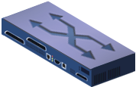





Service Turn-Up
Service
Turn-up
Ongoing
Monitoring
Fault Management
& Recovery
ISP
POP
Service Multiplexed Ethernet UNI
Internet
UNI
UNI
CE
Carrier Ethernet Network
CE
UNI
CE
Point-to-Point EVC
CE
Verify installation, provisioning, and performance of Ethernet connection with line-rate test traffic
Connection Verification
Ethernet OAM - 802.1ag
Continuity Check
MAC Ping
Diagnostics Loopbacks
L1 physical interface loopback
L2/L3 Loopback per flow with MAC/IP swap (up to line rate)
SLA Verification Testing
RFC-2544 based tests
Throughput, Loss and Delay tests
Data integrity tests (BERT), Delay Measurement
Notes:
Validate that the circuit has been installed and provisioned correctly
Validate throughput using RFC 2544 tests per service
Archive test results for reporting and future comparisons (“birth certificates”)
Controlled introduction of a new service typically includes such steps as service setup, in-field testing to validate link and service connectivity, and acceptance tests to verify that the service is running smoothly according to the SLA and the QoS (quality of service) and CoS (classes of service) it defines. Testing at this point also serves for generating a baseline for performance parameters, to which future test results will be compared. Specifically, KPI (key performance indicators) metrics are established for end-to-end throughput, packet delivery ratio, latency, and jitter.

Slide 22
Service Monitoring
Service
Turn-up
Ongoing
Monitoring
Fault Management
& Recovery
ISP
POP
Service Multiplexed Ethernet UNI
Internet
UNI
UNI
CE
Carrier Ethernet Network
CE
UNI
CE
Point-to-Point EVC
CE
Performance Monitoring
Ethernet OAM – Y.1731, Frame Delay, Frame Delay, Frame Loss
Service availability (G.826)
SLA Threshold Reporting
Defining SLA objectives and proactively notified when crossed
Alarms and traps on management system
Statistics Collection Reporting
Statistics collection via SNMP or FTP
Statistics can be used to generate SLA reports
Notes:
Measure the Key Performance & Quality Indicators for the service (24x7x365)
Carrier Ethernet OAM standards (802.1ag/Y.1731)
Alert and Alarm on service degradation and failures
Provide reports to customers, NO
KPI measurements are also performed on an on-going basis, to monitor network health and ensure that QoS is maintained per class of service and in accordance with the contracted SLA. Continuous monitoring is required to detect service degradation and network congestion, prompting relevant alerts and advising when an increase in bandwidth is required. When service outages or connectivity faults are identified C users, executives and managers

Slide 23
Fault Management
& Recovery
Service
Turn-up
Ongoing
Monitoring
Fault Management
& Recovery
ISP
POP
Service Multiplexed Ethernet UNI
Internet
UNI
UNI
CE
Carrier Ethernet Network
CE
UNI
CE
Point-to-Point EVC
CE
Fault Detection & Isolation
Ethernet OAM – 802.1ag
Fault Propagation & Notification
Ethernet OAM – Y.1731
Resiliency & Repair
Linear Protection ( “EVC Protection”) -G.8031
Continuity Check, Loopback
Link Trace
Per EVC ‘Forward’ and ‘Backward ’ Alarm Propagation
Dying Gasp indication to active - 802.3ah
Per port Alarm Propagation
Ethernet Ring Protection - G.8032
Notes:
Avoid truck rolls as much as possible
On-demand in-service troubleshooting using standards based testing (802.1ag/Y.1731)
On-demand out-of-service troubleshooting using standards based testing RFC 2544

Slide 24
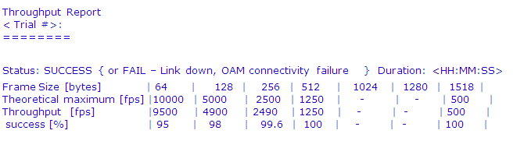
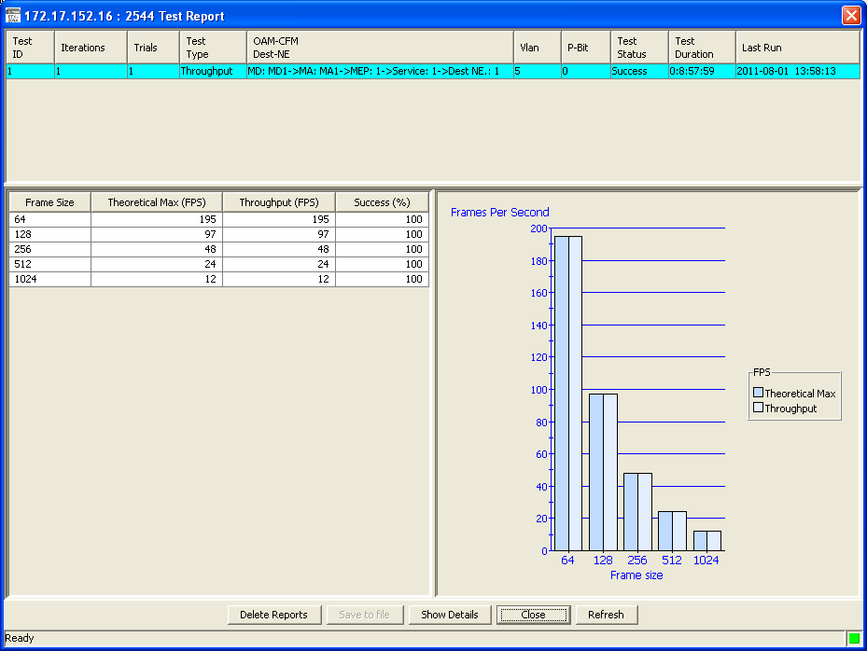
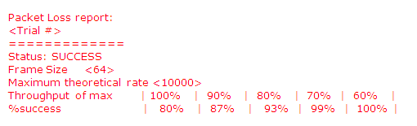


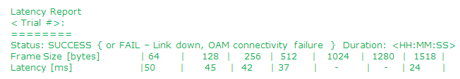
Service Validation
Integrated RFC-2544
ETX integrated RFC-2544 GbEnerator :
  Unidirectional or bidirectional tests
  Measurements of throughput, latency, frame Loss
  Test report creation
  Frame type: OAM messaGbEs
RFC-2544
Retail
Wholesale
Notes:
The Internet Engineering Task Force (IETF) standard RFC-2544, Benchmarking Methodology for Network-Interconnect Devices, defines testing procedures for evaluating the performance of network devices, among which are network throughput measurements. These allow the service provider to baseline service performance and determine the available bandwidth for each EVC, by establishing the maximum transmission rate at which no packets are dropped. In addition to throughput testing, RFC-2544 includes frame loss and frame latency tests.

Slide 25


Ethernet Linear Protection based on G.8031
Confidential
Customer Premises
L2PE
CPE
ETX
X
L3PE
Ethernet
Access Network
Metro /
VPLS
L2PE
GE
Secured access segment
Redundancy on S-Tags in the network
APS is running over one stby EVC only
One EVC failure can trigger on all other EVC’s
End to end service is maintained
  TLS , Accesses to L3 VPN
CPE
ETX
Online EVC
Redundant EVC
APS MSG.

Slide 26


Service Protection Schemes
Customer Premises
Port
Protection
802.3ad (LAG)
Port
Protection
Dual Homing
ETX
CPE
ETH
Customer Premises
ETX
CPE
PE
PE
ETH
Linear Protection G.8031
PE
PSN
ETH/MPLS
ETX
PE
ETH
eNodeB
Resilient Ethernet Ring
G.8032
ETH
ETX
eNodeB
50ms protection, comparable to SDH/Sonet
Combine physical port protection and EVC/logical link protection
Protection can be triggered on physical failures or OAM CC

Slide 27
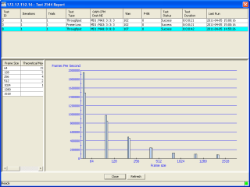
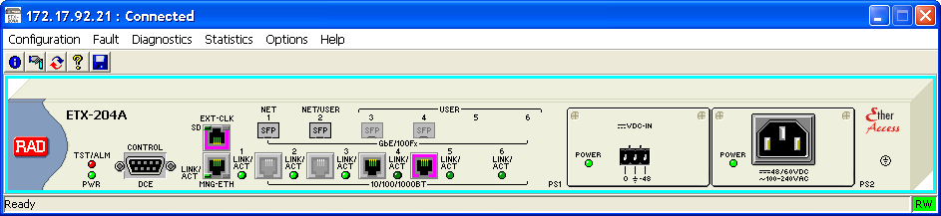
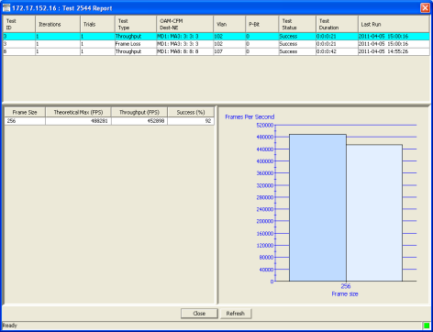

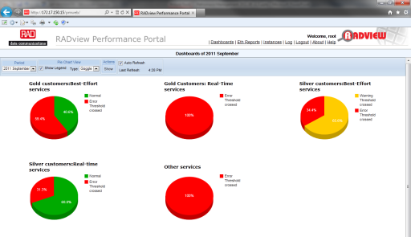
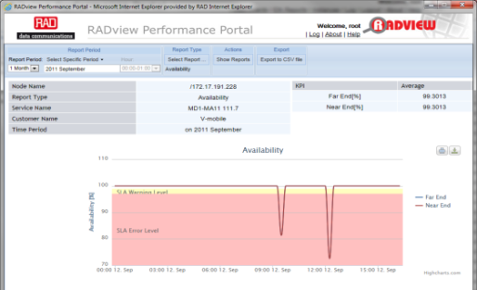
ETX Management
RFC-2544
Turn-up
Monitoring
Troubleshooting
Notes:
RADview-PM portal Collects, stores and presents KPIs (Key Performance Indicators) from RAD devices, fast and efficient!
Accelerates the processing of new report definition
Immediate detection of service degradation allows service providers to take remedial actions to quickly restore appropriate performance levels
Easily evaluate actual performance over time and compare it to SLA guarantees based on Y.1731
Provision
Monitor
Maintain and Optimize
Accelerate time to market by reducing time and effort required for new service rollouts
Cut down truck-rolls, on-site technician calls and Trouble Tickets with remote testing, end-to-end visibility and proactive monitoring
Minimize penalties associated with SLA (service level agreement) breaches
Reduce customer churn with clear service performance reporting and fewer billing disputes
Services that crossed warning level
Services that crossed error level
Services that meet SLA without warning
Policy Management
KPI selection
Thresholds assignment
Management of SLA violations
Real-time status updates
Indication of threshold crossing Alarms
Aggregated OAM reports per Hour/Day/Week/Month
Monthly SLA reports
Dashboards for general SLA status at a glance
Monthly Scheduled reports (PDF)
Customers management

Slide 28


ETX Product Line Review

Slide 29
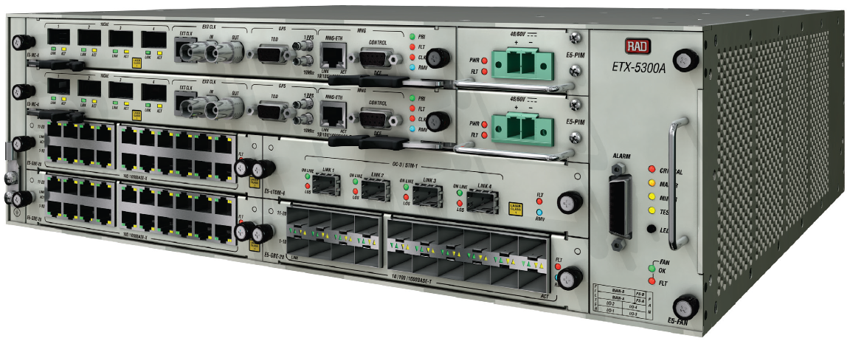
ETX-5300A Main Features &
Architecture
Non blocking architecture with wire speed packet forwarding for all packet size
Ethernet and TDM Services
  E-Line (EPL and EVPL), E-LAN (EP-LAN and EVP-LAN) E-Tree (EP-Tree, EV-Tree)
  TDM – TDM PW – MEF8 & UDP/IP encapsulation
Ring G.8032 & Linear G.8031* topology
Fully redundant chassis including 50 ms switch over
VLAN Forwarding & manipulation
Hierarchical Traffic management
Network Termination Unit like packet classification
Timing over packet – 1588v2, M&S SyncE, Adoptive clock recovery
* G.8031 will not be supported on the first release

Slide 30
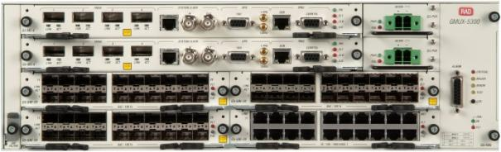
ETX-5300A Front View Description
Clocking Interfaces
Redundant PSU (DC/AC Outlet)
Fan Module
4 x 10GbE XFP fully redundant
Secondary Main Card
Primary Main Card
Alarm output connector
20 x 1GbE Opt SFP I/O card
20 x 1GbE Elec I/O card
Air Filter

Slide 31
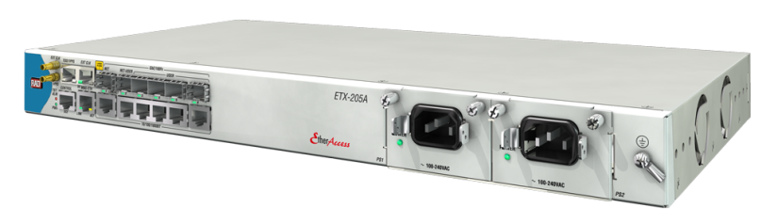
ETX-205A Product Introduction
Advanced Carrier Ethernet
Demarcation Device for:
  SLA-based retail and wholesale Ethernet services
  Mobile backhauling Ethernet demarcation
Carrier-grade design
  Service and port level redundancy
  Redundant power supplies
SyncToP™ synchronization combining:
  Synchronous Ethernet
  IEEE-1588v2 PTP Transparent Clock
  Hardware ready for IEEE-1588v2 Ordinary Clock
MEF compliant EPL and EVPL Ethernet services

Slide 32

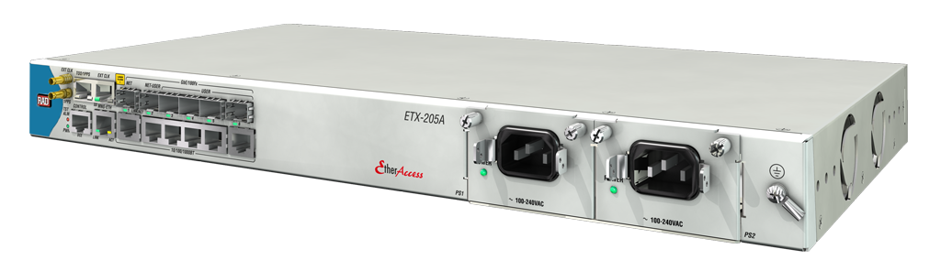
ETX-205A Physical View
  SyntTop™ synchronization ports:
External in/out (T3/T4)
  1PPS and ToD
6 FE/GE combo interfaces:
2 Network ports
4 User ports
Management ports
Out of band - Ethernet port
Local craft terminal - RS-232
Redundant power supplies:
AC: 100–240VAC, 50-60Hz
DC: 24/48VDC
19”, 1U shelf, rack and wall mount

Slide 33
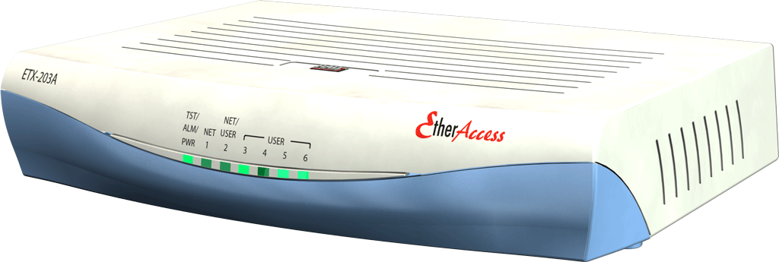
ETX-203AX Product Introduction
Fixed Carrier Ethernet Demarcation
Device for:
  SLA-based retail and wholesale Ethernet services
Flexible Network port selections:
  1 or 2 FE/GE network ports: SFP based
  4 or 5 FE/GE user ports: SFP or UTP
Carrier grade design
  Service and port level redundancy
MEF compliant EPL and EVPL Ethernet services

Slide 34
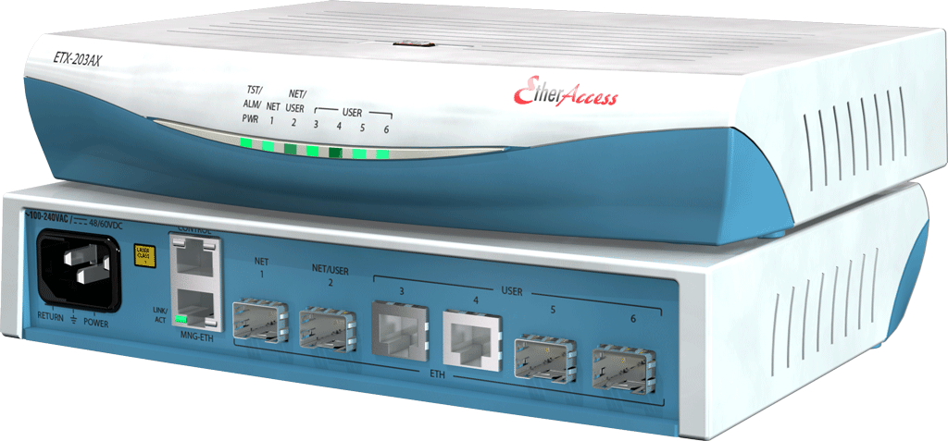
ETX-203AX Physical View
Power
Wide-range AC&DC PS
Management
Out of Band FE port
Local RS-232
Network and User Interfaces
1 or 2 network SFP interfaces (redundancy)
Up to 4 or 5 user ports
Dimensions: 1.7 x 8.4 x 5.8 inch
Low power consumption – 8 W

Slide 35


Award Winning Products

Slide 36
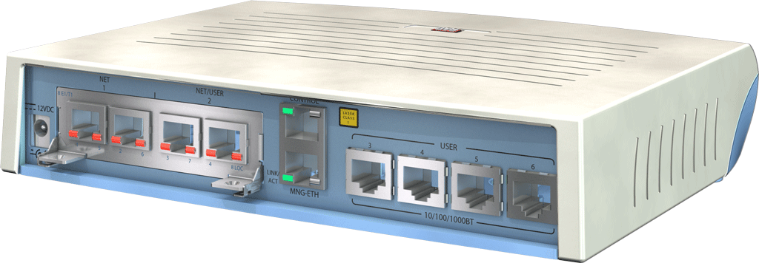
ETX-203AM all-in-one
Available in Ver. 4.3
Ready now for pre-beta trials
OPEX savings driven by:
  Uniformity
  Smooth migration
  Reduced inventory
  Shorter training and expertise
  Management integration
Management
Out of Band FE port
Local RS-232
User interfaces:
4 FE/GE interfaces
SFP or UTP
Shelf types and Power
Integrated AC in metal case
Integrated DC in metal case
External AC in plastic case

Slide 37
ETX-203AM Modules
FE/GbE Combo port uplink module
SHDSL EFM
uplink module*
Ethernet over PDH uplink module*
  2 x 10/100/1000BT
  2 x 100/1000Fx (SFP)
  2wire – 5.7 Mbps
  4wire – 11.4 Mbps
  8wire – 22.8 Mbps
  8xE1/T1
  2xT3
  GFP/VCAT/LCAS
  Single VCG
Management
Out of Band FE port
Local RS-232
User interfaces:
4 FE/GE interfaces
SFP or UTP
Shelf types and Power
Integrated AC in metal case
Integrated DC in metal case
External AC in plastic case
* Module available in future versions

Slide 38
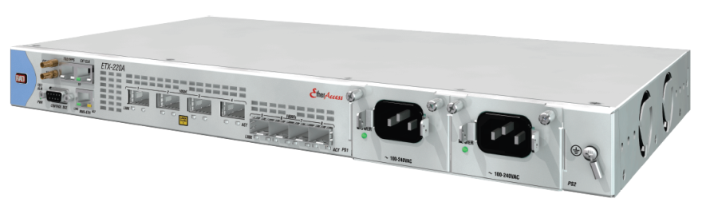
ETX-220A Characteristics
Flexible 10GE Ethernet Demarcation Device for:
  SLA-based retail and wholesale services
  Mobile backhauling Ethernet demarcation
MEF compliant Ethernet services
  E-Line service: EPL and EVPL
  E-LAN services: EPLan & EVPlan
Carrier grade design
  Service and port level redundancy
  Redundant power supplies
ETX family key features:
Per flow H-QOS for SLA assurance
Scalable HW based E-OAM
RFC-2544
DHCP client for zero-touch provisioning

Slide 39

ETX-220A Layout
  H/W ready SyntTop™ synchronization ports:
  RJ-45 and BNC i/f
External in/out (T3/T4)
  ToD and 1PPS
4 x 10GE XFP Based Ports
2 Network i/f 1:1
2 User i/f (only one is functioning in the first release)
Management ports
Out of band - Ethernet port
Local craft terminal - RS-232
H/W ready for 4 x 1GE aggregation
Redundant power supplies:
AC: 100–240VAC, 50-60Hz
DC: 24/48VDC
  19”, 1RU shelf, Rack and wall mount
  Environmentally Hardened Option: -20 to +65C

Slide 40
Summary
Generate new revenue by reaching larger and/or new markets
Leverage Access infrastructure for both L2 and L3 services
  Most providers provide both L2 and L3 services; same Ethernet Access infrastructure can be used for both
Reduce operating costs
  Enhanced service manageability across entire Service Life Cycle
Reduce capital costs
  Optimized price/performance using RAD’s EtherAccess ASIC
Provide Ethernet service over Copper, Fiber and Wireless last mile
  Versatile last mile solution for Ethernet hand-off to the customer
Migrate Legacy services to PSN
  One PSN network and Single access link for Ethernet and Legacy services

