Slide 1

INS –
Integrated Network & Complementary Solutions
Presented by:
David Varsano
Director, Integrated Network System

Slide 2
Outline
INS definition and Missions
Market Segment
INS project process
INS Project Examples

Slide 3
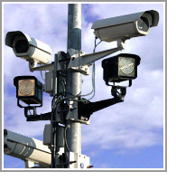
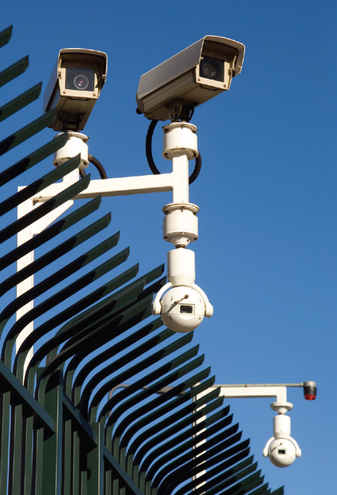
INS – Integrated Network Solutions: New Value Added Services
What are the Business Opportunity and What RAD can offer
RAD INS is offering New Value Added Services
Identify and promote complimentary solutions based on 3rd party products and in-house developments
  Increase RAD attractiveness
We offer - One Stop Shop for turnkey Project.
  Supervising and helping in:
  Planning & Design Network when Third Party product are required
  Providing Full Solution Including Installation and Commissioning

Slide 4
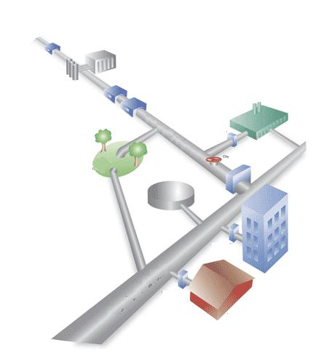
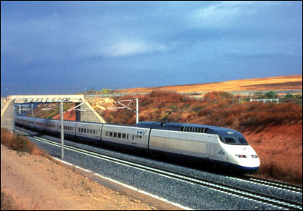

Target Markets and applications
Video Mobility
Railway/Metro
Airports & Highway
Safe City &Video Surveillance
Utility Gas & Oil
  Railway to Road Cross CCTV-on-board
  Internet service on board
  Follow me cars communications
  Smart & Toll Road
  Safe City Video Surveillance
  Critical Assts - Airports, strategic facilities, prisons, plants security
  Protect Oil Distribution
  Video Surveillance in Utility invariant

Slide 5
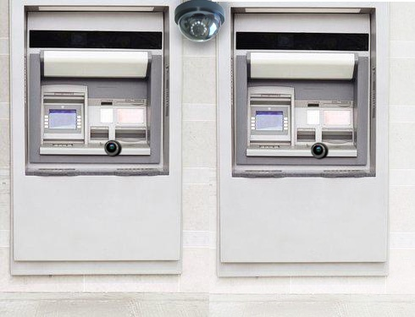
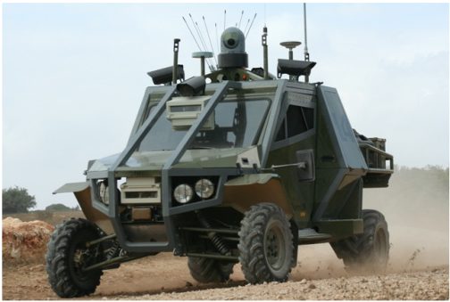
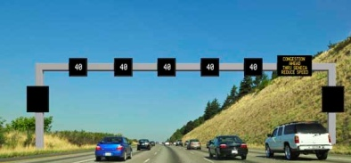
Target Markets and Applications
Banks/ATM
Monitoring & Security
Border Critical Assets Security
Traffic Control &
Mobile Video System
  CCTV in every ATM transaction
  Bank Security using Video recording system DVR and Servers
  Border Monitoring and Alert System
  Critical Assts – Airport Gas Tankers Security
  Tall Road System
  Traffic Light control System

Slide 6
Outbound Solutions Examples
Outbound solutions
  Onboard Video Security
  Compound and Border control
  Road Security
  Safe City Application
  Airport – “Follow Me “ Vehicles
  Gas & Oil Security System
  Cellular BTS Security
  Access Control
  Bank /ATM Monitoring
  Traffic Control and Security

Slide 7
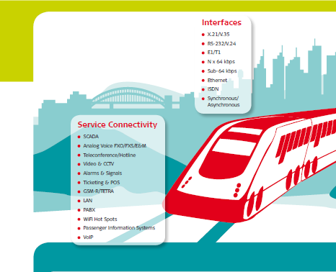
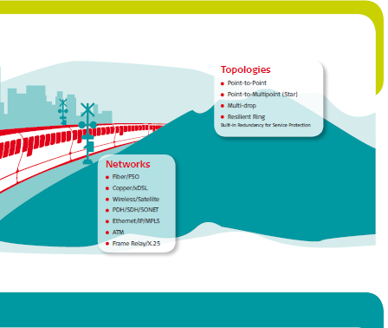
Transportation Solutions:
Railway and Highway

Slide 8
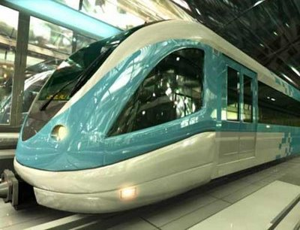

Onboard Video Surveillance

Slide 9
Onboard Video Surveillance
Target Customers
Intercity & Metro trains
Customer requirements
Real time view of train carriages while on the move, enabling event prevention and post analysis of security related events (e.g. vandalism)
Video streaming from carriages is streamed to the control center where it is monitored, recorded and analyzed

Slide 10

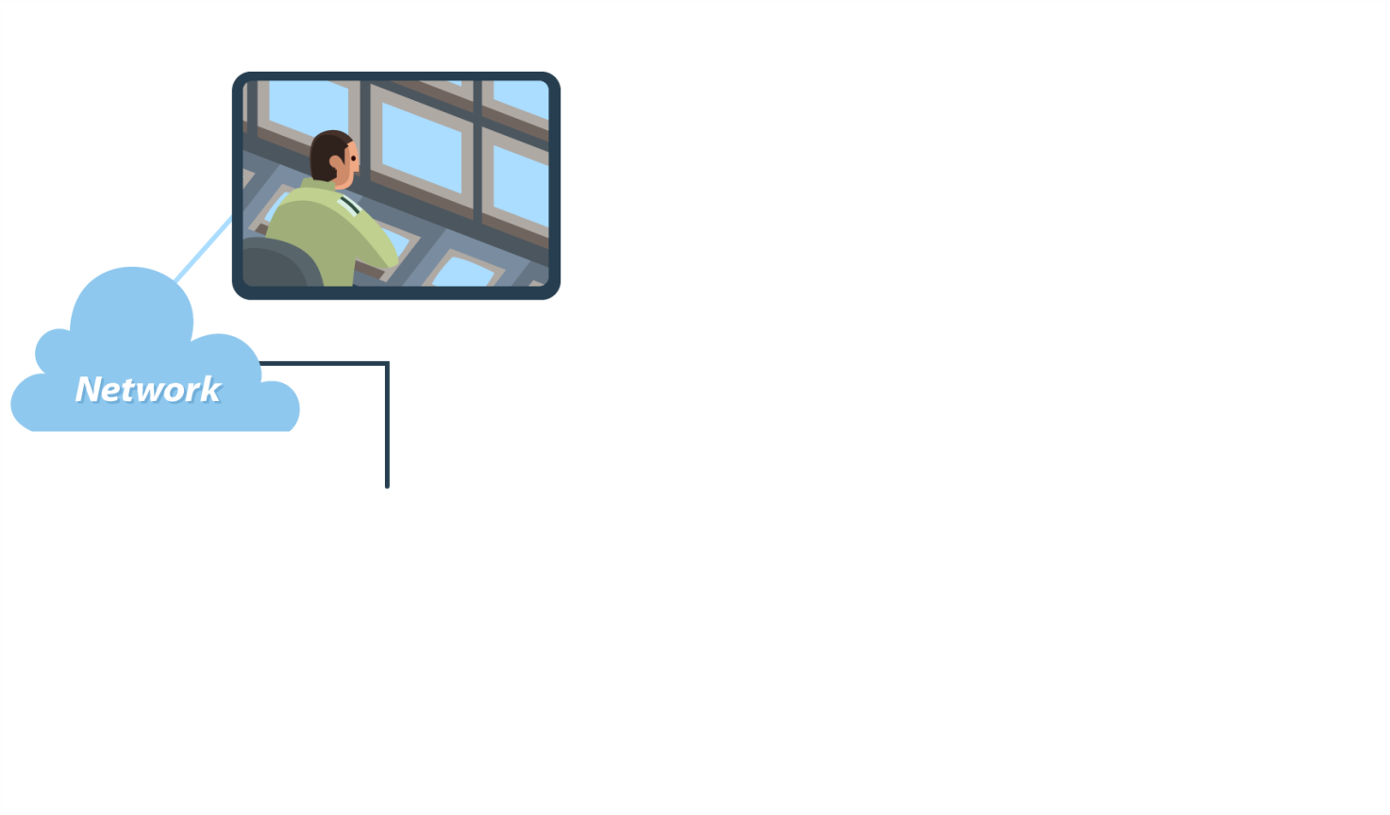




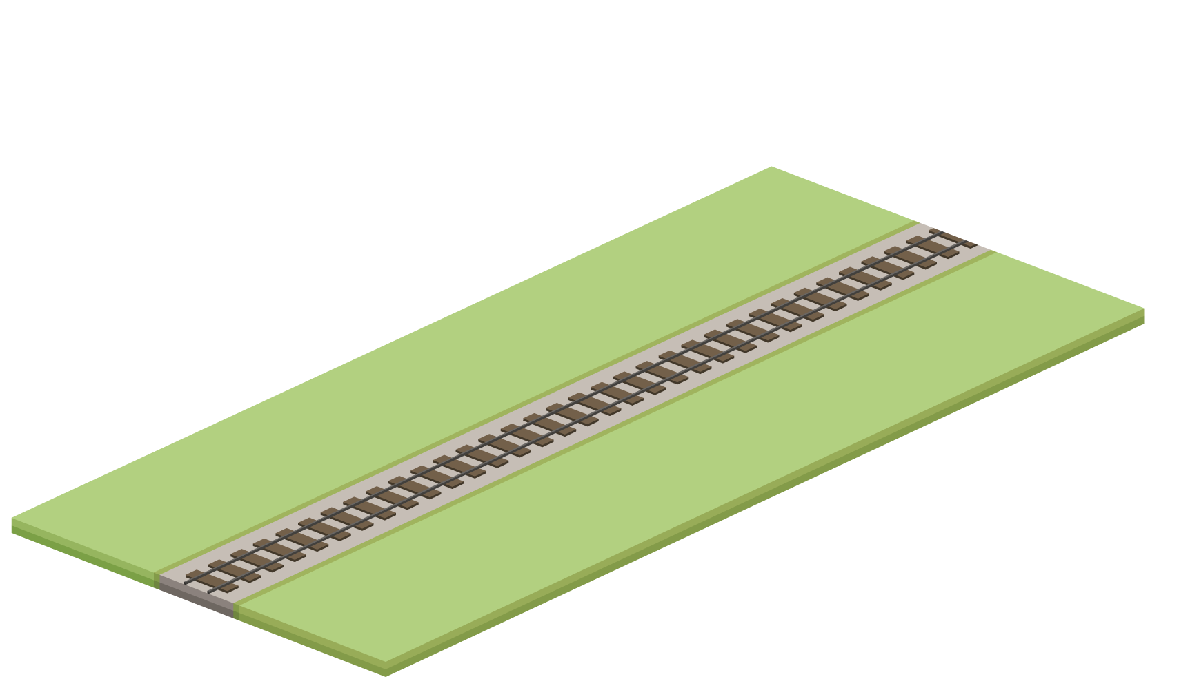





Video Surveillance Application
Radios
Surveillance cameras
are deployed on the train
Backhaul connectivity

Slide 11


Video Surveillance Application
Continuous high capacity video surveillance is secured

Slide 12
Solution Highlights
Wireless system, Airmux-5000 Mobility, covers the entire Railway track
Video information is streamed from cameras located on each carriage to Control Center
Wireless Handover capability to secure communication
Fixed or Wireless backhauling
Central Video Management system

Slide 13
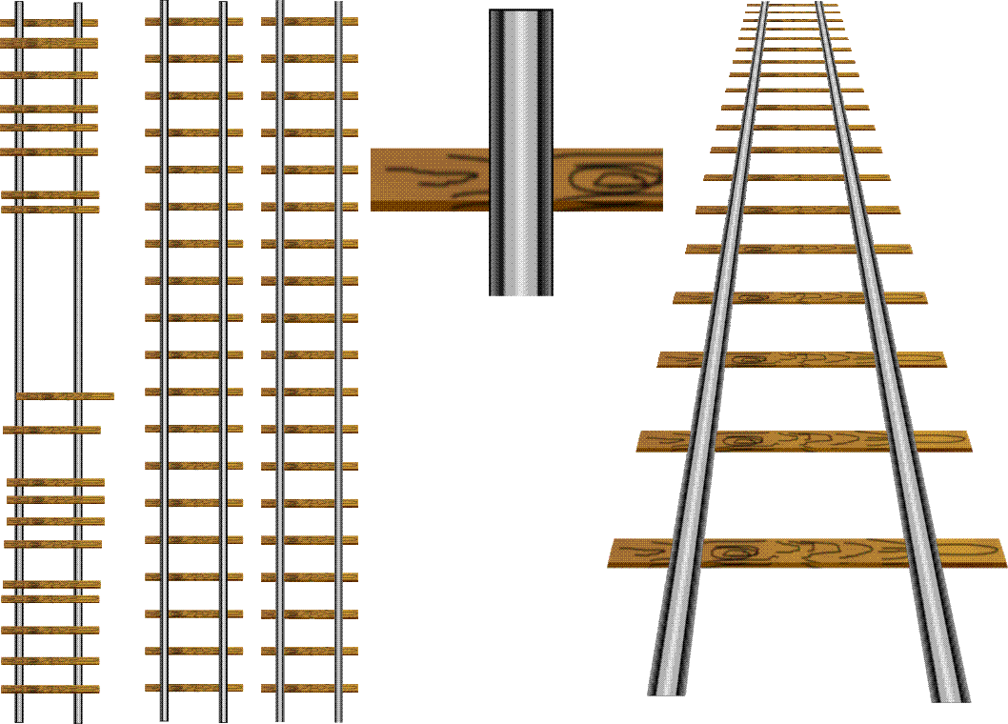


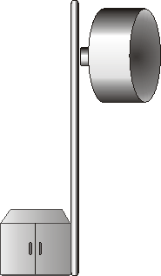

Track Side Architecture
ETX-26 for Radio Backhaul (Protected GbE ring over Fiber Optics)
Airmux-Mobility - Radio connectivity Train to Track-side
Central management solution
Mobile Radio
Mobile Radio
Mobile Radio
Mobile Radio
Radwin
Radwin
Radwin
Radwin
RADview-EMS
ETX-26
ETX-26
ETX-26
ETX-26
Ethernet Fiber Optic Ring

Slide 14







System Architecture – Train Side
Train Antennas
Dynamic Wireless Distribution System
Back Hauling
Bynet WiFi Access Point
PTZ
Camera
Bynet WiFi Access Point
PTZ
Camera
Bynet WiFi Access Point
PTZ
Camera
RADWIN Radio
Backhaul Equipment
Video Surveillance and Access Equipment
Notes:
14

Slide 15
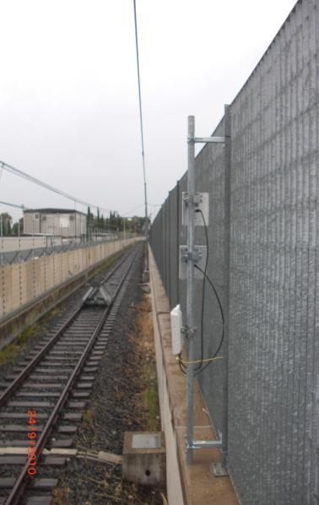
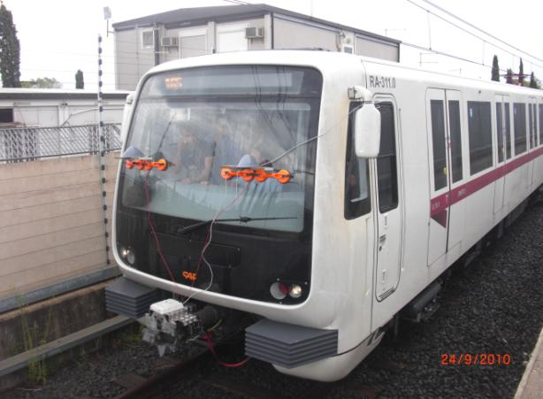
Case Study –
Metropolitana di Roma
Bynet had been chosen by Metropolitana di Roma as a supplier of the wireless mobility system for surveillance cameras backhauling at the metro’s rolling stock
The vendor choosing process was divided to a series of outdoor and indoor test of increasing complexity

Slide 16
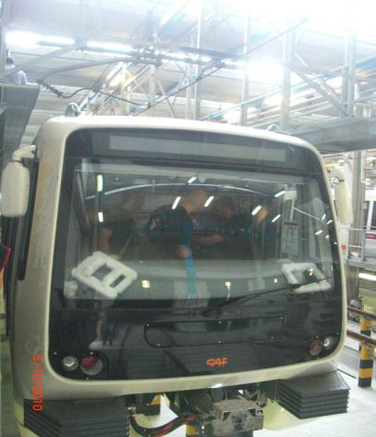
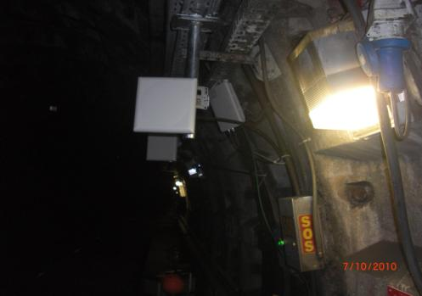
Case Study –
Metropolitana di Roma
The outdoor test was conducted at the depot at the end of line A near Anagnina station, 800 meters of track were covered with a single base station
The indoor test was conducted in the line A tunnels of the Rome Metro between Manzoni and Re di Roma stations. The 1200 meters of track and 3 metro stations were covered with just 4 base stations

Slide 17
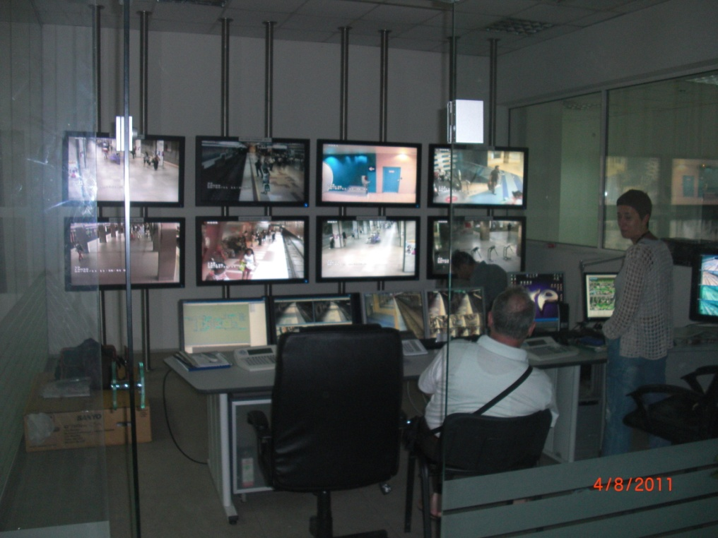
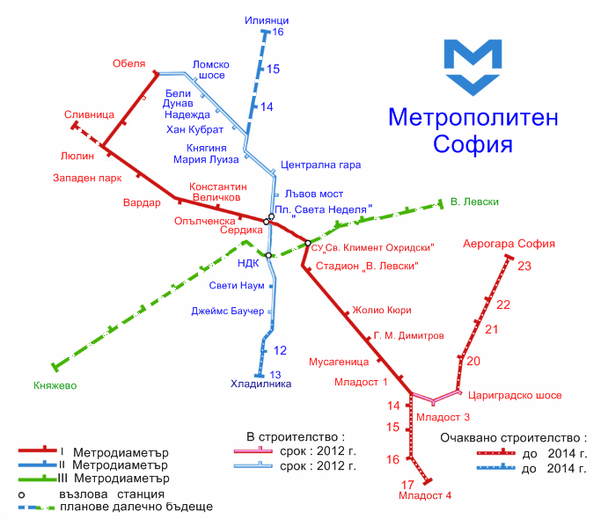
Case Study – Sofia Metropolitan

Slide 18
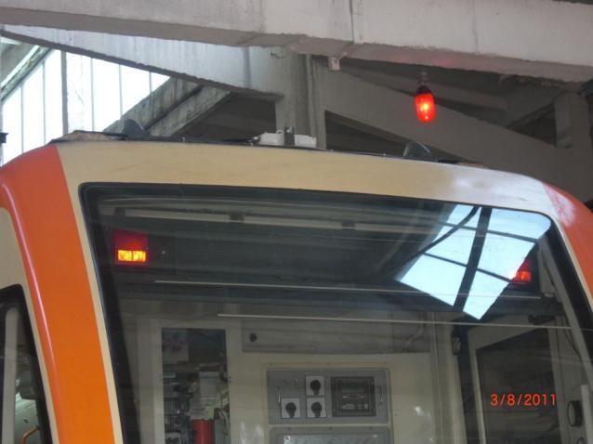
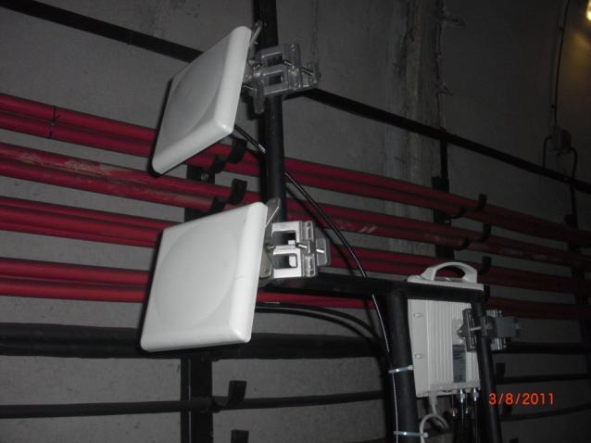
Case Study –
Sofia Metropolitan
Bynet had been chosen by Sofia Metropolitan as a supplier of the wireless mobility system for surveillance cameras backhauling at the metro’s rolling stock
Aerodynamic Train Antennas

Slide 19
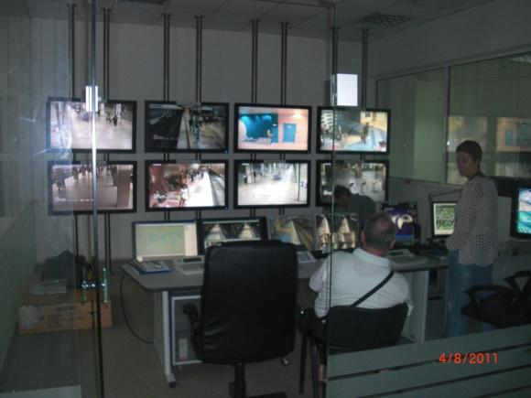
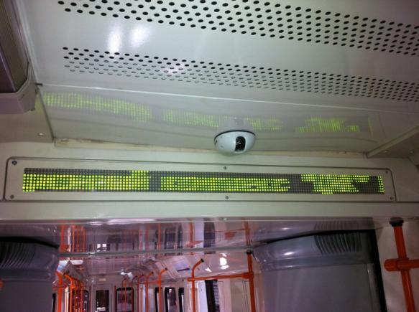
Case Study –
Sofia Metropolitan
The indoor test was conducted at the Main Line A tunnels of the Sofia Metropolitan between Joliot-Curie and Vasil Levski stadium stations
The 2300 meters of track and 2 metro stations were covered with just 2 base stations located at the stations

Slide 20
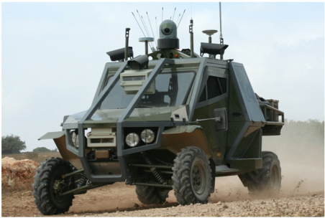
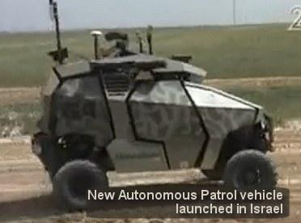
Border & Critical Assets Security

Slide 21
Border & Critical Assets Security
Target Customers
Utilities, Government agencies & Military
Customer Requirements
Provide high capacity communication to border and perimeter control vehicles. Allowing bi-directional real time video streaming.
Video streaming from patrol vehicles is streamed to the control center where it is monitored, recorded and analyzed

Slide 22

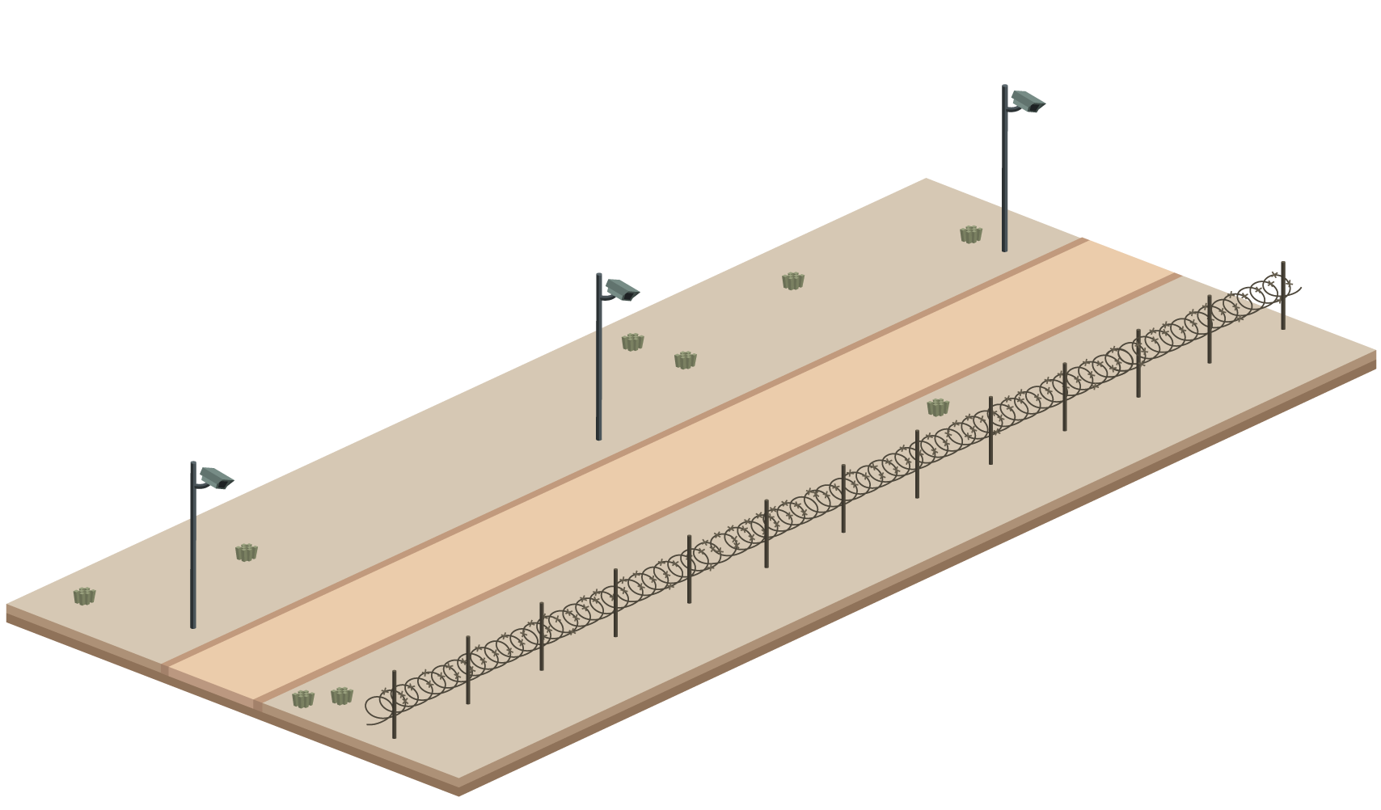
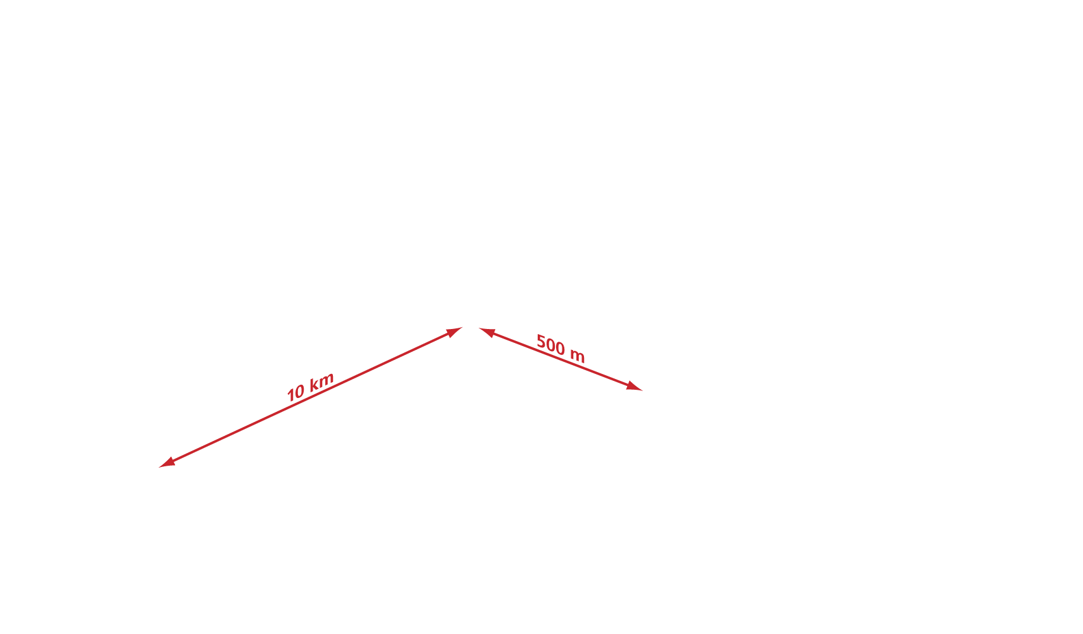
Mobility Solution – Border & Perimeter Control

Slide 23


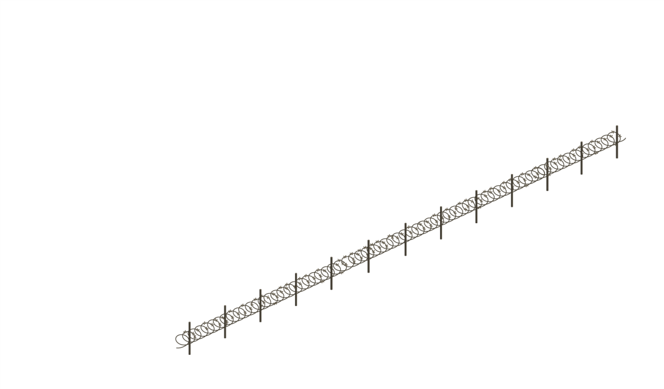
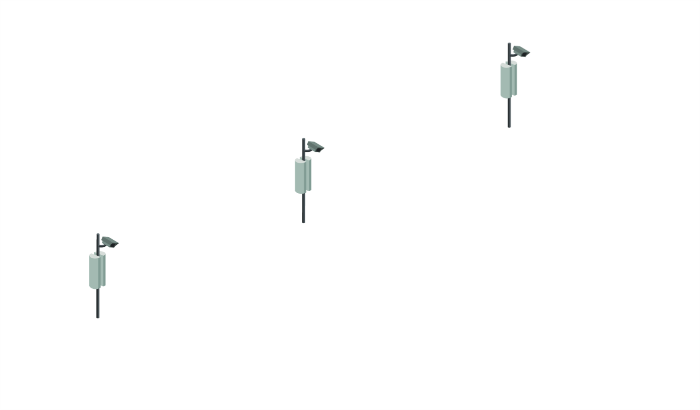

Mobility Solution – Border & Perimeter Control

Slide 24




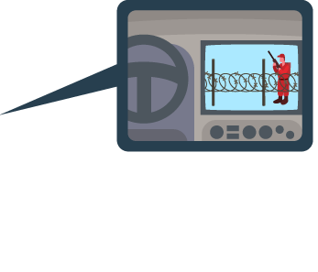
Mobility Solution – Border & Perimeter Control

Slide 25



Mobility Solution – Border & Perimeter Control

Slide 26
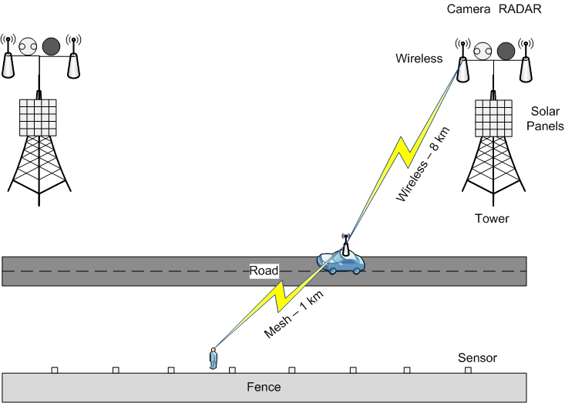
Border Protection Concept
ETX-26
ETX-26
ETX-26
ETX-26
Ethernet Fiber Optic Ring

Slide 27
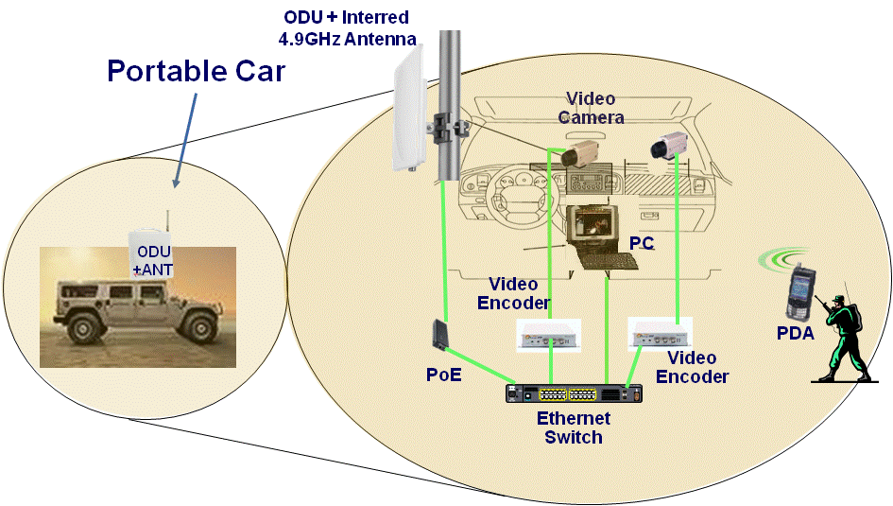
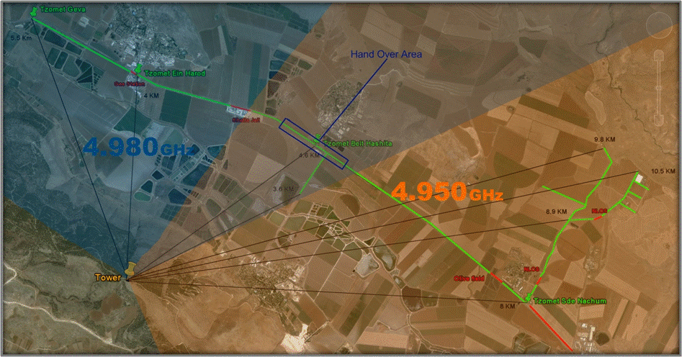
Case Study –
Mobile Broadband Comm.
Mobile Broadband Wireless security solution, enabling Bi-Directional Real-Time transfer of Video streams
Deployed over 1000Km of border !!
* Military customer, under NDA agreement
Unique in-house technology aimed at Military and Civilian applications.

Slide 28

Technical Portfolio
Control & Command Situation Manager (CCSM)
Intelligent Video Management system (VMS)
Cameras, Encoders, Intelligent cameras with integrated video analytics, Video and Audio analytics
Turn-key Solutions
Combined networking and Video Surveillance solution
Proven experience and in-house technologies

Slide 29
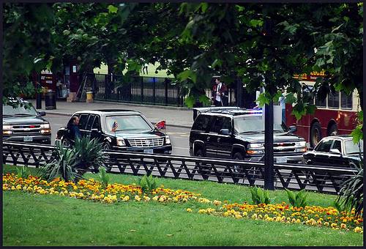
Road Security

Slide 30
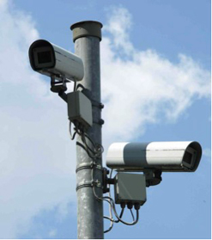

Customer Requirements
Customer
Government
Police
Municipality
Customer requirements
Video streaming from crossroad area towards approaching Junctions and along the Main Roads, Airport to City Road
Approaching Bridge will get real time video communications starting at 5km’ ahead of any Junction
Traffic lights Junctions Visibility
Video Analytics – Plate recognition
Command & Control Situation Manager (CCSM)

Slide 31



Security Concept
Considerations
Placing IP Cameras (box and PTZ) on poles along the way, providing real-time surveillance on the route
Establishing Command & Control Center, equipped with VMS, Video Analytics, Video Recording and CCSM systems, occupied by security team
Fiber/Wireless backhaul of the cameras to the C&C Center
Intersection 4 box and a PTZ camera
Crossroad 3 box and a PTZ camera
2 way 2 box and a PTX camera

Slide 32
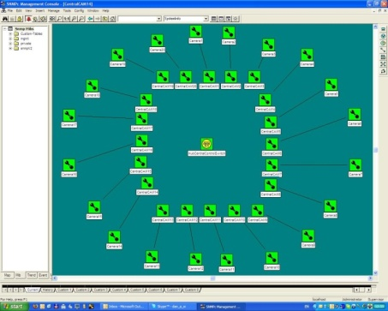
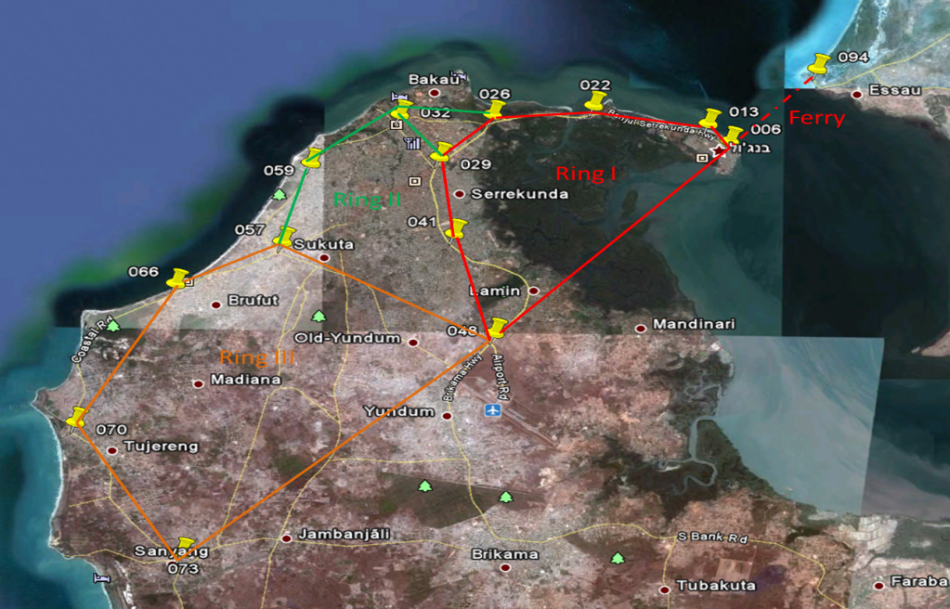
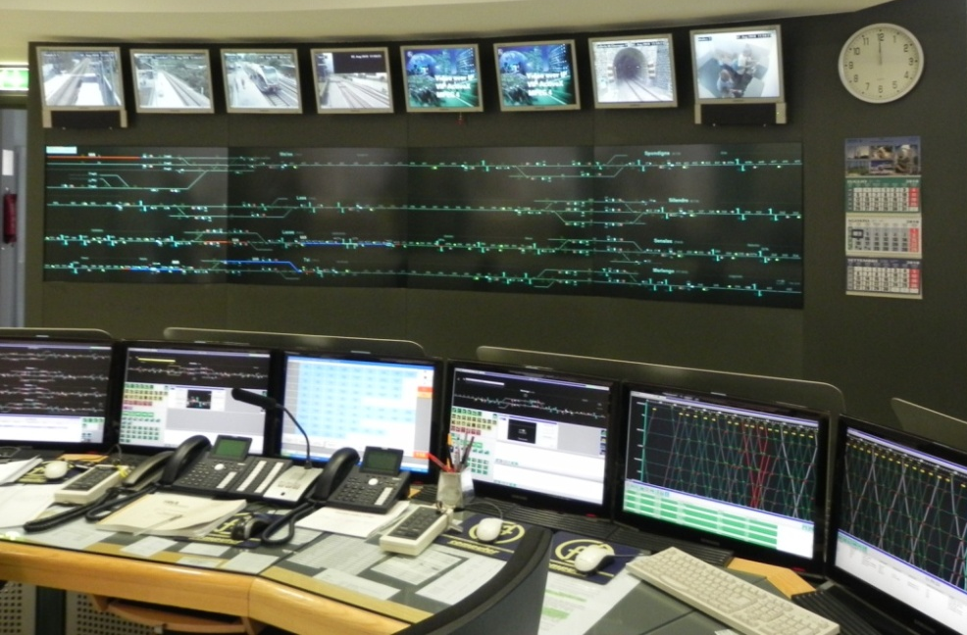
Gambia Safe City
Our Partner and RAD had been Invited for Site Survey in order to Design the Road Video Security Network for the Gambia Police Project
Following to a site survey conducted by RAD in Gambia, the following information was gathered: Main Road need to be Secure, Location and design of the control room

Slide 33
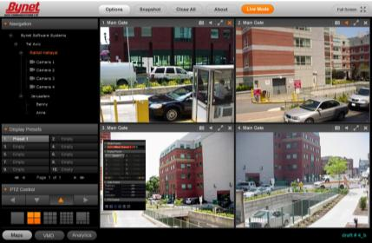
Safe City

Slide 34
Safe City
Target Customer
Municipalities & Governments
Customer Requirements
Make public safety and justice agencies effective
Creating security concept that integrates the technology with the law enforcement capabilities
Mapping security prone targets such as
  Sports Facilities
  City Center
  Transportation

Slide 35
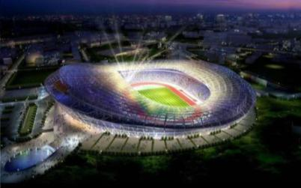
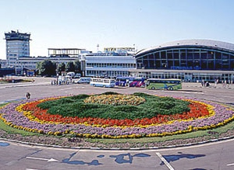
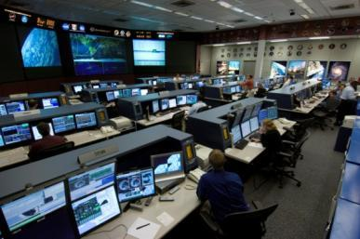
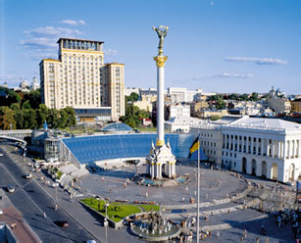
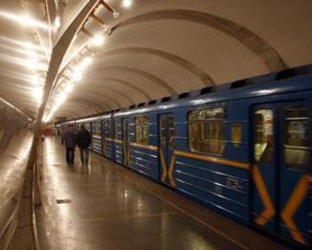

Safe City – Concept
Command & Control Center
Sport Stadiums
Airport
City Center
Metro
Parks

Slide 36
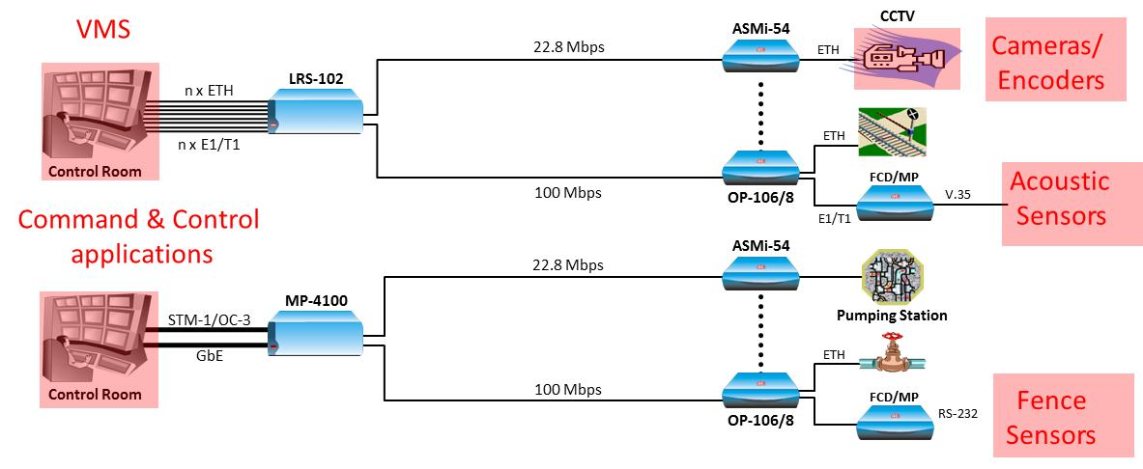
Connecting Security Devices over
Fixed “Dark” Infrastructure
Utilizing available copper or Fiber optics infrastructure for connectivity between security cameras and sensors throughout the city

Slide 37
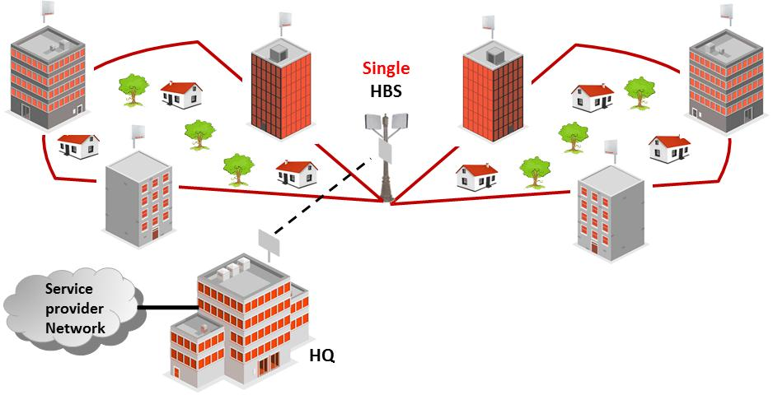
Connecting Security Devices over
Wireless Infrastructure
Covering city areas using Point-to-Point and Point-to-Multipoint wireless infrastructure. Allowing connectivity between security cameras and sensors throughout the city

Slide 38
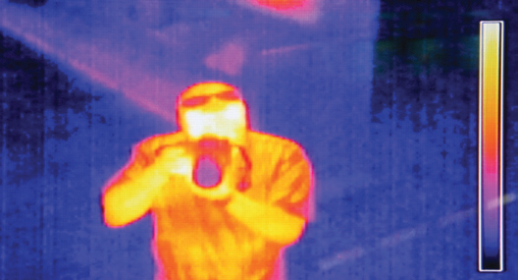
Video Surveillance
Video Cameras
  IP
  Analog
  PTZ
  Infrared
  Thermal
  High Definition (HD)
Video Encoders & Decoders

Slide 39
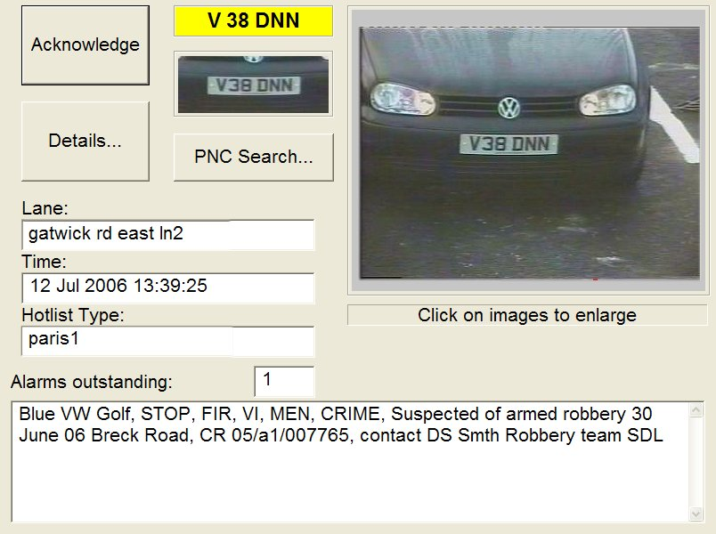
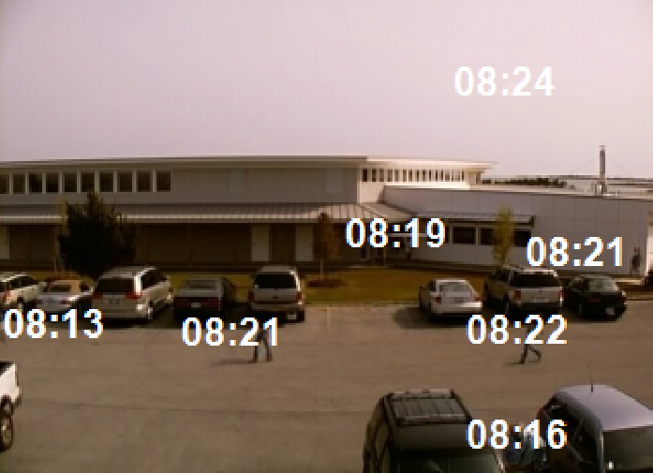
Video Surveillance – Cont.
Video Analytics
  License Plate Recognition (LPR)
  Object Identification & Classification
  Search
  Synopsis
Video Management Systems
Network Video Recorders

Slide 40


Automatic License Plate Recognition
Delivers the ability to read vehicle license plates and check against an installed database for rapid identity verification
  Automatically locate and match vehicle plates against wanted lists
  Simultaneously processing number plates from several high speed traffic cameras
  Connected live to a back office facility database
  Surveillance in any environmental setting, under varying light conditions

Slide 41


Safe City – Command & Control
Command & Control Center
Disaster/Crisis Management Systems
Radio dispatch (RoIP)
Camera Control
  Alarms
  Remote Operation/Configuration
  Events log
  Reports capabilities
Video Management
  Storage (compression ratio?)
  Backup methods
  Central or per site
  Video analytics
  Distribution capabilities….

Slide 42



Case Study – COT Bulgaria
RoIP & Video Surveillance
Design and Implement a Wireless IP infrastructure (PtP & PtMP)
An overlaying solution for delivering
Land Mobile Radio (LMR) over IP and advanced Video surveillance applications
~70% WL Coverage of Sofia – Bulgaria
112 EENA Award winning
Solution !!

Slide 43
Airport – “Follow-Me” Vehicles

Slide 44
Airport – “Follow-Me” Vehicles
Target Customer
Airports
Customer Requirements
Provide high capacity communication to service vehicles (“Follow-me” cars) in airplane parking area
Provide real time operational data, video images and voice communication
Integration with existing airport data application and voice networks

Slide 45

Airport “Follow-Me” Car Comm.

Slide 46







Solution Architecture
Remote Camera
Airmux-5000 CPE
“Follow-Me” Car
AirMux 500 CPE
Airmux-5000 BST
Airmux-5000 BST
“Follow-Me” Car
AirMux 500 CPE
Ethernet Fiber Optic Ring
Airmux-5000 BST
“Follow-Me” Car
AirMux 500 CPE
IP Network
NMS
Client
NMS Server
CCSM Server

Slide 47


Israel International Airport
(Ben-Gurion)
Multidisciplinary project, designed to address all communication needs of Ben-Gurion international airport
More than 1000 cameras and sensors throughout the Airport

Slide 48
Technical Portfolio
Control & Command Situation Manager (CCSM)
Intelligent Video Management system (VMS)
Cameras, Encoders, Intelligent cameras with integrated video analytics, Video and Audio analytics
Turn-key Solutions
Combined networking and Video Surveillance solution
Proven experience and in-house technologies

Slide 49








Gas and Oil – SCADA and Video Surveillance
Industrial
Switch
Video Management
Industrial
Switch
V/D Mux

Slide 50

Oil Industry Security

Slide 51


Oil Industry Security
Oil Distribution need to be protected against vandalism
Solution to protected the network are:
  Video Surveillance
  Leaking detection system
  Movement detection use Wave Alert
  Command & Control Center
The Advantages using our system are:
  Quick detection
  Determine the leak location
  Prevention of Vandalism
  Protected Measurement Equipment
  Very low false alarm

Slide 52

Oil Industry Security – System Capability

Slide 53

Cellular BTS Security

Slide 54




Access Control
Physical Security – Sensors
Access Control Systems
Biometrics

Slide 55


ATM’s Security Concept

Slide 56
Simple and Smart
Each ATM can provide a data of the transactions (by RS232 or TCP\IP) made at the very moment the card is used, this kind of data can “trigger” the system to record the pre and post event an save this data for few month in order to prevent false money claims
The data can be saved at a local database or at a remote machine
If using a centralized data server we can track a stolen\ credit card when someone is trying to use it
Vandalism prevention – any sensor can trigger the DVR and provide images at the centralized security center
Any event can be programmed to record the images both local and remote
Can work at a narrow bandwidth – according to priority
Dual Video database for usual recording and for events

Slide 57




How it’s done ?
External Camera
Internal Camera
When it’s needed the system will draw the data from the main server and the images from the DVR
Bank’s Private Secure Network
Video is kept at the DVR when credit card is used.
Some of the data at the card is sent to the main server for later investigation.
SQL Main Server

Slide 58





Transportation – Traffic Control and Security
ETX-5300A
ETX-5300A
1G / 10G
Ring
ETX-26
ETX-5300A
ETX-5300A
ETX-5300A
ETX-26
1G
Ring
1G
Ring
1G
Ring
ETX-26
ETX-26
ETX-26
ETX-26
ETX-26
ETX-26

Slide 59
Mobile Video Systems

Slide 60
Mobile Video System
Mobile video recording systems using highly sophisticated video processing with state-of-the-art cellular/wireless analog communication
Video solutions designed for the following markets:
  Transportation / logistics
  Homeland security / defense establishment
  General commercial security
  Residential security

Slide 61

Bus Monitoring Solution
Remote Monitoring
Wireless Backup at Main Parking /Service Terminal

Slide 62


Police Monitoring Solution
Police Vehicles
Bynet Video Distributor
LAN
Police
Motor Bikes
Broadband LIVE
Broadband LIVE
Remote Monitoring
Foot Patrol

Slide 63


Remote Surveillance of Cash Carrying Suitcase Based on CVG-M
Control Center
Internet Via Cellular
GSM
Hidden Camera
12V Battery + SIM Card from
Local Carrier
Monitoring from inside the vehicle
CVG-M

Slide 64
Summary
RAD INS Engineering is offering New Value Added Services, One Stop Shop for turnkey Project
  Supervising and helping in: Design Network planning when Third Party product are required.
  We offer: Design, Training and Installations.
  RAD’s offer and also making sure the project is commissioned on time
Outbound Solutions:
  Packaging and promoting of 3rd party products
  Supporting on the fly requirements for niche solutions by in-house development
  Sales plans and promotion of the Outbound solutions

