Slide 1
Company Profile
Presented by:
Efraim Wachtel
President & CEO
RAD Data Communications

Slide 2


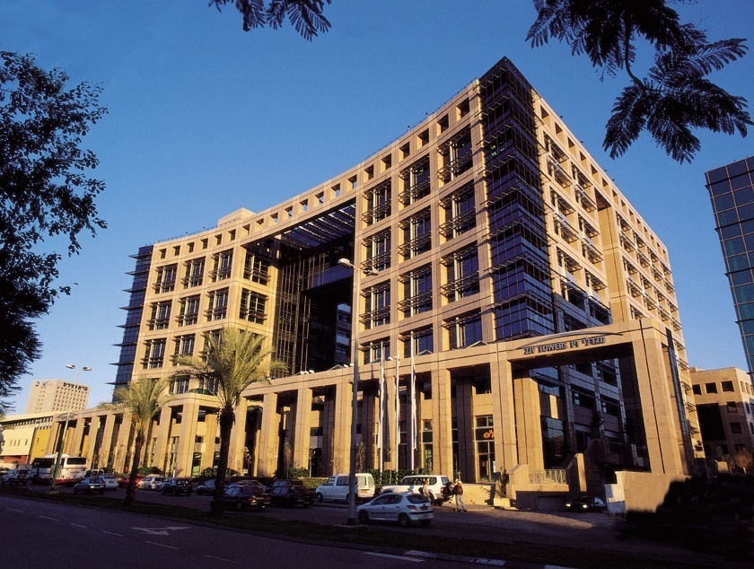
RAD Data Communications
Worldwide Distribution of Sales in 2011
Market-leading provider of access product solutions for carriers, service providers and enterprise customers
Established in 1981 and privately owned
Installed base of more than 12 million units
1,000 employees worldwide
  North America
  21%
  Europe
  39%
Worldwide Presence
  APAC
  15%
Scandinavia
  Israel
  2%
Canada
UK
Germany
USA
France
Russia
  Africa
  4%
  Europe
  46%
Spain
Italy
Israel
China
Japan
Mexico
Hong Kong
300 sales partners in 165 countries
32 offices worldwide
  Latin America
  16%
India
Nigeria
Thailand
Philippines
  Oceania
  3%
Indonesia
Brazil
Australia
Argentina
Total RAD Sales in 2011 = $163 Million

Slide 3












RAD Data Communications:
Member of the RAD Group
No. of employees = 4,500
Group sales in 2011= $1.2 Billion
The Access
Company
Established: 1981
Hi-end Adapters
for Servers
Established: 1987
Network Test
Solutions
Established: 1991
Video Conference
Solutions over IP
Established: 1992
Group Distributor in Israel and Worldwide System Integrator
Established: 1975
Coordinated Strategy
Shared Sales Channels
Joint Development & Technology Sharing
Some Companies are Public
Wireless Mobile Backhaul
Established: 1996
Industrial
Communication
Solutions
Established: 2009
Integrated Application Delivery
Established: 1997
Mobile TV Transmitters
Established: 2006
Wireless USB Chipset Solutions
Established: 2001
CWDM and DWDM Solutions
Established: 2000
Sub-6GHz Wireless Backhaul
Established: 1997

Slide 4




RAD Products Strategy
Access That Lasts
Services/CPE
Access
Network Core
Legacy Services Existing Equipment
ATM DSLAM
Legacy
Core Networks
SDH/SONET, ATM
2G BTS
3G NodeB
Legacy
Serial
New Services and Equipment
New
New
Packet-Switched
Core Networks
GbE, IP, MPLS
IP DSLAM
IP RAN
4G eNodeB
Ethernet
Continued support of legacy services over legacy networks
Legacy services over NGN – Ethernet/IP/MPLS backbones
New Ethernet services over existing (PDH, SDH/SONET and ATM) backbones
Access and aggregation for Carrier Ethernet

Slide 5




Main Solutions
Business Services
E-Line, E-LAN, E-Tree over any Access
Legacy Migration
Legacy Traffic over Packet Networks – Ethernet/IP/MPLS
Mobile Backhaul
Backhaul Solutions over Any Infrastructure
Carrier Ethernet Access
Ethernet Access over Fiber, DSL and Legacy Networks
Utility & Transportation
Legacy and Packet Based Communications for private Networks
Carrier First Mile
Access and Connectivity for Carrier Network
AXCESS⁺
Multiservice Access and First Mile Solutions

Slide 6
Main Solutions
Business Services
E-Line, E-LAN, E-Tree over any Access
Carrier Ethernet Access
Ethernet Access over Fiber, DSL and Legacy Networks
Mobile Backhaul
Backhaul Solutions over any Infrastructure
Legacy Migration
Legacy Traffic over Packet Networks – Ethernet/IP/MPLS
Carrier First Mile
Access and Connectivity for Carrier Networks
AXCESS⁺
Multiservice Access and First Mile Solutions
Utility & Transportation
Legacy and Packet Based Communications for Private Networks

Slide 7
















Multiservice Access Platform
& First Mile Portfolio
Remote Sites
FE
LAN
Remote Sites
SHDSL.bis
ASMi
E1
PBX
E&M
Megaplex
POP
Megaplex
FE
VoIP
ETH
PSN
GbE
FO
Optimux
PBX
E1/T1
E&M
FE
Wireless
Megaplex
ETH
CO
Video
ETH
Airmux
FE
TAC
E1/T1
Megaplex
Airmux
GbE
LAN
SCADA
RS-232
POP
ASMi
FE
SHDSL.bis
FXS
Megaplex/
LRS
E1
PBX
FCD
E1/T1
STM-4/
O C-12
X.21
SDH/
SONET
Management
Optimux
FE
FO
Video
Any Interface, Any Service, Any Infrastructure
  Unified solution, single vendor, single management system to ease integration
Migration Path
  Offer new Ethernet services using existing legacy infrastructure (SDH/SONET)
  Take advantage of Packet Switched Networks (PSNs) to offer legacy services at the customer premises
  Future-ready for all-IP networks (Ethernet services, PSN Infrastructure)
E1/T1
E1/T1
PBX
Megaplex
FXS
V.35

Slide 8

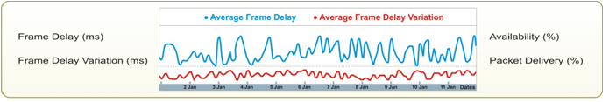






Mobile Backhaul Solutions
Access Network
Core
Metro
Aggregation
First Mile
BTS/
Node B
GbE
ETX
ETX-5300A
10 GbE
ETX
Airmux
Airmux
BTS/
Node B
ETX-5300A
Access Node
PCRF
MME
Remote
Ring
ETX/LA
GbE
DSL
ETX-5300/
MP-4100
DSL
ETX/LA
P-GW
S-GW
ETX-5300A
RNC
BSC
1/10 GbE
Ring
ETX
BTS/
Node B
SDH/
SONET
PDH
ETX/RIC
Egate

Slide 9

Legacy Migration over Packet Networks
Transparent Voice, Video & Data over Ethernet/IP/MPLS,
Investment Protection in Legacy Equipment
Aggregation
RADView
SHDSL.bis;
EFM
LA-210/PWE
E1/V.35/X.21
Up to
16 x Ch. OC-3/STM-1
with 1328/1008 pseudowires
4 x FE
ETX-5300A/
Gmux-2000
IPmux-1E
4 FXS/FXO/E&M/BRI
PSTN
TDM
SDH/SONET
1 x Ch. STM-1
or 32 x E1
Ethernet,
IP or MPLS
Network
FE
IPmux-2L/IPmux-4L
Serial (2L only)
1, 2 or 4 x E1
IPmux-155L
2 x FE
IPmux-4LGE/
IPmux-16L
P2P
Fiber, xDSL, wireless,
DS3 or OC3 (via MiRIC)
4, 8 or 16 x E1
2 x GbE & 3/4 x FE
Topologies
IPmux-24/
IPmux-216
P2P
(link redundancy)
1, 2, 4, 8 or 16 E1/T1
Interfaces
2 x FE/GbE
Daisy Chain
ETX-205A
8, 16 E1/T1
Megaplex
4 x GbE
Multiservice platform
(analog voice, E1/T1,
serial, ETH)
Ring
MP-W

Slide 10





Ethernet Access Portfolio:
Maximum Reach, Uniform Service
Ethernet over PDH
Ethernet over Fiber
GbE
ETX-205A
HQ
Branch
EoPDH
E1/T1/E3/DS3
ETX-5300A
10/100BT
RIC
RIC
ETX-203AX/AM
GbE
Branch
Branch
RIC
10 GbE
ETX-220A
10/100BT
EoPDH/E1/T1/
E3/DS3
Branch
RIC
Ethernet over DSL
10/100BT
SDH/
SONET
DSLAM
n x EoCU
Bonding
Branch
n x EoPDH
Bonding
GbE
LA
10/100BT
STM-1/OC-3
3 x DS3
Packet
Switched
Network
DSLAM
Branch
GbE
GbE
EoCU
LA
10/100BT
Egate
Extending the reach of the provider’s network over a variety of access technologies
Consistent Ethernet service across different access technologies
End-to-end QoS with verifiable SLAs

Slide 11



































































Selected References: Worldwide Customer Base by Industry
Carriers &
Service Providers
Transportation
Utilities
Government,
Military & Financial
Mobile Operators

Slide 12
















RAD’s Value Proposition
Broad Technology Base for many solutions
Flexibility quick reaction to market needs and changing market requirements
Expertise in International Markets
compliance with standards, homologation, FCC/UL/CE
Commitment to Quality ISO 9000, ISO 14000, ISO 27001:2007, winner of Israel Quality Award
Long-term Partnership with customers, channels, suppliers, and employees
Commitment to the Environment
Value Proposition per Market Segment:
Carriers &
Service Providers
Mobile Operators &
Transport Providers
Utilities
Transportation
Government & Enterprises
Vendors

Slide 13


Green @ RAD
First in the industry to pioneer miniaturized modems and other telecom solutions, which reduce material waste
Pioneered self-powered products which derived energy from the current rather than external sources, significantly reducing energy consumption
Early adapter of manufacturing processes free of atmospheric contaminants and eco-friendly, recyclable packaging
Launched new generation of products with ultra low power consumption

Slide 14








The Value Proposition for
Carriers and Service Providers
Deploy new revenue-generating retail and wholesale services with guaranteed SLAs over any access network
Lower OpEx by optimizing network resources
with performance management
Protect existing legacy revenue streams by
facilitating a smooth migration to new
packet-switched infrastructure
Provide customization to meet specific carrier
needs
Access
Network
Worldwide deployment of carrier-class access products

Slide 15








The Value Proposition for the Transportation Industry
Benefit from one-stop shop for multiple applications
over any media and infrastructure
Support multiple types of traffic: LAN,
control and alarms, multimedia, video surveillance,
voice, and data
Provide telecom services
Smooth migration to IP/Ethernet equipment and networks using state of the art technology enablers such as TDM pseudowire and timing over packet
Easy integration of RAD solutions with 3rd party
backbone network provider
Compliance with environmental/EMC industry standards
Worldwide deployment of access and transport solutions

Slide 16









The Value Proposition for Mobile Operators and Transport Providers
Benefit from broad range of backhaul solutions over any type of infrastructure
Enable backhaul of existing 2G, 3G, 4G services over lower
cost packet transport with timing synchronization
Offer premium wholesale backhaul services
over PSN with service quality assurance
Verify SLAs from wholesale provider
using intelligent mobile demarcation
Support LTE’s new network
architecture
Transport
Network
Backhaul
Network
Mobile
Core Network
Radio Stations
Worldwide deployment of access and backhaul solutions

Slide 17




The Value Proposition for Utilities
Benefit from a one-stop shop for multiple applications over any media and any infrastructure
Support multiple types of traffic: LAN, SCADA, smart metering, video surveillance, PLC, Teleprotection, voice, and data
Provide telecom services (“Utelco”)
Smooth migration to IP/Ethernet equipment and networks using state of the art technology enablers such as TDM pseudowire and timing over packet
Easy integration of RAD equipment
with 3rd party backbone network providers
Compliance with environmental/EMC industry standards
PLC
RTU
Worldwide deployment of access and backhaul solutions

Slide 18







The Value Proposition for Government and Enterprise Sectors
Reduce voice and data communications
costs through network convergence
Maintain legacy traffic and applications while migrating to packet transport and Ethernet/IP services
Benefit from flexibility to employ
tailor-made solutions
Main Site
Remote Sites
Voice
Data
LAN
PSN
and/or SDH/SONET
Voice
Data
LAN
Worldwide deployment of access and backhaul products

Slide 19










The Value Proposition for Vendors
Increase vendor’s competitiveness with optimized access solutions
  Enhance vendor’s portfolio and turnkey solutions with complementary access technologies and products
  Shorten time-to-market by outsourcing development based on RAD’s in-house technologies and expertise
Promote jointly new technologies and network architectures in industry standardization bodies and forums

Slide 20
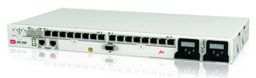
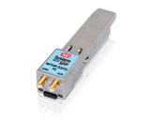


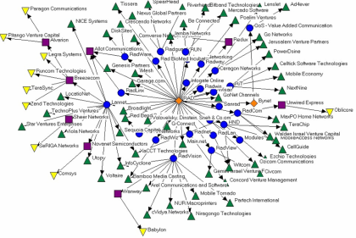
Driven By Innovation
Pioneered pseudowire technologies
and pseudowire access solutions (TDMoIP)
Introduced to the industry the Mobile Demarcation Device (MDD) concept, and was recognized with two Carrier Ethernet Awards
First to “squeeze” smart interworking devices
into SFP form factor
Led industry timing synchronization over PSN: first
to deploy Sync Ethernet and live Tier 1 test of 1588-2008
Entered the Guinness Book of Records for
developing the world’s smallest data modem
RAD serves as an incubator and source of
human capital for hundreds of Israel-based start-ups, established companies and venture capital firms

Slide 21
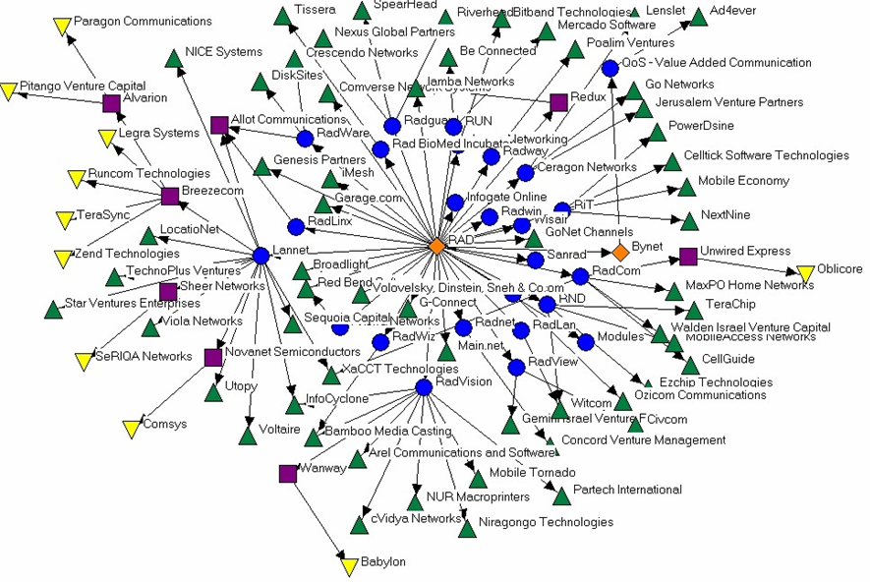
RAD Genealogical Map
RAD Group Companies
Spin-Offs and VCs

Slide 22








RAD Forum Contributions
MEF
  NID, Ethernet service OAM, mobile backhauling
IETF
  Network management, pseudowire emulation, performance measurement and more
  Dr. Yaakov Stein, RAD CTO, co-chairs TICTOC Working Group and is a member of the IETF Performance Directorate
ITU-T
  Pseudowire technologies
  Ethernet OAM (Y.1731)
  Timing/synchronization issues including Synchronous Ethernet
Broadband Forum (formerly IP/MPLS Forum)
  TR-221 (Technical Specifications for MPLS in Mobile Backhaul Networks) and WT-224 (MPLS for Carrier Ethernet)
  Ron Insler, RAD R&D Manager, received Circle of Excellence Award
IEEE
  1588 timing distribution
1588 Conformity Alliance
  Alon Geva, RAD authority on timing synchronization, member of 1588 Conformity Alliance Committee of Experts
FSAN
  GPON solutions

Slide 23





Based in the Most Important Innovation Center Outside the USA
Israel is the second largest foreign country on Nasdaq –
some 60 Israeli companies listed
Over 80 Fortune 500 global corporations conduct leading edge R&D in Israel
The highest per capita number of U.S. patent applications in the world

