Slide 1

Strategic Applications

Slide 2
Agenda
Carrier Applications
  Smart demarcation for efficient traffic management and remote SLA monitoring
  Ethernet service over any infrastructure
  Leased line replacement
Utilities
  Migration to IP networks
  Smart Grid solutions
Transportation
  ATC
  Highway
  Railway

Slide 3



Packet Networks & Infrastructure
PDH
RIC
Egate
SDH/
SONET
ETX
PSN
ETX
Fiber
Access
ETX-5300A
“NG”
Access
Pre-Aggregation
ETX
CPE
Fiber
ETX
CPE
Copper
PSN – Packet Switched Networks
New – pre aggregation device for saving costs on PE ports
Market segments:
  Retail: Internet access, VPN, Hosted services
  Wholesale
  Mobile backhauling
Copper
LA210/
ETX-203AM
MSAN/
IP-DSLAM
(G)PON
FTTH
FTTC
Copper
ETX
ETX?
MSAN/
IP-DSLAM
Copper
Notes:
The Network topology can vary between different customers. GbEnerally we will find Core/Metro domains (based wholely or partially on MPLS ). RAD’s focus is in rthe Access domains which includes the CPE as well as aggregation devices.
Our current strength and key messaGbEs refers to our CPE advantaGbEs where we have limited offering for aggregation (e.g. Egate-100 , ETX-1002). During 2011 our offering for the aggregation part will be enhanced with the release of ETX-212A, ETX-5300A.
It’s important to note that our Sales Pitch will vary according to the access type. Typical scenarios:
CPE connected directly with fiber to the EdGbE node
CPE connected via copper/fibar to MSAN/DSLAM
CPEs connected over PDH/SDH (RICi) with optional aggregation by Egate-100
CPEs connected via fiber to Aggregation node
Access typed not illustrated : Access Rings, GPON

Slide 4


(Carrier) Ethernet services
Internet/
IP
Access to
Higher-Layer Service
Data Center/
Central POP
PSN
Access
Access
CPE
CPE
End to End Service
Scope of the Ethernet Service/Transport can be:
  Access to a higher-layer service (e.g. Internet Access, IP-VPN, Cloud)
  End to End (e.g. VPN)
Notes:
Regardless of the service defined, from Transport perpective we can categorize an Ethernet Access solution to two categories:
Access to a central site/POP , usually connecting to a higher layer service , e.g. Internet, Hosted service (e.g. StoraGbE, VoIP/Ip-Centrex), Cloud Computing
End to End service connecting between customer sites (can be point to point as illustarted by the blue line but also multipoint to multipoint connectivity)

Slide 5
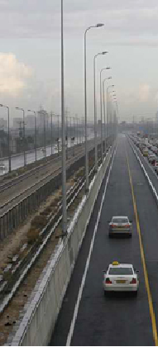
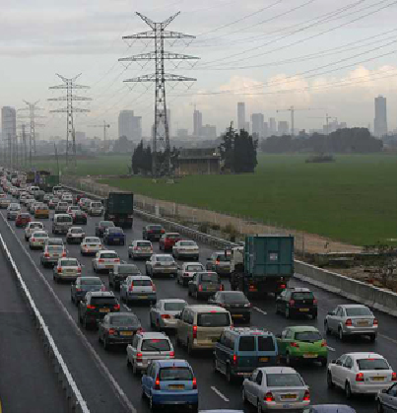
Ensuring SLA
“Fast lane” Solution:
  Move from Best effort service to a tiered CoS
  Tariff is dynamic
Best Effort Service isn’t always Pretty

Slide 6

Adding the Legacy Theme…
TDM
(SDH/SONET)
PSN
(Core/Metro)
Access
NG
Access
Access
NG
Access
CPE
Notes:
The Network topology can vary between different customers. GbEnerally we will find Core/Metro domains (based wholely or partially on MPLS ). RAD’s focus is in rthe Access domains which includes the CPE as well as aggregation devices.
Our current strength and key messaGbEs refers to our CPE advantaGbEs where we have limited offering for aggregation (e.g. Egate-100 , ETX-1002). During 2011 our offering for the aggregation part will be enhanced with the release of ETX-212A, ETX-5300A.
It’s important to note that our Sales Pitch will vary according to the access type. Typical scenarios:
CPE connected directly with fiber to the EdGbE node
CPE connected via copper/fibar to MSAN/DSLAM
CPEs connected over PDH/SDH (RICi) with optional aggregation by Egate-100
CPEs connected via fiber to Aggregation node
Access typed not illustrated : Access Rings, GPON

Slide 7


Adding the Legacy Theme…
TDM
(SDH/SONET)
E1/T1
Access
Legacy Services
Access
Serial
SDH/
SONET
PDH
E1/T1
PSN
(Core/Metro)
“NG”
Access
“NG”
Access
CPE
Legacy infrastructure & services still in place
Reasons for migration scenarios
  Obsolete infrastructure
  Enabling new services (Ethernet)
Notes:
The Network topology can vary between different customers. GbEnerally we will find Core/Metro domains (based wholely or partially on MPLS ). RAD’s focus is in rthe Access domains which includes the CPE as well as aggregation devices.
Our current strength and key messaGbEs refers to our CPE advantaGbEs where we have limited offering for aggregation (e.g. Egate-100 , ETX-1002). During 2011 our offering for the aggregation part will be enhanced with the release of ETX-212A, ETX-5300A.
It’s important to note that our Sales Pitch will vary according to the access type. Typical scenarios:
CPE connected directly with fiber to the EdGbE node
CPE connected via copper/fibar to MSAN/DSLAM
CPEs connected over PDH/SDH (RICi) with optional aggregation by Egate-100
CPEs connected via fiber to Aggregation node
Access typed not illustrated : Access Rings, GPON

Slide 8

Ethernet Everywhere for Everyone
Axcess+
ASMi
E1/T1
TDM
(SDH/SONET)
Megaplex
Access
Legacy Services
Optimux
Serial
PDH
RIC
SDH/
SONET
PDH
RIC/Egate
SDH/
SONET
E1/T1
PSN
(Core/Metro)
Ethernet
Service
Required
“NG”
Access
“NG”
Access
CPE
Legacy infrastructure & services still in place
The need for Ethernet services create a chalange
RIC/Egate solutions extend the Ethernet service coverage over SDH/SONET access
Case for Axcess+ solutions
Notes:
The Network topology can vary between different customers. GbEnerally we will find Core/Metro domains (based wholely or partially on MPLS ). RAD’s focus is in rthe Access domains which includes the CPE as well as aggregation devices.
Our current strength and key messaGbEs refers to our CPE advantaGbEs where we have limited offering for aggregation (e.g. Egate-100 , ETX-1002). During 2011 our offering for the aggregation part will be enhanced with the release of ETX-212A, ETX-5300A.
It’s important to note that our Sales Pitch will vary according to the access type. Typical scenarios:
CPE connected directly with fiber to the EdGbE node
CPE connected via copper/fibar to MSAN/DSLAM
CPEs connected over PDH/SDH (RICi) with optional aggregation by Egate-100
CPEs connected via fiber to Aggregation node
Access typed not illustrated : Access Rings, GPON

Slide 9
Legacy Emulation over Packet
Axcess+
ASMi
TDM
(SDH/SONET)
Megaplex
Access
Optimux
PSN
(Core/Metro)
“NG”
Access
“NG”
Access
E1/
Serial
CPE
E1/
Serial
Legacy services may still be needed over new “NG Access”
  2G backhauling
  E1 business services
Pseudowire technology
E1 service
May be needed also HERE
Notes:
The Network topology can vary between different customers. GbEnerally we will find Core/Metro domains (based wholely or partially on MPLS ). RAD’s focus is in rthe Access domains which includes the CPE as well as aggregation devices.
Our current strength and key messaGbEs refers to our CPE advantaGbEs where we have limited offering for aggregation (e.g. Egate-100 , ETX-1002). During 2011 our offering for the aggregation part will be enhanced with the release of ETX-212A, ETX-5300A.
It’s important to note that our Sales Pitch will vary according to the access type. Typical scenarios:
CPE connected directly with fiber to the EdGbE node
CPE connected via copper/fibar to MSAN/DSLAM
CPEs connected over PDH/SDH (RICi) with optional aggregation by Egate-100
CPEs connected via fiber to Aggregation node
Access typed not illustrated : Access Rings, GPON

Slide 10

Legacy Emulation over Packet
E1/
Serial
Axcess+
ASMi
TDM
(SDH/SONET)
Megaplex
Access
Optimux
PSN
(Core/Metro)
“NG”
Access
“NG”
Access
CPE
E1/
Serial
Legacy services may still be needed over new “NG Access”
  2G backhauling
  E1 business services
Pseudowire technology
Notes:
The Network topology can vary between different customers. GbEnerally we will find Core/Metro domains (based wholely or partially on MPLS ). RAD’s focus is in rthe Access domains which includes the CPE as well as aggregation devices.
Our current strength and key messaGbEs refers to our CPE advantaGbEs where we have limited offering for aggregation (e.g. Egate-100 , ETX-1002). During 2011 our offering for the aggregation part will be enhanced with the release of ETX-212A, ETX-5300A.
It’s important to note that our Sales Pitch will vary according to the access type. Typical scenarios:
CPE connected directly with fiber to the EdGbE node
CPE connected via copper/fibar to MSAN/DSLAM
CPEs connected over PDH/SDH (RICi) with optional aggregation by Egate-100
CPEs connected via fiber to Aggregation node
Access typed not illustrated : Access Rings, GPON

Slide 11







Migration Challenges
Growing Ethernet services (“catching up”) tying up port capacity at the SDH transport, Eth aggregation is required
SDH capacity not scalable enough for Ethernet BW; Metro is slow in reaching the access
PSTN
DSL
E1/V35
L.L
STM-1/STM-4
Aggregator
DSL
ETH
Fiber
ETH+E1
PE
SDH
Core
Metro
Ethernet
Internet Access/VPN
STM-1/STM-4
DSL
E1/V35
Aggregator
DSL
ETH
Fiber
ETH+E1
GbE
Internet Access/VPN

Slide 12



Mobile Backhaul Solutions
Axcess+
ASMi
TDM
(SDH/SONET)
Megaplex
2G,3G, LTE
Access
Optimux
2G,3G, LTE
PDH
RNC/ aGW
ETH
PSN
(Core/Metro)
3G, LTE
“NG”
Access
“NG”
Access
CPE
3G, LTE
Mobile market demands (& Broadband) drives the investment in network infrastructure
  Ethernet Backhauling infrastructure & services
  Self-built or Wholesale
  Ethernet Business services may be deployed on the same infrastructure
Notes:
The Network topology can vary between different customers. GbEnerally we will find Core/Metro domains (based wholely or partially on MPLS ). RAD’s focus is in rthe Access domains which includes the CPE as well as aggregation devices.
Our current strength and key messaGbEs refers to our CPE advantaGbEs where we have limited offering for aggregation (e.g. Egate-100 , ETX-1002). During 2011 our offering for the aggregation part will be enhanced with the release of ETX-212A, ETX-5300A.
It’s important to note that our Sales Pitch will vary according to the access type. Typical scenarios:
CPE connected directly with fiber to the EdGbE node
CPE connected via copper/fibar to MSAN/DSLAM
CPEs connected over PDH/SDH (RICi) with optional aggregation by Egate-100
CPEs connected via fiber to Aggregation node
Access typed not illustrated : Access Rings, GPON

Slide 13
Summary so far…
Carrier Ethernet enables “smart” traffic management and SLA monitoring
Legacy services – still cash cows for many carriers. Can be maintained over packet networks
Obsolete products can be replaced with NG multiplexers and modems

Slide 14
Power Utilities Solutions Training
Transmission ,Distribution
and Generation

Slide 15

Multiservice in the Sub-station over SDH and Ethernet
E1/T1 (DS1)
Fractional E1/T1 (DS0)
Analog voice – FXS/FXO
Analog voice – E&M
Teleconference voice (Omni)
Serial N*56/64Kbps – V.35/X.21/RS-xxx
Serial sub-64Kbps - V.24/RS-232
IEEE-C37.94 (Teleprotection)
G.703 co-directional
Inboud/Outbound dry contact alarm
STM-1/OC-3
STM-4/OC-12
Fiber Optic (Multiplexed E1/T1 + Ethernet of fiber)
ISDN – ‘S’ and ‘U’ interface
SHDSL/SHDSL.bis (Multiplexed E1+Ethernet over copper)
Gigabit Ethernet (UTP and SFP)
Fast Ethernet (UTP and SFP)
Add Drop Multiplexer (ADM)
Add Drop Multiplexer (ADM)
PBX
Packet
Switched
Network
Digital Cross Connect (DACS)
Phone
Phone
FE/GbE
SCADA RTU
Megaplex-4100
Phone - Fixed
Router
STM-1/OC-3
STM-4/OC-12
SCADA RTU
TPR (Teleprotection)
TPR (Teleprotection)
SDH/SONET
Relay/Alarm
Intelligent Electronic Device (IED)
Router
ASMi
Optimux

Slide 16



Fiber and Copper Aggregation of Transformation Sites
  Flexible connectivity of the communication devices over copper or F.O.
  Variety of CPE’s allow connectivity of various interfaces in the transformation sites, including multi-service
  Central management
LV Transformation
LV Transformation
ASMi-54
Aggregation Site
SHDSL
NMS
OP-108
PSN
FO
MP-4100
GbE
STM-1/OC-3
STM-4 OC-12
SHDSL
ASMi-52
SDH/
SONET
LV Transformation

Slide 17




Ethernet Aggregation of Transformation Sites
TM, OAM Timing & Redundancy
Sub-Station
Aggregation/Core Network
GbE/FE
ETX
ETX
ETX-5300A
ETX-5300A
Sub-Station
GbE/FE
1GbE / 10GbE
Ring
GbE
FO
STM-1/OC-3
Optimux-108
MP-4100
NMS
ETX-5300A
SHDSL
Optimux-108
Flexible connectivity of the communication devices over copper or F.O.
Central network management solution including service center for point & click service creation
Traffic management, OAM & Timing over packet solution from MV-Transformation to the core
Path Redundancy with no single point of failure

Slide 18
The “Smart Grid”

Slide 19
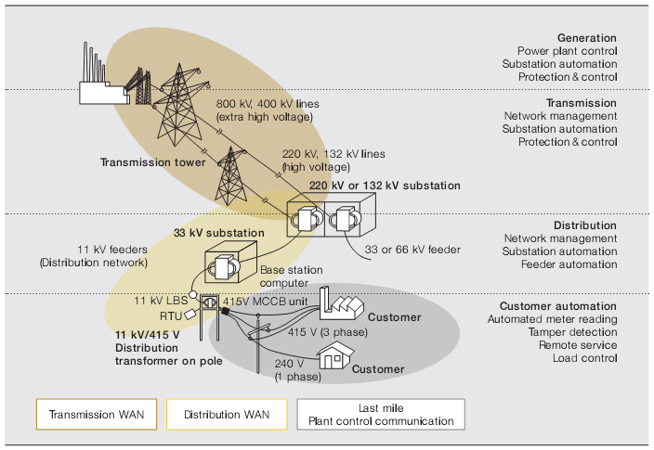
Power Network Elements
Generation
Transmission
Evolving
Distribution
Evolving
Smart Grid
DA
Metering
New

Slide 20
So, What is a Smart Grid?
“An integrated communications and power system infrastructure which allows for robust two-way communications, advanced sensors, and distributed computers to improve the efficiency, reliability and safety of power delivery and use.”
Next to the power system the most critical infrastructure to creating a reliable high-performance Smart Grid is the communications infrastructure.

Slide 21
Smart Grid Main Applications
Smart Metering and AMI – providing frequent and granular consumption and power quality measurements and 2-way communications and control between the utility and the customer premise. This includes the possibility of a customer premise “home area network” (HAN).
Distribution Automation (DA) – delivering a range of advanced services within distribution feeder circuits, including automatic restoration, dynamic reconfiguration, dynamic volt/VAR controls, distributed generation and electric vehicle support.

Slide 22
Sub-Station Networking

Slide 23






Utility Network
Teleprotection
Data
Dry
Contacts
Low speed
Data
Teleprotection
Data
Dry
Contacts
Low speed
Data
38.4 kbps
38.4 kbps
C37.94
64 kbps
Low speed
Data
PBX
Hot
Line
C37.94
64 kbps
Low speed
Data
PBX
Hot
Line
9.6 kbps
9.6 kbps
Challenges
Obsolete equipment
New Ethernet based network elements
New Packet based core networks
Sub-Station
SDH Access
Network
Sub-Station
9.6 kbps
IP Core
38.4 kbps
Headquarters

Slide 24


Utility Network
Tele-protection
Dry
Contacts
Low speed
Data
Tele-protection
Dry
Contacts
Low speed
Data
RTU
38.4 Kbps
RTU
38.4 Kbps
C37.94
64 kbps
Low speed
Data
PBX
Hot
Line
C37.94
64 kbps
PBX
Hot
Line
9.6 Kbps
PDH
Sub-Station
SDH Access
Network
Sub-Station
NG-SDH ADM
Headquarter
9.6 Kbps
PDH
Ethernet over PDH gateway
IP Core
Secure Industrial Ethernet switch
38.4 Kbps

Slide 25

Utility Network
Tele-protection
Dry
Contacts
Low speed
Data
Tele-protection
Dry
Contacts
Low speed
Data
RTU
38.4 Kbps
RTU
38.4 Kbps
C37.94
64 kbps
Low speed
Data
PBX
Hot
Line
C37.94
64 kbps
PBX
Hot
Line
9.6 Kbps
Access Mux
PDH
Sub-Station
PSN
SDH Access
Network
Sub-Station
Headquarter
9.6 Kbps
PDH
Ethernet over PDH gateway
IP Core
Secure Industrial Ethernet switch
38.4 Kbps

Slide 26

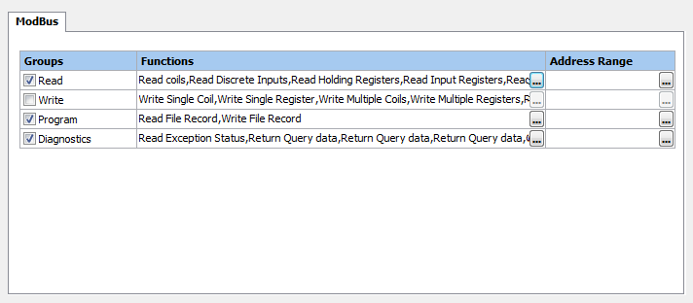





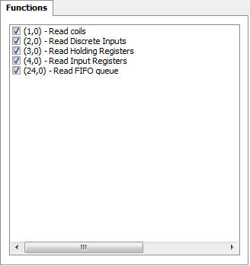
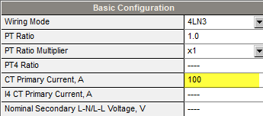

Distributed firewall business-case
In a Smart-Grid DA application an attacker that gains access to 1 site can manipulate the behavior of critical devices in distributed remote sites
RADiFlow distributed service-aware firewall can block such invalid commands by detailed analysis of the commands received in each site
Mobile
Network
Distribution
Automation Center
Distribution Site
2G/3G
PLC
Meters
Concentrator
Control Center
RTU
Power
Monitoring
Secondary
Substations

Slide 27
RADiFlow Offering –
Service-aware Industrial Switch
Service
Management
Operational Simplicity
Defense-in-depth solution
Solid infrastructure
Secure Access
Service Validation
Multi-Service
Resilient
Network
Ruggedized
System
Enabling the introduction of Ethernet as the
Secure infrastructure for Critical Industrial applications

Slide 28
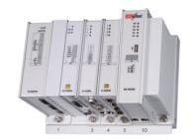

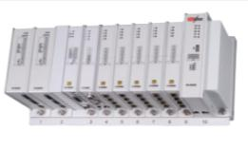
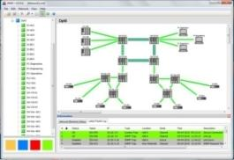
Portfolio Overview
Industrial design
  Modular DIN rail switches (3/7 I/O slots) or Compact system
  Harsh environment - IP30, - 40 ÷ +75° C, IEC 61850-3 EMI
  ETH or RS-232/RS-485 serial interface modules
Networking
  Advanced Ethernet switching and IP routing functionality
  Serial Tunneling or Service translation
  Multi-Service network modems – xDSL, Cellular
Integrated security mechanisms
  MAC/IP filtering per port
  Distributed app-aware firewall
  Remote access and Inter-site connectivity
iSIM – An intuitive Network management tool
  Topology planning and Service provisioning
  Network diagnostics
  Integration with the RADView EMS

Slide 29
Smart Meters

Slide 30









LV Transformation Site Networking:
Eth switching, Security and Backhauling
Airmux
Low Voltage Transformation site with Smart Meters Concentrators
Airmux
HBS
Transformation
Service-aware
Secure Switch
Concentrator
Airmux
Power
Quality meter
Transformation
IP CCTV

Slide 31

F.O access Ring for Backhauling of Smart Meter Concentrators in Transformation Sites
Airmux
Airmux
HBS
LV Transformation
LV Transformation
Airmux
ETX-26
Airmux-5000
Airmux
Sub-station
LV Transformation
Core
Network
ETH Fiber
Optic Ring
Airmux
HBS
ETX-26
LV Transformation
Airmux
ETX-26
LV Transformation
Airmux-5000
LV Transformation

Slide 32
Typical Smart-Grid Deployment – Smart City Project
Mobile
Network
Distribution
Automation Center
Distribution Site
2G/3G
PLC
Meters
Concentrator
Control Center
RTU
Power
Monitoring
Secondary
Substations
“New intelligent MV-LV transformation centers with metering, power monitoring and capacity automation”
  Encrypted tunnels over a public wireless network
  Firewall for uplink protocols

Slide 33
Transportation

Slide 34
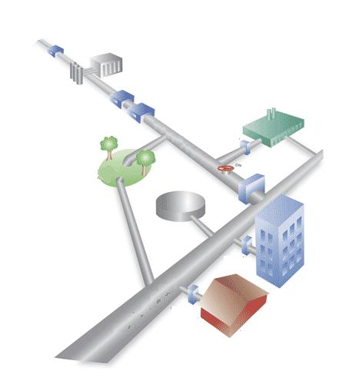
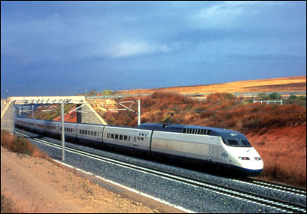
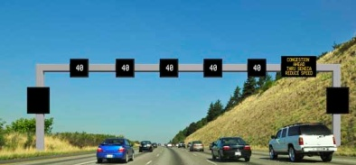
Target Markets and Applications
Railway/Metro
Solutions
High Way
Solutions
Air Traffic
Control
  Railway & Metro Data Voice and Video Network
  TDM & IP network solutions
  Emergency Voice system
  Traffic Light control System
  Board enouncement System
  Critical Assts – Airports, strategic facilities, Voice and Data Solutions

Slide 35

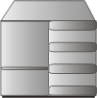







Air Traffic Control – ATC
Where it applies
In all ATC agencies (civilian and military)
Regional ATC Center
AFTN Data
9.6 kbps
National ATC Center
AFTN Data
9.6 kbps
Leased Line
64/128 kbps
Kilomux-2100
4W
Radar
Radar Monitor
DDN
X.21
Kilomux-2100
X.21
Approach & Control Tower
AFTN Data
9.6 kbps
Kilomux-2100
ISDN/
PSTN
ISDN Backup
64/128 kbps
Kilomux-2100
4W
Leased Line
64/128 kbps
Radar
X.21
Notes:
This is an example of a mission-critical application for connectivity of ATC centers and remote control towers, where RAD solution provides the following:
Variey of interfaces, including LS data and voice interfaces
Voice compression for efficient usage of leased lines.
Dial-up backup that maintains connectivity for such a mission-critical application
The drivers for this application – End of life muxes replacement
Expentions
New services that were not delivered till now are now added ( Different sensors)
New IP based units that should be delivered over TDM
Managed network – Till now they didn’t have the need to manage the network elements but now the understand the advantages of the remote management.

Slide 36
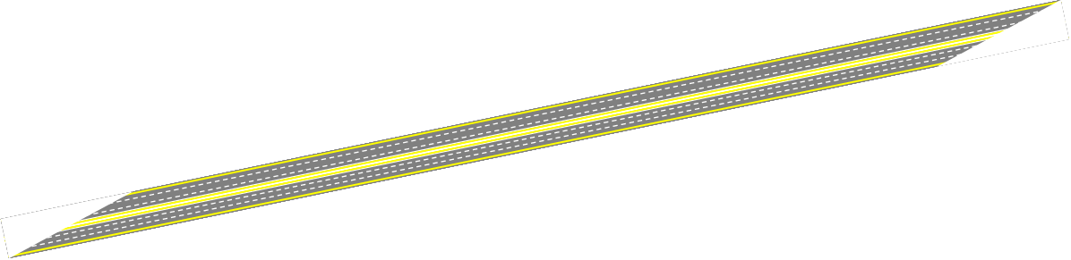


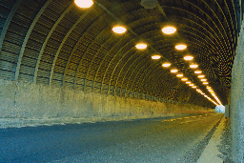



Highway Connectivity
Customer Benefits:
Leverage Copper Infrastructure remote
stations connectivity
Ethernet extension over multiple bonded
copper pairs (8W)
Supports extended temperature range
RAD Advantages:
22.8 MBps over 8W utilizing SHDSL.Bis
Combination of fiber and copper
Enhanced QoS and Fault propagation
Long distance connectivity
Tunnel
Highway
Service Area
Interchange
Remote Monitoring Control Equipment
Remote Monitoring Control Equipment
Remote Monitoring Control Equipment
ETH
ETH
ETH
ETH

Slide 37









Protected Multi-Station Connectivity
Control Center
Megaplex-4100
Megaplex-4100
Megaplex-4100
Megaplex-4100
Carrier
Network
SDH/SONET
Ring
Megaplex-4100
Megaplex-4100
Megaplex-4100
Megaplex-4100
Wide range of protected ring capacities: 1.5 Mbps, 2 Mbps, 20 Mbps, 45 Mbps, 100 Mbps, 155 Mbps, 622 Mbps
Provide NSPF (no single point of failure) resiliency for critical applications
High ring granularity at E1/T1 or VC-12/VT-1.5 level allows bandwidth optimization over copper, dark fiber and SDH/SONET

Slide 38

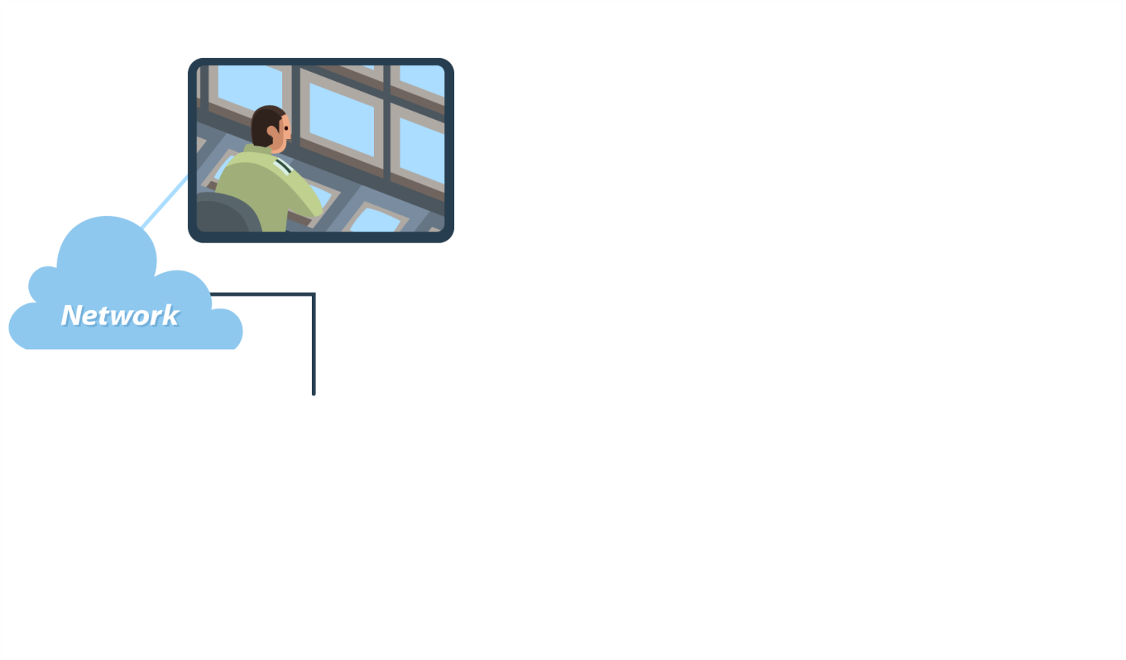

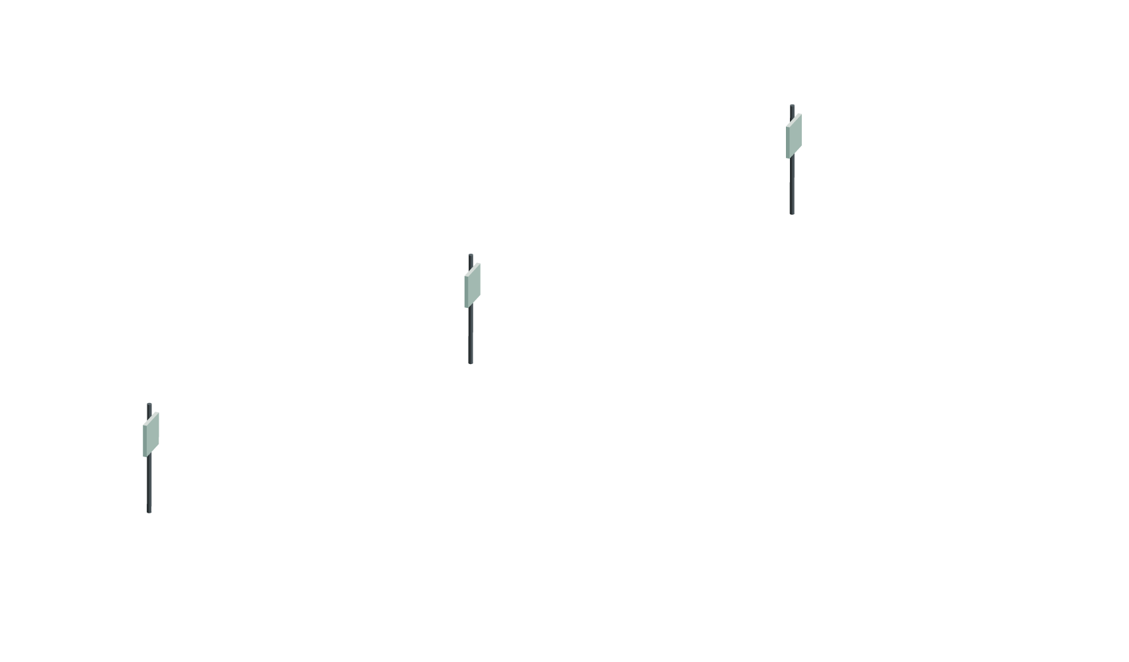


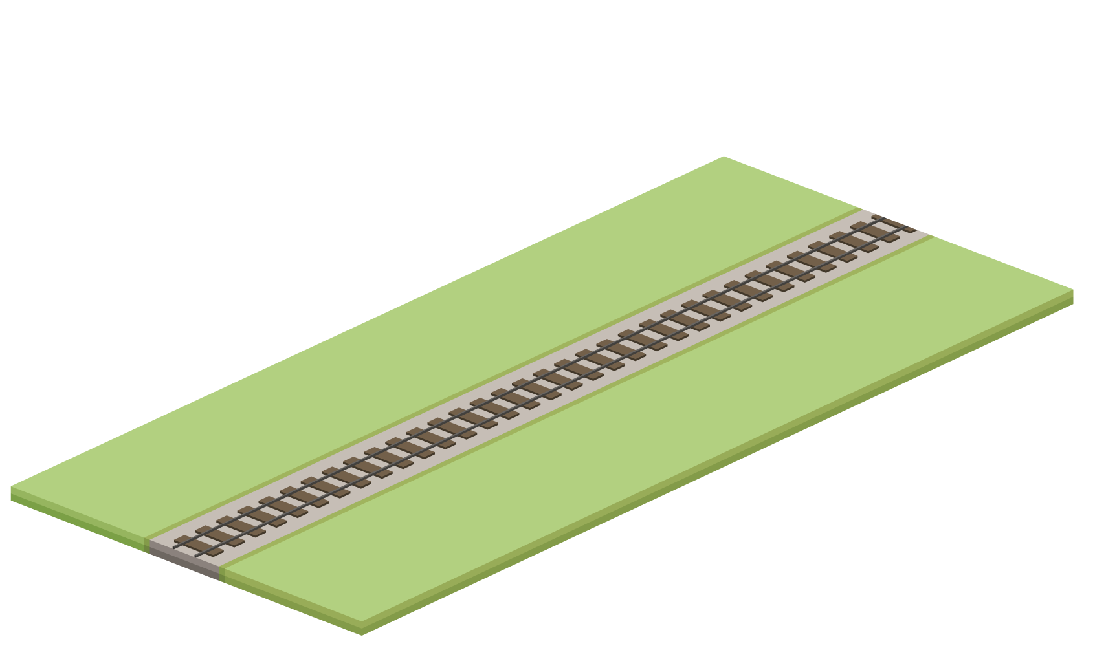
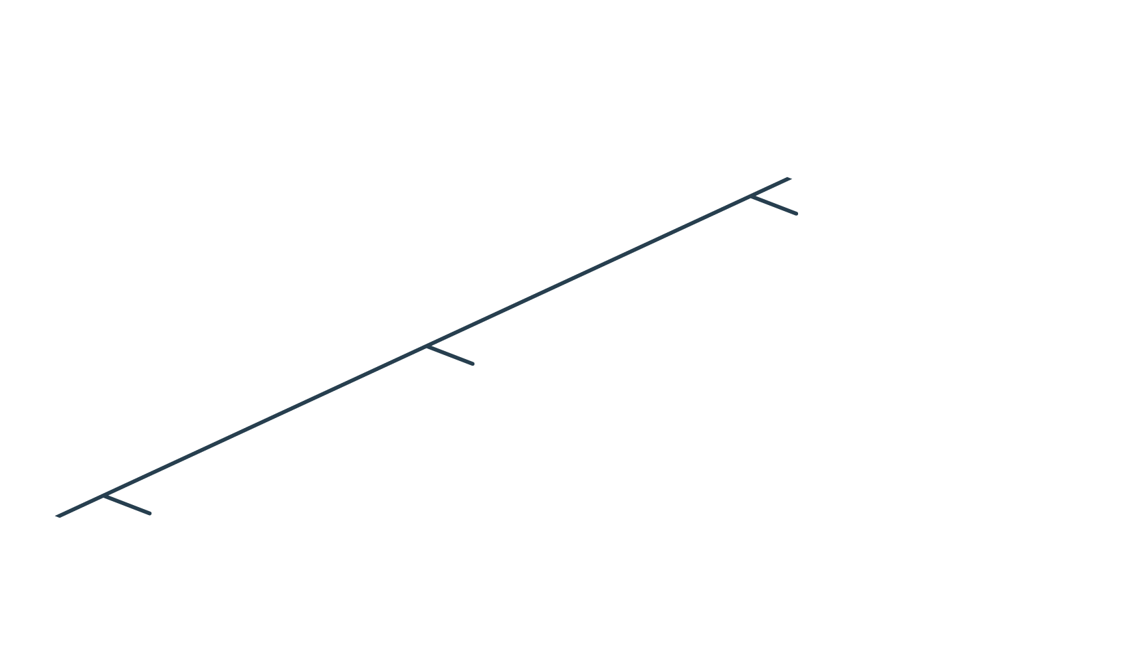




On Board Broadband Connectivity
Radios
Surveillance cameras
are deployed on the train
Security

Slide 39


On Board Broadband Connectivity
Continuous high capacity video surveillance is secured

Slide 40
Solution Highlights
Wireless system, Airmux-5000 Mobility, covers the entire Railway track
Video information is streamed from cameras located on each carriage to Control Center
High speed internet connectivity for passengers
Wireless Handover capability to secure communication
Fixed or Wireless backhauling
Central Video Management system

Slide 41
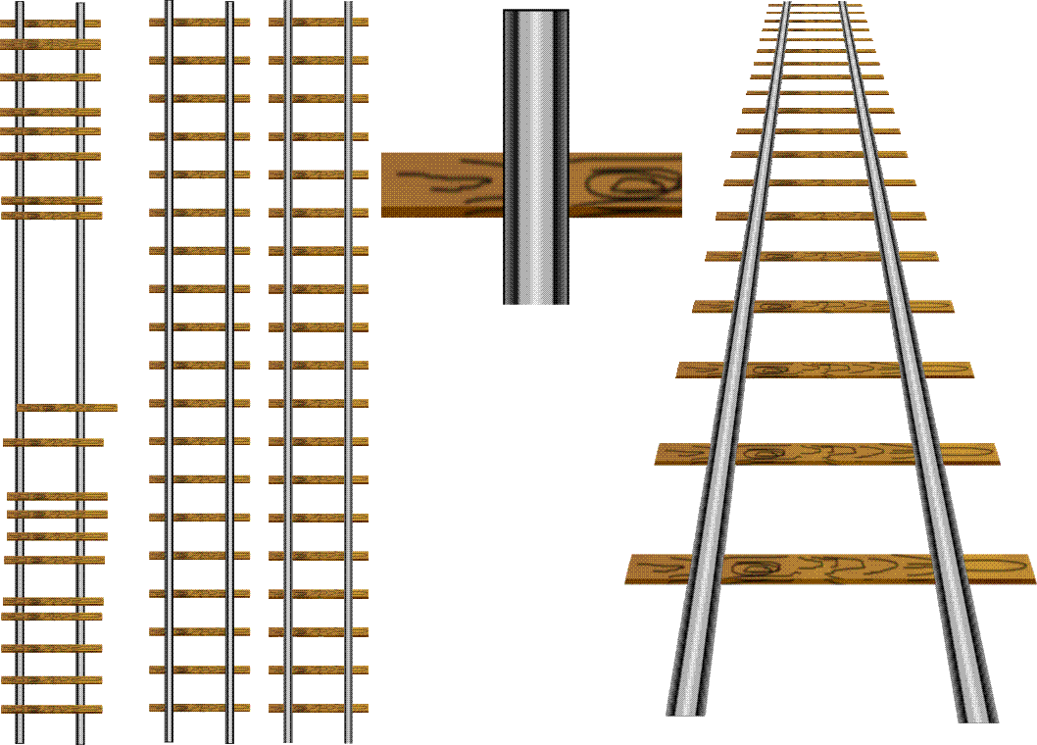


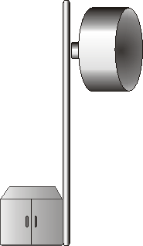


Track Side Architecture
ETX-26 for Radio Backhaul (Protected GbE ring over Fiber Optics)
Airmux-Mobility – Radio connectivity Train to Track-side
Central management solution
Mobile Radio
Mobile Radio
Mobile Radio
Mobile Radio
Airmux
Airmux
Airmux
Airmux
RADview-EMS
ETX-26
ETX-26
ETX-26
ETX-26
Ethernet Fiber Optic Ring
ETX-26

Slide 42
Summary
Carrier Applications
  Smart demarcation for efficient traffic management and remote SLA monitoring
  Ethernet service over any infrastructure
  Leased line replacement
Utilities
  Migration to IP networks
  Smart Grid solutions
Transportation
  ATC
  Highway
  Railway

