Slide 1
RADview-EMS Version 3.0 incl. Performance Portal
Karsten Gietz
PreSales Engineer

Slide 2
Agenda
RADview Value Proposition
Network Scheme
RADview-EMS Benefits & Features
What’s new
FCAPS
How it looks like
Performance Management portal
Turnkey system
Business-Continuity
Integrations
Packages
What’s next…
RADview Release Schedule

Slide 3
RADview Value Proposition
RADview
Performance Monitoring & SLA
Premium services
Capacity Up-Sell
One Stop Shop
OPEX reductions

Slide 4
Network Management Topology Scheme
BSS – Business support systems (billing and CRM)
OSS – Operation Support Systems (Service Assurance)
Resource Management
(i.e. Cramer)
Fault
Management
(i.e. NetCool)
Performance Management
(i.e. InfoVista)
Service
Activation
Integration of RADview into the OSS layer saves lots of overhead and money, due to low incremental investments for additional products and firmware upgrades.
Other vendors’ specific NMS
RADview
RADview is responsible for synchronizing missing Traps and collecting statistic information after network outage between EMS and NE
*supported devices only
Network Elements
Notes:
4
Network Management Topology (scheme)

Slide 5
RADview-EMS advanced FCAPS
Fault management
Detects and isolates faults in network devices, initiates remedial actions and distributes alarm messages to other management entities in the network.
Configuration management
Enables operators to configure, install and distribute software to all devices across the network. In addition, the system tracks version changes and maintains software configuration history
Accounting management
Manages individual and group user accounts and passwords, generating network usage reports to monitor user activities.
Performance management
Supports real-time monitoring of QoS and CoS, producing real-time and periodic statistics. The statistics collector compresses data to minimize bandwidth use for management traffic and exports CSV files to OSS or third-party management systems
Security management
Allows network administrators to track user activities and control the access to network resources with a choice of security features
F
C
A
P
S

Slide 6
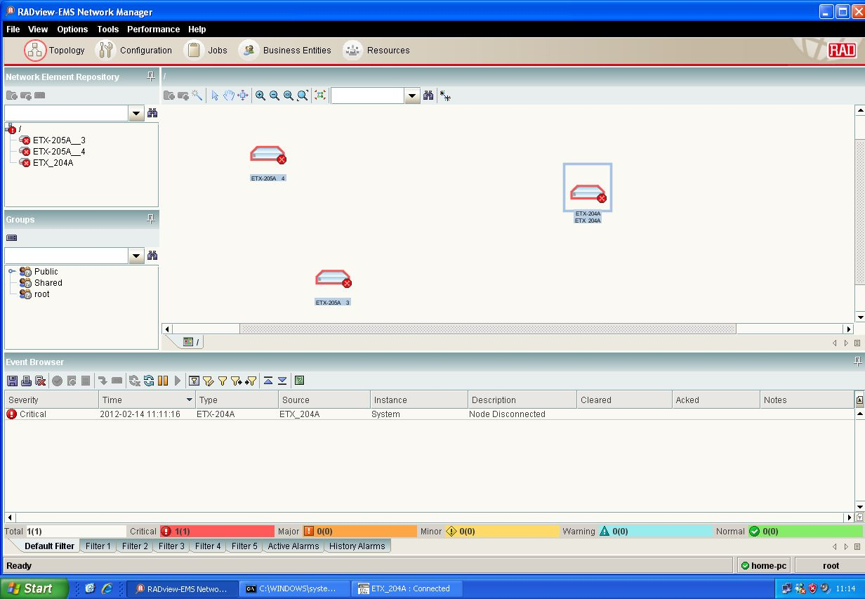
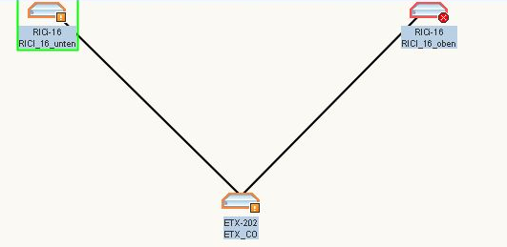
How it looks like
ETX-202
RICi-16_1
RICi-16_2

Slide 7
Make Things Easy
ETX-202
RICi-16_1
RICi-16_2

Slide 8
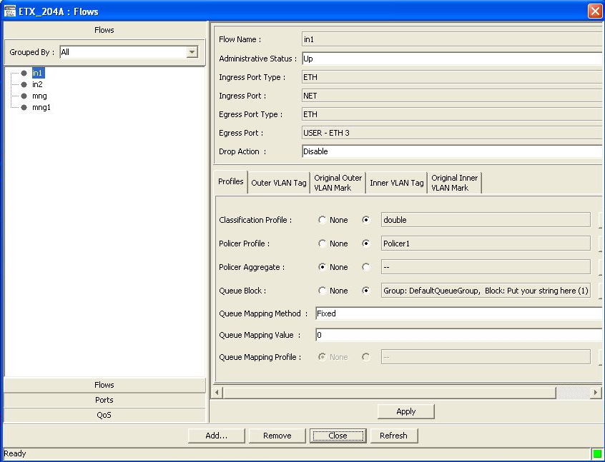
Make Things Easy
ETX-202
RICi-16_1
RICi-16_2

Slide 9
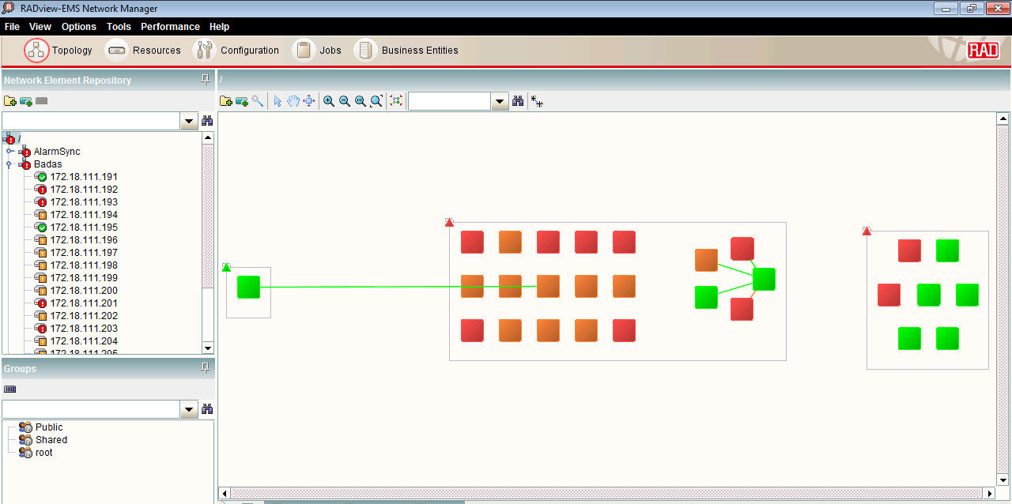
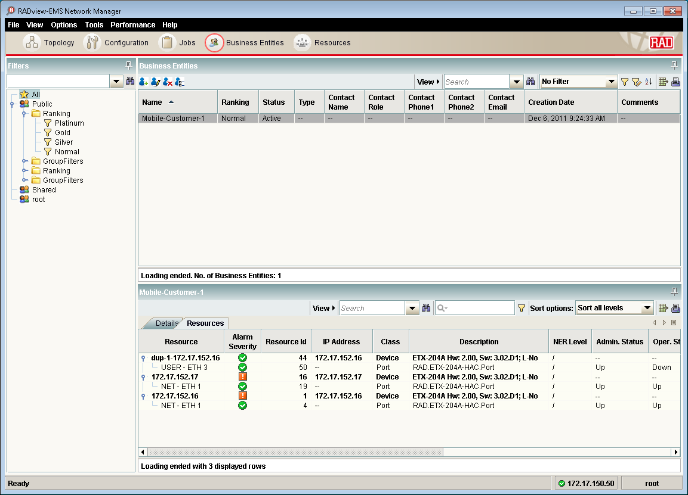
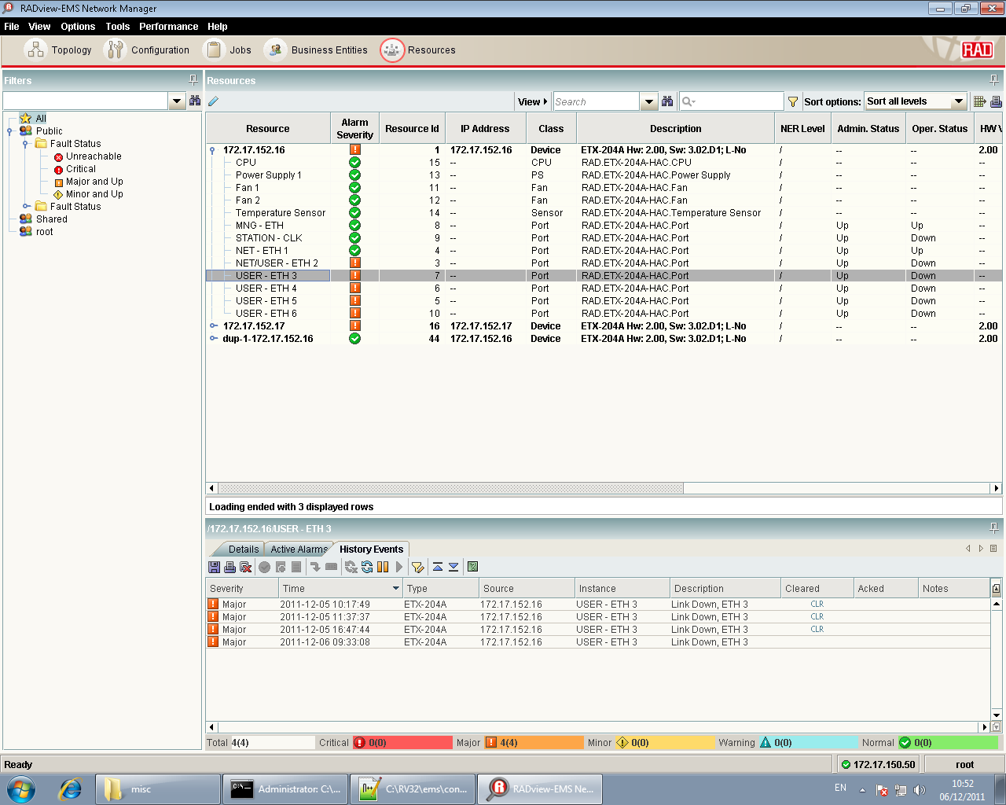
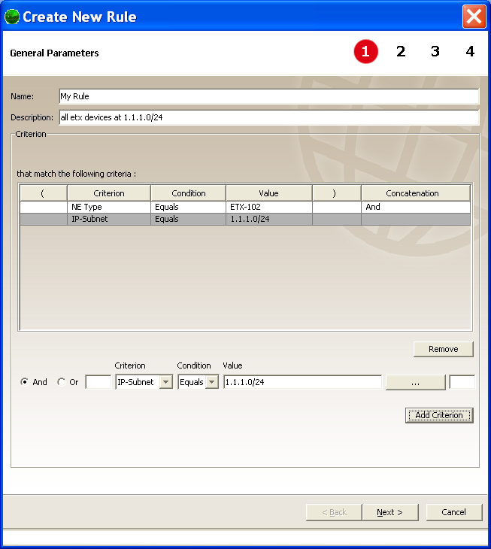
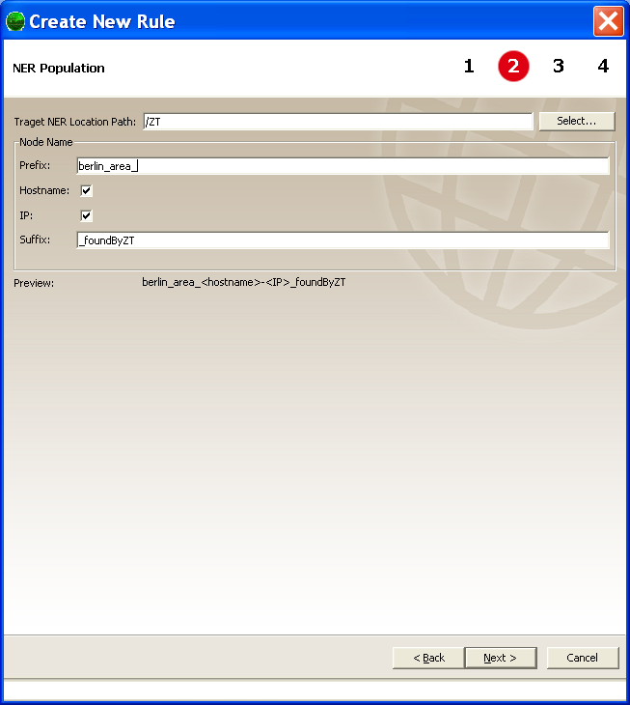
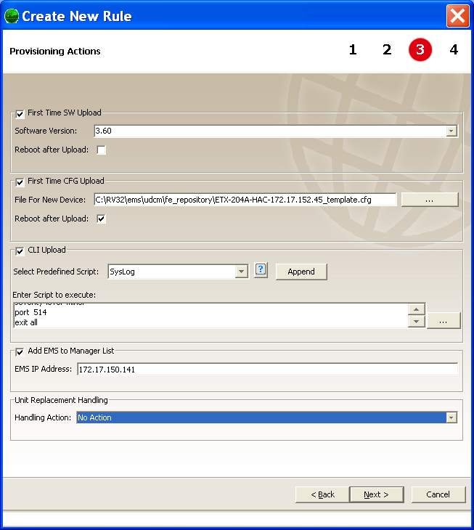
RADview-EMS New Features
Improve ease of use
Interoperability
Performance portal
Convergence of ordering options
Customer Management
Zero-Touch
Resource Management
Link status &new layout

Slide 10
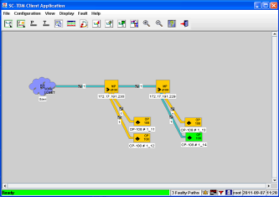
RADview-EMS New Features
Improve ease of use
Interoperability
Performance portal
Convergence of ordering options
RADview-SC/TDM
Windows Server 2008 R2
Windows 7
RADview-SC/TDM over PACK1

Slide 11
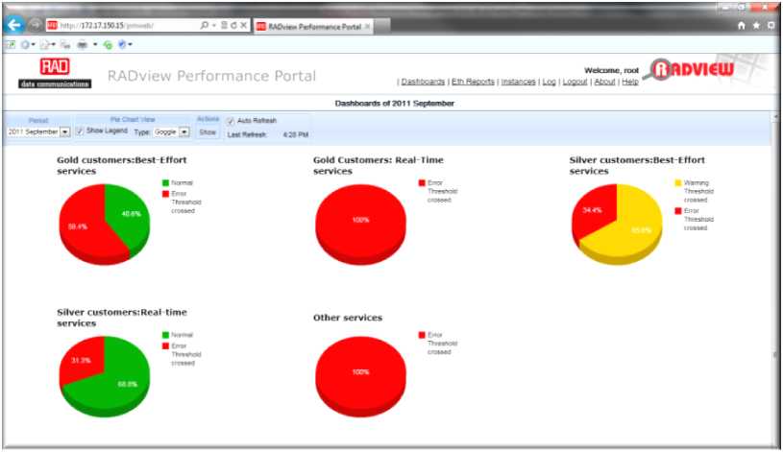
RADview-EMS New Features
Improve ease of use
Interoperability
Performance portal
Convergence of ordering options
RADview Performance Portal V2.0

Slide 12
RADview-EMS New Features
Improve ease of use
Interoperability
Performance portal
Convergence of ordering options
8
3
1
2008
2009
2010
2011
2012

Slide 13
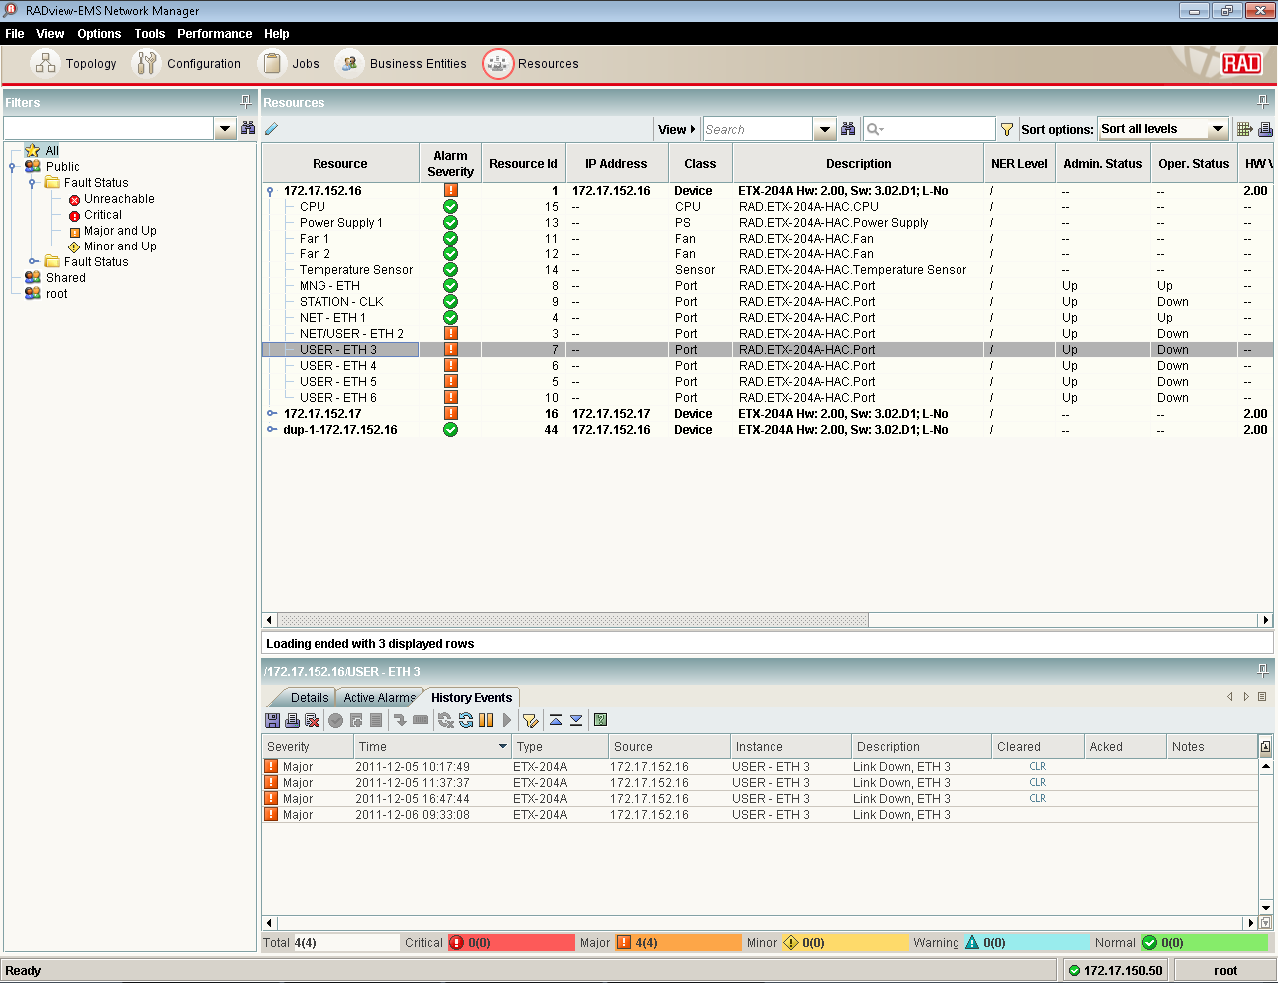
RADview-EMS Resource Management
Filters
New Ribbon buttons
NEW
Details, Active and History alarms
Linked customer
Notes:
Let s start to review the resource management console.
Filters
List of entities
their status
Active Alarms
History alarms
Linked customers
And many various fields as defined in by the entity mib

Slide 14
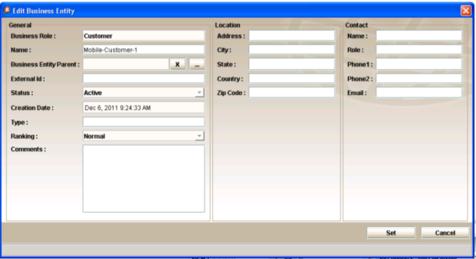
RADview-EMS Customer Management
NEW
Customer and Providers
External ID
Ranking
Linked resources
Linked customer
Notes:
As you noticed in the previous screen the customers who listed under the resource screen can be managed through here.

Slide 15
RADview-EMS Configuration Management
Provides Configuration change management per device
Tracking configuration changes
Tracking software update
Browse and edit CLI configuration
Define Network/Device configuration baseline for easier rollback
Compare Startup-config vs. running-config
Table view of network elements enable sorting and filtering

Slide 16
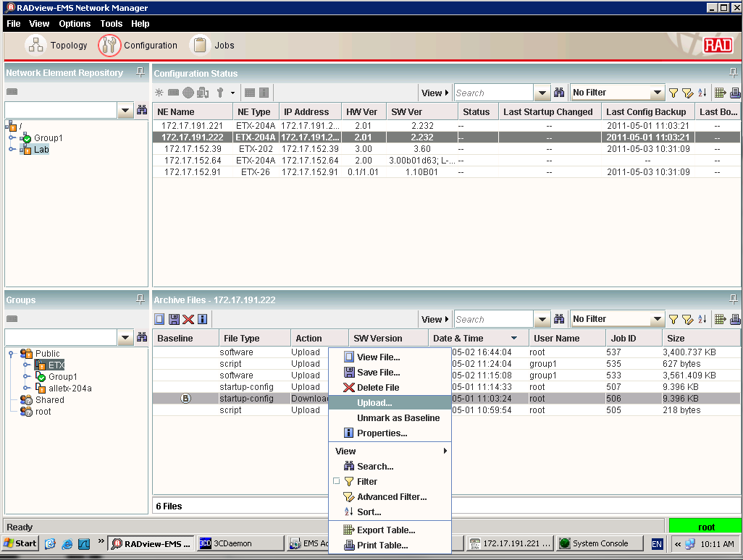
Configuration Management

Slide 17
Task Management Jobs
Automation of network operations
Configuration backup
Software backup
Push CLI configuration updates
Management of mass configuration changes
Task Scheduler
Reports and notification of jobs status
A TFTP server is required

Slide 18
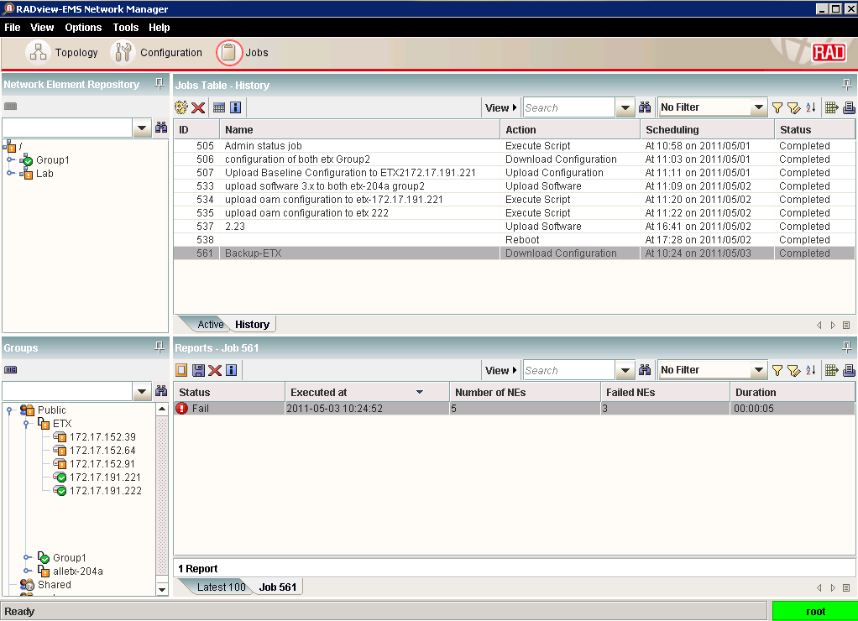
Job Management

Slide 19
RADview-EMS Supports 3rd Party equipment
24/7 Connectivity Status Alerts
Displaying Generic Traps
GUI Cut Through to the device’s Web Management
Supporting CLI over Telnet/SSH
Manual discovery of NEs (Network Equipment)
Inventory management for NEs supporting RFC-4133 (Entity MIB)

Slide 20
Performance Monitoring

Slide 21
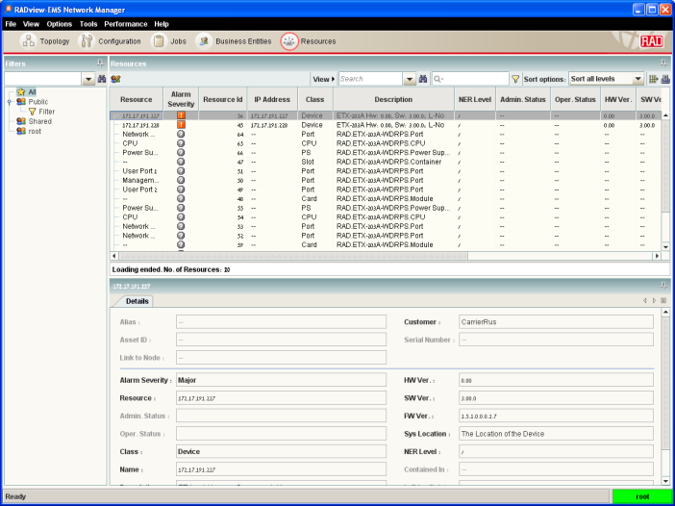
RADview-EMS Performance portal
NEW
Part of RADview-EMS v3.0
Full FCAPS
Policy Management
Performance Dashboard
Aggregated and SLA Reports
Detailed Graphs
Monthly Scheduled reports
Customers management

Slide 22
RADview-EMS Performance portal
NEW
Part of RADview-EMS v3.0
Fault Management
Full FCAPS
Detects and isolates faults in network devices
Policy Management
Configuration Management
Enables to install and distribute software to all devices
Performance Dashboard
Accounting Management
Manages individual and group user accounts and passwords
Aggregated and SLA Reports
Performance Management
Detailed Graphs
producing real-time and periodic statistics.
Monthly Scheduled reports
Security Management
Track user activities and control access to network resources
Customers management

Slide 23
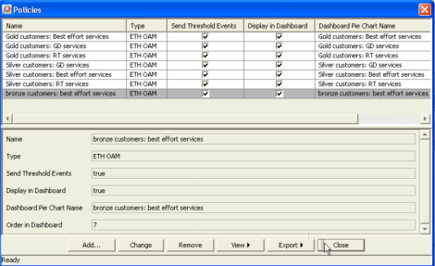
RADview-EMS Performance portal
NEW
Part of RADview-EMS v3.0
KPI
Thresholds
Customers & CoS
Policy=SLA
Full FCAPS
Policy Management
Performance Dashboard
Aggregated and SLA Reports
Detailed Graphs
Monthly Scheduled reports
Customers management

Slide 24
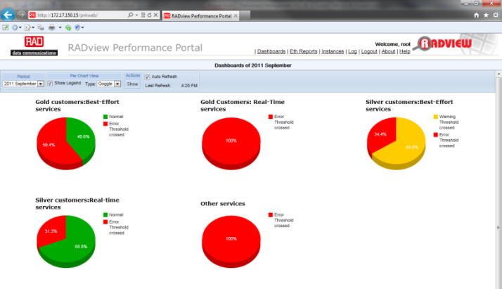
RADview-EMS Performance portal
NEW
Part of RADview-EMS v3.0
Full FCAPS
Policy Management
Performance Dashboard
Aggregated and SLA Reports
Detailed Graphs
Monthly Scheduled reports
Customers management

Slide 25
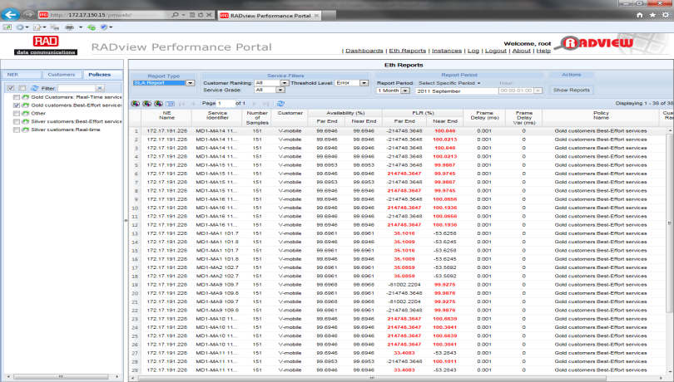
RADview-EMS Performance portal
NEW
Part of RADview-EMS v3.0
Full FCAPS
Policy Management
Performance Dashboard
SLA Reports
Detailed Graphs
Monthly Scheduled reports
Customers management

Slide 26
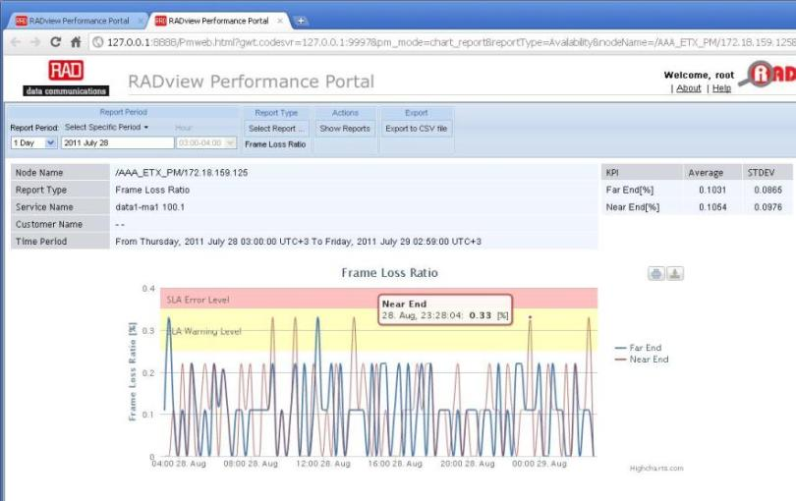
RADview-EMS Performance portal
NEW
Part of RADview-EMS v3.0
Full FCAPS
Policy Management
Performance Dashboard
Aggregated and SLA Reports
Detailed Graphs
Monthly Scheduled reports
Customers management

Slide 27
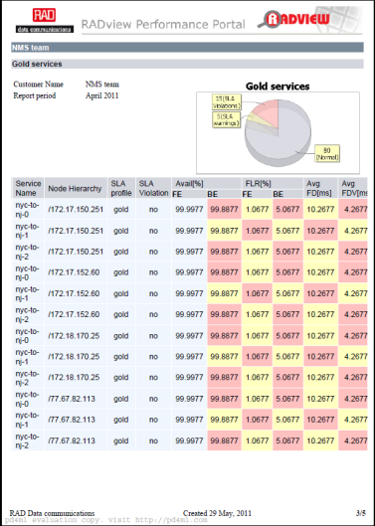
RADview-EMS Performance portal
NEW
Part of RADview-EMS v3.0
Full FCAPS
Policy Management
Performance Dashboard
Aggregated and SLA Reports
Detailed Graphs
Monthly Scheduled reports
Customers management

Slide 28
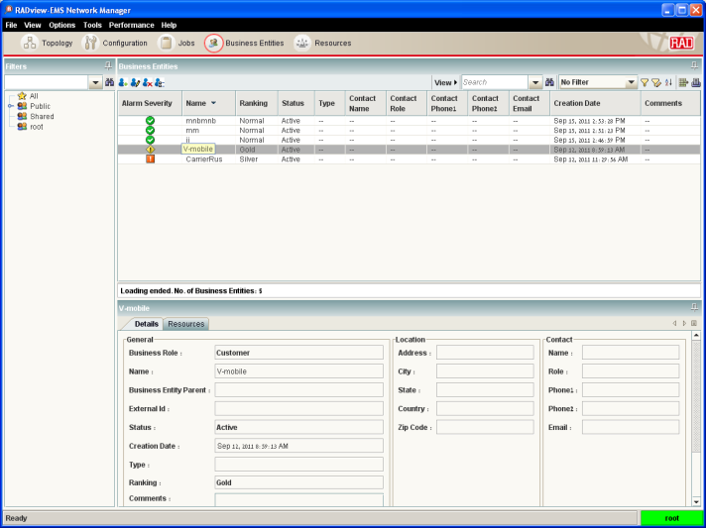
RADview-EMS Performance portal
NEW
Part of RADview-EMS v3.0
Full FCAPS
Policy Management
Performance Dashboard
Aggregated and SLA Reports
Detailed Graphs
Monthly Scheduled reports
Customers management

Slide 29
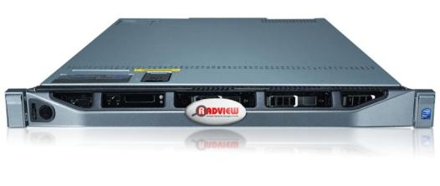
RADview-EMS Turnkey System – Plug & Play
RADview-Server, windows based system
Based on Dell PowerEdge R610 systems
Intel® Xeon® processor 5500 and 5600 series
Reliable Dell hardware
Customized for Entry/Medium/High level
Windows Server®2008SP2 , installed
Latest releases of RADview-EMS and Oracle, installed
39 Months HW world wide warranty, NBD/RADcare
Plug & Play

Slide 30
Business-Continuity Levels
Backup and Restore
High Availability (HA) Cluster
Disaster Recovery (DR) 1+1

Slide 31
Business-Continuity Options
Backup and Restore
Primary site
Backup site
Based on RADview-EMS/<Win&Unix>Pack1/R backup and restore tool
Backup file can be saved anywhere
Restore from backed-up files – RPO can be very long
High Availability (HA) Cluster
Local clustering - RPO and RTO are short
Immediate recovery in the event of OS or HW failure in a single site
Automatic failover
Disaster Recovery (DR) 1+1
Geographically separated NMS servers that are replicated constantly
RPO and RTO are short
Manual switchover
Notes:
RPO- Recovery Point Objective
RTO-Recovery Time Objective

Slide 32
Integrations
OSS - Operation Support Systems
Fault Management – NetCool (validated by IBM)
3rd Party EMS/NMS application
Cisco-ANA
Carrier’s in-house
GNE certification program For CLI based devices
Northbound interface (NBI)
CORBA northbound
SNMP Fault Management northbound
CSV PM files
OSS heartbeat
ALU 5620SAM
Cramer – in process
Notes:
32
The GNE certification program will take care of
Connectivity
Configure node via CLI as required
Create GNE profile with RAD’s provided info
Create discovery rule with RAD’s provided info
Discover NE on map etc
Test node reboot, loss of connectivity
Discover and validate GNE interfaces and interface alarms
Collect stats based on traffic
Install RAD provided alarm catalogue (XML script)
Go though each trap set/clear and observe SAM alarm raise/clear
And some more…

Slide 33
RADview Packages
Pack 1 – Software only
RADview-EMS standalone software only
Includes 300ENW, 5 Clients
Pack 2 - Turnkey system (Regular)
RADview-EMS server based on Dell R610, Windows server 2008SP2
Includes one server, 300ENW, 5 Clients and 3 Years worldwide HW warranty
Pack 3 - Turnkey system (DR mode)
RADview-EMS system based on Dell R610, Windows server 2008SP2
Includes 2 servers in replication (DR) mode, 300xRV-LIC/ENW/R, 5 Clients and 3 Years worldwide HW warranty
Pack 4 - Turnkey system (HA Mode)
RADview-EMS system based on Dell R610, Windows server 2008SP2
Includes 2 servers and external storage in local clustering (HA) mode, 300ENW/R, 5 Clients and 3 Years worldwide HW warranty

Slide 34
Success Stories
RV-EMS

Slide 35
B2B Ethernet Connection DSLAM Backhaul over PSN
RAD View EMS
Network Management
ETX-201
Customer A
IP-DSLAM
GBE
ETX-202
GBE
GBE
Internet
IP-DSLAM
L2 Private Network
ETX-202
GBE
GBE
GBE
GBE
IP-DSLAM
ETX-201
ETX-201
ETX-201
ETX-202
Customer A
Customer B
Customer B

Slide 36
Multiple Services over RAD Equipment
EWSD
RAD View EMS
Network Management
IPMUX-1E
S0
IPMUX-1E
IP-DSLAM
IP/Eth Network
IPMUX-1E
S0
IP-DSLAM
OP-108
OP-108
OP-108
OP-108
IPMUX-1E
S0
Fiber

Slide 37
RADview Release Schedule
Release Schedule | 2012
 | Q1 | Q2 | Q3 | Q4
RADview-EMS | v3.0 GA New Inventory Customer Management PMv2 Threshold management Report Generator Dashboards ETX-203A v3.01 ETX-204A v3.01 LRS-102 v3.4 MP-2100 v12.9 PacketLight: PL-1000EM PacketLight: PL-1000RO PacketLight: PL-1000TN PacketLight: PL-2000 RADiflow: SIS-3700 v1.0 RADiflow: SIS-3080 v1.0 ASMi-54LRT v2.1 ASMI-52 v2.9 ASMI-54L v2.6 | v3.1 GA Enhance search functionality including device location LRS-102 Modem List Dialog Zero Touch Configuration PM Portalv2.1 ETX-204Av3.02 ETX-205Av4.01 ETX-220Av4.01 ETX-5300Av1.0 IPMUX-4Lv1.40 MIRIC-155v2.1 MIRIC-E1/T1v2.53 MIRIC-E3/T3v2.53 MITOP-E1/T1v2.51 MITOP-E3/T3v2.51 MP-4104v3.07 LA-210v3.5 | v3.2 GA ASMI-52v3.0 ETX-205Av4.3 RIC-LCv2.0 | v3.3 GA ETX-205Av4.5 ETX-36v1.0 MP-4100v2.25 MP-4100v3.1 RICI-16v4.0

Slide 38
Summary
FCAPS compliant platform
RADview-EMS Benefits & Features
Lots of new Features which are for easy and intuitive working
3rd party device integration ( Multi Vendor Network )
Performance Management portal for customer SLA’s
Turnkey system, one stop shopping
Scalable Business-Continuity Levels
Flexible for interworking with 3rd Party OSS
Packages for any requirement
Worldwide Success Storys

