Slide 1

Designing RAD Solutions
2012 Workshop
Patrick Attias
Senior Training Manager
Patrick_a@rad.com

Slide 2
Purple Telecom Requirements
Customer background:
  “Purple” is a company formed by the merger of “Green Telecom” and “Red Telecom”
  Purple owns an IP/MPLS network and an SDH network (legacy from “Green Telecom”)
  They have two major POPs connected to the SDH network (co-located with the SDH ADMs)
  Purple is targeting business customers and they have defined several customer types (A-F)
Requirements
  Purple provided their requirements in the attached Excel table
  Wherever possible, they want to direct all the high speed Ethernet traffic (above 1 Mbps) to the PSN and all the Voice traffic, to the SDH (low speed Ethernet services, under 1Mbps,should also be directed to the SDH network)
  They intend to start offering Smart Ethernet services over the PSN for large customers (for example: Customers of type E)
  All network elements must be managed
  Customer F will use his own Routers and needs a transport solution for this traffic in addition to the E1 services
You are requested to:
  Define the products to be used in all sites including the POPs
  Provide the correct ordering options
  Note: All copper wire is 26 gauge

Slide 3
"Purple" Telecom Traffic Flow
Site name | Service | Baud rate | Link type | Connector | Distance | Total Baud rate | Unit Power | Harden | Destination site | Notes
A1 | Ethernet | 10Mbps | n x 2w |  | 2.5km | 12Mbps | 220v | No | A2 via POP 1
 | E1 | 2Mbps |  |  |  |  |  |  | A2 via POP 1
A2 | Ethernet | 10Mbps | FO (SM/1310nm) | SC | 25km |  |  |  | A1 via POP 2
 | E1 | 2Mbps |  |  |  |  |  |  | A1 via POP2
B1 | Ethernet | 10Mbps | FO (SM/1310nm) | LC | 2km | 26Mbps | 2 X 220v | No | B2 via POP1
 | 8xE1 | 2Mbps each |  |  |  |  |  |  | B2 via POP1
B2 | Ethernet | 24Mbps | FO (SM/1310nm) | LC | 3km |  |  |  | B1 via POP2
 | 8xE1 | 2Mbps each |  |  |  |  |  |  | B1 via POP2
C1 | E1 | 2Mbps | FO (SM/1310nm) | SC | 5km | 2Mbps | (-48VDC) | No | C2 via POP1
C2 | E1 | 2Mbps | n x 2w |  | 4km | 2Mbps | (-48VDC) | No | C1 via POP2
D1 | Ethernet | 2Mbps | nx2w |  | 5km | 2Mbps | (-48VDC) | No | D2 via POP1
D2 | Ethernet | 2Mbps | FO (SM/1310nm) | SC | 15km | 2Mbps | 220v | No | D1 via POP2
E1 | Ethernet | 10Gbps | 2x FO (SM/1300nm) Redundancy | LC | 3Km | 10Gbps | 2x220v | No | E2&E3 via PSN
E2 | Ethernet | 5Gbps | FO (SM/1300nm) | SC | 4Km | 5Gbps | 2x220v | No | E1 via PSN
E3 | Ethernet | 5Gbps | FO (SM/1300nm) | SC | 4Km | 5Gbps | 2x220v | No | E1 via PSN
F1 | Ethernet | 60Mbps | FO (SM/1300nm) | SC | 3km | 72Mbps | 2x220v | No | F2-F7 via PSN
 | 6xE1 | 2Mbps each |  |  |  |  |  |  | F2-F7 via PSN
F2-F7 | Ethernet | 10Mbps | FO (SM/1300nm) | SC | 3km | 12Mbps | 220v | No | F1 via PSN
 | E1 | 2Mbps |  |  |  |  |  |  | F1 via PSN
POP #1 | Ethernet | 10Mbps | n x 2w | SC | 2.5km | 12Mbps | 2x(-48VDC) | No | A1 | STM-1 FO (SM1310nm) GbE FO (SM1310nm)
 | E1 | 2Mbps |  |  |  |  |  |  | A1
 | Ethernet | 10Mbps | FO (SM/1310nm) | LC | 2km | 26Mbps |  |  | B1
 | E1 | 16Mbps |  |  |  |  |  |  | B1
 | E1 | 2Mbps | FO (SM/1310nm) | SC | 5km | 2Mbps |  |  | C1
 | Ethernet | 2Mbps | n x 2w |  | 5km | 2mbps |  |  | D1
POP # 2 | Ethernet | 10Mbps | n x 2w | SC | 2.5km | 12Mbps | 2x(-48VDC) | No | A2 | n x LL = N x E1, GbE (SM/1310nm)
 | E1 | 2Mbps |  |  |  |  |  |  | A2
 | Ethernet | 10Mbps | FO (SM/1310nm) | LC | 2km | 26Mbps |  |  | B2
 | E1 | 16Mbps |  |  |  |  |  |  | B2
 | E1 | 2Mbps | FO (SM/1310nm) | SC | 5km | 2Mbps |  |  | C2
 | Ethernet | 2Mbps | n x 2w |  | 5km | 2mbps |  |  | D2

Slide 4
"Purple" Telecom Application
E1
nx2w/ 2.5km
FO / 25km
E1
A1
A2
10Mbps
10Mbps
8xE1
Pop # 1
Pop # 2
8xE1
B1
FO/2km
FO/3km
B2
10Mbps
10Mbps
Pop # 1
STM-1 (FO)
n x LL
Pop # 2
FO/ 5km
SDH Network
nx2w/ 4km
E1
C1
C2
E1
FO / 2km
FO / 2km
2Mbps
D1
nx2W/5km
FO / 15km
D2
2Mbps
PSN
FO / 3km
FO / 4km
E2
10Gbps
E1
5Gbps
100Fx / 3km
100Fx / 3km
6xE1
F2
F3
F7
F1
1000Fx / 3km
FO / 4km
E3
E1
E1
E1
5Gbps
60Mbps
10Mbps
10Mbps
10Mbps
Notes:
Site POP # 2:
They want to use a single fiber to the PSN and multiple LL to the SDH

Slide 5




"Purple" Telecom Solution
ASMi-54
OP-108L
E1
E1
4x2w/ 2.5km
FO / 25km
A1
A2
10Mbps
10Mbps
8xE1
OP-134
OP-134
8xE1
B1
FO/2km
Pop # 1
Pop # 2
FO/3km
B2
10Mbps
STM-1
10x E1
10Mbps
MP-4100
SDH
Network
MP-4100
OP-108L
FO/ 5km
1x2w/ 4km
ASMi-52L
E1
C1
C2
E1
FO / 2km
FO / 2km
D2
S-RPT
ASMi-52L
ETX
D1
1x2W/5km
FO / 15km
D2
2Mbps
2Mbps
IP/Eth Network
ETX-220A
ETX-220A
FO / 4km
E2
5Gbps
10Gbps
FO / 3km
E1
100Fx / 3km
100Fx / 3km
6xE1
IPmux-216
F2
F3
F4
ETX-220A
1000Fx / 3km
IPmux-2L
IPmux-2L
IPmux-2L
FO / 4km
E3
5Gbps
60Mbps
F1
E1
E1
E1
10Mbps
10Mbps
10Mbps
Notes:
Site B1 : Can not use OP-134 since there is no OP-134 card for the MP-4100 that can work Vs. the OP-134

Slide 6

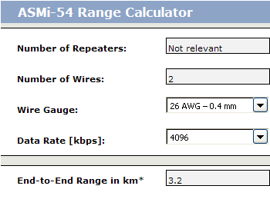

Customer A
Site A1
  Total bandwidth = 12Mbps, distance =2.5Km
  ASMi-54
    Supports Max. 4Mbps / 3.2Km / 2w → We will need 8W
  Ordering option
    ASMi-54/E1/4ETH/8W
Site A2
  Total bandwidth = 12Mbps
  OP-108L
    E1
    10Mbps Ethernet
  The correct ordering option
    OP-108L/B/ETH/SC/13L
Notes:
Customer A:
Site A1:
E1 +10Mbps Eth over 2w=> The right answer is ASMi-54. As per the calculator, the max distance that the ASMi-54 can carry 4Mbps over 2w is 3.2km. We need 2.5km but for 12Mbps, so we will have to use 8w.
The ASMi-54C for the MP-4100 works with up to 16 wires -- > 8x2w or 4x4w or 2x8w
Other solutions:
The ASMi-52 can’t do here. We need a total of 10Mbps (ETH) +2Mbps (E1) = 12Mpbs. The ASMi-52 supports up to 2.3Mbps over 2w (SHDSL) and 4.6Mbps over 4w
The ASMi-54L can’t do here- > It supports max 4w
Site A2:
E1 +10Mbps Eth over FO=> OP-108L (Opposite an OP-108 card in the LRS)
Since we need to support 25km, we will have to use the Laser option (SC/13L) – where can I see the supported distances?
No SFP , it has built-in optical uplinks
Other Solutions:
1. OP-108 can do here but is more expensive than the “ L” version ($720 Vs. $585)

Slide 7
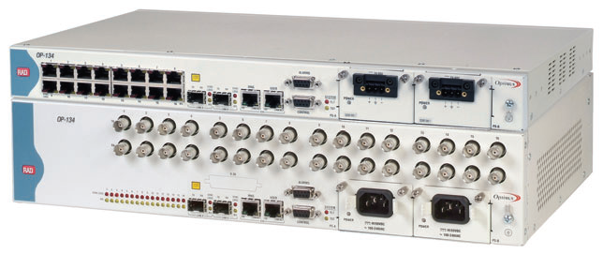
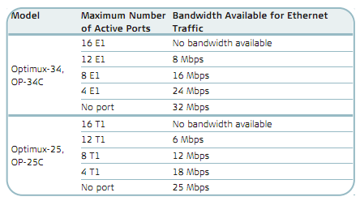
Customer B
Site B1
  Total bandwidth = 26Mbps
  OP-34
    Operation mode:
      16 x E1 or 32Mbps Ethernet Granularity of 8Mbps
Site B2
  Same as site B1
Notes:
Customer B:
Site B1
We need a total of 26Mbps -- > We used to have the OP-34 but now we have replaced it with the OP-134 that has two mode of operations – as an OP-34 or as an OP-134
The Eth service should be limited to 24Mbps -> the OP-134 can be ordered in the OP-34 mode = Granularity of 8Mbps
The OP-134 in the OP-34 mode can work Vs. the OP-34C card in the LRS/MP-4100
Other options:
OP-34 - > problem – Terminated….
Site B2:
Same as site B1.

Slide 8
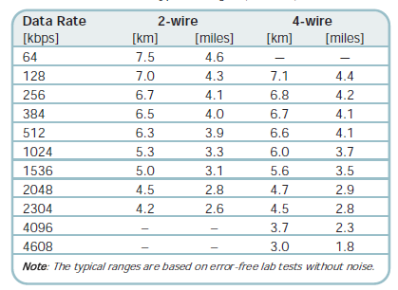
Customer C
Site C1
  Total Bandwidth = 2Mbps / 4km
  OP-108L
    E1 over fiber
Site C2
  Total bandwidth = 2Mbps
  ASMi-52L
    E1
    1x 2w to support 2Mbps over 4km
Notes:
Customer C:
Site C1:
E1 over fiber = OPTIMUX. Since we do not need PS redundancy, we will use the OP-108L and not the OP-108.
As per the table in the data sheet, we will have to use a laser fiber interface in order to overcome the 4km distance
The PS is a Wide range, so no need to specify 48VDC in the Cat. number
Other Options:
OP-108 - > More expensive.
IPmux-2L -> More expensive and requires an IPmux in the POP in the LRS or MPW card in MP-4100
Site C2:
ASMi-52L supports a single E1 user port. As per the data sheet, in order to carry this E1 (2Mbps) across 4 km, we need only one pair of 2w.
BTW, the ASMi-52L doesn't require a different card in the LRS-102. The ASMi-54C/N can work Vs. the ASMi-52 & ASMi-54
The PS is a Wide range, so no need to specify 48VDC in the Cat. number
ASMi-52L/E1/2W ( $360)
Other Options:
ASMi-52L -> Not a good solution- it has no E1 option, only Ethernet-------????????
2. ASMi-54 => Can do here, but it is more expensive and do not support only E1 ( ASMi-54/E1/4ETH/4W ($1093).

Slide 9
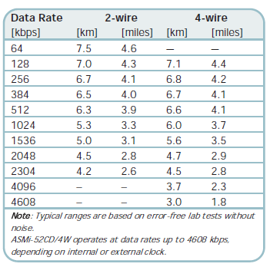

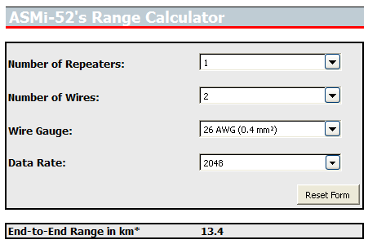
Customer D
Site D1
  Total bandwidth => 2Mbps / 5km / nx2w
  ASMi-52L
    Ethernet service
    Wide range PS
    Max 4.7km / 4w……..
      A repeater is needed
  We should order
    ASMi-52L/ETH/2W
    S-RPT
Site D2
  Total Bandwidth => 2Mbps / 15km/FO
  OP-108L
    Wide range PS
    Ethernet service
  Ordering option
    OP-108L/B/ETH/SC/13L
Notes:
Customer D:
Site D1:
We need an Ethernet service over copper. Since we need only a single service (ETH), the most cost effective solutions is the ASMi-52L, yet it can not carry 2Mbps over 5km. We need a repeater.
Other solutions:
ASMi-52 -> more expensive
ASMi-54 -> more expensive.
ASMi-54L -> more expensive since it comes with 4ETH switch by default (ASMi-54L/4ETH/24 $518 vs. ASMi-52L/ETH.2W $360)
Site D2:
The OP-108L with E1 ports. Laser in order to cover 15km
Other solutions:
IPmux -> more expensive & requires an IPmux in the POP

Slide 10

Customer E
Site E1
  Total bandwidth => 10Gbps / 3km
  ETX-220A
    10Gbps user interface
    10Gbps (1+1) network interface
  Ordering option
    ETX-220A/ACR/2X10GE
    XFP-1D
Site E2 & E3
  Total bandwidth => 5Gbps
  ETX-220A
    10Gbps user interface
    Traffic management (CIR/EIR) to limit the user to 5Gbps
  Ordering option
    ETX-220A/ACR/X10GE
    XFP-1D
Notes:
Customer E:
Site E1
ETX-220A is the only product that supports 10Gbps.
XFP-1D supports a 10GbE over 10km

Slide 11
Customer F
Site F1
  Total bandwidth => 72Mbps / 3km
  IPmux-216
    6XE1
    60Mbps Ethernet
    Power supply redundancy
  Ordering option
    IPmux-216/ACR/8E1/6/N/UTP
Site F2 – F7
  Total bandwidth per site => 12Mbps /3km
  IPmux-2L
    1xE1
    10Mbps Ethernet
  Ordering option
    IPmux-2L/1E1/2
Notes:
Customer F:
Site F1:
Since we need PS redundancy, we can use the IPmux-216.
Site F2-F7:
The most cost effective solution is the IPmux-2L

Slide 12
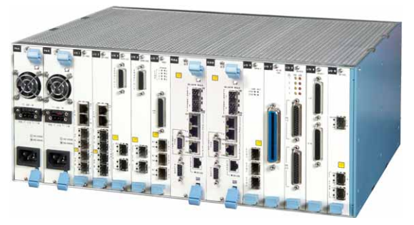
POP # 1, 2
Types of remote CPEs to serve:
  SHDSL bis. Modems (ASMi-54)
  SHDSL Modems (ASMi-52L)
  Optical Modems (OP -134 & OP-108)
Connection to the SDH
  STM-1 (POP#1)
  N x Leased lines (POP#2)
  Traffic Grooming
The Solution
  MP-4100

Slide 13
Point to Point Leased lines Vs. Aggregation Solutions
What is the difference between the MP-4100 and the LRS-102?
Pop # 1
Pop # 2
MP-4100
LRS-102
Traffic Aggregation Solution
MP-4100
Multiplexer
Point To Point Solution
LRS-102
Modem Rack
MP-4100
LRS-102
STM-4 SDH Network
E1
STM-1 / STM-4 / GbE
STM-1 / STM-4
E1
GbE
ETH
IP/Eth
Network
E1 &
ETH
Traffic Aggregation Solution
Point To Point Solution

Slide 14

SuperEther Requirements
SuperEther (SE) is an alternative carrier that owns a PS network
SE offers a wholesale Ethernet service to their Mobile operator and retail services to their business customers.
SE offers three types of services – Ethernet only , E1 leased line , and Multi services (Eth+E1).
SE has made a strategic decision to differentiate their Ethernet service offering by using the MEF standards and offer Carrier Ethernet services to their “Ethernet only” or “Multi service” customers.
SE has defined several types of customers that they need to support:
The mobile operator
  Provides 2G and 3G services.
  Site A2 -> The solution in this site should enable the delivery of the 3G traffic coming from the Node B to the RNC located in site A1 (The solution should have dual power supply)
  Site A3 -> The solution in this site should enable the delivery of the 2G and the 3G traffic to the BSC & RNC located in site A1. The 2G (BTS) is equipped with max 4xE1s (The solution should have dual power supply).
  Site A1 -> This site contains the RNC and the BSC. It is accessed via SE’S PSN using a 10GbE fiber connection. They need a protected connection for this fiber. Some additional 3G Node B’s will be connected by GbE fiber to site A1 in the near future (The solution should have dual power supply).
The Business Customers
  Site B1 -> (Works opposite site B2) Is accessed via nxE1 (For Max 16Mbps Ethernet service) via the incumbent’s SDH network (Off-net access).
  Site B2 -> (Works opposite site B1) Requires an Ethernet service (up to 16Mbps) over 4W lines via an IP DSLAM
  Site C1 -> (Works opposite site C2) requires an E1 leased line service (2Mbps) via the PSN
  Site C2 -> (Works opposite site C1) requires an E1 leased line service via the IP DSLAM

Slide 15
SuperEther Requirements Cont.
  Site D1 -> (Works opposite site D2) requires a multi service support (Ethernet & E1). The Ethernet service requires 2Mbps and the E1 service requires 2Mbps as well.
  Site D2 - > (Works opposite site D1) requires a multiservice support (2Mbps Eth and 2Mbps E1) via a 4w Line to the IP DSLAM
  Site E1 -> (Works opposite site E2) requires an Ethernet service (5Mbps). This site is accessed by a GbE fiber.
  Site E2 -> (Works opposite site E1) requires a 5mbps Ethernet service and is accessed via 4Wlines via the IP DSLAM.
  Site F1-> This is a POP site. It is connected to several remote customer’s sites and aggregates the traffic (Preserving the QOS of each customer service) into a 10GbE fiber link to the PSN
  Site G1-> This is an aggregation site and the gateway between SE’s network and the Incumbent’s network. It is connected to the SDH via n X STM-1 and to the PSN via a protected 10GbE fiber. This site is also connected to the Metro Eth network via a protected 10GbE fiber
  Site H1 -> (Works opposite site H2) This is a type of customer that requires a 100Mbps Ethernet service. These types of customers are accessed via an STM-1 link, using the Incumbent SDH but SE intends to access these customers via their PSN (GbE Fiber) in the future.

Slide 16




“SuperEther” Carrier Application
B1
8xE1
Eth
?
G1
H1
STM-4 SDH Network
N x
STM-1
A2
Eth
?
STM-1
GbE
?
GbE
?
Node B
10GbE
Metro Eth Network
Future
Future
GbE
A3
GbE
GbE
GbE
GbE
GbE
10GbE
GbE
A1
Node B
10GbE
GbE
GbE
?
BSC
STM-1
IP/Eth
Network
4xE1
BTS
?
IP DSLAM
IP DSLAM
RNC
GbE
10GbE
F1
4w
4w
4w
4w
?
E1
?
GbE
D1
Eth
?
?
?
?
E1
GbE
GbE
E1
?
E1
Eth
Eth
Eth
C1
D2
E2
B2
C2
GbE
H2
Eth
?
?
E1
Eth

Slide 17



“SuperEther” Carrier Solution
B1
RIC-LC
8xE1
Eth
Egate-100
G1
STM-4 SDH Network
STM-1
A2
H1
MiRIC
STM-1
GbE
GbE
Eth
STM-1
GbE
ETX-205A
Node B
ETX-203AX
MiRIC
10GbE
Metro Eth Network
Future
Future
ETX-5300A
GbE
A3
GbE
GbE
GbE
GbE
GbE
10GbE
GbE
A1
A1
Node B
10GbE
GbE
GbE
BSC
STM-1
IP/Eth
Network
ETX-205A
4xE1
BTS
ETX-5300A
IP DSLAM
IP DSLAM
RNC
GbE
10GbE
F1
4w
4w
4w
4w
MiTOP
ETX-203AX
ETX-5300A
LA-210
LA-210
LA-210
LA-210
E1
GbE
D1
Eth
IPmux-4L/GE
E1
Eth
Eth
Eth
E1
E1
GbE
GbE
D2
E2
B2
C2
C1
H2
ETX-203AX
GbE
ETX-203A
Eth
E1
Eth
Notes:
Site A2 – Actually, we could use the ETX-203Ax but since we defined a need for dual PS, it has to be the ETX-205A
Site A3 – The E1s in the ETX-205A will be supported by Q3/2012. An immediate solution – IPmux-24A + ETX-203A
Site G1 – The ETX-5300A doesn’t support ETHoPDH (GFP/VCAT) so we need an external device to do it = Egate-100.
The ETX-5300A will support it (it is in the road map but with no date yet), and then we will not need an Egate to work Vs. the RIC-LC
RIC-LC -> more cost effective then RICi-16

Slide 18


ETX-5300A :
1GE and 10GE Aggregation for PE
Access Aggregation
Access Segment
Last Mile
Middle Mile
GE / 10GE Agg UNI | 10GE LAG to PE NNI | CIR BW | Modules
6 x 10GE | 2 Intercard LAG | 10GE | 2 x Main
6 x 10GE 20 x 1GE | 2 Intercard LAG | 10GE | 2 x Main 1 x GE I/O
12 x 10GE | 4 Intercard LAG | 20GE | 2 x Main 4 x 10 GE I/O
8 x 10GE 40 x 1GE | 4 Intercard LAG | 20GE | 2 x Main 2 x 10GE I/O 2 x 1GE I/O
80 x 1GE | 4 Intercard LAG | 20GE | 2 x Main 4 x 1GE I/O
FE/GE
1G (LAG)
ETX-203A
ETX-204A
ETX-5300A
10GE
10G (LAG)
10G
Metro
Core
ETX-220A
10G
10GE
10G (LAG)
ETX-220A
10G Ring
FE/GE
10G (LAG)
ETX-212A
ETX-212A
Complete Access Solution
  OAM
  TM
  Timing
  SDH/ SONET Replacement
  PW (Legacy Migration)

Slide 19





Ethernet & TDM Pseudowire
RADview
ETX/MiTOP
T1/E1 or T3/E3
2 x FE / GE
UP TO:
16 OC-3/STM-1
ETX-5300A*
ETX-205A*
TDM /
SONET
GE/10GE
4 or 8 E/T1
Ethernet,
IP or MPLS
GE/10GE
ETX-212A*
5 x FE / GE
IP / ETH
8, 16 or 32 E1/T1
8 x FE / GE
ETX-5300A Sample Configurations
IPmux-24/216
1,2,4,8 or 16 E1/T1
Ports Aggregated |  | 10GE LAG Groups (Card Protection) | Modules Req.
Ch OC3/STM1 | Ethernet
- | 6 x 10GE | 1 (2 ports) | 2 x Main
4/2+2 | 6 x10GE | 1 (2 ports) | 2 x Main 1 x TDM I/O
8/4+4 | 6 x 10GE | 2 (4 ports) | 2 x Main 2 x TDM I/O
8/4+4 | 40 x GE 6 x 10GE | 2 (4 ports) | 2 x Main 2x TDM I/O 2 x GE I/O
16/8+8 | 6 x 10GE | 2 (4 ports) | 2 x Main 4 x TDM I/O
2 x FE / GE
IPmux-1E
4 FXS/FXO/
E&M/BRI
MP-4100/2100
160 x T1/E1
160 x analog phones
120 a serial interfaces
and more…
MPW / ML-IP
* New

Slide 20
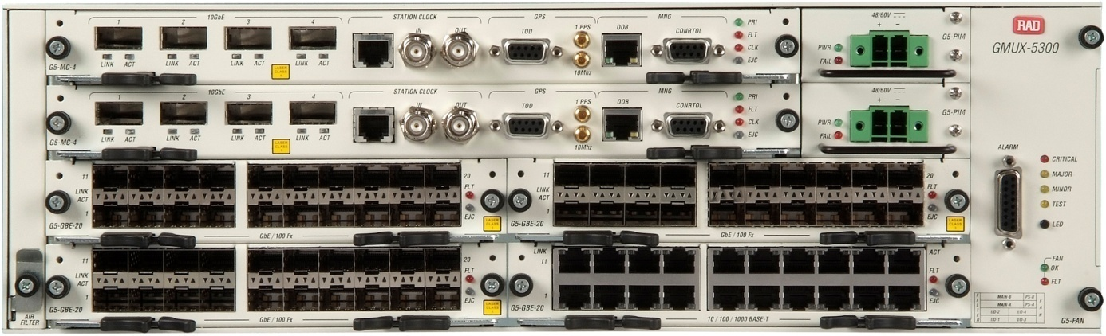
ETX-5300A Front View Description
Clocking Interfaces
Redundant PSU (DC/AC Outlet)
Fan Module
4 x 10GbE XFP fully redundant
Secondary Main Card
Primary Main Card
Alarm output connector
20 x 1GbE Opt SFP I/O card
20 x 1GbE Elec I/O card
Air Filter

Slide 21
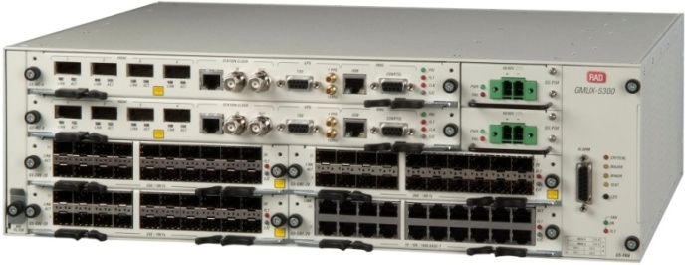
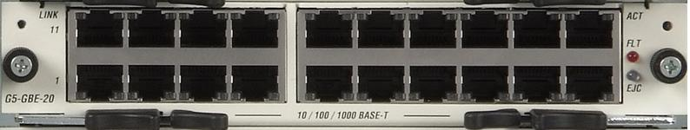

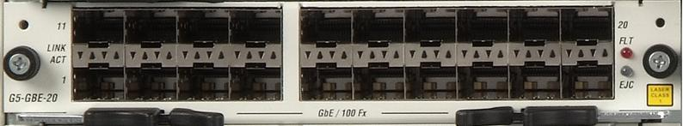
ETX-5300A Fully Redundant Platform
3U fully redundant platform:
  Up to 80 x GbE & 8 x 10GE / 16 x 10GE
  Up to 16 STM-1 & 8 x 10GE
Non-blocking architecture with wire speed packet forwarding for all packet sizes
Ethernet and TDM Services
  E-Line (EPL and EVPL), E-LAN (EP-LAN and EVP-LAN) E-Tree (EP-Tree, EV-Tree)
  TDM / TDM PW / MEF8 & UDP/IP encapsulation
Ring G.8032 & Linear G.8031 topology
Fully redundant chassis including 50 ms switchover
VLAN Forwarding & manipulation
Hierarchical Traffic management
Network Termination Unit like packet classification
Timing over packet – 1588v2, M&S SyncE, Adaptive clock recovery

Slide 22
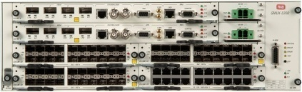
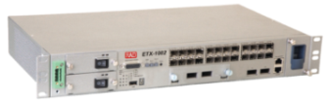





ETX Portfolio – Performance & Scale
Performance
ETX-5300A
ETX-1002
ETX-220A
ETX-212A
ETX-204A
ETX-204A
ETX-203A
ETX-102
ETX-202
Scale

Slide 23
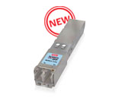
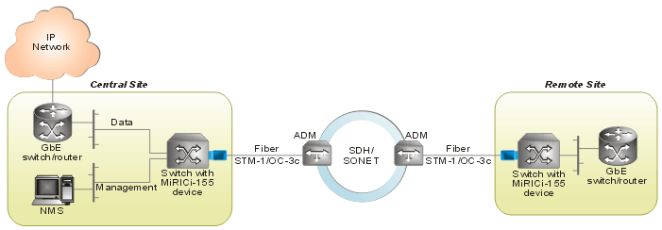
The MiRIC 155
Miniature intelligent SFP converter -> Ethernet over STM-1/OC-3
Full-duplex 1000 Ethernet remote bridge over STM-1 or OC-3
Direct GbE mapping to VC-4/STS-3c; standard GFP encapsulation (ITU-T G.8040, G.7041/Y 1303)
Up to four QoS queues per VLAN priority (IEEE 802.1p) with Strict Priority scheduling
Increases network flexibility by allowing quick, ad-hoc installations
Supports a scalable migration to fiber Ethernet access
Eliminates the need for equipment certification and integration, and for special operator training
Interoperable with third-party routers and switches

Slide 24
Gas-Star Requirements
GAS-Star is a Gas distribution company. They have 30 sites across the country. They are looking for a solution that will connect all the remote sites to the main sites (Site 22 & site 30).
They want to build a resilient private network based on SDH technology (STM-4) between sites 16-19
They want to build a resilient STM-1 network between sites 19-22
They will need to use the Carrier PSN for connectivity to some sites
Site 1-15: These sites are located near the Gas pipeline. Each site is equipped with 2x IP cam ( 5Mbps per CAM) . There is no infrastructure to these sites, so a wireless solution is required
Site 16: The solution in this site should be able to aggregate the video traffic from sites 1-15 and hand it over to the SDH network. Please specify the interface to be used
Site 17: The solution in this site should be able to connect 12 ports of RS-232 service (from the RTUs) and the Ethernet traffic coming from sites 24-26 and hand it over to the SDH network.
Site 18: The solution in this site should carry the Ethernet traffic coming from site 27-29 (over 2w line) towards the data server in site 30. In addition it should be able to be part of the SDH network and hand over the data and video traffic from all the remote sites to site 30
Site 19: The solution in this site should interconnect the STM-4 SDH and the STM-1 SDH networks to enable the traffic flow between these two network
Site 20: The solution in this site should support 2 x E1 and 100Mbps Ethernet traffic. Both E1 & Eth services should be delivered to site 30 via an STM-1 resilient network

Slide 25
Gas-Star Requirements
Site 21: The solution in this site should support 16 x FXO, 30Mbps Ethernet traffic & 10 x RS-232 ports). Both E1 & Eth services should be delivered to site 30. The RS-232 services should be delivered to site 22 (SCADA server)
Site 22: This is one of the main sites. The solution in this site should support 12 x FXO and 20Mbps Ethernet traffic. Both E1 & Eth services should be delivered to site 30. The 30xRS-232 traffic are connected to the SCADA server and comes from the different remote sites ( Including two RS-232 spare ports)
Site 23: This site aggregates the traffic from sites 24-26 and delivers it to the PSN network via a GbE fiber line. The video traffic should be delivered to the video server in site 30. The RS-232 services should be delivered to site 22 (SCADA server)
Site 24-25: The solution in this site should carry 3Mbps IP camera traffic and 1 x RS-232 RTU traffic (9.6Kbps). The Video traffic is delivered to site 30 via site 23 over a 100FX fiber line and the RTU traffic goes to site 22. The solution in these sites and in site 26 should support :
  Extended temperature of -40 to 75°c d
Site 26: Future site - The solution in this site should support 3Mbps IP camera traffic and 2 x RS-232 RTU traffic (9.6Kbps each). The traffic is delivered to site 23 via a 2w (1km). They plan to have 8 sites similar to site 26 by the end of the 2012
Sites 27-29: These sites require Ethernet support (1Mbps each) to be delivered to site 30 via site 17
Site 30: The is one of the main sites. It holds the Video server, Data server and the main PBX. Please define the link between this site and the STM-4 network (Site 18)

Slide 26







Gas-Star Utility Application
Video Server
Data Server
30
1Mbps
29
PBX
20
STM-1
PBX
?
2xE1
GbE
4E1
PSTN
1Mbps
28
?
GbE
?
?
2W
100Mbps
STM-1
?
1Mbps
27
18
2W
2W
PBX
21
STM-1
?
?
RTU
IP cam 3Mbps
16x FXO
STM-1
17
STM-4
SDH
Network
12xV24
1xV24
10xV24
?
STM-1
Ring
?
?
GbE
24
?
30Mbps
STM-1
19
Ethernet
Network
STM-1
PBX
22
?
12xFXO
?
16
GbE
RTU
IP cam 3Mbps
STM-1
20Mbps
?
23
100FX
1xV24
STM-1
?
100Fx
25
25xV24
2W
?
Future
RTU
1xV24
IP cam 3Mbps
1
2
3
15
26
?
Ipcam 1
Ipcam 2
Ipcam 3
Ipcam 4
Ipcam 5
Ipcam 6
Ipcam 14
Ipcam 15
10Mbps
?
10Mbps
?
10Mbps
?
10Mbps
?
Gas Pipeline
Notes:
SHDSL.BIS support in the RADiflow - > 4/2012 works Vs. ASMi-54

Slide 27
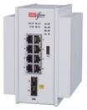


Gas-Star Utility Application
Video Server
Data Server
30
1Mbps
29
PBX
20
PBX
2xE1
150Mbps
4E1
PSTN
1Mbps
28
ASMi-54
FCD-155E
160Mbps
MP-4104
2W
100Mbps
STM-4
1Mbps
27
ASMi-54
18
2W
2W
PBX
21
MP-4104
RTU
Ipcam 3Mbps
16x FXO
ASMi-54
STM-4
SDH
Network
12xV24
1xV24
10xV24
STM-1
Ring
MP-4104
MP-4100
MP-4104
GbE
30Mbps
19
17
Ethernet
Network
3080
24
PBX
22
MP-4104
12xFXO
GbE
GbE
RTU
Ipcam 3Mbps
16
1xV24
20Mbps
MP-4100
24
100FX
25
22xV24
Airmux-5000
MP-4104
100FX
2W
3080
1xV24
3080
RTU
26
Ipcam 3Mbps
1xV24
Airmux-5000
1
Airmux-5000
2
Airmux-5000
3
Airmux-5000
15
3080
Ipcam 1
Ipcam 2
Ipcam 3
Ipcam 4
Ipcam 5
Ipcam 6
Ipcam 14
Ipcam 15
10Mbps
10Mbps
10Mbps
10Mbps
Gas Pipeline
Notes:
Site 22: all the V24 from sites

Slide 28
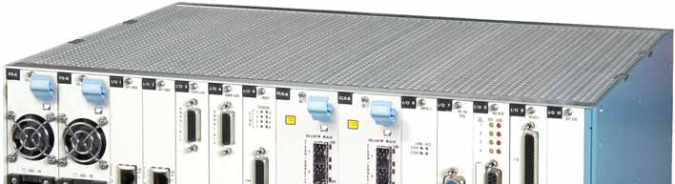
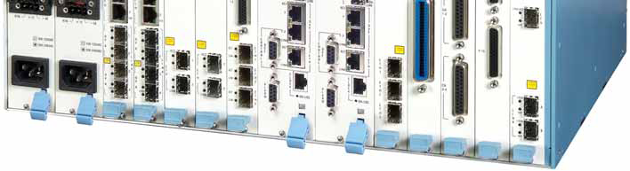

The MP-4100/4104
The NGN Multi service Access Platform
Megaplex-4100/4104
  An “all in one” multiservice platform that supports TDM and Ethernet services, fiber and copper aggregation, Next Generation Ethernet and legacy interfaces and DS0 cross-connect capabilities.
Customers
  Utilities & transportation
  Tier 3 carriers (Tier 1 developing countries) & alternative carries
  Private networks: airports, military and government
Applications
  Multiservice traffic (voice, data, Ethernet) connectivity
  Integrated data and voice solutions for private networks
  Legacy services (DS0) migration to PSN
  TDM and Ethernet over fiber and copper aggregation
  Resilient rings (E1, SHDSL, Eth, STM-1, STM-4)

Slide 29







Typical Solution for Substation Multiservice Connectivity
Multiple service connectivity over any infrastructure
Lower CapEx by using a single-box solution and lower OpEx by converging services and optimizing bandwidth utilization
Migration of non-critical and mission-critical services to PSN, saving forklift costs and ensuring a future-proof solution
Continued support for legacy services and obsolete vendor replacement
Teleprotection
Voice
PBX
SCADA
MP-2100
Voice
E1 or SHDSL Ring
MP-4100
Control Center
FCD-IP
STM-1
MP-4100
Teleprotection
MP-4100
SCADA
PSN
ETH
GbE
MP-4100
Voice
SCADA
STM-1/ STM-4
PBX
Voice
E1/T1
MP-4100
MP-2100
Airmux-200
MP-4100
SHDSL
E1/T1
Fiber
MP-2100
Airmux-200
SCADA
SHDSL.Bis
PBX
ASMi-54
OP-106/8

Slide 30
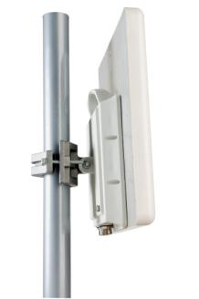
The Airmux Family in Video Surveillance Security Application
The Airmux provides a comprehensive video surveillance transmission solution that includes:
  High capacity wireless radios (up to 200Mbps):
    Point-to-Point – Backhaul base stations and cameras
    Point-to-Multipoint – Camera Connectivity
  Intelligent surveillance network planning - Radio Planner
  Comprehensive management for network control - RADview

Slide 31
The Airmux -5000
Point- to –Multipoint Wireless Solution
Up to 200 Mbps throughput per sector
Up to 50 Mbps per *SU!
Guaranteed SLA
Long range (40km)
Carrier grade PtMP
Frequency Bands :
  3.3-3.8GHz
  4.9-6.0GHz
Base Stations | Airmux- 5000/BS/200M | 200 Mbps
 | Airmux- 5000/BS/50M | 50 Mbps
Subscriber Units | SU/50 | 50 Mbps
 | SU/20 | 20 Mbps
 | SU/10 | 10 Mbps
 | SU/5 – Q1/12 | 5 Mbps
*SU = Subscriber Units

Slide 32
The DSL Modem Solutions
2M
4M
5.7M
11.4M
22.8M
SHDSL
SHDSL.bis
ASMi-52/52L
ASMi-54/ASMi-54L
2Mbps - 4.5km
5.7Mbps -2.6km
2Mbps 4Mbps 5.7Mbps 11.4Mbps 22Mbps
2W 4W 2W 4W 8W

Slide 33
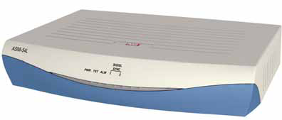
The ASMi line
SHDSL / SHDSL.Bis Modems
ASMi-52
SHDSL based
MUX services
ASMi-52L
SHDSL based
Single service
ASMi-54
SHDSL.BIS based
Mux services
ASMi-54L
ASMI-54LRT
SHDSL.bis based
SHDSL.bis based
CPE or CO
CPE or CO
Fiber and copper line
Daisy Chain/multipoint/ring topology
MUX services
CPE or CO
Routing capabilities
CPE or CO
Mux services
Notes:
Current network status: The second application that we would like to introduce is a Carrier that the main networks that have in their site in SDH network and the main services were E1 PRI. The meaning is that the carrier provides E1 services to corporate users and the E1 PRI was connected directly to the SDH network of this carrier.
Limited ETH ports: As all of you know there is an increase with the need for ETH services and if till now the carriers could provide this ETH connectivity directly from the ADM ports, today this demand is for high ETH numbers and because of the fact that the ADM is limited to 6 ETH ports in most of case, there is a need to install another equipments externally.
Management outsourced: Another trend that we can see in these carriers is the need to have one management platform that will manage all the devices in the network while the carriers are doing an outsourcing for that services. The companies that taking that charge of managing the carriers networks have very specific demands how to manage these devices and which management functionality each device should be complies.
The main reason of these carriers in to reduce the opex and capex especially and later we will see how these carriers are overcome this management challenge.
Reduce capex and opex : Last but not least is the main migration from TDM to IP while the carriers would like by general to transmit couple of services type ETH and E1 or V35 and would like to minimized the investment. They would like to have minimum devices in each locations and the customer premises and in the network side.

Slide 34
Ruggedized Industrial Ethernet Switch - Typical Customer Requirements
Customer type
Energy – Electric Power manufacturer and distribution
Customer requirements
Migration of serial devices over IP between SCADA and RTUs.
Transparent tunneling of Modbus and DNP3 serial protocols
Remote site connectivity via secure VPN over P2Mp Ethernet Radio link.
Resilient network - second SCADA system for buck up.
Industrial design hardened L2 switch.
Secure network.

Slide 35
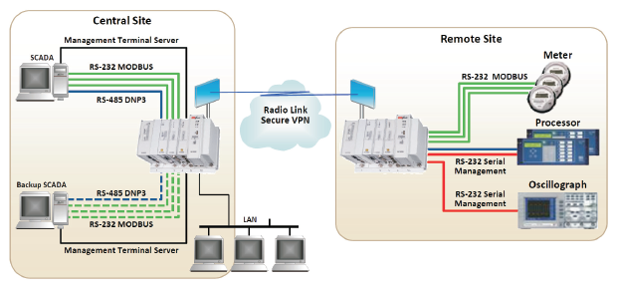
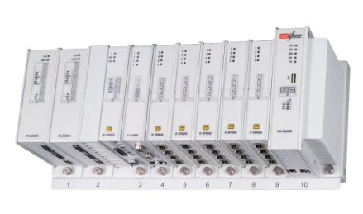
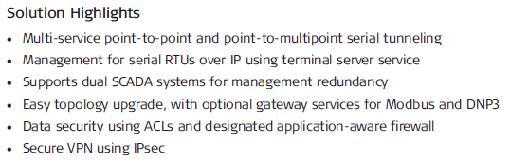
RADiflow Solution -
Distributed Automation

Slide 36
Solution Benefits
Industrial Ethernet L2 and L3 modular Switch.
Interfaces types includes Ethernet and Serial ports on the same modular chassis.
Easy to upgrade due to modularity of the system.
Transparent serial tunneling.
Gateway services for Modbus and DNP3 protocols.
Terminal server service for management purposes of serial devices over IP.
Application aware firewall for :
  Modbus
  DNP3
Security using ACLs.
Secure VPN using GRE Tunnel and IPsec.
Real time system using QOS.
A multi point to multi point configuration option for serial services to allow a redundant SCADA system.
Resilient network using xSTP.
Complete

Slide 37
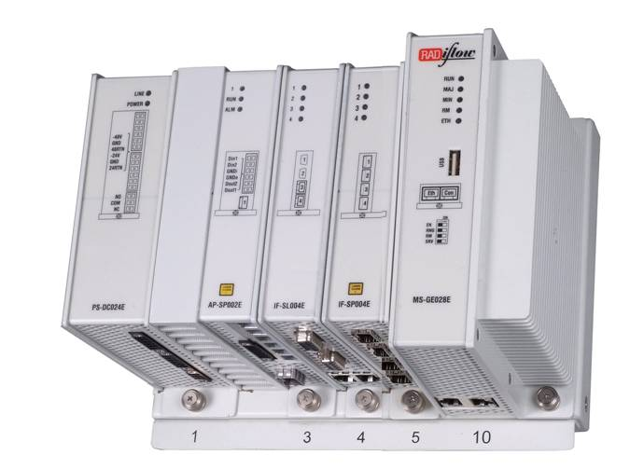
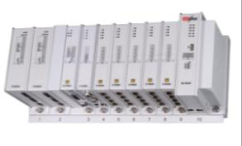
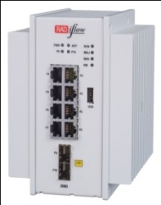
RADiflow 3300/3700/3080
Industrial design
Modular DIN rail switches
Networking
3 or 7 I/O slots
Harsh environment - IP30, - 40 ÷ +75° C, IEC 61850-3 EMI
ETH or RS-232/RS-485 serial interface modules
Power supply redundancy
Advanced Ethernet switching and IP routing functionality
Serial Tunneling or Service translation
Physical Interface :
Copper – Fast Ethernet / Gigabit Ethernet
Fiber – Single Mode / Multi Mode.
xDSL modems
Integrated security mechanisms
MAC/IP filtering per port
Remote access and Inter-site connectivity
Distributed app-aware firewall
Cellular – GPRS /UMTS
3300
3700
3080

Slide 38
Smart Power Requirements
Smart power is a Power distribution company. They made a strategic decision to implement Smart Grid technology in their network.
They decided to install Smart meters in some big industrial parks and they need to backhaul this traffic to the control room (Site 36) .
Sites 1-10 are part of Business Park # 1 which is accessed by a wireless link located at several points in the business park and in site 33.
Sites 11-30 are part of the second business park which is accessed via DSL and FO lines to site 31 ( A Sub-station site connected to both rings).
They have also decided that they want to have resilient networks wherever possible, therefore they want to implement a ring between all the remote business parks aggregation sites (Sites 31-33).
Smart Power owns a PSN but this network doesn’t cover the new business parks area, so they will use an STM-1 leased line from the incumbent’s SDH network (Site 34) to backhaul the traffic to the control room (Site 36)
Site 35 is the gateway between Smart Power PSN and the incumbent’s SDH network.
As part of the Smart Grid implementation, they have also decided to implement a remote automatic control of all their legacy RS-232 controlled devices that are located in different locations in their network (sites 37-40). They need a solution to carry this traffic in a ring topology as well via site 31 to the control room (Site 36)
Site 36 is the HQ. All the RS-232 services should be terminated here as an IP Interface towards the SCADA Server as well as all the Ethernet Smart meters traffic from the business parks

Slide 39



Smart Power Application
1
2
?
?
10
33
?
Incumbent’s
SDH Network
STM-1
70Mbps
?
100Fx
?
Resilient
Ring
?
34
32
11
STM-1
35
?
31
2w/2km
Eth
?
Sub-station
?
GbE
21
Core
Network
?
40
2w/4km
?
Eth
2x
RS-232
?
Resilient
Ring
22
GbE
37
2x
RS-232
?
FO
Eth
36
39
?
?
2x
RS-232
?
?
30
38
FO
Eth
SCADA
Server
2xRS-232
?

Slide 40





Smart-Power solution
1
2
HBS
Airmux-5000
Incumbent’s
SDH Network
STM-1
70Mbps
FCD-155
100Fx
ETX-26
ETX-26
34
32
33
G.8032
Ring
(GbE)
10
11
35
STM-1
ASMi-54
FCD-155
Sub-station
2w/2km
Eth
GbE
ETX-26
31
21
Core
Network
MP-4100
40
ETX-26
2w/4km
Eth
1x
RS-232
ASMi-54
22
G.8032 Ring
(GbE)
37
1x
RS-232
FO
Eth
36
39
Eth SW
1x
RS-232
ETX-102
38
30
FO
Eth
SCADA
Server
1xRS-232
ETX-102
Notes:
The RADiflow can send the RS-232 traffic in 2 ways: As a tunnel, and then you will have an RS-232 in the central site for each remote site, or as a terminal server, which means that it converts the RS-232 into IP packets. This conversion is called 101 to 104 conversion (101 is an RS-232 based RTU and 104 is an IP based RTU) – This flexibility allows a mixed of RTUs in the network (Old ones and new IP based ones)

Slide 41
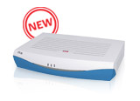
The ETX-26
Compact Ethernet access switch for wire-speed Layer 2 connectivity
Three Gigabit Ethernet 1000BaseFX SFP ports
Six Fast Ethernet 10/100BaseT UTP ports
Ethernet bridging and switching per 802.1D, 802.1Q, 802.1Q-in-Q
Four QoS priority queues with SP, WFQ scheduling
ITU-T G.8032 Ethernet Ring Protection Switching (ERPS)
Power over Ethernet (PoE) support
Wide range of AC/DC power supplies
SNTP, Net Inventory and Dying gasp support for management, configuration and diagnostics

