Slide 1
Managing RAD’s Network
CIS Technical Seminar 2013

Slide 2
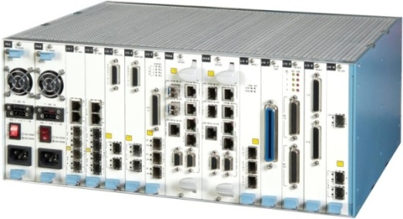
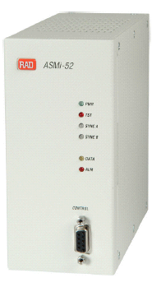
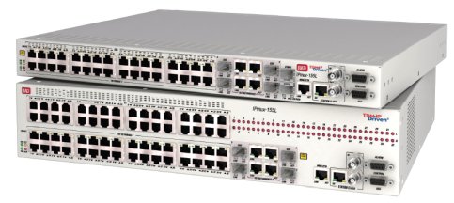
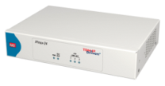
Managing RAD’s Network

Slide 3
Agenda
RADview Value Proposition
Network Scheme
RADview-EMS Benefits & Features
How it looks like
FCAPS
Performance Management portal
What’s new
SAA, Service Assured Access
Business-Continuity
Integrations
What’s next…
RADview Release Schedule

Slide 4
RADview Value Proposition
RADview
Performance Monitoring & SLA
Premium services
Service Assured Access
One Stop Shop
OPEX reductions

Slide 5
RAD Management According to TMN model
Network Element
Element Management
Network Management
Service Management
Business Management
RADview-SC/MS
Network Element
Shelf-View
RADview-EMS Standalone
RADview-SC/TDM
OSS
Umbrella
RADview-SC/TDMoIP

Slide 6
Network Management Topology Scheme
BSS – Business support systems (billing and CRM)
OSS – Operation Support Systems (Service Assurance)
Resource Management
(i.e. Cramer)
Fault
Management
(i.e. NetCool)
Performance Management
(i.e. InfoVista)
Service
Activation
Other vendors’ specific NMS
RADview
Network Elements
Notes:
6
Network Management Topology (scheme)
Integration of RADview into the OSS layer saves lots of overhead and money, due to low incremental investments for additional products and firmware upgrades.
RADview is responsible for synchronizing missing Traps and collecting statistic information after network outage between EMS and NE
*supported devices only

Slide 7
RAD View Benefits and Features
RAD supports a high variety of products for different services
Most of them have a management IP interface
Most of them are able to work with standard SNMP protocol
RAD-View is the solution for all RAD products on one Platform
RAD-View is fully integrated into RAD SAA concept

Slide 8
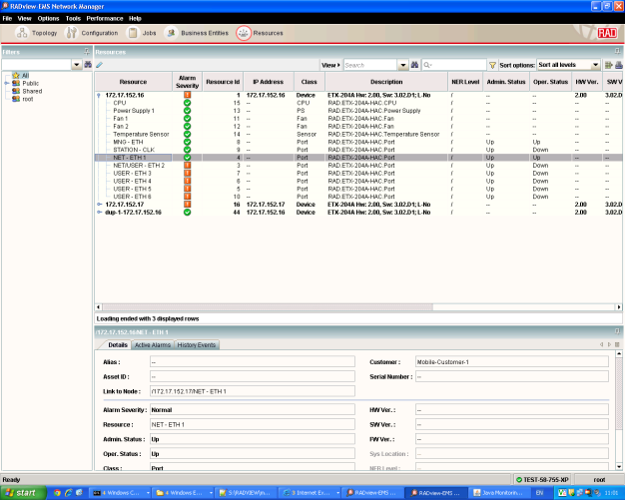
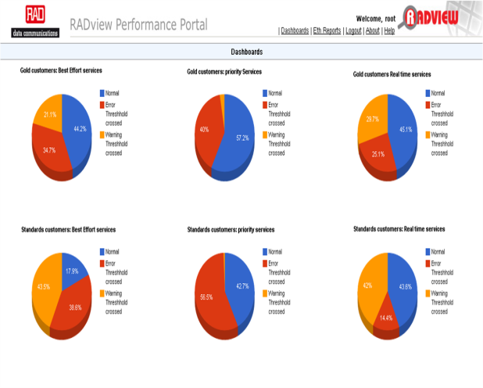
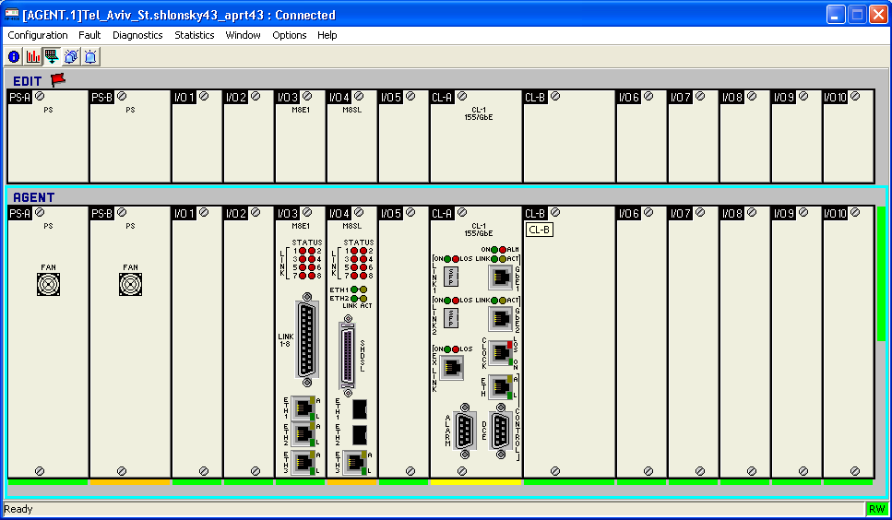
Key Features
GUI vs CLI
Network Inventory & Discovery
Performance Management &SLA
Intuitive GUI, visual Topology, Visual status indication , data validation.
Saves 50% time in configurations
Real time device inventory, location, port count.
Capex saving and capacity planning
Real time PM, utilization and thresholds management.
Premium services , trending and analysis

Slide 9
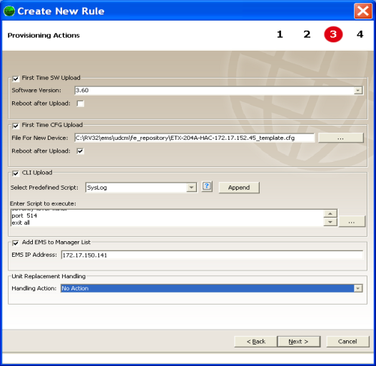
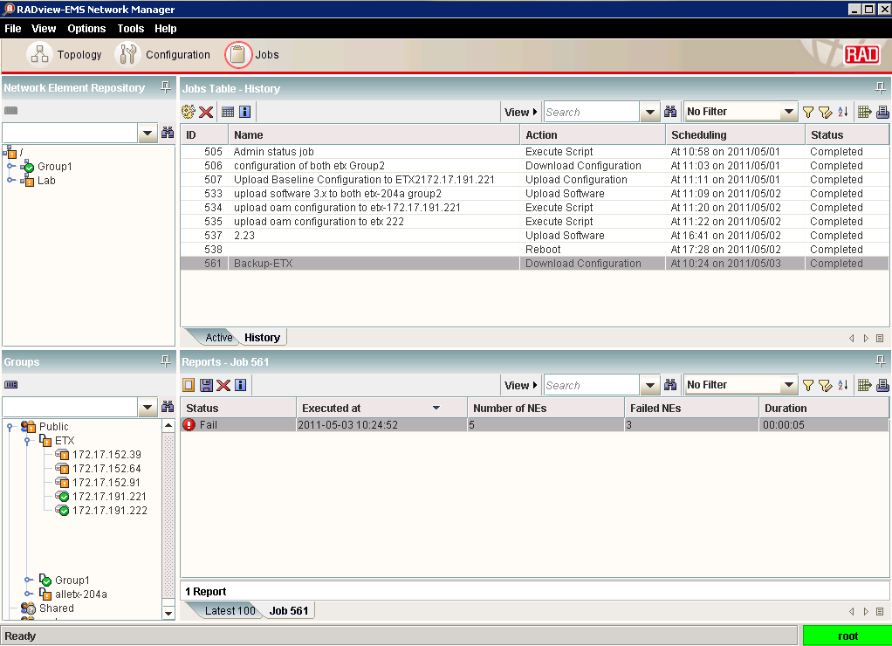
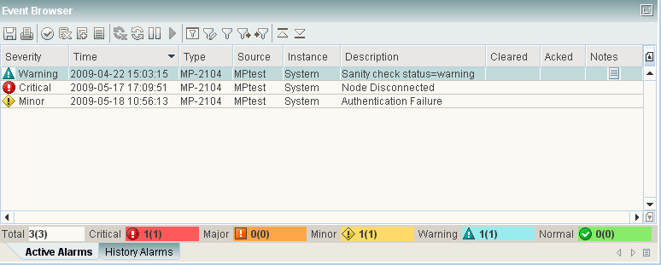
Key Features
Fault Management
Zero-touch
Job Automation
Active and History alarms, correlation to customer and services. Easy fault localization, cuts network troubleshooting to half
Automatic device configuration and automatic backup.
Capex saving
Automation of network backup, mass configuration update and software update for easy network maintenance

Slide 10
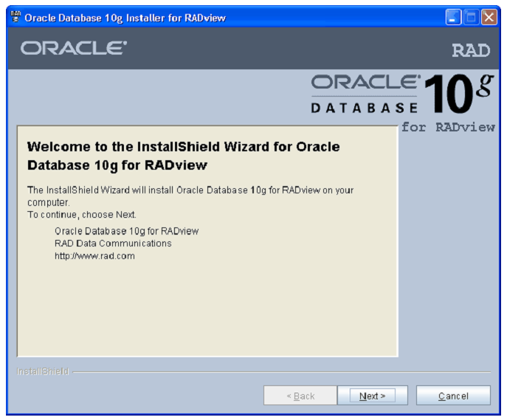
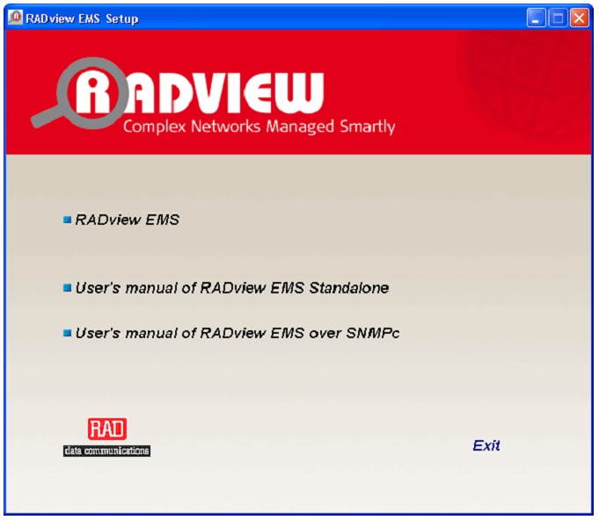
Easy to Install
RADview database works with reliable Oracle technology
Oracle DB is delivered with RV Software
No Oracle knowledge is required
Easy installation, only basic information are required for installation
Runs on standard PCs or WIN/UNIX Servers
Can be installed on several virtualization platforms
High skilled Tech. Support Engineers are available on demand

Slide 11
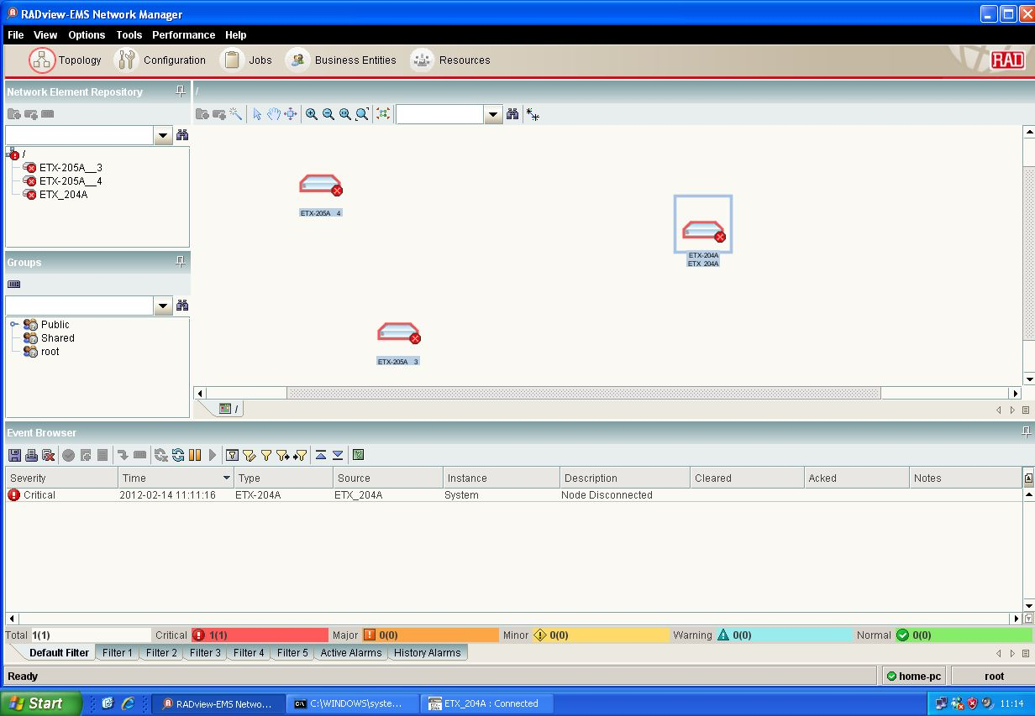
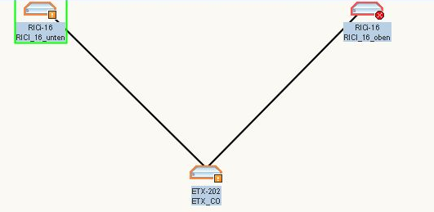
How it Looks Like
ETX-202
RICi-16_1
RICi-16_2

Slide 12
Make Things Easy
ETX-202
RICi-16_1
RICi-16_2

Slide 13
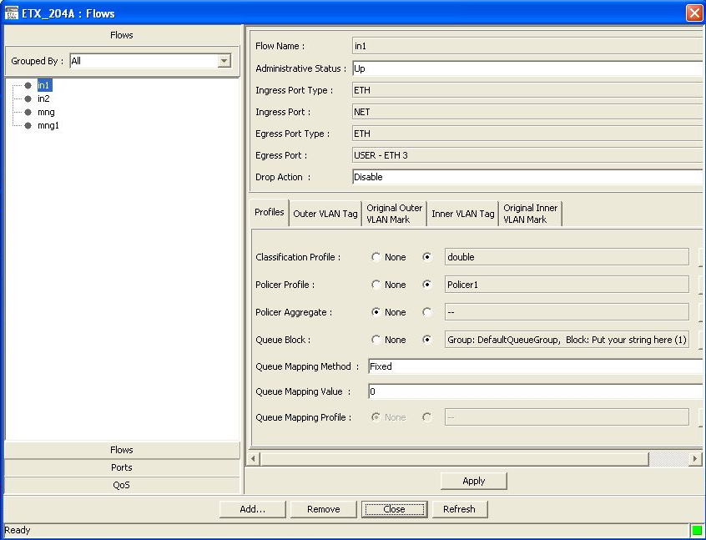
Make Things Easy
ETX-202
RICi-16_1
RICi-16_2

Slide 14
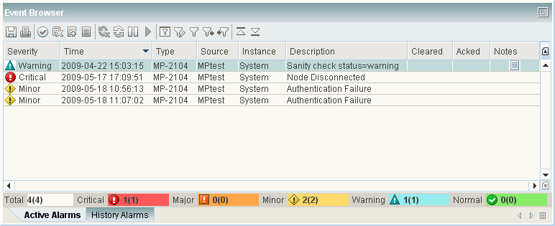
RADview-EMS FCAPS
Fault
Configuration
Administration
Performance
Security
Manage Event Log parameters:
Mask, Severity, Deduplication
Events display
Trap Synchronization
IBM Tivoli’s Netcool®/OMNIbus™ plug-in
Notes:
Manage Event Log parameters, and share notes
Mask, Severity, Deduplication, Forwarding, Threshold, Clearing, Formatting
Manage the way Events are displayed in the Event Browser
Trap Synchronization upon connection failure between RADview-EMS to NE (*supported devices only)
IBM Tivoli’s Netcool®/OMNIbus™ plug-in

Slide 15
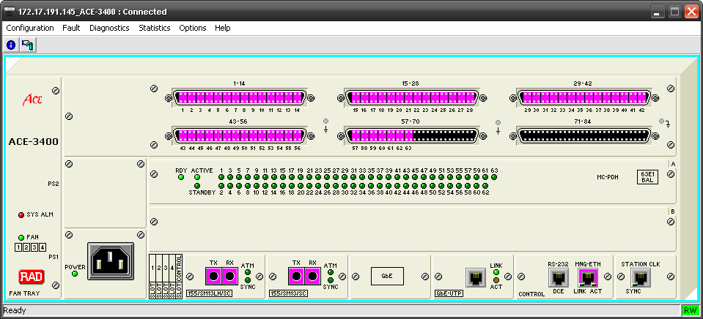
RADview-EMS FCAPS
Fault
Configuration
Administration
Performance
Security
Tracks changes
Network Elements update & Configure
Viewing and/or modifying:
Configuration
Diagnostics
Status
Shelf-View
Notes:
Realistic representation of the devices (shelf-view)
Tracks configuration changes
Configures, installs, and distributes software and configuration files across the network
Viewing and/or modifying configuration (system, ports, and alarms)
Enables viewing the diagnostics and status information

Slide 16
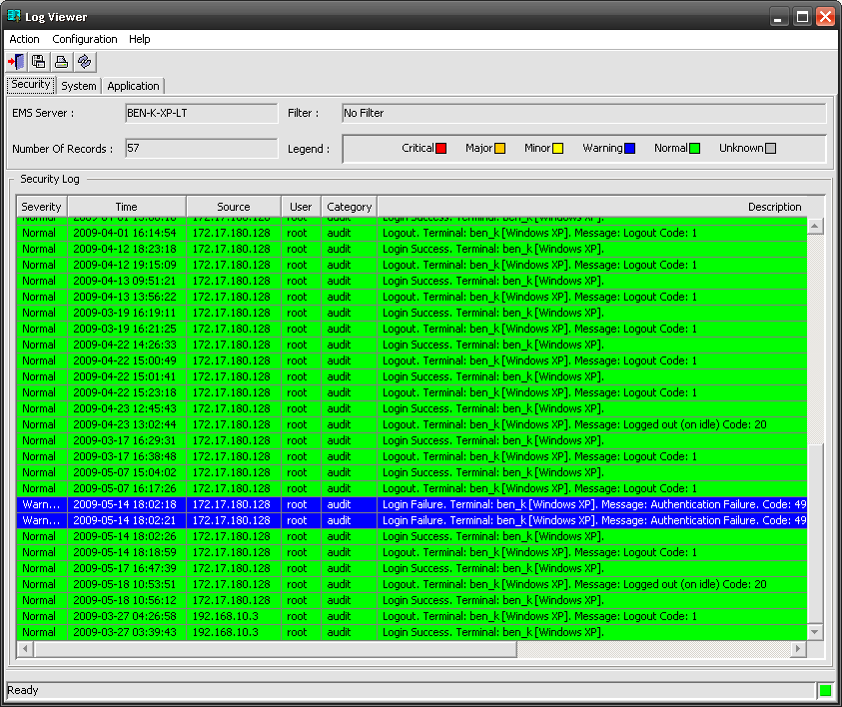
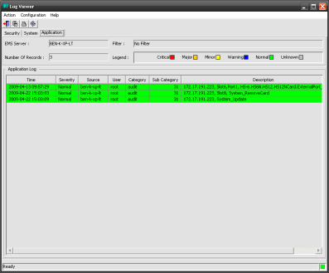
RADview-EMS FCAPS
Fault
Configuration
Administration
Performance
Security
Auditing
Create and manage users accounts
Security logs
Applications activities
Notes:
Audit trails for Security, System and Applications activities
Create and manage user accounts and groups

Slide 17
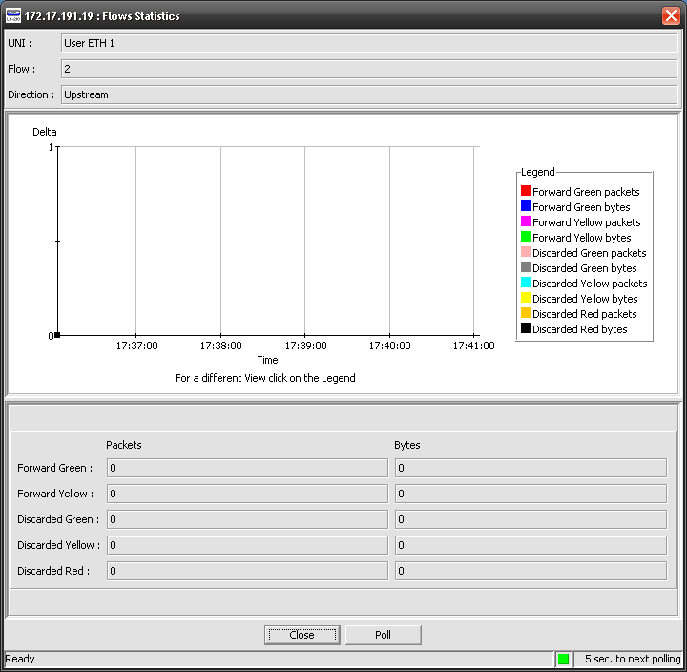
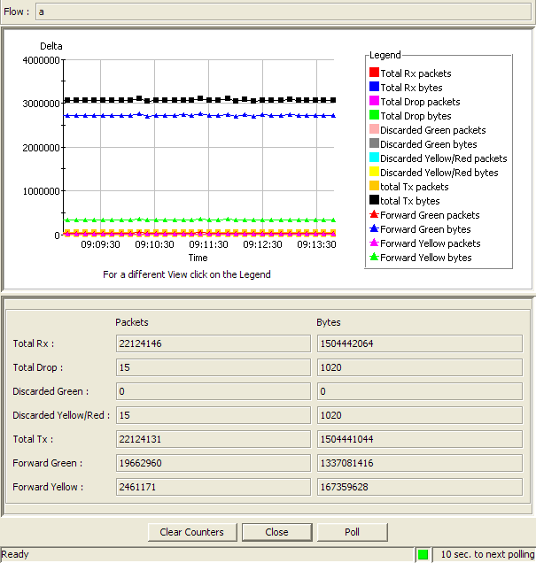
RADview-EMS FCAPS
Fault
Configuration
Administration
Performance
Security
Real Time Performance Monitoring
Network performance (QoS, CoS)
Current statistics (Real-time)
Intervals statistics
Long Term Performance Monitoring
Performance Management Portal
Statistics
Notes:
Real Time Performance Monitoring
Monitors network performance (QoS, CoS)
Current statistics (Real-time)
Intervals statistics
Reflects Agent statistics
Long Term Performance Monitoring
Performance Management Portal

Slide 18
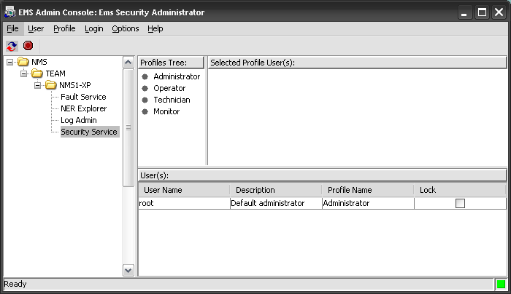
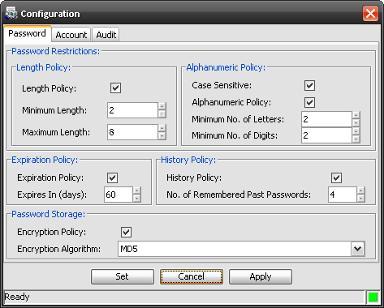
RADview-EMS FCAPS
Fault
Configuration
Administration
Performance
Security
Security profiles:
Create
Manage
Passwords policies
Security profiles
Password policy
Notes:
View and manage EMS Security profiles in a graphical interface.
Create Common/Private view profiles per user/group
Define password policies

Slide 19
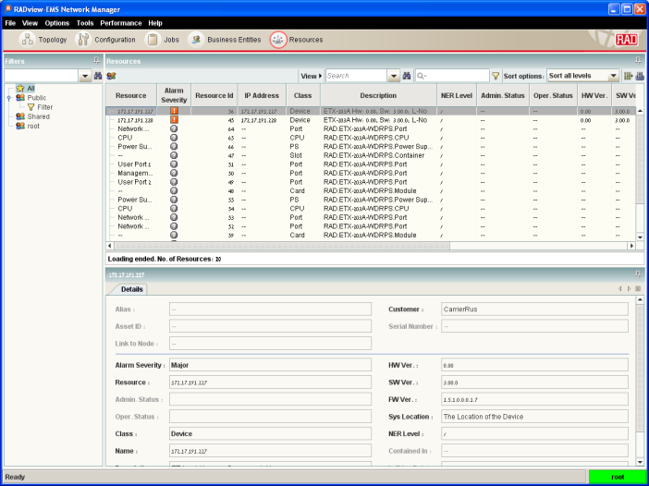
RADview-EMS Performance portal
NEW
Part of RADview-EMS v3.0
Policy Management
Performance Dashboard
Aggregated and SLA Reports
Detailed Graphs
Monthly Scheduled reports
Customers management

Slide 20
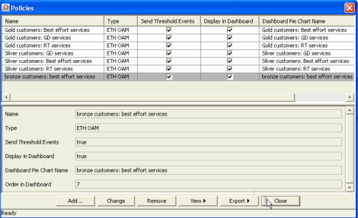
RADview-EMS Performance portal
NEW
KPI
Thresholds
Customers & CoS
Policy=SLA
Part of RADview-EMS v3.0
Policy Management
Performance Dashboard
Aggregated and SLA Reports
Detailed Graphs
Monthly Scheduled reports
Customers management

Slide 21
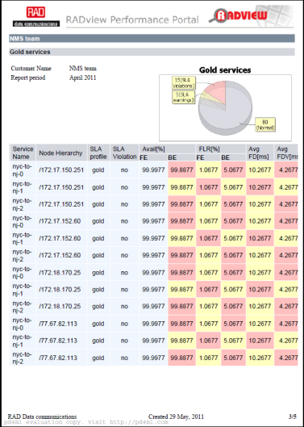
RADview-EMS Performance Portal
NEW
Part of RADview-EMS v3.0
Policy Management
Performance Dashboard
Aggregated and SLA Reports
Detailed Graphs
Monthly Scheduled reports
Customers management

Slide 22
Carrier-Ethernet Service Lifecycle
Service
Turn-up
Ongoing Monitoring
Fault Management & Recovery
“Before I start paying”
“While it’s working”
“When something went wrong…”
Notes:
Since Mbps is a Mbps we cannot compete on bandwidth. Differentiating is in the service itself.
Service parameters:
Before it’s working I want to know where I start
When it’s working I want visibility:
Customer Visibility - reporting
Accuracy of measurements – develop trust
When it’s not working I want it repaired
Loopbacks
On demand throughput testing

Slide 23
Service Management Summary: Managing the Service Lifecycle
Service
Turn-up
On-going Monitoring
Fault Management & Recovery
Connectivity Verification
Performance Monitoring
Fault Detection & Isolation
Ethernet OAM - 802.1ag
Continuity Check
MAC Ping
Ethernet OAM – Y.1731
Frame Delay, Frame Delay, Frame Loss
Service availability (G.826)
Ethernet OAM – 802.1ag
Continuity Check
Loopback
Link Trace
Diagnostic Loopbacks
SLA Threshold Reporting
Fault Propagation & Notification
Loopbacks
L1 physical interface loopback
L2/L3 Loopback per flow with MAC/IP swap (up to line rate)
Defining SLA objectives and proactively notified when crossed
Alarms and traps on management system
Ethernet OAM – Y.1731
Per EVC ‘Forward’ and ‘Backward ’ Alarm Propagation (AIS and RDI)
Dying Gasp indication to active - 802.3ah
Per port Alarm Propagation
SLA Verification
Testing
Statistics Collection Reporting
Resiliency & Repair
RFC-2544 based tests
Throughput, Loss and Delay tests
Data integrity tests (BERT)
Delay Measurement
Collecting SLA statistics
Statistics collection via SNMP or FTP
Statistics can be used to generate SLA reports
Linear Protection ( “EVC Protection”) -G.8031
Ethernet Ring Protection - G.8032
port protection based on Link Aggregation - 802.3 (formerly 802.3ad)

Slide 24
What’s New

Slide 25
RADview SMS Service Management System
Branch A
Headquarters
PE
Ethernet over
PDH NTU
Real Time
Real Time
EVC
Priority Data
Priority Data
Ethernet over
Fiber NTU
UNI
Best Effort
Best Effort
EVC1
PE
Packet Switched Network
Branch B
Real Time
UNI
EVC2
Ethernet over
xDSL NTU
Priority Data
Real Time
Best Effort
EVC
Priority Data
IP DSLAM
UNI
Best Effort
Managed Service- EVC
Management of :
End to End Ethernet services
Customer
Easy to use
Support for ETX-2xxA and ETX-5300A devices
EVC:
bi-directional, Single /Multiple CoS,
Notes:
Support for ETX-2XXA and ETX-5300A devices
Management of :
Customer
Ethernet services
Easy to use
Easy services creation
Predefined service configurations
Fault Management
Any fault in the network is correlated to the impacted services and customers
Customer management
Support for links and clouds (3rd party service providers)
Easy to use GUI designed for management of large networks
Association between customer and service/resource
Management of end-to-end Ethernet services
Wizard based provisioning
Monitoring
SLA assurance
Support for ETX-2XXA and ETX-5300A devices
Easy creation of services based on templates
Catalog – Allows definition of predefined service configurations
Fault Management – Any fault in the network is correlated to the impacted services and customers
Standard TMF MTOSI northbound interface for easy integration to OSS
Ethernet Service managed by SMS is EVC.
EVC is a bi-directional connection between two or many UNIs,
EVC can be Single CoS or Multiple CoS,
EVCs types can be E-Line, E-LAN, or E-Tree
EVC.CoS is a subset of the service that provides TM, OAM and SLA measurements (FD, FDV, Availability).

Slide 26
What we Have Today
Branch A
PE
Ethernet over
PDH NTU
Real Time
EVC
Priority Data
UNI
Best Effort
Packet Switched Network
Branch B
Ethernet over
xDSL NTU
Real Time
EVC
Priority Data
IP DSLAM
UNI
Best Effort
Managed Service- EVC
P2P EVC between ETX-20XAX with QOS
Transparent for transport an Core

Slide 27
Next Releases
Branch A
PE
Ethernet over
FiberNTU
Headquarters
Real Time
ETX-5300A
EVC
Priority Data
Real Time
Ethernet over
Fiber NTU
UNI
Best Effort
Priority Data
PE
Packet Switched Network
Best Effort
ETX-5300A
EVC
Branch B
ETX-5300A
Ethernet over
xDSL NTU
UNI
Real Time
EVC
Priority Data
IP DSLAM
UNI
Best Effort
Managed Service- EVC
Integration of ETX-5300A for P2P EVC with QOS
Integration for ETX-A Family Bridge and Ring Support
E2E Service Management for the full path covered with RAD devices

Slide 28
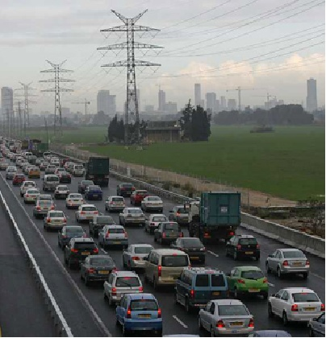
Service Assurance and Traffic Management

Slide 29
SAA, Service Assured Access
RADview EMS is fully integrated to RAD SAA concept
Performance Portal
END to End Service creation with SLA and traffic Management
Monitoring and Reporting of Performance thresholds
Complete E2E view over different devices on different media
Reduce the administrative efforts to ensure SAA

Slide 30
Business-Continuity Levels
Backup and Restore
High Availability (HA) Cluster
Disaster Recovery (DR) 1+1

Slide 31
Business-Continuity Options
Backup and Restore
Primary site
Backup site
Based on RADview-EMS Pack1/R backup and restore tool
Backup file can be saved anywhere
Restore from backed-up files – RPO can be very long
High Availability (HA) Cluster
Local clustering - RPO and RTO are short
Immediate recovery in the event of OS or HW failure in a single site
Automatic failover
Disaster Recovery (DR) 1+1
Geographically separated NMS servers that are replicated constantly
RPO and RTO are short
Manual switchover
Notes:
RPO- Recovery Point Objective
RTO-Recovery Time Objective

Slide 32
Integrations
OSS - Operation Support Systems
Fault Management – NetCool (validated by IBM)
3rd Party EMS/NMS application
Cisco-ANA
Carrier’s in-house
GNE certification program For CLI based devices
Northbound interface (NBI)
CORBA northbound
SNMP Fault Management northbound
CSV PM files
OSS heartbeat
ALU 5620SAM
Cramer – in process
Notes:
32
The GNE certification program will take care of
Connectivity
Configure node via CLI as required
Create GNE profile with RAD’s provided info
Create discovery rule with RAD’s provided info
Discover NE on map etc
Test node reboot, loss of connectivity
Discover and validate GNE interfaces and interface alarms
Collect stats based on traffic
Install RAD provided alarm catalogue (XML script)
Go though each trap set/clear and observe SAM alarm raise/clear
And some more…

Slide 33
Summary
Industry standard FCAPS compliant platform
RADview-EMS Benefits & Features
Lots of new Features which are for easy and intuitive working
3rd party device integration ( Multi Vendor Network )
Performance Management portal for customer SLA’s
Service creation by clicking the mouse
Scalable Business-Continuity Levels
Flexible for interworking with 3rd Party OSS
Packages for any requirement
Worldwide Success Storys

Slide 34
Success Stories
RV-EMS

Slide 35
B2B Ethernet Connection DSLAM Backhaul over PSN
RAD View EMS
Network Management
ETX-201
Customer A
IP-DSLAM
GBE
ETX-202
GBE
GBE
Internet
IP-DSLAM
L2 Private Network
ETX-202
GBE
GBE
GBE
GBE
IP-DSLAM
ETX-201
ETX-201
ETX-201
ETX-202
Customer A
Customer B
Customer B

Slide 36
Multiple Services over RAD Equipment
EWSD
RAD View EMS
Network Management
IPMUX-1E
S0
IPMUX-1E
IP-DSLAM
IP/Eth Network
IPMUX-1E
S0
IP-DSLAM
OP-108
OP-108
OP-108
OP-108
IPMUX-1E
S0
Fiber

Slide 37
Dummy for Roadmap

